Slide 1
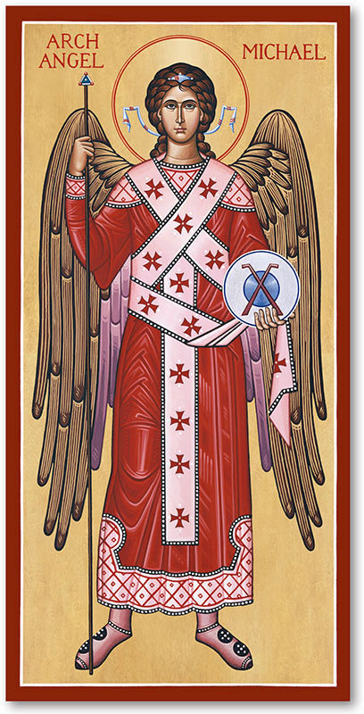
The Archangel Michael’s Defense of God’s People
Daniel 12:1-4

Slide 2
Jesus, the Divine Man, the Son of Man, now tells Daniel about the Archangel Michael. He is the guardian angel of God’s people and he will arise “at that time” to defend them (12:1). The time is the period of the eschatological king (the Antichrist) (11:36-45). Michael is also placed in charge of the heavenly warfare in defense of the saints (cf. Rev. 12:7-8).
Daniel 12:1-4

Slide 3
Daniel is told that the rule of the Antichrist will bring “a time of distress.” This phrase occurs five time in the OT and the result of this distress is that God will bring about deliverance from the distress. Jesus refers to this in St. Matthew 24:29, 30; St. Mark 13:24-27, and St. Luke 21:25-27.
Daniel 12:1-4

Slide 4
Despite this distress, Daniel (and you) are assured that God’s people who believe in the One true God and are thereby heirs of His eternal kingdom “will be delivered.” This promise is extend to “everyone who is found written in the book” [the Book of Life or the Lamb’s Book, Rev. 3:5; 13:8; 17:8; 20:12, 15; 21:27].
Daniel 12:1-4

Slide 5
In verse 2, we have the clearest reference to the bodily resurrection of believers and unbelievers in the entire OT. Our Lord say, “Many of those sleeping in the dusty earth will awake….” What does he mean by “many?”
The Hebrew word is “rab” (br1). It’s a plural adjective that has the meaning of a number that is too large to count. So Jesus is telling Daniel that the number resurrected will be so large that it will be undeniable that all have been raised!
Daniel 12:1-4

Slide 6
There will be one of two outcomes!
First, the believers will be raised “to everlasting life,” while the unbelievers will be raised “to contempt, to everlasting abhorrence.” These two states are emphasized by our Lord in St. Matthew 25:46 and St. John 5:28, 29).
Those banished from the Lord will never be in His presence, they will never be blessed; but, suffer for eternity under our Lord’s Divine wrath!
Daniel 12:1-4

Slide 7
The best explanation of v.3 is found in the NT where Jesus describes this state in St. Matthew 13:43. St. Paul also discusses in Phil 2:15 and Gal 3:26-29.
Then, in verse 4, Daniel is told to “…close up the words and seal the scroll until the time of the end.” This is our Lord describing the cessation of any further divine revelation to Daniel!
Daniel 12:1-4

Slide 8
This also means that the scroll will not be understood until the coming of the Lord; it was being opened during our Lord’s First Advent. The victorious Lamb is the only One who has the authority to open or unseal the scroll (Rev 5:1 – 8:1).
Jesus inaugurated the “time of the end” by His suffering, death, resurrection, ascension, and session in power at the right hand of the Father!
Daniel 12:1-4

Slide 9
The last part of verse 4 is our Lord revealing to Daniel that many will investigate the meaning of this vision, and knowledge concerning it will increase. At our Lord’s First Advent, much of the prophecies given to Daniel were fulfilled…making it easier to understand!
Yet, the increase in understanding is especially given to those who have the gift of the Holy Spirit!
Daniel 12:1-4

Slide 10
Vv.7-12 – What is announced and portrayed by John staggers our mind. ⁷And there was war in heaven. Warfare in heaven must be interpreted as a spiritual war in which the dragon attempts to displace Jesus, the victorious Lamb who was slain, in order to establish himself in the presence of God as the prince of angels and as the one who has dominion over humanity on earth, and expressly, as the one who has the authority to stand before God and accuse man for their sins. At the center of this warfare is Satan’s ability to stand in God’s holy presence and indict the saints of God (cf. v.10).
Revelation 12:7-12

Slide 11
How do we know this? Isaiah tells us!
Let’s read Isaiah 14:12-21.
Isaiah’s prophecy concerns the Fall of the “King” of Babylon. Note that in v.12, the “Bright One, son of Dawn” in the Septuagint “Bright One,” is translated as oJ ejwsfovroV, “the dawn-bringer.” In the 4th c., Jerome translated this Greek word into Latin as “Lucifer, the light-bearer.” Thus, the popular view at the time, was that verses 12-15 describes Satan’s fall and subsequent consignment to hell. As a result, the Latin translation Lucifer was taken to be the personal name for Satan!
Revelation 12:7-12

Slide 12
Though this prophecy is against the “king of Babylon,” as we have studied in Revelation, the power behind all self-deifying earthly kings as epitomized by the king of Babylon is Satan. We are reminded of this in Rev. 13, since the Beast of the Sea is all oppressive, evil governments empowered by the dragon.
This king of Babylon’s desire is to be “like God” takes us back to the Garden of Eden (Gen. 3) and in fact characterizes Satan!
While Is. 14:12 doesn’t directly refer to Satan, the history of exegesis does make a connection (cf. 1 Thess 2)!
Revelation 12:7-12

Slide 13
The war in heaven was concluded by “Michael and his angels” and it reached its climax when Michael cast the dragon out of heaven. The casting out of Satan took place as a result of our Lord’s victory and at His Ascension and session at the right hand of God (5:1-14). Once Jesus, the Savior and Champion of His people, had defeated the dragon and had taken His seat at the right hand of God, the dragon was expelled, at the Father’s command, by Michael and never again can Satan appear before God.
Revelation 12:7-12

Slide 14
V.10 – This is the song of victory for “the accuser” of God’s saints “has been hurled down.” Notice that the saints are called “our brothers.” This leads us to the conclusion that the “great voice” is that of the twenty-four elders, since they represent the OT Israel and NT Church. The victory is won, for them and us, at the cross, and the completeness of our Lord’s victory is demonstrated by His resurrection for all to see and witness. Jesus now has full authority and no enemy can accuse His followers (you!) for by His authority His saints have been exonerated.
Revelation 12:7-12

Slide 15
V.11 – How have we, His saints, overcome? “…by [diav - because of] the blood of the Lamb.” This is the actual cause of their (and your) acquittal and “the words of their witness” was the result that testified to their victory in Christ. The saints held to that witness even in the face of severe persecution, threats, suffering, and death. Their faith was their victory in Christ because they stood firm (cf. 1 John 5:4-5).
Revelation 12:7-12

Slide 16
V.12 – The “great voice” then calls upon the very “heavens” and all “you who dwell in them” to celebrate! They praise God because of the fulfillment of all His promises. The angels, archangels, and all the company heaven now celebrate. And even though the angels are not the recipients of the saving victory of Christ, they, nevertheless, celebrate with the followers of the Lamb (cf. 5:11-14). They also celebrate because their Lord, the Christ of God, has returned triumphantly to claim His rightful seat at the Father’s right hand in the council of angels.
Revelation 12:7-12

Slide 17
V.12 – The “great voice” also cries out, “But woe to the earth and the sea, because the devil has gone down to you!” Satan, can no longer vent his hatred or plot evil against Jesus, so he will unleash his fury on the human race, life on earth, and the Church. The dragon also knows, “that his time is short” in his attempt to destroy God’s creation. The End will soon come and Satan will be forever separated from all of God’s creation. And so the devil sets to work at once with redoubled zeal, goaded by his defeat, to destroy that which God loves – His Church; His Beloved Bride!
Revelation 12:7-12

Slide 18
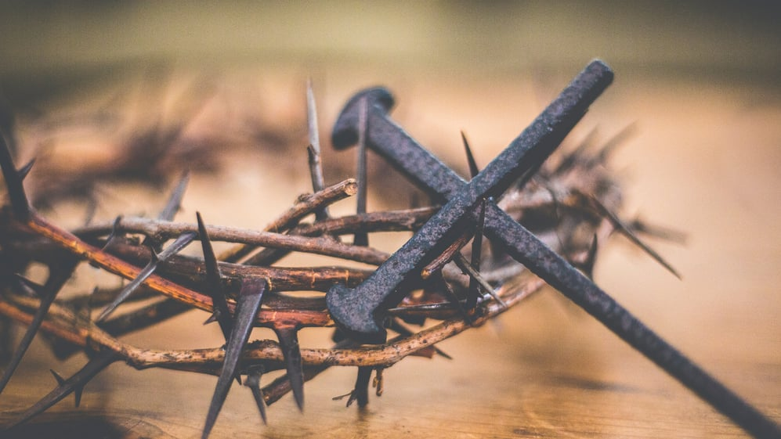
The Doctrine of Justification
The Chief Article of Our Faith
NEXT WEEK

