Slide 1
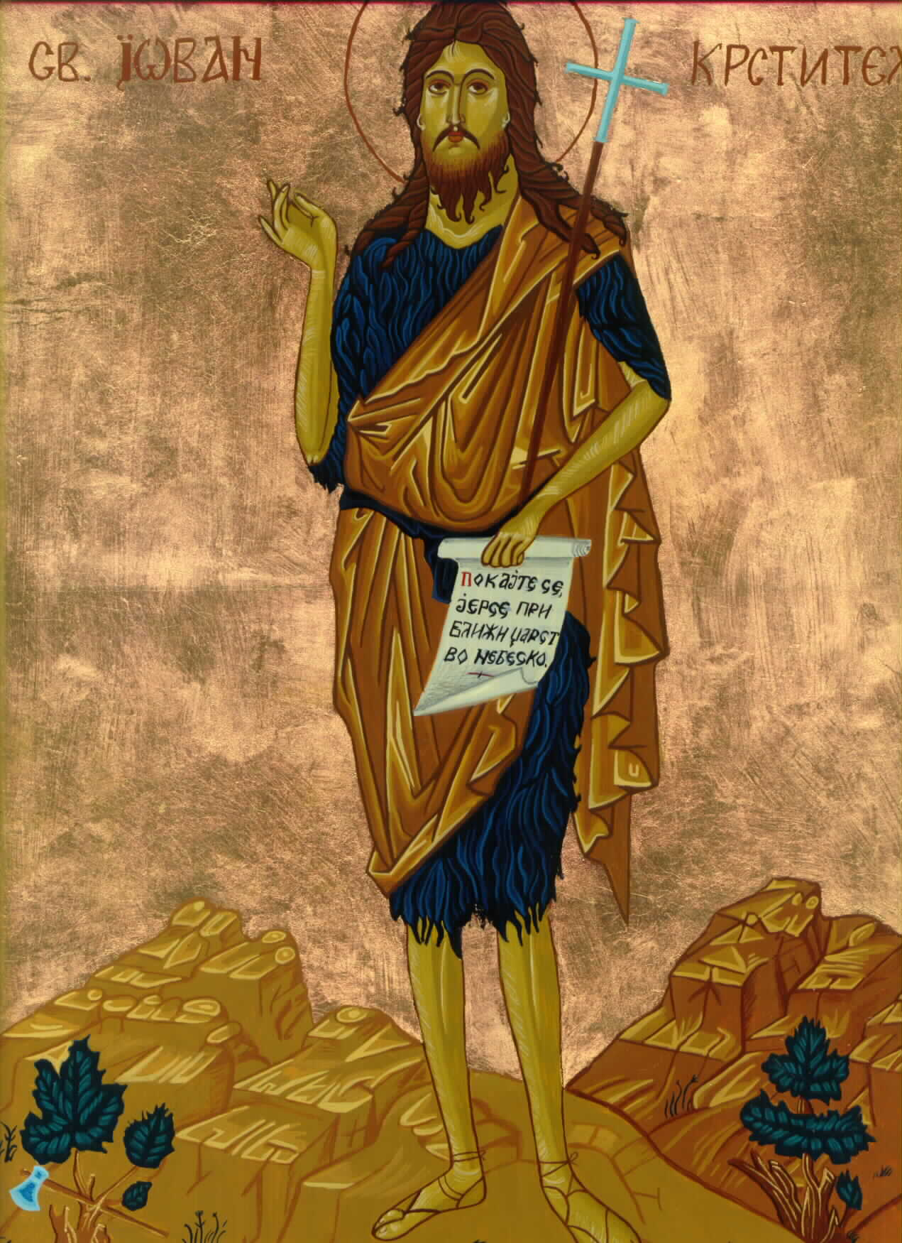
St.
Matthew
3:1-12
The Baptism of Our Lord
His Forerunner

Slide 2
The third chapter of Matthew skips over our Lord’s childhood and begins with His ministry. Why do you think that is the case?
Remember St. Matthew’s purpose! He is presenting Jesus to Jewish readers as the Messiah! The only report that we have of our Lord’s childhood is from St. Luke 2:41-52. Additionally, Joseph, who played a central role in the first two chapters of the gospel according to St. Matthew’s is never mentioned again!
This chapter begins with the preaching and baptizing of John the Baptist and his call of Israel’s repentance. St. Matthew then recounts our Lord’s baptism, which we will study next week.
Vigil of The Epiphany
Prologue

Slide 3
The third chapter of Matthew skips over our Lord’s childhood and begins with His ministry. Why do you think that is the case?
Remember St. Matthew’s purpose! He is presenting Jesus to Jewish readers as the Messiah! The only report that we have of our Lord’s childhood is from St. Luke 2:41-52. Additionally, Joseph, who played a central role in the first two chapters of the gospel according to St. Matthew’s is never mentioned again!
This chapter begins with the preaching and baptizing of John “The” Baptizer ( jIwavnnhV oJ Baptisth;V) and his call of Israel’s repentance. St. Matthew then recounts our Lord’s baptism, which we will study next week.
Vigil of The Epiphany
John the Baptizer

Slide 4
¹Then in those days, comes John the Baptist, preaching in the wilderness of Judea, ²and saying, Repent; for has drawn near the kingdom of the heavens.
In those days. The only event that we know of our Lord’s life between the return from Egypt and His baptism is the visit to the temple when He was twelve years old [cf. Luke 2:41-52]. His work of Messiah and Redeemer begins in earnest when He is baptized at approximately age 29. The appearance of John the Baptist takes place in at the same time as the prophetically announced events of our Lord’s conception, birth, and early years. Remember, that all the event “in those days” are days of the fulfillment of God’s OT promises!
Vigil of The Epiphany
Verse 1 & 2

Slide 5
¹Then in those days, comes John the Baptist, preaching in the wilderness of Judea, ²and saying, Repent; for has drawn near the kingdom of the heavens.
John the Baptist. Who is John? John the Baptist was a Levite by both parents, since his father, Zacharias, was a priest of the course of Abia or Abijah (cf. 1 Chr. 24:10; St. Luke 1:5), and his mother, Elizabeth, was of the daughters of Aaron (St. Luke 1:5). His birth was foretold, by an angel sent from God, and is recorded at length in St. Luke 1.
The birth of John was six months before our Lord’s. John was ordained to be a Nazarite from his birth (St. Luke 1:5). Dwelling by himself in the wild and thinly-populated region westward of the Dead Sea, he was prepared for the wonderful office to which he had been divinely called. His dress was that of the old prophets -- a garment woven of camel’s hair, (2Ki 1:8) attached to the body by a leather girdle. His food was locusts (Lev. 11:22) and wild honey (Ps 81:16).
Vigil of The Epiphany
Verse 1 & 2

Slide 6
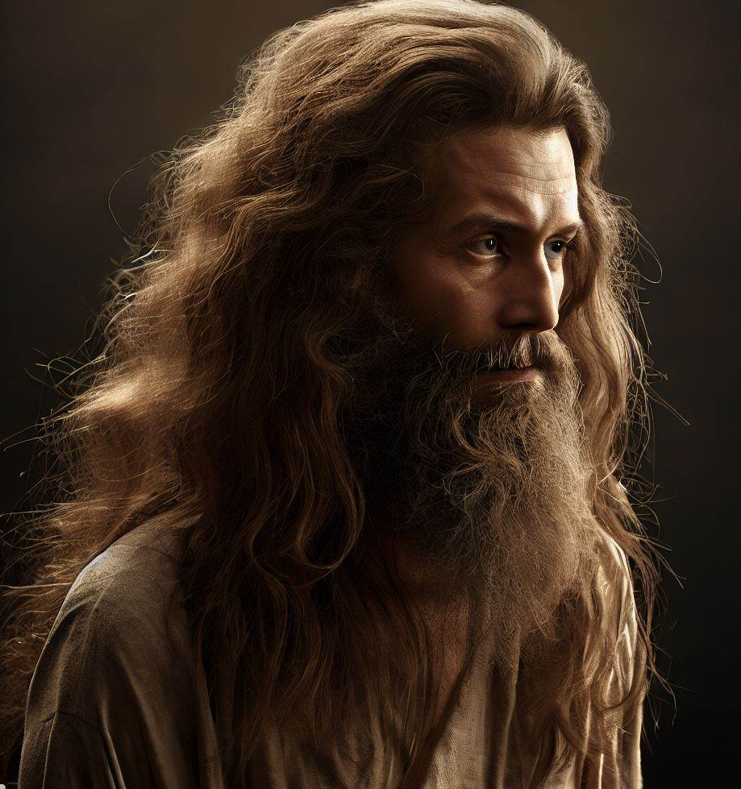
¹Then in those days, comes John the Baptist, preaching in the wilderness of Judea, ²and saying, Repent; for has drawn near the kingdom of the heavens.
What is a Nazarite Vow?
A Nazarite vow is described in Numbers 6:1-23. There two different types of Naziritism, the temporary and the perpetual. Of the latter type, there are only three known, that of
Samson, Samuel, and John the Baptist.
Nazarite means to “vow” “dedicate” or
“consecrate;” therefore, these are the
distinguishing “vows” of a Nazarite:
1) no use of wine or of anything of the vine
(no eating grapes!); 2) prohibition of the
use of a razor (no shaving or haircuts); and
3) avoidance of dead bodies.
Vigil of The Epiphany
Verse 1 & 2

Slide 7
¹Then in those days, comes John the Baptist, preaching in the wilderness of Judea, ²and saying, Repent; for has drawn near the kingdom of the heavens.
Now, the long-secluded Nazarite came forth, to discharge his office. His supernatural birth, his life, and the general expectation that some great one was about to appear, were sufficient to attract to him, a great multitude from “all the region” (St. Matthew 3:5).
Many of every class pressed forward to
confess their sins, and to be baptized.
Jesus came from Galilee to Jordan, to be
baptized. According to St. John 3:23; 4:1
and 19:3, John and his disciples continued
to baptize, for a time after our Lord entered
upon his ministry. We gather also that John
instructed his disciples, in certain moral and
religious duties, as fasting (9:14; Luke 5:33)
and prayer (Luke 11:1).
Vigil of The Epiphany
Verse 1 & 2

Slide 8
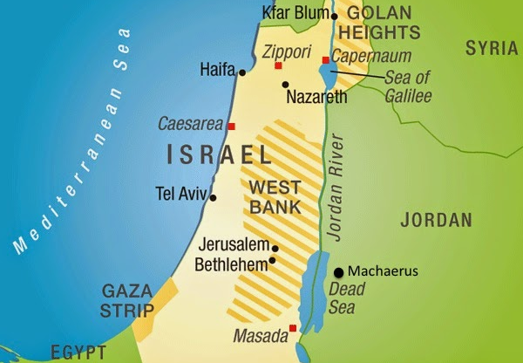
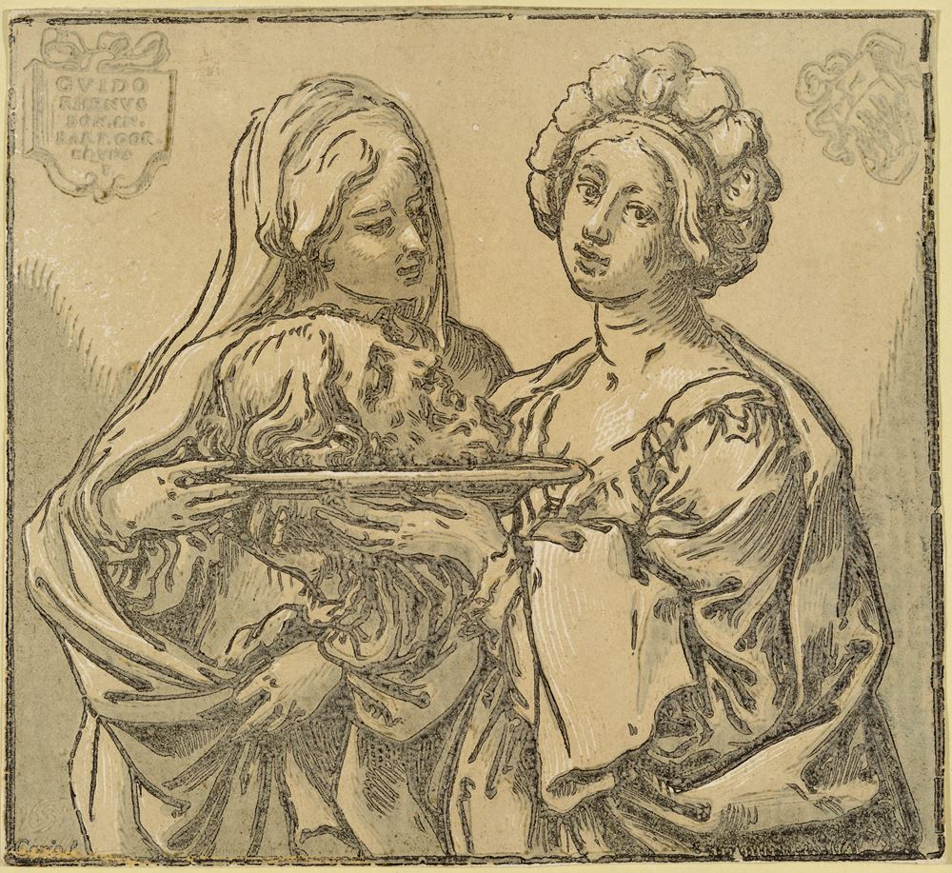
¹Then in those days, comes John the Baptist, preaching in the wilderness of Judea, ²and saying, Repent; for has drawn near the kingdom of the heavens.
Shortly after John’s testimony of Jesus as the Messiah, his public ministry was brought to a close. In daring disregard of the Divine Law, Herod Antipas had taken Herodias, the wife of his brother Philip, as his new wife; and when John reproved him for this, as well as for other sins (cf. St. Luke 3:19), Herod cast him into prison.
John’s prison was at the fortress of Machaerus, a fortress on the eastern shore of the Dead Sea. Nothing, but the death of the Baptist, would satisfy the resentment of Herodias. A court festival was held at Machaerus in honor of the king’s birthday. After supper, the daughter of Herodias (Salome) came in, and danced for the king and, in lust, Antipas promised with an oath, to give her whatsoever she should ask. Salome, prompted by her maligned mother, demanded the head of John the Baptist. Herod gave instructions to an officer of his guard and John was executed by beheading.
Vigil of The Epiphany
Verse 1 & 2

Slide 9
¹Then in those days, comes John the Baptist, preaching in the wilderness of Judea, ²and saying, Repent; for has drawn near the kingdom of the heavens.
Here are some interesting facts about the life of John the Baptist:
• Zacharias and Elizabeth were of advanced age, and Elizabeth was barren. Her conception was miraculous in line with many of the opening barren wombs of the OT (i.e., Sarah or Hannah).
• At the birth of John, Zacharias “was filled with the Holy Spirit” and gives a prophecy of his son. Perhaps the best summary of John’s work are found in St. Luke 1:76, 77.
• John is the promised and expected forerunner of the Messiah. This is seen in St. Matthew’s quotation of Isaiah 40. See also the very last verses of the OT, Malachi 4:4-6.
• John is the last of the OT prophets. Jesus commends John’s ministry in St. Matthew 11:11-15.
Vigil of The Epiphany
Verse 1 & 2

Slide 10
¹Then in those days, comes John the Baptist, preaching in the wilderness of Judea, ²and saying, Repent; for has drawn near the kingdom of the heavens.
Preaching in the wilderness. John comes preaching, that is, as a herald! You should note that preaching, in the Biblical sense, is to announce clearly and distinctly exactly what God orders to be announced…His Word! We dare not change the message by alteration, omission, or addition. The preacher is not to utter his own “eloquent” wisdom, but is to confine himself to the foolishness; the skandalon of the Gospel.
Repent. John’s preaching is summarized, “Repent; for has drawn near the kingdom of the heavens” (v.2). The word “repent” is one of the most important words of Holy Scripture. What does this mean?
“Properly speaking, repentance consists of these two parts: one is contrition, that is, terror smiting the conscience with the knowledge of sin, and the other is faith, which is born of the Gospel, or of absolution, believes that sins are forgiven for Christ’s sake, comforts the conscience, and delivers it from terror.” [AC, XII.3-5]
Vigil of The Epiphany
Verse 1 & 2

Slide 11
¹Then in those days, comes John the Baptist, preaching in the wilderness of Judea, ²and saying, Repent; for has drawn near the kingdom of the heavens.
John’s preaching of repentance is a call to both sorrow and faith, that his hearers would embrace and trust the promises of the soon coming of the Messiah, “for has drawn near the kingdom of the heavens.” This sermon by John is the same sermon that Jesus preaches as He begins His teaching after His temptation, “Repent; for has drawn near the kingdom of the heavens” ^{(St. Matthew 4:17)}.
In the very first of the 95 Theses, Luther says, “When our Lord and Master Jesus Christ said, ‘Repent,’ he willed the entire life of believers to be one of repentance.” Some have said that the whole Reformation was a debate about the Biblical teaching of repentance.
Vigil of The Epiphany
Verse 1 & 2

Slide 12
¹Then in those days, comes John the Baptist, preaching in the wilderness of Judea, ²and saying, Repent; for has drawn near the kingdom of the heavens.
The Kingdom of the Heavens. The kingdom of the heavens is a constant theme in Matthew (occurs 32 times) and in the teaching of Jesus. While the teaching of the kingdom will continue to unfold in Matthew and the teaching of Jesus, we will make a few comments by way of introduction. It is clear that the kingdom of God is nothing more than the rule of the King (Jesus) among men. This is what we call the church. When John says, “…for has drawn near the kingdom of the heavens” he is saying, “The Messiah is at hand!”
Jesus teaches us to pray, “Thy kingdom come.” How does the kingdom come? “God’s kingdom comes when our heavenly Father gives us His Holy Spirit, so that by His grace we believe His holy Word and lead godly lives here in time and there in eternity.” Thus, the Kingdom of the Heavens is in contrast to the bloody and ruthless kingdom of Herod in chapter two.
Vigil of The Epiphany
Verse 1 & 2

Slide 13
³“For this is the [One] having been spoken of through Isaiah the prophet, saying, ‘[The] voice of one crying in the wilderness, prepare the way of [the] Lord; make straight His paths’”
The context of Isaiah’s prophecy, from 40:3, describes a herald who will announce the good tidings of great joy of God’s mercy in restoring the exiles of Judah. As Matthew has already announced a new and greater “exodus” that is taking place through the “exodus” from Egypt of God’s Son (2:15), now is the proclamation of a new and greater return from exile in John’s day. Note the imperative words “prepare” ( Jetoimavsate). This verb is used in the NT to denote the act of preparing or making ready. It often implies a sense of anticipation or readiness for a future event or purpose. This preparation can be physical, spiritual, or metaphorical, depending on the context and “make straight” (eujqeivaV poiei:te). This verb is used to convey a sense of urgency. It describes actions that occur without delay, emphasizing promptness and directness that also correspond with the Baptist’s from the imperative of “repent!”
Vigil of The Epiphany
Verse 3

Slide 14
³“For this is the [One] having been spoken of through Isaiah the prophet, saying, ‘[The] voice of one crying in the wilderness, prepare the way of [the] Lord; make straight His paths’”
John preaches Law and Gospel. He calls the people to repent of their wickedness and their pride, of their presumption that their patronage is their salvation. “God can raise up children of Abraham from these stones” (3:9). Indeed, to be a child of Abraham has nothing to do with blood; yet, everything to do with faith. “Therefore know that only those who are of faith are sons of Abraham” (Gal 3:7); [see also 3:26-29, Eph 2:11-19; Rom 9:6ff]. John, indeed, has his preaching ax laid at the root of all pride, cutting it low to make straight our Lord’s way.
John also preaches the Gospel; preaching about Jesus! Granted, Jesus will come in judgment, “His winnowing fan is in His hand,” [3:12], but Jesus will graciously gather His wheat into the barn. Whose wheat? His wheat, the beneficiaries of His Baptism of the Holy Spirit in the forgiveness of all of your sins.
Vigil of The Epiphany
Verse 3

Slide 15
⁴“Now John himself had the garment of the hair of a camel, and a leather belt around his waist, and his food was locusts and wild honey. ⁵At that time were going out to him Jerusalem, and all Judea, and all around the region [of the] Jordan, ⁶and [they] were being baptized in the Jordan by him, confessing their sins.”
Why does Matthew describe John’s dress and diet? He underlines John’s dress and diet for the purpose of drawing a parallel between Elijah and John ^{(cf. 2 Ki 1)}. Matthew also intends to draw out that John is fulfilling what was written about Elijah and that John is the “Elijah who has come” ^{(11:14)}. John is also the promised Elijah, who has come to turn the hearts of the people to one another and to God ^{(Mal. 4:5-6)}.
In response to John’s preaching, the people “were being baptized in the Jordan by him, confessing their sins” ^{(v.6)}. Matthew establishes a clear link between John’s ministry and the work that Jesus has come to accomplish; in that the people being baptized are confessing that from which their Messiah has come to save them: “their sins” ^{(1:21; 3:6)}.
After St. Matthew summarizes the content of John’s preaching and the reason for it, he will now give a detailed synopsis of John’s ministry (vv.4-6); his denunciation of the religious leaders (vv.7-10); and, finally, John’s contrast between his work as a forerunner and that of the Mightier One to follow (vv.11-12).
Vigil of The Epiphany
Verses 4-6

Slide 16
⁴“Now John himself had the garment of the hair of a camel, and a leather belt around his waist, and his food was locusts and wild honey. ⁵At that time were going out to him Jerusalem, and all Judea, and all around the region [of the] Jordan, ⁶and [they] were being baptized in the Jordan by him, confessing their sins.”
The uniqueness of John’s baptism is shown in its relation to his preaching. Just as John shockingly addressed his call to conversion to Israel, and not to Gentile; so John’s baptism is only for all Israel. As John announced the in-breaking of God’s end times and His Kingly deeds, so John’s baptism was eschatological and probably sealed the repentant, marking them as those who would pass through the coming judgment to enter into the Messianic Kingdom.
Vigil of The Epiphany
Verses 4-6

Slide 17
⁴“Now John himself had the garment of the hair of a camel, and a leather belt around his waist, and his food was locusts and wild honey. ⁵At that time were going out to him Jerusalem, and all Judea, and all around the region [of the] Jordan, ⁶and [they] were being baptized in the Jordan by him, confessing their sins.”
So, this raises a continuing theological question: “What did John’s baptism do?” First, it is necessary to distinguish, as John does, between his baptism with water and the baptism that Jesus will administer on the Last Day: a baptism “with The Holy Spirit and fire” (v.11). John’s baptism was preparatory, it does not, however, equate with the End Times baptism of our Lord Jesus. We also make a mistake by equating John’s baptism with Christian Baptism, which our Lord will institute at the end of Matthew’s Gospel. The Lord’s Baptism incorporates the Christian (you) into the Holy Triune Name (we will discuss this in Matthew 29:19)! Paul clearly distinguishes between John’s baptism and Christian Baptism in Acts 19:1-7. What Paul is says in passages such as Rom 6:1-4; Eph 4:4-6; and Col 2:11-13 also concerns Christian Baptism, and not John’s.
Vigil of The Epiphany
Verses 4-6

Slide 18
Secondly, and to fully answer the question, the people who came to John’s baptism seem to have already repented, because as soon as they were being baptized they were confessing their sins. Matthew does not give us any explicit information about the precise relationship between John’s baptism and the forgiveness of sins.
Matthew’s Gospel would surely accommodate the idea that God forgave the people’s sins through John’s baptism, since the people being baptized are confessing the sins from which they needed to be saved, and from which Jesus, their Messiah, will save them (1:21). We can conclude, then, that through John’s baptism God granted forgiveness and further repentant faith. John’s preaching had already moved the people to participate in this new, end-time reentry into the Promised Land and into membership in God’s covenant people (the children of Abraham), and to look for the Mightier One, their Messiah, Jesus, and His end-time deeds!
Vigil of The Epiphany
Verses 4-6

Slide 19
⁷“Now having seen many of the Pharisees and Sadducees coming to his baptism, he said to them, ‘Brood of vipers, who forewarned you to flee the coming wrath? ⁸Produce, therefore, fruit worthy of repentance. ⁹And [do] not presume to say within yourselves, we have [as] father Abraham. I say to you that God is able out of these stones to raise up children unto Abraham. ¹⁰Now already the ax is applied to the root of the trees; therefore every tree not producing good fruit is cut down and thrown into [the] fire.’”
St. Matthew now shifts to the sobering reality that not all people responded rightly to John’s preaching and baptism. As his ministry moved forward, John correctly perceived that the Pharisees and Sadducees were approaching him and thinking that they too should receive his baptism. The members of these two groups share this in common: they have failed to reckon with their own need to repent and be converted to true faith in the Messiah in preparation for the coming of the End.
Vigil of The Epiphany
Verses 7-10

Slide 20
⁷“Now having seen many of the Pharisees and Sadducees coming to his baptism, he said to them, ‘Brood of vipers, who forewarned you to flee the coming wrath? ⁸Produce, therefore, fruit worthy of repentance. ⁹And [do] not presume to say within yourselves, we have [as] father Abraham. I say to you that God is able out of these stones to raise up children unto Abraham. ¹⁰Now already the ax is applied to the root of the trees; therefore every tree not producing good fruit is cut down and thrown into [the] fire.’”
So then, these two groups approach John with the intention of being baptized. Why does John, however, treat them so vilely? The key lies in his statement in v.9: “And [do] not presume to say within yourselves, we have [as] father Abraham. I say to you that God is able out of these stones to raise up children unto Abraham.” John has called the people out to a new exodus and back through the waters of the River Jordan; in short, to conversion and faith again in YHWH who is about to manifest His reign on the earth in His Beloved Son.
Vigil of The Epiphany
Verses 7-10

Slide 21
⁷“Now having seen many of the Pharisees and Sadducees coming to his baptism, he said to them, ‘Brood of vipers, who forewarned you to flee the coming wrath? ⁸Produce, therefore, fruit worthy of repentance. ⁹And [do] not presume to say within yourselves, we have [as] father Abraham. I say to you that God is able out of these stones to raise up children unto Abraham. ¹⁰Now already the ax is applied to the root of the trees; therefore every tree not producing good fruit is cut down and thrown into [the] fire.’”
Physical descent from Abraham is no substitute for heartfelt brokenness and confession of sin. The only proper response is to acknowledge one’s need, one’s complete absence of merit, that all are completely poor in spirit! The Pharisees and Sadducees failed to do. These two groups’ essentially believes the following:
God chose Israel and gave them the Law. The Law implies both God’s promise to maintain election and the requirement to obey. God rewards obedience and punishes transgression. The Law provides for means of atonement, and atonement results in the re-establishment of the covenantal relationship. All those who are maintained in the covenant by obedience, atonement, and God’s mercy belong to the group which will be saved.
Vigil of The Epiphany
Verses 7-10

Slide 22
⁷“Now having seen many of the Pharisees and Sadducees coming to his baptism, he said to them, ‘Brood of vipers, who forewarned you to flee the coming wrath? ⁸Produce, therefore, fruit worthy of repentance. ⁹And [do] not presume to say within yourselves, we have [as] father Abraham. I say to you that God is able out of these stones to raise up children unto Abraham. ¹⁰Now already the ax is applied to the root of the trees; therefore every tree not producing good fruit is cut down and thrown into [the] fire.’”
John flatly refuses to accommodate them since they do not understand their need to flee the coming wrath of God against sin and evil. John calls for them to produce fruit that was worthy of true repentance. The very fact that such fruit was not forthcoming from them indicated that they had not begun to repent. John tells them to truly repent and acknowledge your need; confess your sins; flee from God’s wrath! When they do this, the fruit that is worthy of repentance will come forth. For John, repentance consists of acknowledging that one deserves the wrath of God, confessing one’s sins, and looking for the in-breaking of the reign of God through the coming of the Mightier One (The Messiah). This true repentance always issues forth in good works, as our Confessions also affirms (cf. Ap XII 28, 131).
Vigil of The Epiphany
Verses 7-10

Slide 23
¹¹“Indeed, I baptize you with water to repentance, but after me is coming [One] mightier than I, He of whom I am not fit to carry [His] sandals. He will baptize you with [the] Holy Spirit and with fire, ¹²whose winnowing fork [is] in His hand; and He will clear His threshing floor and will gather His wheat into the barn; but the chaff He will burn up with unquenchable fire.”
John is now addressing all who are present at the Jordan, and not only the unrepentant religious leaders. John contrast his own ministry with the work of the One coming after him, who is far more significant! John’s baptism takes place in light of the Last Day, in anticipation of God’s final ruling deeds. John speaks of the One who is Mightier than himself and who will perform His work on that Last Day. It’s important to note that St. Matthew uses a series of future indicatives: “He will baptize…He will clear…will gather…He will burn.”
Vigil of The Epiphany
Verses 11-12

Slide 24
¹¹“Indeed, I baptize you with water to repentance, but after me is coming [One] mightier than I, He of whom I am not fit to carry [His] sandals. He will baptize you with [the] Holy Spirit and with fire, ¹²whose winnowing fork [is] in His hand; and He will clear His threshing floor and will gather His wheat into the barn; but the chaff He will burn up with unquenchable fire.”
Now we come to a confusing section: “He will baptize you with [the] Holy Spirit and fire…! The terms “baptize” and “[the] Holy Spirit and fire” leads us to think of the Sacrament of Holy Baptism that our Lord instituted just prior to His glorious Ascension. But we must remember that John is talking of the end-times that Jesus is bringing to bear in His ministry and work. Thusly, John is pointing out the final salvation and judgment that the Christ (Messiah) will administer when He returns in glory. So, again, John is not referring to Christian Baptism! John is looking to the future end-times fulfillment.
Vigil of The Epiphany
Verses 11-12

Slide 25
In summary, St. Matthew presents the end-time preaching and baptizing of John. John’s ministry is Divinely ordained; he is the one spoken of in Isaiah. John announces that Israel’s lost sheep must repent in order to be saved! The people must turn from their unbelief and sin to genuine faith in expectation that God’s reign, the promised eschatological in-breaking, is near! John baptizes those who repent, and they look eagerly for the One who will come and do what God can do: send out the Holy Spirit! Those who find their security in anyone else or their works face the fearsome threat of fiery judgment for the Mightier One, the Messiah!
This same truth echoes in our Divine Service, as it should! Or as we have confessed this morning: “He will come again with glory to judge both the living and the dead.”
Vigil of The Epiphany
The Summary

Slide 26
I. The Birth and Early Years of our Lord (Ch. 1-2)
A. Genealogy (1:1-17) (Jan 5)
B. Birth (1:18 – 2:12) (taught during Dec)
C. His Sojourn in Egypt (2:13-23) (taught during Dec)
II. The Lord’s Ministry Begins (3:1 – 4:11)
A. His Forerunner (3:1-12) (Jan 12)
B. His Baptism (3:13-17) (Jan 19)
C. His Temptation (4:1-11) (Jan 26)
III. The Lord’s Ministry in Galilee (4:12 – 14:12)
A. The Beginning of His Galilean Ministry (4:12-25) (Feb 2)
B. First Discourse: The Sermon on the Mount – Ch 5 (Feb 9)
C. First Discourse: The Sermon on the Mount – Ch 6 (Feb 16)
D. First Discourse: The Sermon on the Mount – Ch 7 (Feb 23)
Vigil of The Epiphany
Our Outline of St. Matthew

Slide 27
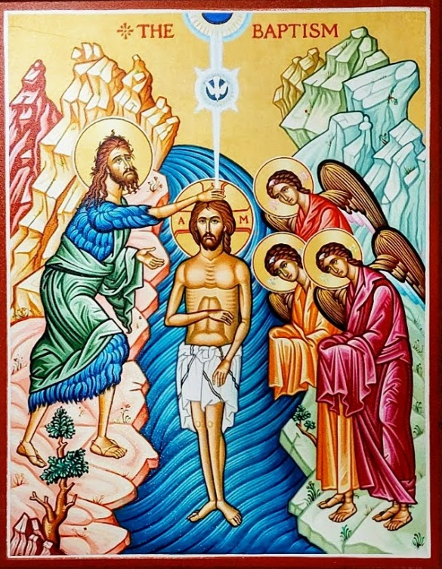
St.
Matthew
3:13-17
Next Week
The Baptism of Our Lord

