Slide 1
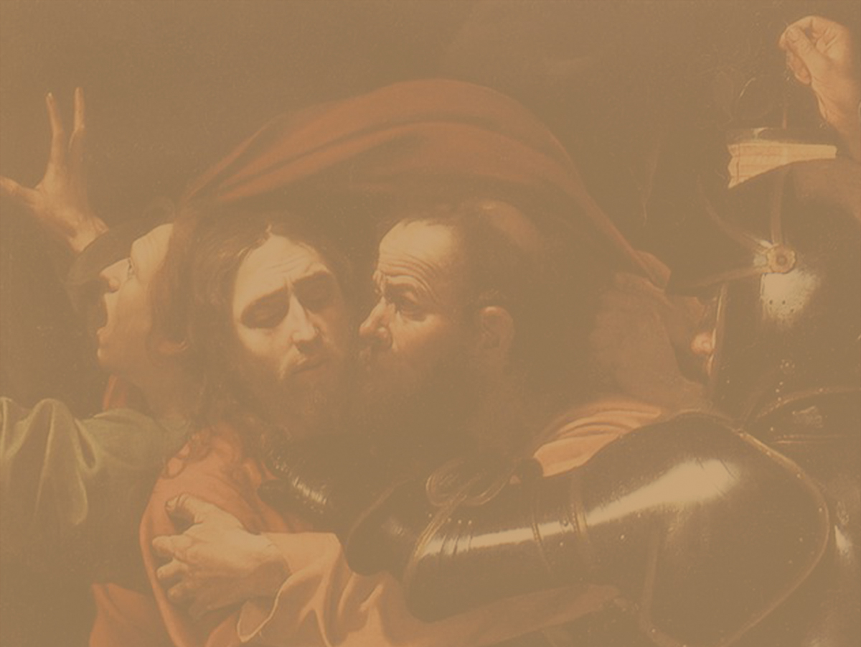
St. Matthew
Chapter 2
Notes:
All of this is an historical record of what took place, but in back of it there is a tremendous truth being presented, and we don’t want to miss that. We have said before that each gospel was directed to meet the needs of a particular group of people and that Matthew was written to the nation of Israel. It is for religious people. Recorded here is the fulfillment of four prophecies. To show how these Old Testament prophecies were fulfilled at the birth of Jesus is the purpose.
Chapter one has focused on the identity of the Child (“who He is”), showing His connection to the royal line of David, and describing Him as the One promised by the prophets to bring salvation to His people. Chapter two, however, takes an interesting turn, for it describes the manner in which the King, Yeshua, would be received (“what He is”). Foreigners who were gentiles (the magi) come to give Him honor (vv. 1–12), while Herod seeks to take His life (vv. 13–23). From the very beginning of Matthew’s story, we are confronted with the fulcrum of God’s love—the person of Yeshua. Those who reject Him are left to their own demise, but those who receive Him as King, are granted entrance into His kingdom. Moreover, we are introduced to an undercurrent of Matthew’s story—the ingathering of the Gentiles. Here, the first to honor Yeshua are foreigners, and at the end of Matthew’s Gospel, the injunction to make disciples of the nations forms the final commission of the Master.

Slide 2
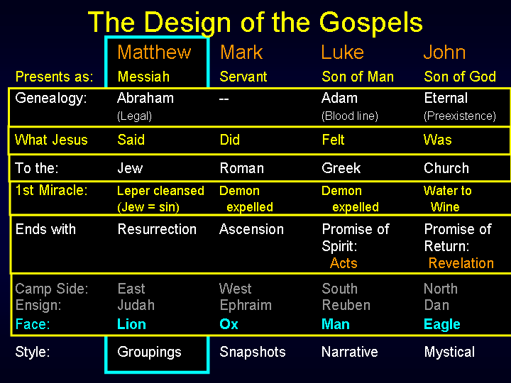
Spiritual
Notes:
Face: The four faces of the cherubim. Whenever we see the thrown of Ged in the Scripture we see these four faces of the Cherubim.

Slide 3
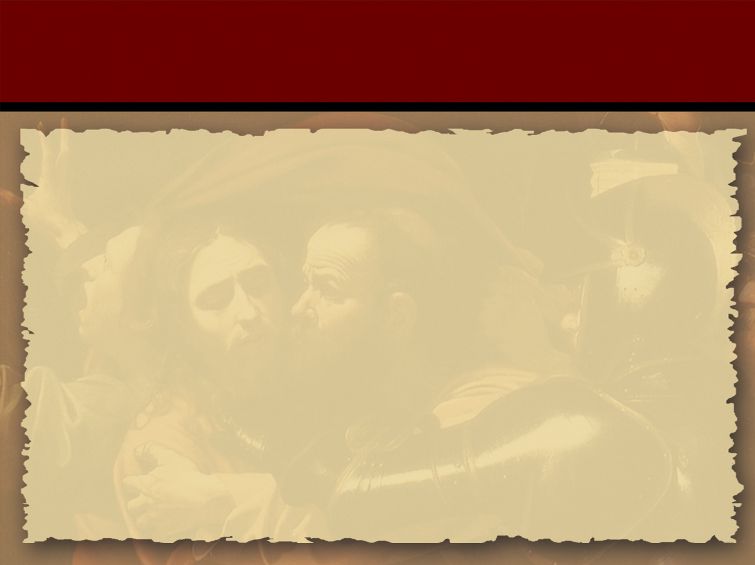
Integrated Design
66 Separate Books
- Penned by over 40 different individuals
- Over several thousand years
Design anticipates, in detail, events before
they happen
- From outside our dimension of time
and space
Notes:
Forty different guys most of whom did not know each other.
Outside time domain – this can be proved, and in that regard you can prove that the Bible is the Word of God.
Demonstrates integrity of Design.

Slide 4
Epistemological Approach
Establish
the Integrity
of Design
Establish
the Identity of Jesus Christ
Authentication
Notes:
Study of knowledge its scope and limits.
We can establish the Integrity of the Bible, Establishing the integrity of the design,
That Establishes the Identity of Jesus Christ who in turn authenticates the Bible.

Slide 5
Chapter 2
Visit of the Magi 2:1-15
Massacre at Bethlehem 2:16-18
Flight to Egypt 2:19-22
Return into Nazareth 2:23

Slide 6
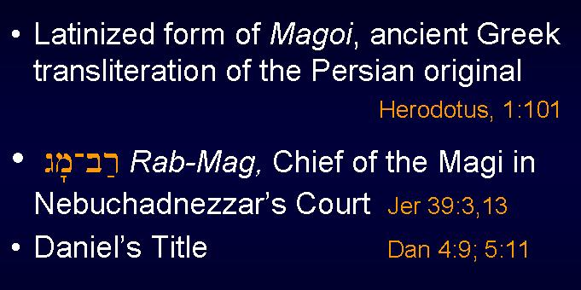
Magi of Medo-Persia
Notes:
The visit of the Magi – who were they? The Medes had a hereditory priesthood. They were called the Magi.
There were some of these in Nebuchadnezzar’s court, and Daniel was the chief of the Magi, the Rab-Mag.
Daniel’s Title (Dan 4:9; 5:11). [This Jewish appointment may have had repercussions among the hereditary Median priesthood, leading to the plot of Daniel 6, which involved the ordeal of the lion’s den.]
Singular magus... “magic.” “Magicians” (a profession, rather than citizenship or cultural link), presented in the book of Acts as vile men without standing or morals:
Persian magi were credited with profound and extraordinary religious knowledge. (Babylonian magi often considered mere imposters.)

Slide 7
Magi of Medo-Persia
Oneiromancy, not astrology, was their key
skill Divination by dreams Herodotus 1.107, 120; VII.19
Established as the state religion of Persia
by Darius the Great, after some Magi who
were considered to be expert in interpretation
of dreams had been attached to the Median
court.
(Not originally followers of Zoroaster)
Encyclopedia Britannica 7:691
Notes:
This all could have started with the skill of Daniel. Later: Philo of Alexandria, Cicero, and Philo, and others, record that the Magi were attached to senior Roman courts with acknowledged gifts and standing.

Slide 8
Magian Religion vs. Judaism
Each had its monotheistic concept of one beneficent
creator of all good who in turn was opposed by a
malicious evil spirit.
Each had its hereditary priesthood which became
the essential mediator between God and man by virtue
of blood sacrifice.
Each depended upon the wisdom of the priesthood
in divination.
Each held concepts of clean and unclean forms of life.
Magi were priestly caste during Seleucid, Parthian, and
Sasanian (Neo-Persian or Iranian) periods.
Notes:
This all could have started with the skill of Daniel. Later: Philo of Alexandria, Cicero, and Philo, and others, record that the Magi were attached to senior Roman courts with acknowledged gifts and standing.

Slide 9
Political Background
Since the days of Daniel the fortunes of both the Persian
and the Jewish nation had been closely intertwined.
Both nations had in their turn fallen under Seleucid
domination in the wake of Alexander’s conquests.
Both had regained their independence:
- the Jews under Maccabean leadership
- the Persians as the dominating ruling group within the
Parthian empire.
It was at this time that the Magi in their dual priestly
and governmental offices composed the upper house of
the council of the Magistrates whose duties included the
absolute choice and election of the king of the realm!
Notes:
This all could have started with the skill of Daniel. Later: Philo of Alexandria, Cicero, and Philo, and others, record that the Magi were attached to senior Roman courts with acknowledged gifts and standing.

Slide 10
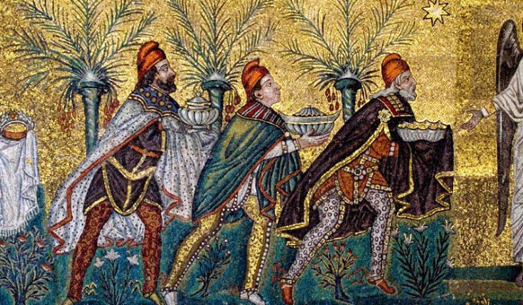
Magistrates
It was in a dual capacity as priests and counselors
whereby civil and political counsel was invested with
religious authority.
Thus, the Magi became the supreme priestly caste of
the empire!
Notes:
This all could have started with the skill of Daniel. Later: Philo of Alexandria, Cicero, and Philo, and others, record that the Magi were attached to senior Roman courts with acknowledged gifts and standing.

Slide 11
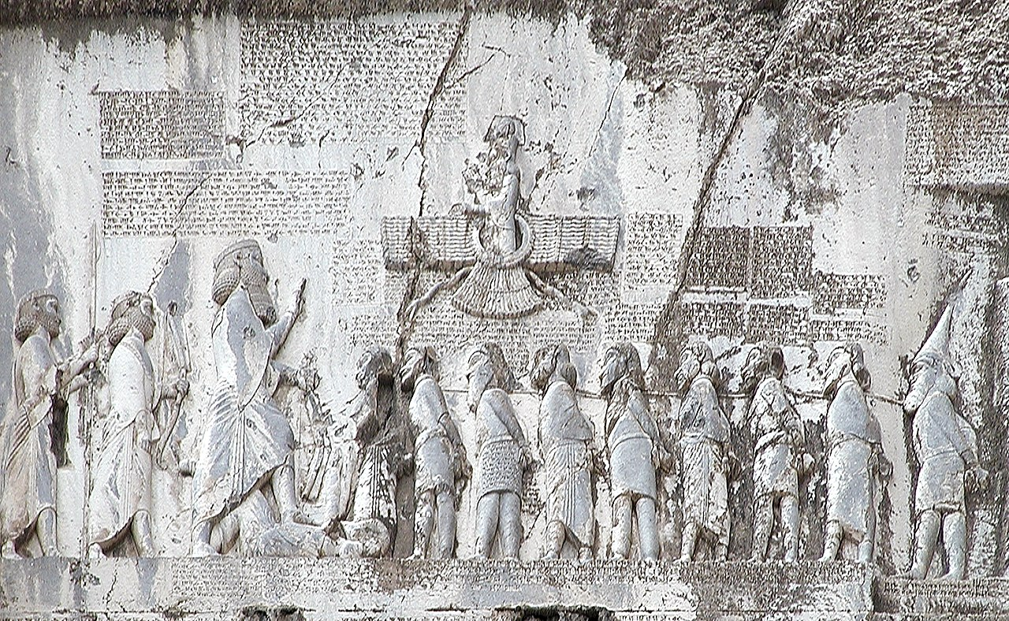
The Inscription of Bihistun
Darius I (The Great) (522-486 BC)
Three languages
- Elamite
- Akkadian
- Old Persian
Speaks of his speedy and final triumph over a
revolt of Magi in 522 BC
King Darius says: My father is Hystaspes [Vištâspa]; the father of Hystaspes was Arsames [Aršâma]; the father of Arsames was Ariaramnes [Ariyâramna]; the father of Ariaramnes was Teispes [Cišpiš]; the father of Teispes was Achaemenes [Haxâmaniš]. King Darius says: That is why we are called Achaemenids; from antiquity we have been noble; from antiquity has our dynasty been royal. King Darius says: Eight of my dynasty were kings before me; I am the ninth. Nine in succession we have been kings.
Notes:
This is like a giant Rosetta stone, gives information on how to translate languages because it is in multiple languages.

Slide 12
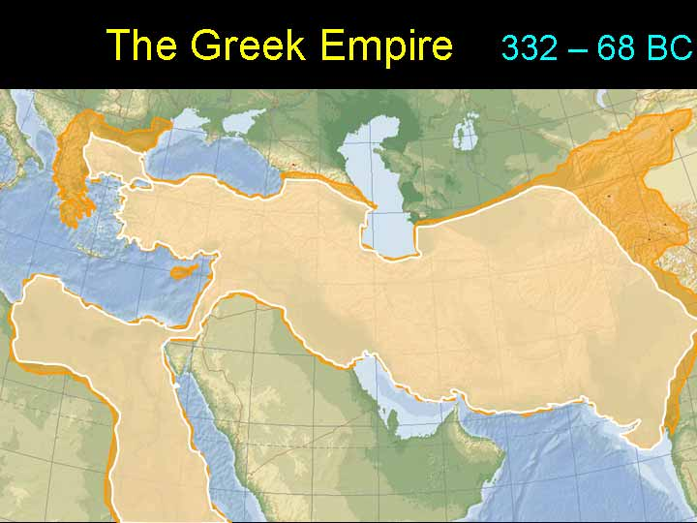

Slide 13
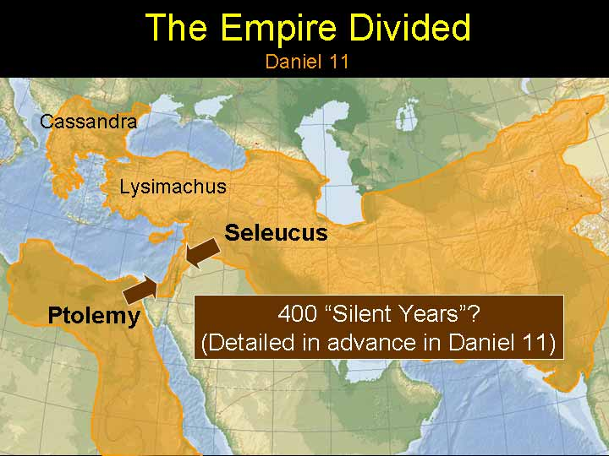

Slide 14
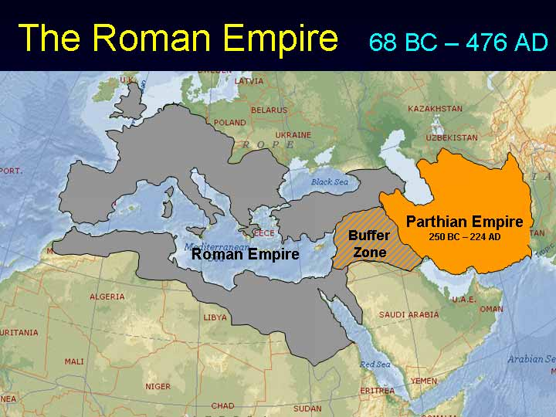

Slide 15
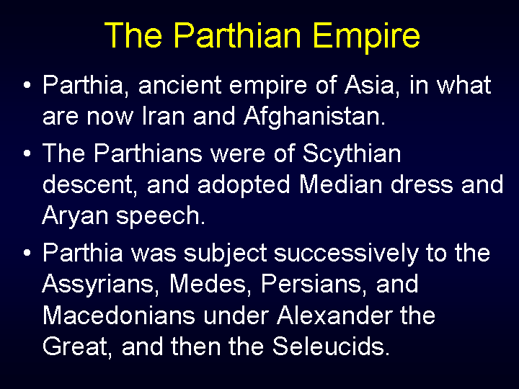

Slide 16
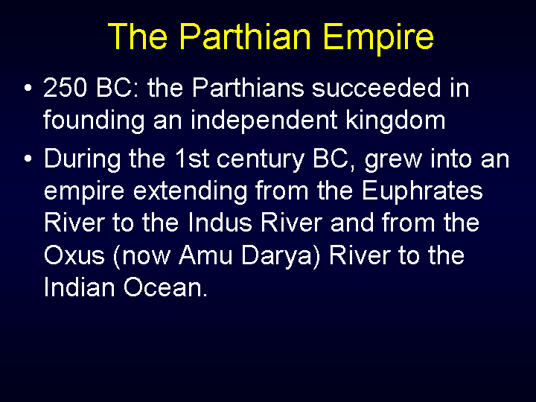

Slide 17
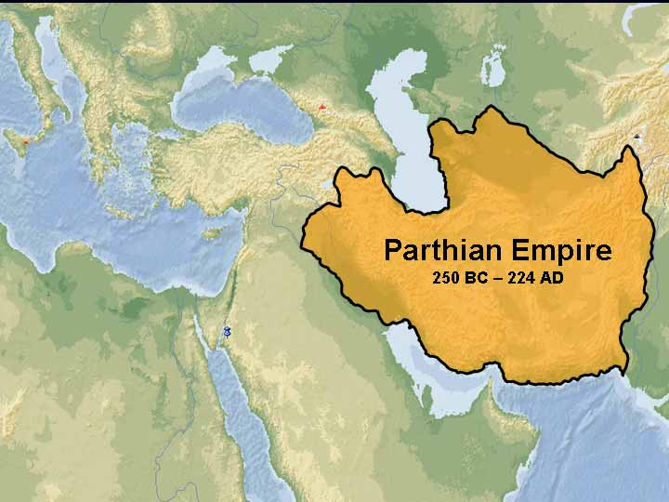

Slide 18
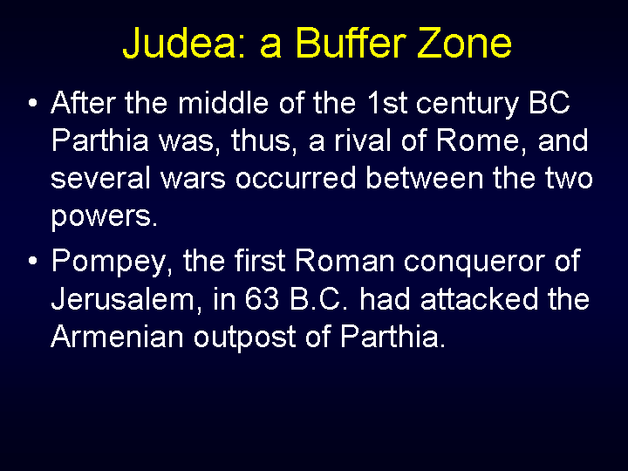

Slide 19
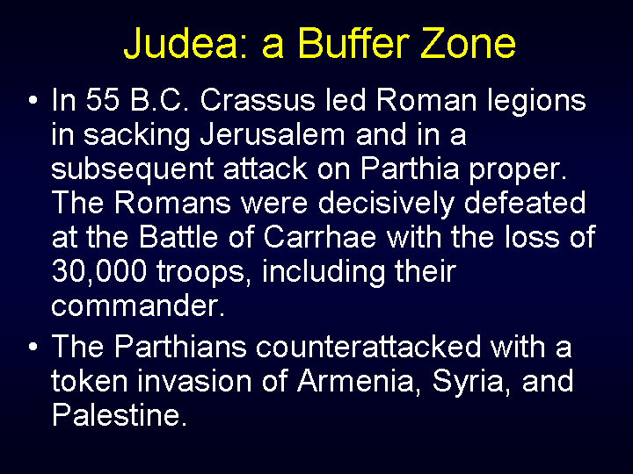

Slide 20
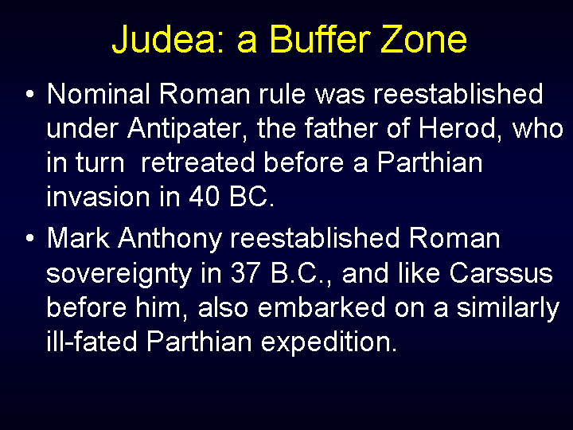

Slide 21
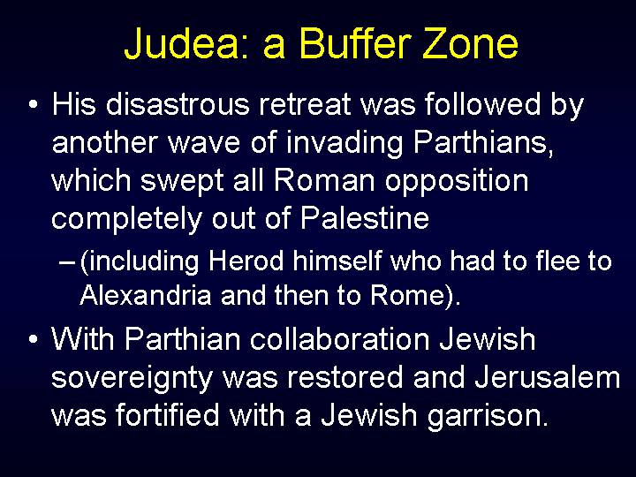

Slide 22
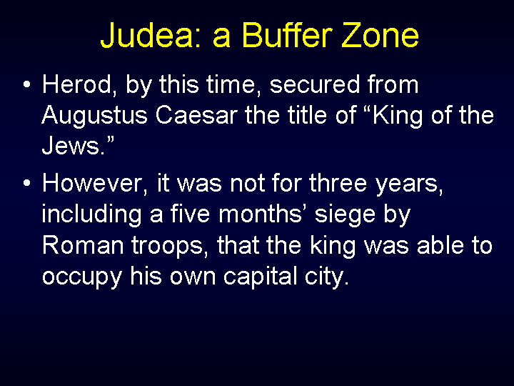

Slide 23
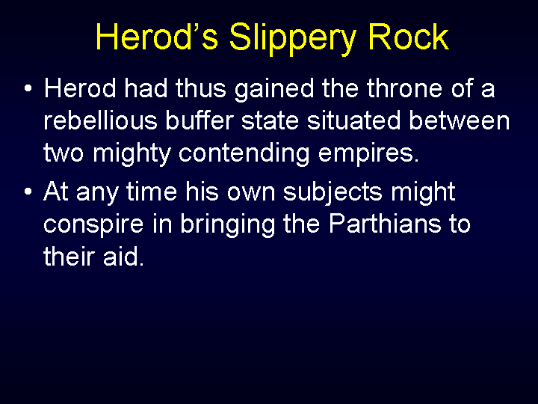

Slide 24
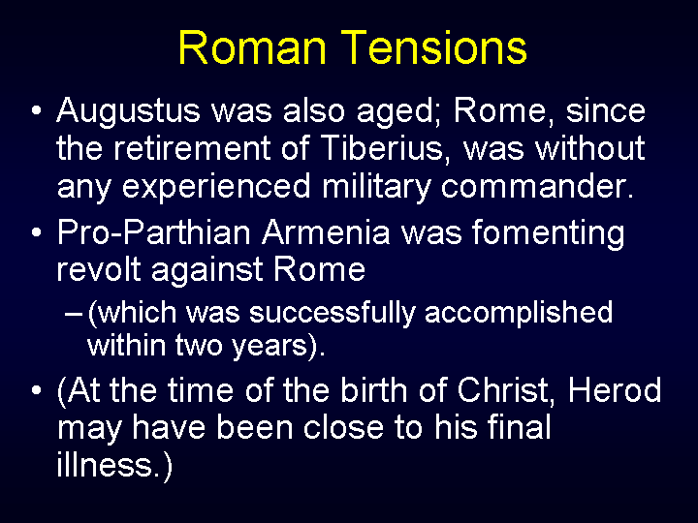

Slide 25
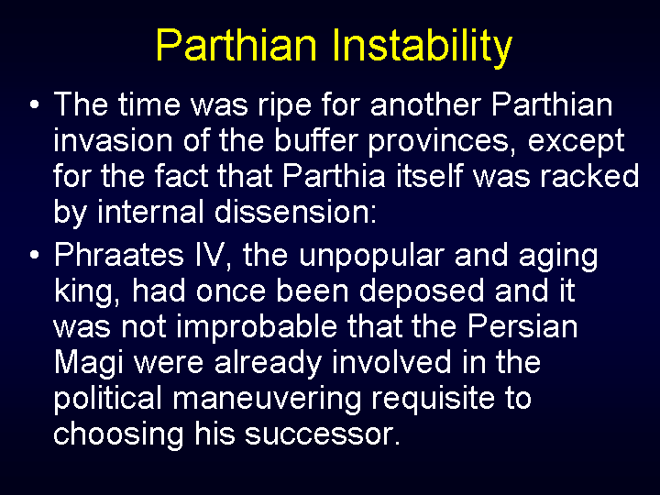

Slide 26
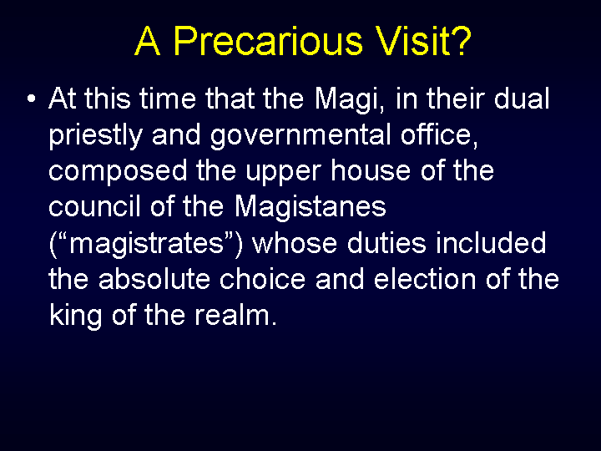

Slide 27
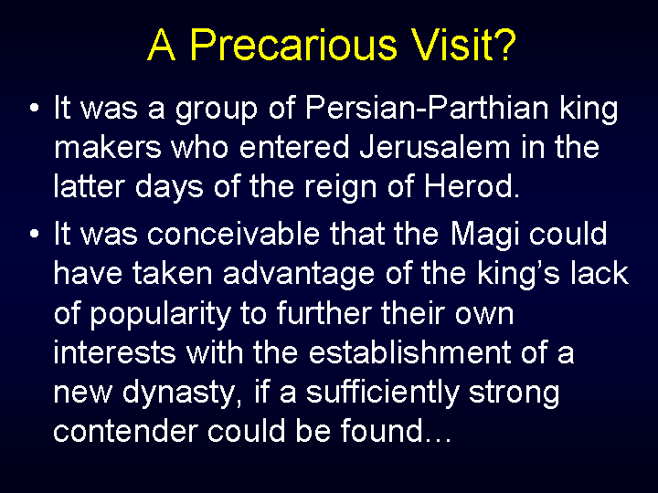

Slide 28
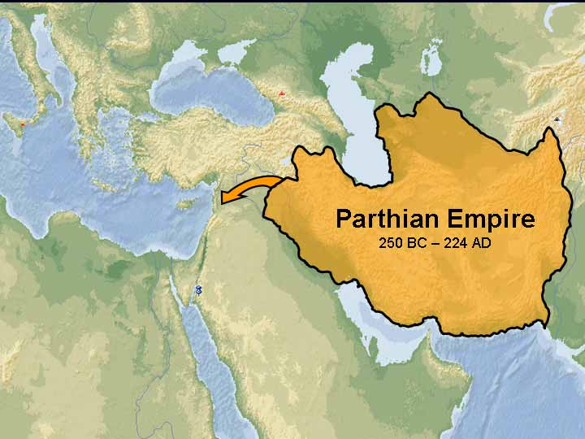
Syria

Slide 29
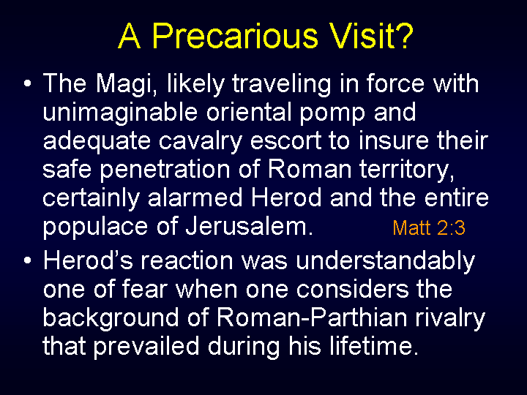
End of Section I

Slide 30
Matthew 2:1
Now after Jesus had been born in Bethlehem of Judea in the days of Herod the king, behold, Magi [mavgoi] from the east appeared in Jerusalem…
Notes:
[wise men] Greek: magoi (GSN-3097), wise men. They were a priestly hereditary caste that uttered prophecies, explained omens, interpreted dreams, and practiced foretelling (Daniel 2:2,48; Daniel 4:9). The original word here is magoi from which comes our word magician, now used in a bad sense, but not so in the original. The men here denoted were philosophers, priests, astronomers, fortunetellers and they also practiced other occult arts. They dwelt chiefly in Persia and Arabia. They were held in high esteem by the Persian court, were admitted as counselors, and followed the camps in war, to give advice.
[Now after Yeshua was born] The paragraph in the Greek begins with a genitive absolute in the form of an aorist participle. This gives the reader notice that the events about to be described took place subsequent to the birth, with the context specifying the time-frame more precisely. On the syntax of the genitive aboslute, see Blass-Debrunner, Greek Grammar, §423 (p. 218).

Slide 31
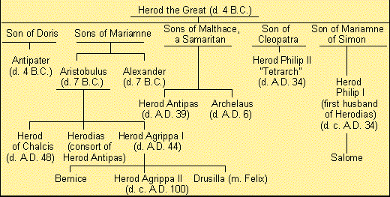
Family Tree of Herod
(d.1 B.C.)
Notes:
“Herod the king” is Herod the Great, who was born in 74 b.c. and died in April , 4 b.c. His father Antipater was a Jew of Idumean (Edomite) descent, who was appointed procurator of Judea in 47 b.c. by Julius Caesar.

Slide 32
Micah 5:2
But thou, Bethlehem Ephratah, though thou be little among the thousands of Judah, yet out of thee shall he come forth unto me that is to be ruler in Israel; whose goings forth have been from of old, from everlasting.
Notes:
Being born in Bethlehem is the fulfillment of Prophecy Micah 5:2. Bethlehem is a small town five miles south of Jerusalem. It sits on a high ridge over 2,000 feet above sea level. It is mentioned in more detail in the Gospel of Luke. Luke also explains why Joseph and Mary were in Bethlehem when Jesus was born, rather than in Nazareth, their hometown.
It was also called Ephratah, a word supposed likewise to signify fertility, Genesis 35:19, Ruth 4:11, Psalms 132:6. It was called the city of David, (Luke 2:4) because it was the city of his nativity, 1 Samuel 16:1,18. It was called Bethlehem of Judea, to distinguish it from a town of the same name in Galilee, Joshua 19:15.

Slide 33
Matthew 2:2
…and said, “Where is the King of the Jews who has been born? For we saw his star in its rising, and we have come to show reverence to him.”
Notes:
This question is a major insult to Herod! These are the only words the magi speak.
There was, at this time, a prevalent expectation that some remarkable person was about to appear in Judea. The Jews were anxiously looking for the coming of their Messiah. By computing the time mentioned by Daniel, (Daniel 9:25-27), they knew that the period was approaching when the Messiah should appear. This man, they supposed, would be a temporal prince, and they were expecting that he would deliver them from Roman (and Herodian) bondage. It was a historical expectation, since Josephus and Philo, two Roman-Jewish historians, make mention of the same expectation. The fact that such a person was expected is clearly attested.
The grammar of the opening phrase makes it clear that the meaning is not, “Where is He who had been born, King of the Jews?” but that this One is the new-born King. He has come for the purpose of reigning as King!

Slide 34
Numbers 24:17
I shall see him, but not now: I shall behold him, but not nigh: there shall come a Star out of Jacob, and a Scepter shall rise out of Israel, and shall smite the corners of Moab, and destroy all the children of Sheth.
Notes:
There is little doubt that the prophecy of Balaam (Num 24:17) informed the Jewish perspective that a star would accompany the appearance of Messiah: Notice that the prophecy says a Star shall come out of Jacob—that is, Israel. And a scepter shall rise out of Israel. The star and the scepter go together. That is the only place I know where they are put together in prophecy in the Old Testament. The Messiah would therefore destroy Moab and Moab’s (Sheth’s) children…all those who oppose him! The wise men in the East had that prophecy, and so they came out of the mysterious East seeking this king.

Slide 35
1st Questions
The 1st question of the New Testament:
“Where is he that is born King of the Jews?”
The 1st question of the Old Testament:
God called to Adam “Where art thou?”
The first question in the Old Testament deals
with the first Adam;
The first question in the New Testament deals
with the last Adam.

Slide 36
Matthew 2:3
But when King Herod had heard, he was troubled, and all Jerusalem with him...
Notes:
Their information makes Herod nervous as he was not King of the Jews, he was appointed by Rome, remember, he’s Idumaean. Their request of Herod, regarding the one “who has been born king of the Jews,” was a calculated insult to him who had contrived and bribed his way into that office. Herod had obtained the kingdom by great crimes, and by shedding much blood. Herod was paranoid that is why he built fortresses like Masada. Herod also has a history with the Parthians…he possibly felt that they were going to make another military move against the Romans and attempt, again, to seize Judah…meaning that Herod would have to flee, again!
We may note similar language in 2 Sam 4:1, Now when Ish-bosheth, Saul’s son, heard that Abner had died in Hebron, he lost courage, and all Israel was disturbed.
The fact that foreigners were coming with such knowledge would have been unnerving.
We should understand “Jerusalem” in this context may stand for the leaders of the Jewish community. But this may have been quite the entourage and did scare all of Jerusalem.

Slide 37
Matthew 2:4
…and when he had gathered all the chief priests and scribes of the people, he began to inquire from them, “Where will the Christ be born?”
Notes:
[Inquired, or asked of them]. As they were the learned men of the nation, and as it was their business to study and explain the Old Testament, they were presumed to know what the prophecies had declared on that point. His object was to ascertain from prophecy where he was born, that he might strike an effectual blow. He seems not to have had any doubt about the time when he should be born. He was satisfied that the time had come.
The “chief priests and scribes” were two separate classes of leaders, though Matthew and Luke have them together in several places (Matt 16:21; 20:18; Luke 9:22; 22:66). More often, Matthew combines the scribes with the Pharisees.
The chief priests comprised more than merely the high priests, present and past. They comprised an established college which included the current high priest and his predecessors, the captain of the temple, the heads of the weekly courses, the directors of the daily courses, the temple overseers, and the temple treasurers.
Scribes, on the other hand, were the teachers of the Torah, the lawyers who interpreted the legal aspects of the Torah, and administered justice. The Scribes functioned as an independent body of leaders, but always in connection with either the Sadducees or Pharisees.

Slide 38
Matthew 2:5
And they said to him, “In Bethlehem of Judea, for thus it stands written through the the prophet,
Notes:
Matthew often quoted Old Testament prophets. This prophecy, paraphrasing Micah 5:2, had been delivered 700 year prior.
Notice that the chief priests and scribes didn’t have to go search for the prophecy…they knew it quite well and readily quoted it to Herod.

Slide 39
Matthew 2:6
“‘And you, Bethlehem, land of Judah, by no means are least among the rulers of Judah, for from you will come forth a Ruler who will indeed shepherd my people, Israel.’”
Notes:
Two kinds of people found here in Chapter 2, those with hatred or those paying homage! The entire world falls into one of these two categories.
Most religious leaders at this time believed in a literal fulfillment of all Old Testament prophecy; therefore, they believed the Messiah would be born in Bethlehem. Ironically, when Jesus was born, these same religious leaders became his greatest enemies. When the Messiah for whom they had been waiting finally came, they didn’t recognize him.
When Herod asked the scribes this question, they didn’t have to search the Scriptures for it; they knew where it was—Micah 5:2. As a matter of fact, they didn’t need even to turn to it, because they had it in their minds. They could quote it. They knew all about the coming of the Messiah. The problem was that their knowledge was academic. It was not personally meaningful to them. They are examples of folk who know the history contained in the Bible and they know certain factual truths, but these things carry no personal meaning for them.

Slide 40
Micah 5:2
But thou, Bethlehem Ephratah, though thou be little among the thousands of Judah, yet out of thee shall he come forth unto me that is to be ruler in Israel; whose goings forth have been from of old, from everlasting.
Notes:
They base their answer upon the words of Micah 5:2, that the Messiah would be born in Bethlehem of Judea, the tribal allotment of Judah. The older notion that the Sadducees relied entirely upon the five books of Moses (the Torah) and gave no credence to the Prophets, has been shown to be in error. Here, both the chief priests and the scribes base their answer to Herod upon Micah, and show that they considered the Prophets to be included in the canon of their authoritative scriptures.
The prophecy tells that he is going to be born but that he has always been; that he, the Messiah, is supernatural. He is the preexistent one and will not be their political King, but rather, their spiritual King…their true King, Lord, and God!

Slide 41
Matthew 2:7
Then Herod secretly called the Magi and ascertained from them the time when the star began to appear…,
Notes:
The account would seem to indicate that the star was a supernatural and not a natural phenomenon. It may not have been at his birth but some time after, a consideration for the people who look in the heavens for the star. Remember that they made the trip by camel—not by car, train or jet. It is a long, hard trip! I am of the opinion that they didn’t arrive in Jerusalem until at least a year after the appearance of the star.

Slide 42
Matthew 2:8
…and he sent them to Bethlehem and said, “Go and inquire accurately about the child, and as soon as you find [him], report to me in order that I also may come and show reverence to him.”
Notes:
Herod took all possible means to obtain accurate information respecting the child, that he might be sure of destroying him. He not only ascertained the probable time of his birth, and the place where he would be born, but he sent the wise men that they might actually see him, and bring him word. All this might have looked suspicious if he had not clothed it with the appearance of religion. He said to them, therefore, that he did it that he might go and worship him also…in other word, go and show obeisance…literally to prostrate himself before the newborn Messiah! We know this to be a lie, but the Magi probably believed Herod.
From this we may learn, 1) that wicked men often cloak their evil designs under the appearance of religion. 2) Wicked men often make use of the pious to advance their evil purposes. 3) The plans of wicked men are often well laid.

Slide 43
Matthew 2:9
After they had heard the king they went and, behold, the star, which they had seen in its rising, began to lead the way for them until it came and stood above where the child was.
Notes:
The star seems to appear, disappear, and reappear. Apparently it appeared to magi while they were still “in the east,” and now it reappears in order to guide them to the location of the Child.

Slide 44
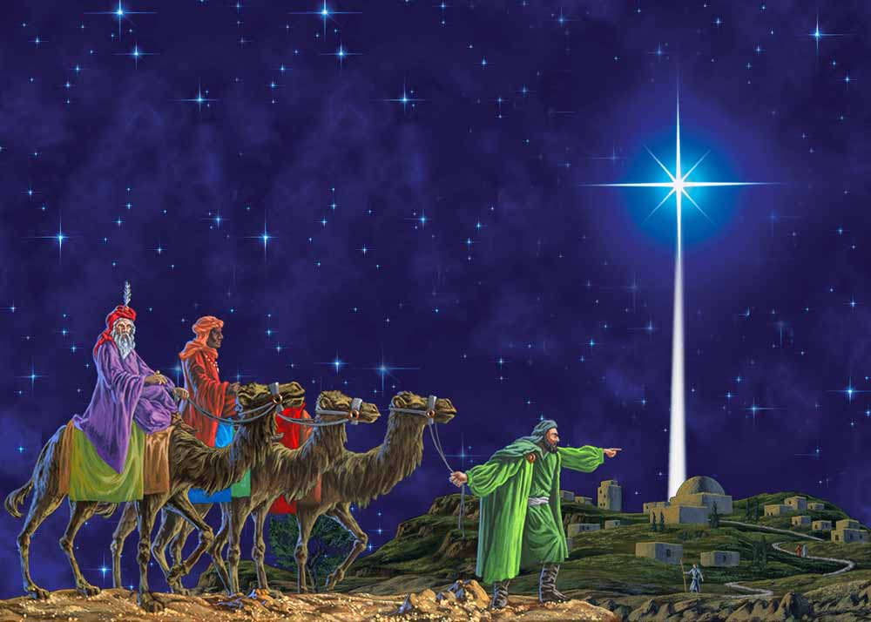
Matthew 2:10
When they had seen the star they rejoiced with extremely
strong joy.
Notes:
Matthew makes it clear that this star was a very unusual star; in fact, it was a supernatural star. It was miraculous, and we needn’t try to find an explanation for it.
We wonder why the magi would have had such joy at knowing that a king had been born in Israel, especially when we have just read that all of Jerusalem was troubled over the matter (v. 3). Whatever the case, we may once again note the sub-theme of Matthew in regard to the ingathering of the Gentiles to the worship of the Messiah. Here, Gentiles have come from a foreign nation, and express joy at the birth of the Messiah. Whatever the cause of rejoicing may have been for the magi themselves; Matthew highlights the fact that the birth of the Messiah signaled the time foretold by the prophets, when the nations would come to Israel’s light, and offer worship to Him. The O.T. prophecy from Micah 5:2 has been fulfilled!

Slide 45
“Star” of Bethlehem ?
Balaam’s prophecy?
- not quoted by Matthew: Numbers 24:17
- Conjunctions? Isaiah 60:3
Johannes Kepler suggested the conjunction of Jupiter and Saturn in 6 BC from an erroneous inference from Josephus. (wrong date: 4 BC)
Not a natural phenomenon: it settled over a specific location. Where?
Notes:
Interesting Matthew does not quote Numbers 24, it seems as though Matthew doesn’t miss a chance to quote Old Testament.

Slide 46
Shekhinah ?
The Creation Gen 1
The Abrahamic Covenant Gen 15
Burning Bush Ex 3
Pillar of fire by night Ex 13
Flames at Pentecost Acts 2
Why not here? Matt 19
Notes:
Visible manifestation of the Holy Spirit.

Slide 47
Matthew 2:11
And when they went into the house, and they saw the child with Mary his mother, and they fell down and showed reverence to him; they opened their treasures and offered to him gifts – gold , and frankincense and myrrh.
Notes:
went into the house: Joseph, Mary, and the Babe now in Nazareth? Or in the house of a relative. But why would they have stayed in Bethlehem so long…over a year. And what about Joseph’s employment in Nazareth? And their family there? See the handout I’ve given you. Many theologians, including myself, think that Joseph, Mary, and the Babe are in Nazareth, but Herod and the Jewish leaders thought the Messiah is still in Bethlehem.
Gold = deity; Frankincense = priesthood (mixed into the shewbread by the priests); Myrrh = an ointment for burial.
“The young Child” paidion, ( Gk.), and not “the Babe” brephos. Please note that when they saw the young child with Mary, His mother, they fell down and worshiped Him. Jesus is the Deity and the King; not Mary. They didn’t worship her—they were wise men! They worshiped Him and presented to Him their treasures.

Slide 48
Gifts
Not necessarily all gifts are mentioned.
These gifts are mentioned because they
are prophetic:
- Gold = deity [King]
- Frankincense = priesthood (mixed into
the showbread by the priests) [Priest]
- Myrrh = an ointment for burial [a
Prophet who would die]

Slide 49
Isaiah 60:6
The multitude of camels shall cover thee, the dromedaries of Midian and Ephah; all they from Sheba shall come: they shall bring gold and incense; and they shall show forth the praises of the LORD.
Notes:
At the second coming of Christ they will bring him Gold and frankincense, but no myrrh,
Myrrh represents death and at his second coming his death is over and will live and rule forevermore.

Slide 50
Matthew 2:12
And because they had been warned in a dream not to return to Herod, they departed into their own land by another route.
Notes:
Second of six dreams in Matthew. God communicates to them in a way they will understand and the way they are use to.

Slide 51
Matthew 2:13
Now after they had departed, behold, an angel of the Lord did appear in a dream to Joseph and said, “Get up and take the child and his mother and flee to Egypt and be there until I tell you, for Herod is about to seek the child in order to destroy him.”
Notes:
The second section of Chapter Two deals with the flight to Egypt by Joseph, Mary, and Yeshua, in order to escape the persecution perpetrated by Herod.
Egypt at this time was a Roman province. Greek was spoken there.
This was the second dream or vision that Joseph received from God. Joseph’s first dream revealed that Mary’s child would be the Messiah (1:20-21). His second dream, the third of Matthew, told him how to protect the child’s life.

Slide 52
Matthew 2:14
And he got up and took the child and his mother during the night and departed to Egypt…,
Notes:
Egypt fit the circumstances well. It was close, and a well established Roman province outside of Herod’s jurisdiction. Moreover, it had a large Jewish population. According to Philo (Flaccus 43), a million Jews lived in Egypt.

Slide 53
Matthew 2:15
…and he was there until Herod’s death, in order that what was spoken by the Lord through the prophet might be fulfilled, saying, “Out of Egypt I called my son.”
Notes:
Matthew is implying that there is a symbolic validity to the history of Christ in terms of the history of Israel. As Israel was driven into Egypt and then called out, and that concept is tied up with the Passover Lamb, likewise, Jesus Christ, as a babe, was sent to Egypt for a while is called out and then goes into the wilderness (like Israel). Jesus fasted 40 days
in the wilderness; Israel was in the wilderness 40 years.
The 3rd Old Testament prophecy fulfilled in Matthew! Thus, the quote in Matthew’s story is given to parallel the exodus event as the demonstration of God’s covenant faithfulness to Israel which resulted in her redemption, with the coming of Yeshua as His Messiah

Slide 54
Hosea 11:1
When Israel was a child, then I loved him, and called my son out of Egypt.
End of Section II
Notes:
Hosea 11:1 was written 700 years before!
Pattern Is Prophecy
Matthew here points out that some of these passages that discuss the nation Israel also have a valid Messianic interpretation.
• Exodus 4:22: Israel nationally spoken of as God’s son (Jer 31:9; Rom 9:4-5).
• All through Isaiah, the thought shifts between the nation and the Messiah: Isaiah 41:8:

Slide 55
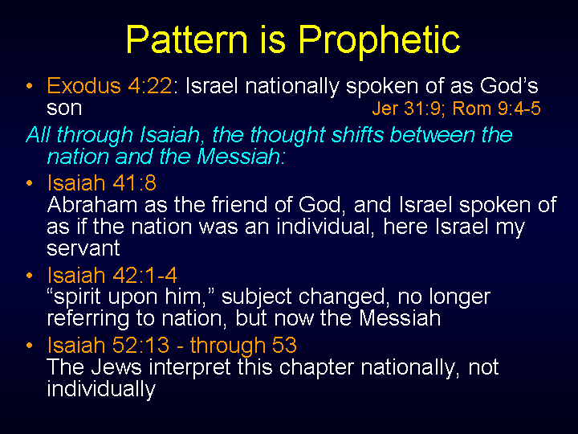

Slide 56
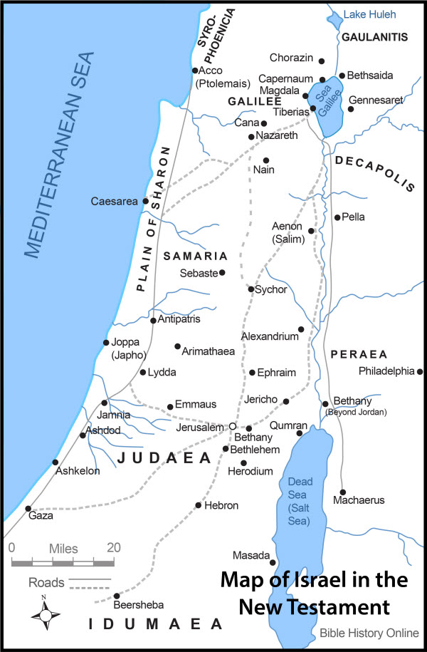
Journeys of Jesus’ Birth

Slide 57
Matthew 2:16
Then Herod, when he had seen that he had been deceived by the Magi, became exceedingly enraged, and he sent and did away with all the children [boys] who were in Bethlehem and all its district–from two years of age and younger–according to the time that he had ascertained from the Magi.
Notes:
The Greek word that Matthew uses is paidas which is a masculine plural noun.
How many male children were massacred is not known, but given the fact that the population of Bethlehem and its district was most likely around 1,000, and given the birth and mortality rates of the time, it is likely that the number would be in the neighborhood of 20. The tradition in the Christian church exaggerated the number to 14,000 or even 64,000. As note above, Herod expanded his execution order both geographically and chronologically: Herod wants to ensure that this newborn King of the Jews is eliminated!

Slide 58
Matthew 2:17
Then what was spoken through Jeremiah the prophet was fulfilled, saying,

Slide 59
Matthew 2:18
“A sound in Ramah was heard, weeping and much mourning, Rachel lamenting her children;
and she was not willing to be comforted,
because they are not.”
Notes:
This quotation is taken from Jeremiah 31:15. The word "fulfilled“ is in the sense that the words in Jeremiah aptly express the event which Matthew was recording.
The appeal to Jeremiah 31:15 once again requires explanation for Matthew’s use of the Tanach in his narrative. Clearly, Matthew has made a connection between the death of children spoken of by Jeremiah, and the situation in Bethlehem at the time of Yeshua’s infancy. If we look more closely at Jeremiah 31, we will see some remarkable parallels to Matthew’s story. Moreover, it is clear that Jer 31 was understood eschatologically as speaking of the time of Yeshua, for the New Covenant passage

Slide 60
Jeremiah 31:15
Thus saith the LORD; A voice was heard in Ramah, lamentation, and bitter weeping; Rachel weeping for her children refused to be comforted for her children, because they were not.
Notes:
Rachel is being used by Jeremiah, idiomatically, as mother Israel. But Rachel is specifically linked to Bethlehem, since there she died giving birth to Benjamin, which, ironically, in Hebrew means, son of my right hand.
The 4th Old Testament prophecy fulfilled in Matthew (Matthew 2:18; Jeremiah 31:15).

Slide 61
Matthew 2:19
But after Herod had died, behold, an angel of the Lord did appear in a dream to Joseph in Egypt…
Notes:
Third of four angelic dreams of Joseph (Matthew 1:20; Matthew 2:13,19).

Slide 62
Matthew 2:20
…and said, “Arise, and take the child and his mother, and journey to the land of Israel, for the ones who were seeking the child's life have died.”
Notes:
Used twice (Matthew 2:20-21). Called "land of the Jews" (Acts 10:39), thus proving that Jews and Israel were one people. All the tribes were still known (Matthew 19:28; Acts 26:7; James 1:1).
Herod’s death is recounted in Josephus (Ant. 17.168–69), and his death occurred just before Passover in late March, 4 BC during a lunar eclipse; apparently he died of some disease of the brain, possibly cancer that later became known as Herod’s Evil. Herod did not die in Jerusalem, but in Jericho.
How long were Joseph, Mary, and Yeshua in Egypt? The biblical text gives us no answer.

Slide 63
Matthew 2:21
And he got up and took the child and his mother and entered the land of Israel.
Notes:
His obedience to all God's commands proves that he was a man of good character and consecration to God.
What does the New Testament call the Holy Land? Not Palestine but Eretz-Israel, “the Land of Israel.” Similarly, the regions north and south of Jerusalem are called not the West Bank but “Y’hudah” and “Shomron” (Judea and Samaria; see Ac 1:8). The New Testament, like the Israelis of today, uses the names the Hebrew Bible uses, not those employed by the Romans or other conquerors.

Slide 64
Matthew 2:22
But when he heard that Archelaus was reigning over Judea in the place of his father Herod, he was afraid to go back there, and because he had been warned in a dream, he departed into the parts of Galilee…,
Notes:
[Galilee] The region north of Samaria.
Once again, Joseph is fully obedient to the word of God given by the angel in a dream. He and his family return to Israel as God has instructed. This verse also causes difficulty when compared to Luke. Yet, it can also mean that as Joseph drew near to Judea, where devout Jews would want to travel through, he was warned not to travel through Judea, but to turn north toward Galilee and Nazareth. My previous map shown the probable route that Joseph could have taken upon travelling to and from Egypt.

Slide 65
Matthew 2:23
…and he went and dwelt in a city called Nazareth, in order that what was spoken through the prophets might be fulfilled for he will be called a Nazarene.
Notes:
The 5th Old Testament prophecy fulfilled in Matthew (Matthew 2:23).
Once again, Matthew wants his readers to know that each part of Yeshua’s life is in direct fulfillment of the prophetic message regarding the Messiah. Thus, His living in Nazareth becomes the fulfillment of the prophets: “He shall be called a Nazarene.” Yet, as we quickly discover, no prophet of the Tanach makes such a statement, and we are left wondering exactly what text Matthew appears to be quoting. However, we should note that, unlike Matthew’s other quotes, here he attributes the saying, not to a particular prophet, but to “the prophets” (plural). This is important, because it alerts us to the fact that Matthew is not giving us a verbatim quotation of one particular Scripture from the Tanach, but he is rather appealing or alluding to a general perspective gleaned from the wider voice of the prophets.

Slide 66
Isaiah 11:1
A shoot will come up from the stump of Jesse; from his roots a Branch will bear fruit.
Notes:
The 5th Old Testament prophecy fulfilled in Matthew (Matthew 2:23) The words here are not found in any of the books of the Old Testament; and there has been much difficulty in ascertaining the meaning of this passage. Some have supposed that Matthew meant to refer to Judges 13:5, to Samson as a type of Christ; others that he refers to Isaiah 11:1, where the descendant of Jesse is called "a Branch;" in the Hebrew Netzer.

Slide 67
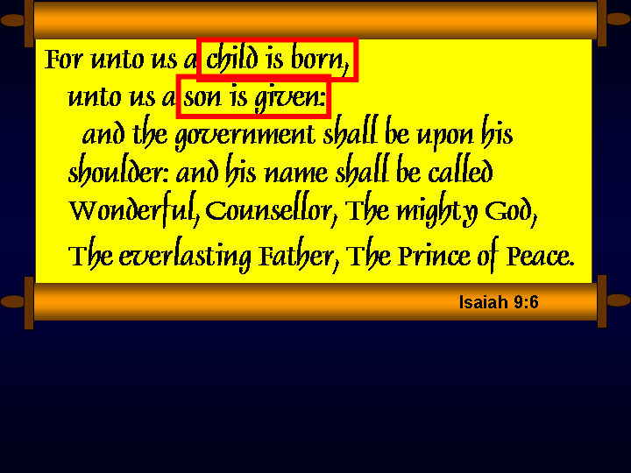

Slide 68
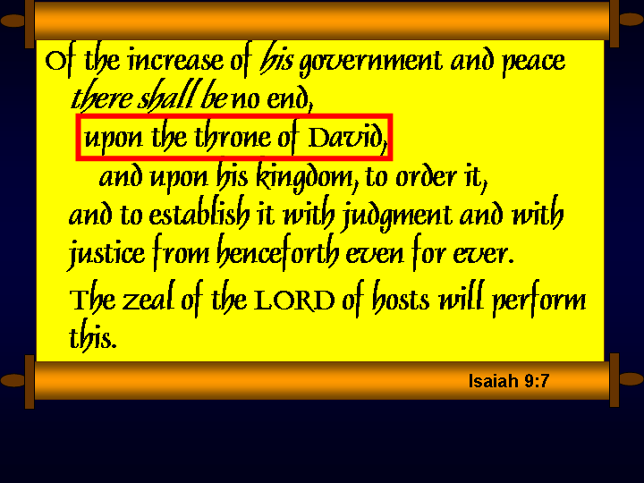

Slide 69
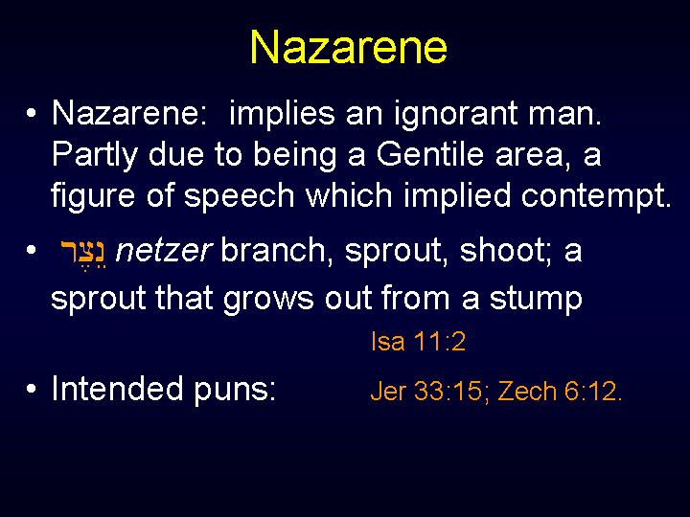
Notes:
Then there is the obvious “put down” as voiced by Nathanael, “Nazareth! Can anything good come from there (John 1:46)?”

Slide 70
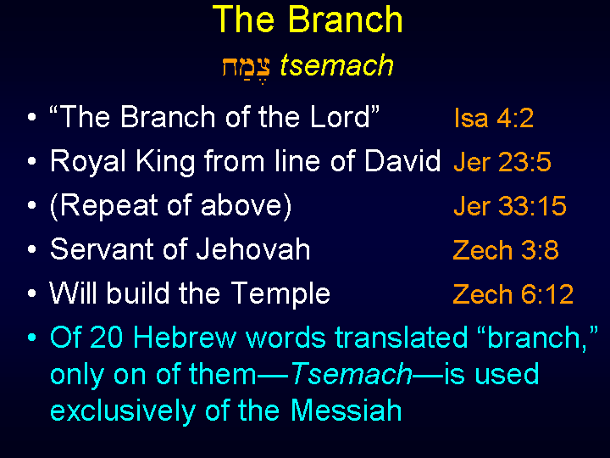

Slide 71
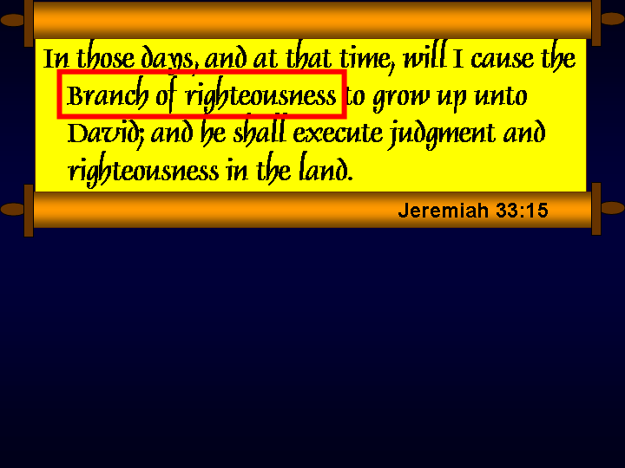

Slide 72
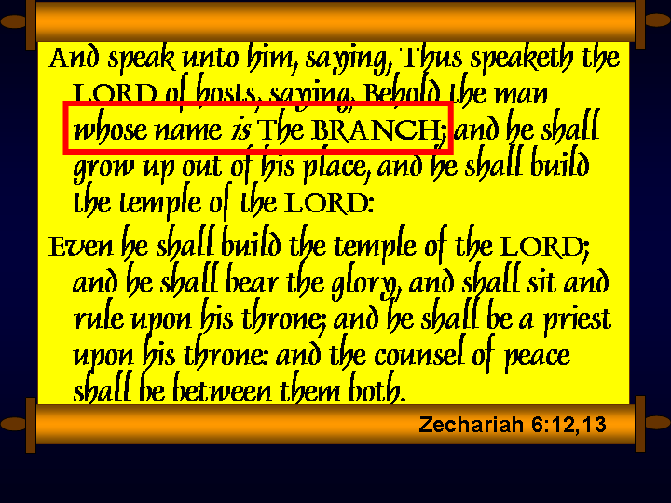

Slide 73
Questions???

