Slide 1
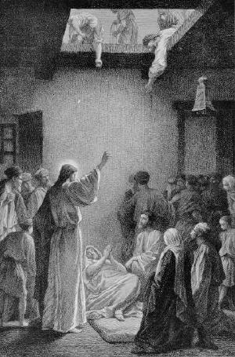
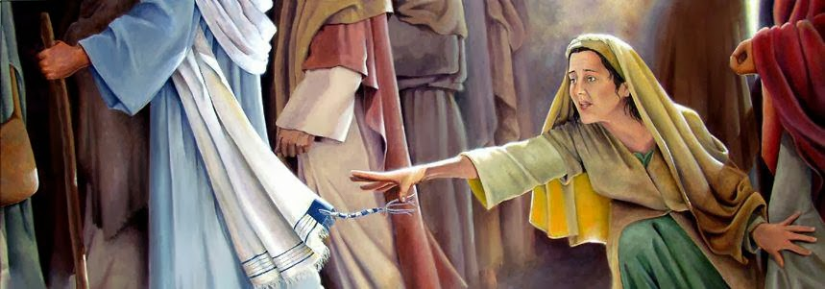
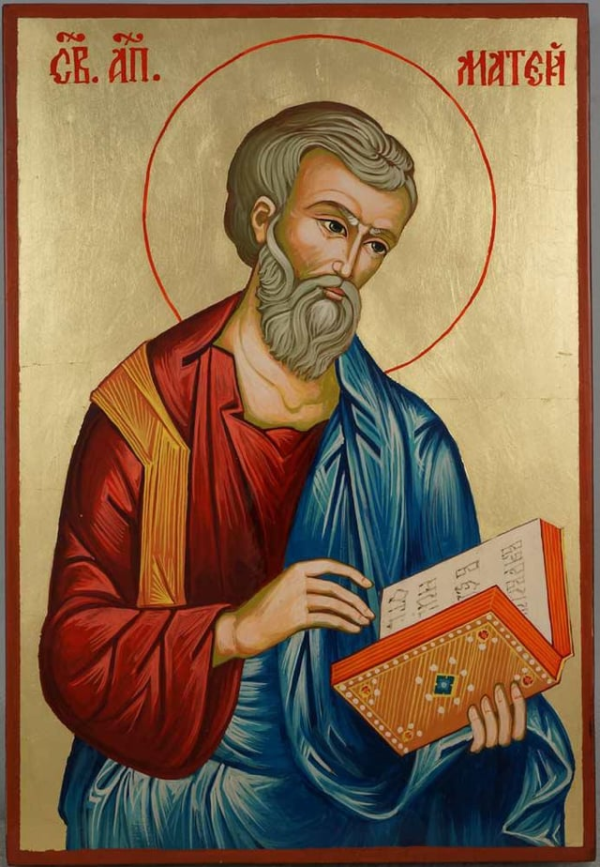
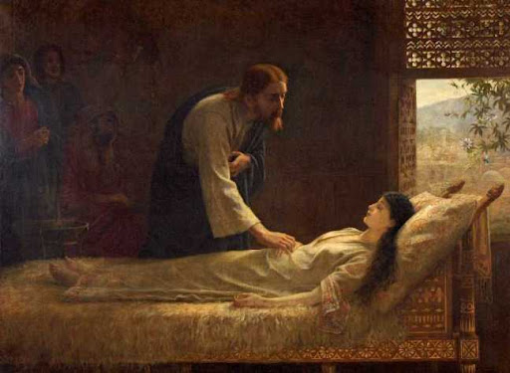
Next
Week
More Miracles (and a Call) in Capernaum
St. Matthew 9

Slide 2
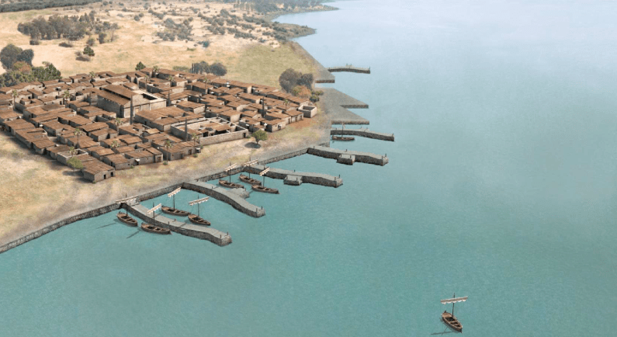
Because the Gergesenes resisted Jesus He departs from them and heads back to “His own city,” Capernaum. Upon His return He continues to teach and work miracles.
St. Matthew 9
Introduction

Slide 3
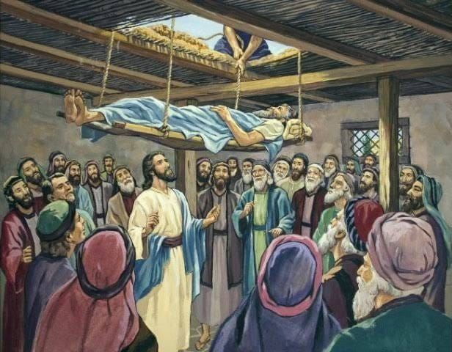
This is the traditional Gospel text for the 19th Sunday after Trinity in the One-Year Series. St Matthew just gives us the details that the paralytic is brought to Jesus. St. Mark and St. Luke tell us more details; that Jesus is surrounded by the people so that there is no room for anyone to gather around (St. Mark 2:1), the man is carried by four friends (St. Mark 2:3), and because they cannot get their friend to Jesus they make an opening in the roof and lower their friend before Jesus (St. Mark 2:4; St. Luke 5:19).
9:1-8
Healing of the Paralytic

Slide 4
What Jesus says to the man is at first
shocking. Here lays a paralytic man
who cannot move, who is clearly in need
of healing, and Jesus says to him,
“Cheer up, child, dismissed are thy sins!”
Jesus doesn’t heal the man’s body, but
speaks of the forgiveness of his sins, and
speaks the absolution. His word of
forgiveness is the word that this and all
sinners need to hear. The scribes who had come to hear Jesus (in order to make a case against Him) react to His words. They accuse Jesus among themselves, “This is blasphemy!” [v.3] St. Mark and St. Luke tell us their reasoning, “Who can forgive sins but God alone?” [Mark 2:7; Luke 5:21] They are right that God alone can forgive all sin; yet, they are wrong since they do not know or believe that Jesus is God!
9:1-8
Healing of the Paralytic

Slide 5
Jesus then puts a text before them with a question, “Which is more difficult to say, ‘Your sins are Forgiven’ or ‘Stand up and walk?’” We see how this is setting up. Forgiveness is easy to say, but hard (nay, impossible except for God) to do; no one can see the result.
On the other hand, saying “Stand up” to a paralyzed man is hard because if you are a fraud you will be immediately discovered to be so! Jesus says, “Stand up,” so that all could see the results of His words, and they would know that He has the authority (ejxousiva, not “power”) to forgive sins. Jesus thus demonstrates His authority to forgive, which comforts the paralytic and amazes the crowd; so they fear and glorify God.
9:1-8
Healing of the Paralytic

Slide 6
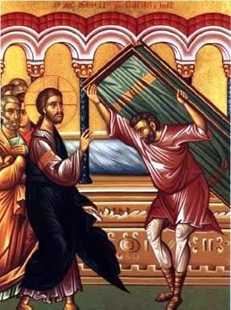
They glorify God who has given such authority to men. Indeed their fear and astonishment comes from the acute awareness of their own sin as well as the knowledge that God has now drawn near to them in the person of Jesus. We, too, rejoice that Jesus still has the authority to forgive all our sins.
9:1-8
Healing of the Paralytic

Slide 7
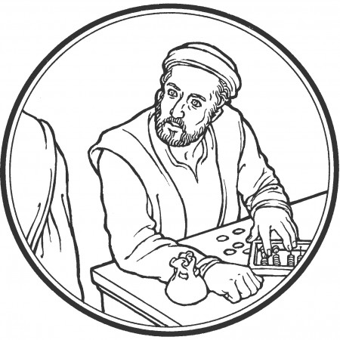
How Matthew must have recalled with such joy and thankfulness this day when Jesus came into his collection booth and called him, “Be following Me.”
Tax collectors were despised for two reasons:
they worked for
the Roman govern-
ment, the occupying
force, and thus tax
collectors had no
patriotism, and;
2) they often
extorted all they could get to make themselves wealthy.
9:9-13
The Call of St. Matthew

Slide 8
Thus “publican” (from the KJV) came to mean the same as a “sinner” (v.11 and 18:17). When Jesus calls Matthew he leaves everything to follow Him. Matthew’s call to follow Jesus is a picture of the grace, love and compassion of Jesus. This is further seen in the banquet which Matthew holds in celebration of his calling. Jesus and His disciples eat with tax collectors and sinners. Again Jesus’ enemies are there to accuse and question, asking the disciples, “Why does your Teacher eat with tax collectors and sinners?” The Pharisees understood such company as threatening their personal holiness and integrity; eating with sinners is having fellowship with their unrighteousness. Jesus sees it exactly opposite, when He “eats” with sinners they share in His holiness.
9:9-13
The Call of St. Matthew

Slide 9
Jesus answers His accusers, “Those who are well have no need of a physician, but those who are sick. But you go and learn what this means, ‘I desire mercy and not sacrifice.’ For I did not come to call the righteous, but sinners, to repentance” (vv.12-13). Jesus argues from the Pharisees own distorted self understanding. They see themselves as well, all others as sick; themselves righteous, all others sinners.
They would then accuse Jesus of being a sinner because He is surrounded by sinners, but, Jesus says, this is as absurd as calling a doctor sick because he is surrounded by sick people. In the midst of sickness is where a good doctor is to be found; in the midst of sinners is where your Savior is found!!!
9:9-13
The Call of St. Matthew

Slide 10
Jesus is not saying that the Pharisees are well and righteous, in fact the very opposite. If they were righteous they, too, would seek to save the lost and rescue those who need help. Their guilt is three-fold: 1) they arrogantly think too high of themselves; 2) their pride stands in the way of acting mercifully, and 3) their lack of mercy causes them to see Jesus’ compassion as sin.
Jesus is the Good Physician, even for the Pharisees, and gives them a bit of medicine from the Prophet Hosea: “Go and learn what this means, ‘I desire mercy and not sacrifice’” (Hosea 6:6). Jesus will quote this text again in Matthew 12:7.
9:9-13
The Call of St. Matthew

Slide 11
We, too, ought to learn what this means. The Lord’s desire is for mercy, not sacrifice. He means that we serve the Lord and please Him by being merciful. This is a description of the Law, that we love our neighbor as our self! Why, then, did the Lord institute sacrifices? If they are not His desire and are not for His benefit, who benefits from them? The Lord gave the sacrifices to us, as a preaching of the Gospel. The sacrifices are not our service to God, but His service to us. Every time a bull or goat or lamb’s blood was spilt on the Altar in the Tabernacle or Temple, the people were to know and believe that this blood would not be theirs, but that the Lord would provide a substitute for them by sending His Son to die in their place. The sacrifices are not for God’s benefit; but for ours.
The Pharisees had turned this on its head and sought to please God by their works of sacrifice! If you want to serve God, says Jesus, act mercifully toward your neighbor, just as I have act for you, even by dying for your salvation.
9:9-13
The Call of St. Matthew

Slide 12
Seeing Jesus feasting aroused some questions of John’s disciples (John the Baptist is currently in prison). They, apparently, were observing a fast, and wondered at the feasting of Jesus and His disciples. This question is not to be understood as malicious and plotting as the questions of the Pharisees. Jesus answers them by explaining the joy of His ministry. Jesus was not opposed to fasting, as we have already heard in His teaching [Matthew 6:16ff, “When you fast...”]. Fasting is fitting for times of mourning and sadness, but with Jesus there is great joy. “In your presence is fullness of joy; at Your right hand are pleasures forevermore” [Ps. 16:11].
9:14-17
The Question of Fasting

Slide 13
Jesus then speaks the parable of the old and new garments and the old and new wine skins.
“The old robe is the Judaism of that period, namely, what the scribes and the Pharisees had made of it with their doctrine and their practice, all the old formalism, outward observance, and false righteousness [5:20]. It was useless to try to patch this with a bit of the teaching or the doctrine of Jesus. The new would only tear the old more than ever. The doctrine of grace and faith and the life that springs from it cannot possibly be combined, even in small part, with Pharisaic Judaism either in its ancient or its modern forms. Discard the old, rotten robe, take in its place the robe of Christ’s righteousness” [Lenski, 369-370].
9:14-17
The Question of Fasting

Slide 14
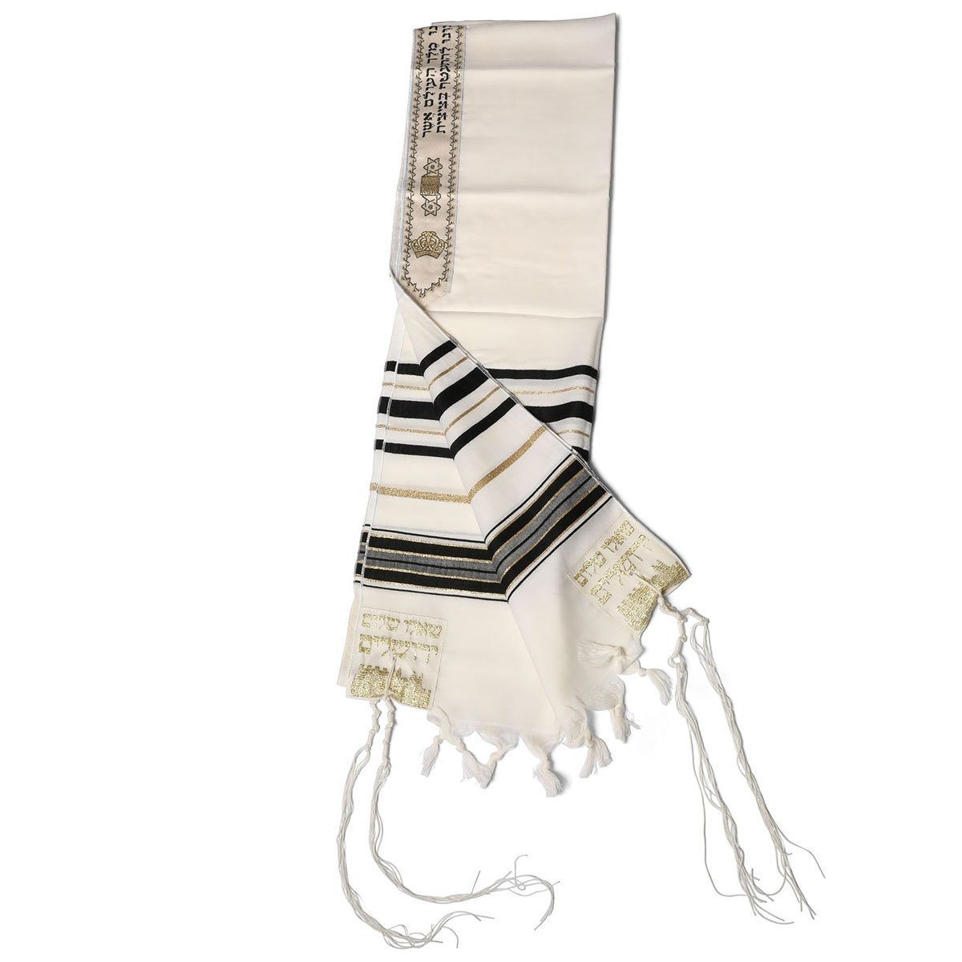
This text is the traditional Gospel text for the twenty-Fourth Sunday after Trinity in the Lutheran Missal and the One-Year Series. It contains two unique miracles which are intertwined. Jesus is called to the house of a ruler of the synagogue who came to Jesus and worshiped Him, asking that He would come and restore his dying daughter. Again, Mark and Luke give a fuller narrative ^{[Mark 5:21f., Luke 8:40]}.
Thanks to Mark & Luke, we know this man's name is Jarius and that when he left home his daughter was still alive; yet, on the cusp of death. As Jesus travels to his home He is “touched” by a woman who had a flow of blood for 12 years. Again, we learn more from Mark and Luke: Jesus was surrounded by the crowds, but when this lady touched the hem of His garment Jesus stopped, for the power had gone out of Him. “Like all true Jews, Jesus wore the shemla, a square cloth that was used as an outer robe and had tassels and the four corners according to the requirement laid down in Deuteronomy 22:12.” ^{[Lenski, 373]}
9:18-26
A Woman Healed and A Girl Restored to Life

Slide 15
He looked around, asking who touched Him (to the amazement of His disciples who are quick to note that everyone is touching Jesus, He’s in the middle of a crowd). When He finds the lady He commends her faith. “Be of good cheer, daughter; your faith has made you well” ^{(v.22)}. This touching of faith is different from all the other incidental contact Jesus had with the crowds. We pray that Jesus would grant us such faith that we would come to Him expecting every good thing.
After Jesus heals the woman, people come from Jarius’ house to report that his daughter is dead and that there is no need to trouble the Lord. Yet Jesus and Jarius continue the home. We are then taken into the midst of Jewish mourning customs. There were those who were hired to wail and beat their breasts. Beyond this there were doubt many friends of the family who had gathered. The whole house was full of noise, but Jesus sends them all away with a word, “Make room, for the girl is not dead but sleeping” ^{(v.24)}. Notice how quickly the mock tears of the hired mourners turns to laughter and scorn. But, as always, it is as Jesus’ word: He touched the girl and she arose. Jesus gives all good things.
9:18-26
A Woman Healed and A Girl Restored to Life

Slide 16
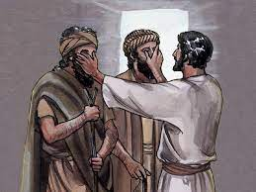
As Jesus leaves Jarius home He is followed by two blind men who cry out to Him, “Son of David, have mercy upon us.” This is a common prayer in the Scriptures, for all true worship is looking to the Lord for mercy and forgiveness.
Notice how the two blind men address Jesus, “Son of David.” This recalls the very first verse of Matthew, “The book of the genealogy of Jesus Christ, the Son of David, the Son of Abraham.” Jesus is the long expected Messiah, promised to David to be his heir (2 Sam 7:13). In St. Matthew, Jesus will be called “The Son of David” with increasing frequency and fervor [12:23; 15:22; 20:30,31; 21:9,15; 22:42].
The two blind men pray the prayer we call the Kyrie, (Gr. Kyrie Elesion, “Lord, have mercy.”) In the Divine Service, it is prayed after the Introit and before the Gloria. In the prayer offices (like Matins and Vespers) it is prayed after the canticle before the Lord’s Prayer.
Two Blind Men, A Mute Man, and
His Compassion
9:27-38

Slide 17
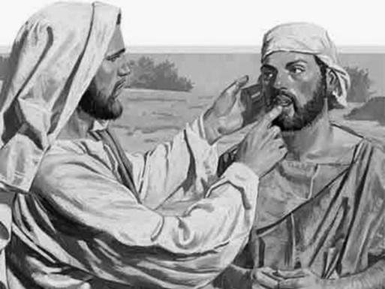
There was a man made mute by a demon
that Jesus casts out. All through this
chapter we have seen how the physical
healing and spiritual healing go hand
in hand. The paralytic is forgiven and healed.
By this we see that the forgiveness of all of our sins is a guarantee of the resurrection of our bodies, our final, perfect and complete healing which the Lord will give us on the day He returns in glory. Notice how after this healing the Pharisees begin to accuse Jesus of casting out demons by the ruler of demons, an accusation which will come to fruition and be answered by Jesus in Matthew 12:22-37.
Two Blind Men, A Mute Man, and
His Compassion
9:27-38

Slide 18
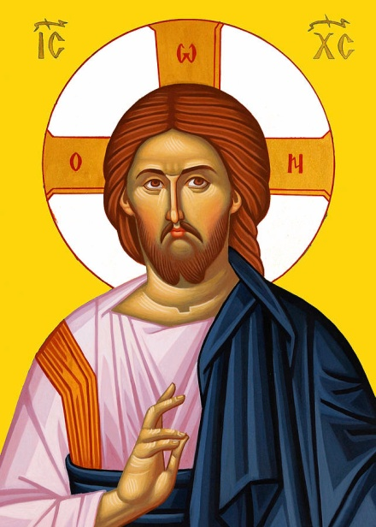
St. Matthew ends this section of our Lord’s miracles with another summary statement. All of Jesus’ words and deeds are motivated by His compassion for the people who are “weary and scattered like sheep without a shepherd.”
Our Lord’s compassion also moves Him to urge His followers to pray for workers to preach the kingdom. Their prayers are answered when Jesus chooses twelve of His disciples to be His Apostles. We continue to pray that our Lord would send faithful workers in the harvest, that His people would continue to hear the Holy Gospel and that many would come into the kingdom of heaven.
Two Blind Men, A Mute Man, and
His Compassion
9:27-38

Slide 19
III. The Lord’s Ministry in Galilee (4:12 – 14:12)
A. The Beginning of His Galilean Ministry (4:12-25) (2/2)
B. First Discourse: The Sermon on the Mount – Ch 5 (2/9)
C. First Discourse: The Sermon on the Mount – Ch 6 (2/16)
D. First Discourse: The Sermon on the Mount – Ch 7 (2/23)
E. A Collection of Our Lord’s Miracles
1. Chapter 8: Capernaum & Gadarenes (3/2)
2. Chapter 9: Back in Capernaum (3/9)
F. The Second Discourse: The Commissioning of the Twelve Apostles – Ch 10 (3/16)
G. His Ministry Throughout Galilee (Chapter 11:1 to 12:45 (3/23)
H. The Third Discourse: The Parables of the Kingdom (Ch 12:46 – 13:53) (3/30)
This outline will be undated as we reach successive narratives and the discourses in St. Matthew.
Our Outline of St. Matthew

Slide 20
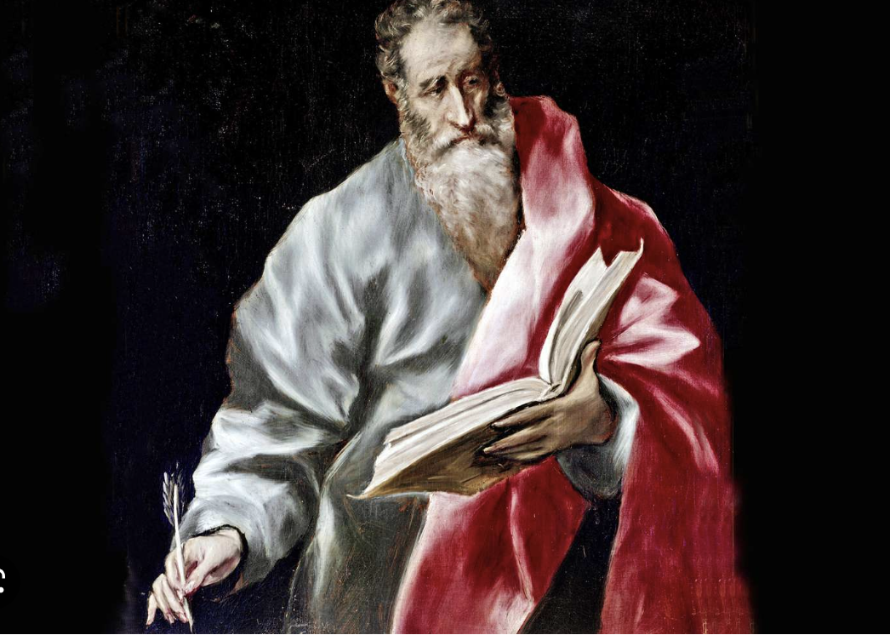
The Commissioning
of the Twelve
Apostles
Next
Week
St. Matthew 10

