Slide 1
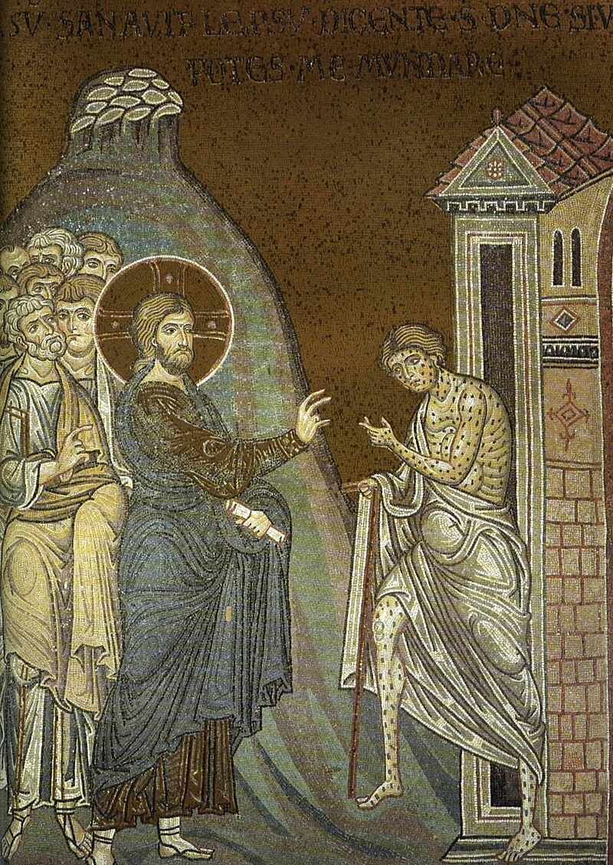
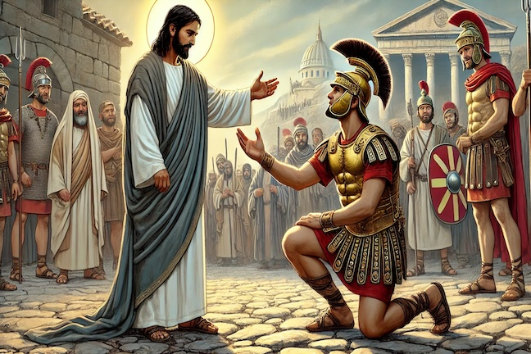
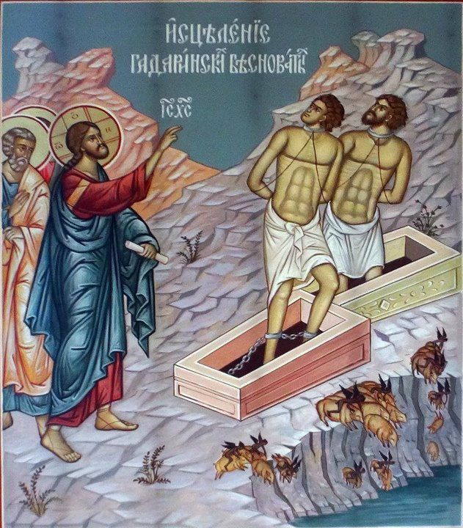
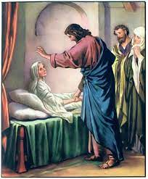
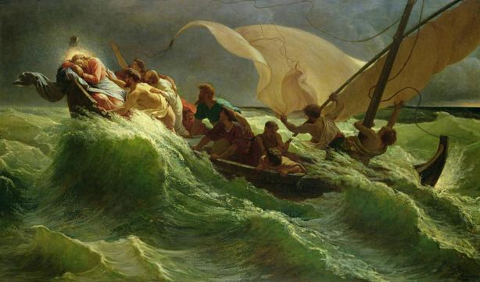
8:1-34
A Collection of Miracles

Slide 2
St. Matthew (4:23) gives us a summary of our Lord’s work, “Now Jesus went about Galilee, teaching in their synagogues, preaching the Gospel of the kingdom, and healing all kinds of sickness and all kinds of disease among the people.” The Sermon on the Mount was this teaching and preaching the Gospel, and now, in chapter 8, St. Matthew tells of our Lord healing sicknesses and all kinds of disease.
As Jesus comes down the mountain He fills His Messianic office by healing people and performing many miracles. This chapter has five unique miracles and a summary of His miracles. In the middle of the miracles are perched two very brief conversations between Jesus and a scribe (vv.19-20); and an unnamed disciple (vv. 21-22). Via His miracles, Jesus is “filling up” the OT, with His words and deeds.
St. Matthew 8
Introduction

Slide 3
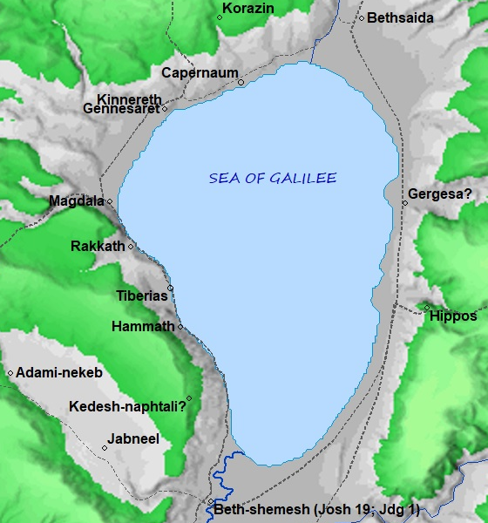
When Jesus finishes His
sermon He comes down
from the mountain.
St. Matthew then reports
three successive healings,
each one prefaced by our
Lord’s travels: “When He
had come down from the
mountain” (v.1); “When He had
entered Capernaum” (v.5); and,
“When Jesus had come into Peter’s house” (v.14).
8:1-17
Three Healing Miracles

Slide 4
The first miracle is the cleansing of a leper. Leprosy is a skin disease that was so common and contagious in ancient times that it had its own set of detailed laws in the Levitical code (cf. Lev. 13 and14).
The leper was to keep a distance from all people and, when approached, cry out “Unclean! Unclean!” If someone came into contact with a leper, they were ritually unclean, unfit to approach the holy things of God. Here uncleanness is not a moral quality (leprosy isn’t criminal), but a matter of declared fitness to be in the presence of God! One moves from unclean to clean by certain sacrifices, (Lev. 14), and cleanliness, finally, is something declared by the priest.
8:1-4
Healing a Leper

Slide 5
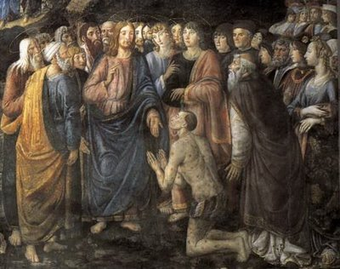
The leper in our text comes to Jesus and (just like the Magoi, 2:11) falls down to worship Him, confesses his need for Jesus, and His faith in Him. Jesus first reaches out His hand and touches the leper. This is a stunning picture of our Lord Jesus drawing near to us, even in our sin. This is the gracious beauty of His incarnation for us, that He takes hold of our sinfulness and gives us His holiness.
8:1-4
Healing a Leper

Slide 6
Jesus answers him, “I am willing.” Many times our Lord’s miracles are attributed to the will of the Father or the Holy Spirit, but this miracle is done of His own will, for He is true God. Jesus then sends the leper to the temple and to the priest to fulfill the Mosaic requirements (again, Lev.14). The cleansed leper is to be a “testimony” to them, that Jesus has not come to destroy the Law, but that He is the fulfillment of it.
8:1-4
Healing a Leper

Slide 7
As Jesus enters Capernaum, He is approached by a Roman soldier, a centurion (a commander of one hundred), who has need that his servant be healed. Jesus responds, indicating that He would come to the centurion’s home, but the centurion responds in faith, “Lord, I am not worthy that you should come under my roof....”
Jesus commends the greatness of the centurion’s faith, and his faith is seen in this:
1. He is humble, acutely aware of his own unworthiness (highly unusual!); and,
2. He trusts in Jesus, knowing that His Word has authority even to heal all diseases.
8:5-13
Healing the Centurion’s Servant

Slide 8
It is then, with the authority which astonished the crowds, that Jesus heals the man’s servant “…from that very hour.” This expression of humility and faith, “I am not worthy that You should come under my roof,” has been taken into the church’s piety as part of a prayer before receiving the Lord’s Supper.
“Lord, I am not worthy to be a guest at your holy table, yet I have heard the sweet words of your invitation, and you have promised me forgiveness of my sins through your body and blood which I eat and drink in this sacrament.”¹
¹[Attributed to Martin Luther, no German original found in Die Gebete Luthers, from The Collection of Baron Bunsen, p. 182 #3 Tr. Catherine Winkworth].
8:5-13
Healing the Centurion’s Servant

Slide 9
The centurion’s faith is occasion of a prophesy. Jesus sees this Gentile and says, “I say to you that many will come from east and west, and sit down with Abraham, Isaac, and Jacob in the kingdom of heaven. But the sons of the kingdom will be cast out into outer darkness. There will be weeping and gnashing of teeth” (vv. 11, 12).
The faith of the centurion is the picture of faithful Gentiles who will be gathered into the true people of God. Those who are far off (in the east and the west) will be brought near and those who think they are near will be sent away destitute, into eternal condemnation.
8:5-13
Healing the Centurion’s Servant

Slide 10
The Jewish nation knew, and crucified Him; the Gentile world heard and believed. Note that Jesus binds the faith of the centurion to the healing of his servant. “Go your way; as you have believed, so let it be done for you” (v.13). How are we to understand this? Does Jesus give His gifts only in accord with the size of our faith? Does faith empower Jesus or affect His miracles?
As Lenski wrote, “We should not generalize this word of Jesus so as to make it mean: whatever we believe he will grant us…, or that the degree of our faith insures the gift we desire. A wrong faith may be ever so strong in expecting a wrong gift; Jesus will not meet that faith and expectation, he will first correct it. And often he will do wondrous things where there is no faith present in order to produce faith” ^{(Lenski, 333)}.
To summarize Luther’s words about Holy Baptism, our faith does not constitute a miracle, it receives it. Jesus speaks and it is so; from the very instant He speaks, the servant is healed.
8:5-13
Healing the Centurion’s Servant

Slide 11
After teaching and performing many miracles,
Jesus and His disciples retire to Peter’s house.
Peter’s mother-in-law was sick with a fever,
Jesus heals her, and she begins to serve them.
From this text we learn about Peter’s domestic
life more than we do about any of the other
disciples. Peter was married, and his wife’s mother lived with them (a custom in the Far East that still occurs today). Peter’s wife also went with him on apostolic journeys (cf. 1 Cor. 9:5).
In St Mark 1:21, 29 we learn that all of the previous events occurred on a Sabbath. This helps us understand why the people waited until after dark to bring their sick to Him, the Sabbath would have ended at sundown. Jesus then heals them, casting out demons with a word.
Peter’s Mother-in-Law,
and Others, are Healed
8:14-17

Slide 12
Our Lord’s miracles and healing are a fulfillment of Biblical prophecy; this is something that Matthew wants to show. He does so by quoting Isaiah 53:4, “He himself took our infirmities and bore our sickness.” With this quotation, St. Matthew gives us some theological insight into Jesus’ miracles. His healings are not detached acts of omnipotence; He does not cast our sins and diseases far away. He takes them and bears them. The Greek word for “bear” is bastavzw, “to carry (like a child in the womb), endure, bear, tolerate, pick up, etc.” St. Matthew uses the past tense verb in singular form: He (Jesus) bore!
Peter’s Mother-in-Law,
and Others, are Healed
8:14-17

Slide 13
When Jesus is healing He is taking the sin and sicknesses upon Himself; wrapping Himself in our infirmity and death. This is not to be understood as if Jesus is sick, gets leprosy, has a fever, etc. But just as Jesus is the sin-bearer, so He bears our sickness and death. Isaiah continues, “By His stripes we are healed” (Isa 53:5). Notice that he doesn’t say, “By His power we are healed,” or “By His divinity we are healed.” Thus, the Hebrew noun that Isaiah uses is “chabburah” (hr2wBj1), which primarily refers to a physical wound or bruise, often resulting from a blow or strike. It conveys the idea of a mark or injury on the body, typically associated with suffering or punishment. In a broader sense, it symbolizes the consequences of sin or the suffering endured for the sake of others. It is our Lord’s suffering and death that brings healing and deliverance and salvation; this is true of all of His miracles and healings; they are all brought about and accomplished by His death on the cross.
Peter’s Mother-in-Law,
and Others, are Healed
8:14-17

Slide 14
When Jesus announces plans to travel across the Sea of Galilee, a scribe says, “Teacher, I will follow you wherever You go” (v.19). This seems like a laudable confession, there are no “if’s” or “buts’,” however, Jesus, who knows the heart of this man, may remind us of the Parable of the Sower. This man “…is like the seed on stony ground which grew but lacked root to withstand the hot sun.” He is an idealist and over-enthusiastic. He is superficial and does not count the cost. He sees the soldiers on parade, the fine uniforms and the glittering arms, and thinks that it is easy, forgetting the exhausting marches, the bloody battles, the graves, perhaps unmarked. It is less cruel to disillusion such a man than to let him rush in and go down to disappointment. To such exuberant and reckless willingness Jesus speaks a word of warning, “the Son of Man has nowhere to lay His head” (v.20).
8:18-22
Following Jesus

Slide 15
This is the first time that we hear the title “Son of Man” in the Gospel of St. Matthew. It is our Lord’s favorite “self-title,” and He is the only one using it (except for Stephen in his great confession before his martyrdom in Acts 7:56). Theologians of old used this title to express Jesus’ humanity, His human nature. But there is more to the name than this. The title derives from Daniel 7:13, 14.
So the Son of Man is a title that is universal and eschatological, but not to the exclusion of our Lord’s humility. The Son ascends into heaven because He is risen from the dead, and He is risen from the dead because He died for the sins of all people.
8:18-22
Following Jesus

Slide 16
Another man, an unnamed disciple, comes to Jesus with an excuse; he cannot cross over with Jesus since he is needed at his father’s funeral. There are no excuses for the disciple, none. The call of discipleship is all-embracing; to the disciple who hesitates, the Lord has words of strict command, “Follow Me, and let the dead bury their own dead” (v.22). The disciple is to be concerned with the words of life which come from the mouth of the Lord.
Did these two disciples remain with Jesus? St. Matthew does not answer; perhaps, leaving the question to you! Are you willing to follow Jesus not having counted the cost; or do you put any earthly affections before the call of the Kingdom?
8:18-22
Following Jesus

Slide 17
Many commentaries on the
Gospels have noted that the
geography of the Sea of Galilee
(and especially it’s shallowness
and the deep valleys leading
down to it) accounts for sudden
and violent storms. This still
occurs today and such is the
case on this night. “A great
tempest arose... the boat was
covered in waves” (v.24). “…seismo;V mevgaV, is the Greek, literally, “a great tempest (a deadly storm!).” Jesus (who has nowhere to lay His head) is sleeping through it, which explains His exhaustion and perfect faith in His heavenly Father.
8:23-27
A Trip Across the Sea

Slide 18
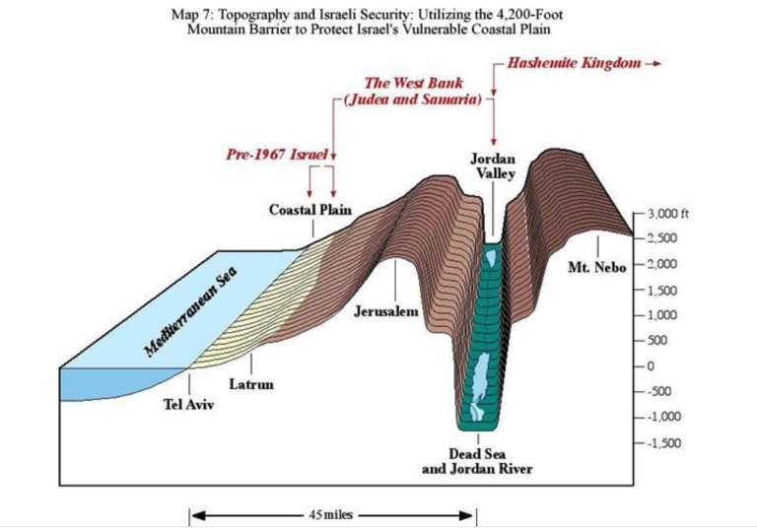
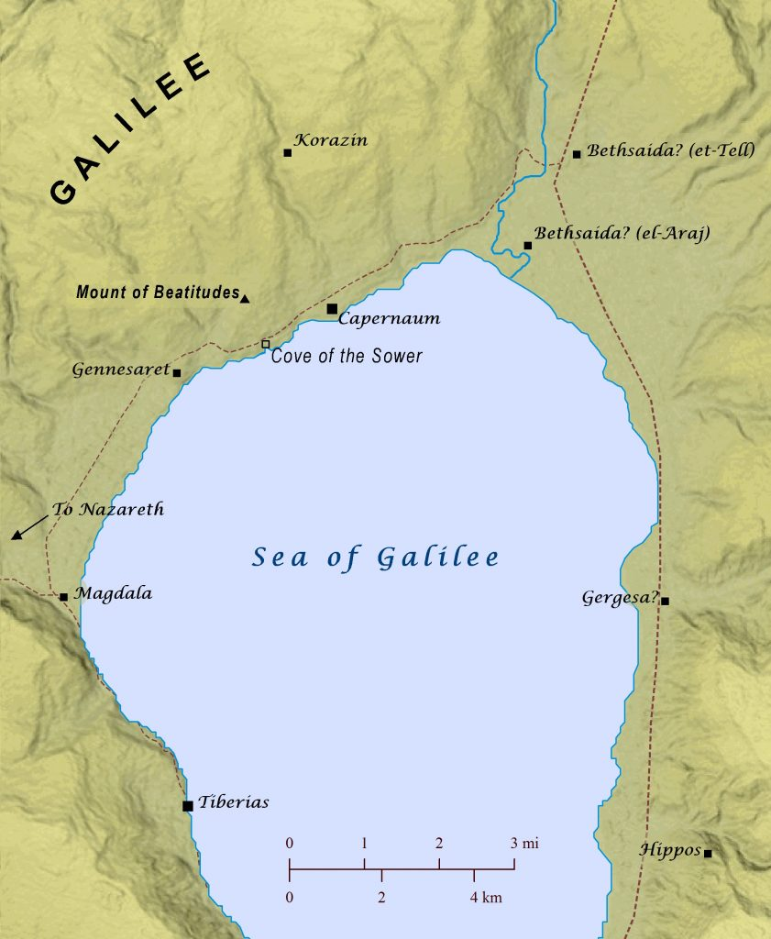
Approximately 4.5 to 5 miles
8:23-27
A Trip Across the Sea

Slide 19
The disciples, however, are not asleep!
They are very afraid, but their fear is
mixed with a little faith. This is seen in
that they have seemingly forgotten that
they are the professional fishermen, the
Ones who have spent countless nights
battling the sea. Since they have
forgotten, they look to Jesus for help in time of need. And yet they are afraid, as if they have forgot Jesus’ words spoken just hours before: “Therefore do not worry” (6:31).
Jesus wakes, rebukes the disciples and then the waves, and there is complete calm; as the Psalmist wrote: “Which stilleth the noise of the seas, the noise of their waves, and the tumult of the people” (Ps. 65:7). We know this miracle deeply impressed the disciples: “They marveled” (v.27). Who could this Man be…but God!
8:23-27
A Trip Across the Sea

Slide 20
The arrival of the boat on the other side of the Sea, the “land of the Gadarenes,” is the occasion of Jesus rescuing two men from the grasp of demons. They are described as “…exceedingly fierce so that no one could pass that way” ^{(v.28)}. But those who cause others to fear are themselves afraid of Jesus, and tremble, saying, “What have we to do with You, Son of God? Are You come here before the time to torment us” ^{(v.29)}?
The news of Jesus’ arrival had spread faster among the demons than among the people. His arrival is Good News for us, which means bad news for the demons. Indeed, Jesus came for the express purpose of crushing the devil’s head (cf. Gen 3:15); “For this reason the Son of God was manifest, to destroy the works of the devil” (1 John 3:8).
8:28-34
Two Demon-Possessed Men

Slide 21
The multitude of demons that tormented these two men requested of Jesus that He would send them into the herd of 2,000 swine (St. Mark 5:13); instead of into the abyss (cf. St. Luke 8:31; Rev. 20:10). Pigs were unclean according to the Torah (Lev. 11:7), and thus raising pigs was illegal for Jews. However, this was a Gentile area and raising pigs would not have been illegal. According to the Synoptics, its unknown if the owner(s) of this herd was Jewish. In any event, the demons do not want to be “tormented” by Jesus so they ask permission to enter the pigs, who then rush headlong into the sea (which also represents the Abyss), destroying the herd. It is the nature of demons to bring such violent death.
8:28-34
Two Demon-Possessed Men

Slide 22
The people of the area whose livelihood was bound to the pigs are very afraid. They care nothing for the miracle and the deliverance of the two men, but simply want Jesus out of town fearing that He may continue to destroy their livelihood. St. Matthew does not record that Jesus commands the men to remain and to tell what He has done for them, which they do (cf. St. Mark 5:20).
8:28-34
Two Demon-Possessed Men

Slide 23
Thus we hear in this chapter that our Lord Jesus heals a leper, restores the sick servant of a Roman Centurion whose faith amazed Him; performs a number of other miracles, gives a lesson in discipleship, stills the tempest, and drives out the devils from two Gadarene demoniacs.
Next week Jesus returns to Capernaum where He will continue to work miracles, and in between, will call the writer of this Gospel!
Chapter 8
The Epilogue

Slide 24
III. The Lord’s Ministry in Galilee (4:12 – 14:12)
A. The Beginning of His Galilean Ministry (4:12-25) (2/2)
B. First Discourse: The Sermon on the Mount – Ch 5 (2/9)
C. First Discourse: The Sermon on the Mount – Ch 6 (2/16)
D. First Discourse: The Sermon on the Mount – Ch 7 (2/23)
E. A Collection of Our Lord’s Miracles
1. Chapter 8: Capernaum & Gadarenes (3/2)
2. Chapter 9: Back in Capernaum (3/9)
F. The Second Discourse: The Commissioning of the Twelve Apostles – Ch 10 (3/16)
G. His Ministry Throughout Galilee (Chapter 11:1 to 12:45 (3/23)
H. The Third Discourse: The Parables of the Kingdom (Ch 12:46 – 13:53) (3/30)
This outline will be undated as we reach successive narratives and the discourses in St. Matthew.
Our Outline of St. Matthew

Slide 25
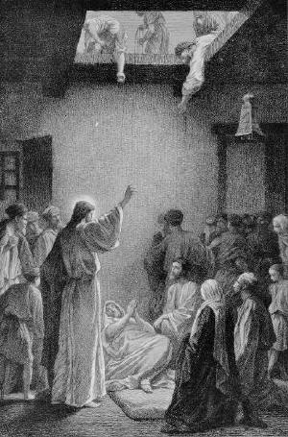
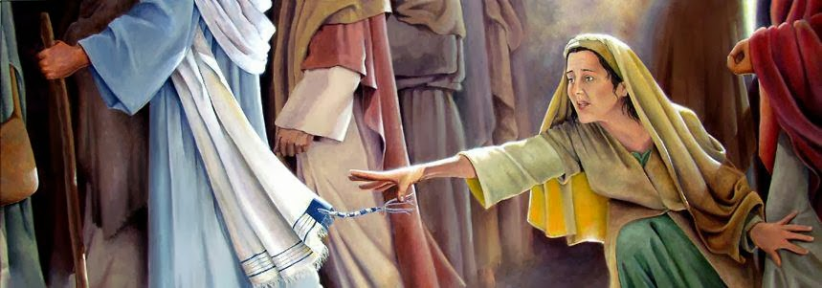
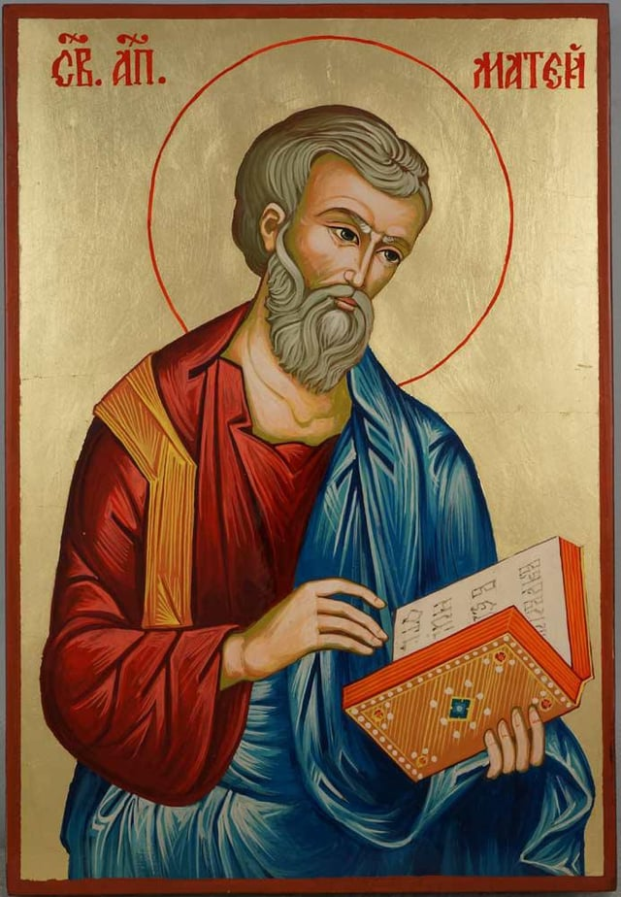
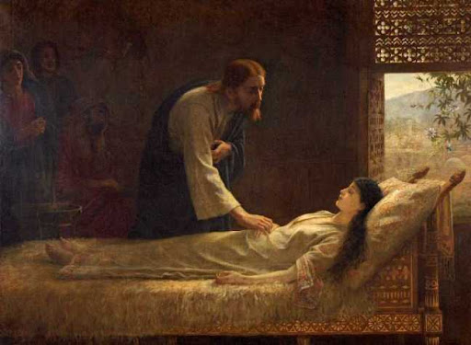
Next
Week
More Miracles (and a Call) in Capernaum
St. Matthew 9

