Slide 1
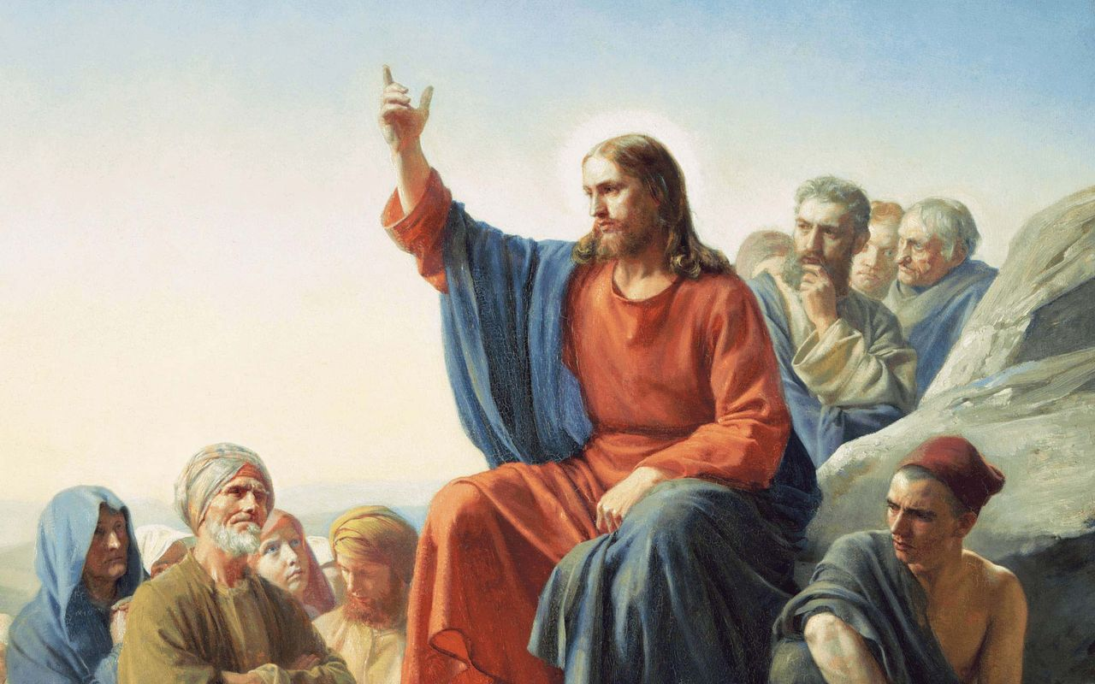
Chapter 7
The Sermon on the Mount

Slide 2
For generations the most famous Bible passage was our Lord’s beautiful summary of the Gospel in John 3:16! The last few decades have seen a shift, and now perhaps the most famous passage is His warning about judgment in 7:1: “Judge not, that you not be judged.” This text is wrongly used as the banner text for lawlessness (called “tolerance”); since, no one has the right to say anything negative about anyone else’s thoughts or words or deeds. There is no judging because there is nothing wrong, nothing bad, nothing evil; the standard of good and right is simply what I want or what I feel like. This is the law of tolerance, we are to tolerate each other’s actions, live and let live! But tolerance isn’t merely passive; we are also supposed to embrace all the nuttiness and flat out wickedness of others!
7:1-12
Judge Not (vv.1-5)

Slide 3
Judge not! The only act that is considered “sinful” is being intolerant. So we often hear the criticism that our Lord’s Church is “judgmental” because it is slavishly bound to the conviction that there is a right and a wrong way to believe, think, speak and live. According to the law of tolerance, if we want to keep the Lord’s command and “Judge not,” then we need to jettison the Ten Commandments as a norm for good behavior, in fact, we need to jettison all norms of behavior and life, and tolerate everyone’s free choices!
7:1-12
Judge Not (vv.1-5)

Slide 4
Consider the overturning of the money-changers table, or the “woes” to the Pharisees, or the “Go and sell all you have…” to the rich young ruler, or even His teaching in the Sermon on the Mount. Does Jesus sound tolerant in saying, “Unless your righteousness exceeds that of the scribes and Pharisees, you will by no means enter the kingdom of heaven... If your right hand causes you to sin, cut it off... When you pray, you shall not be like the hypocrites... No one can serve two masters... Hypocrite! First remove the plank from your own eye... Beware of false prophets... Not everyone who says to Me, ‘Lord, Lord,’ shall enter the kingdom of heaven...”
7:1-12
Judge Not (vv.1-5)

Slide 5
Are these examples of tolerance? Indeed the very idea of a last judgment is anathema (ajnavqema) to the creed of tolerance*
*[In the NT, “anathema” refers to something or someone that is cursed or devoted to destruction. It is used to denote a person or thing that is set apart for divine wrath or judgment. The term carries a strong connotation of being cut off from the community of believers and from God’s favor. However, in today’s society, it means that you should be personally, financially, and socially destroyed or “cancelled!”]
7:1-12
Judge Not (vv.1-5)

Slide 6
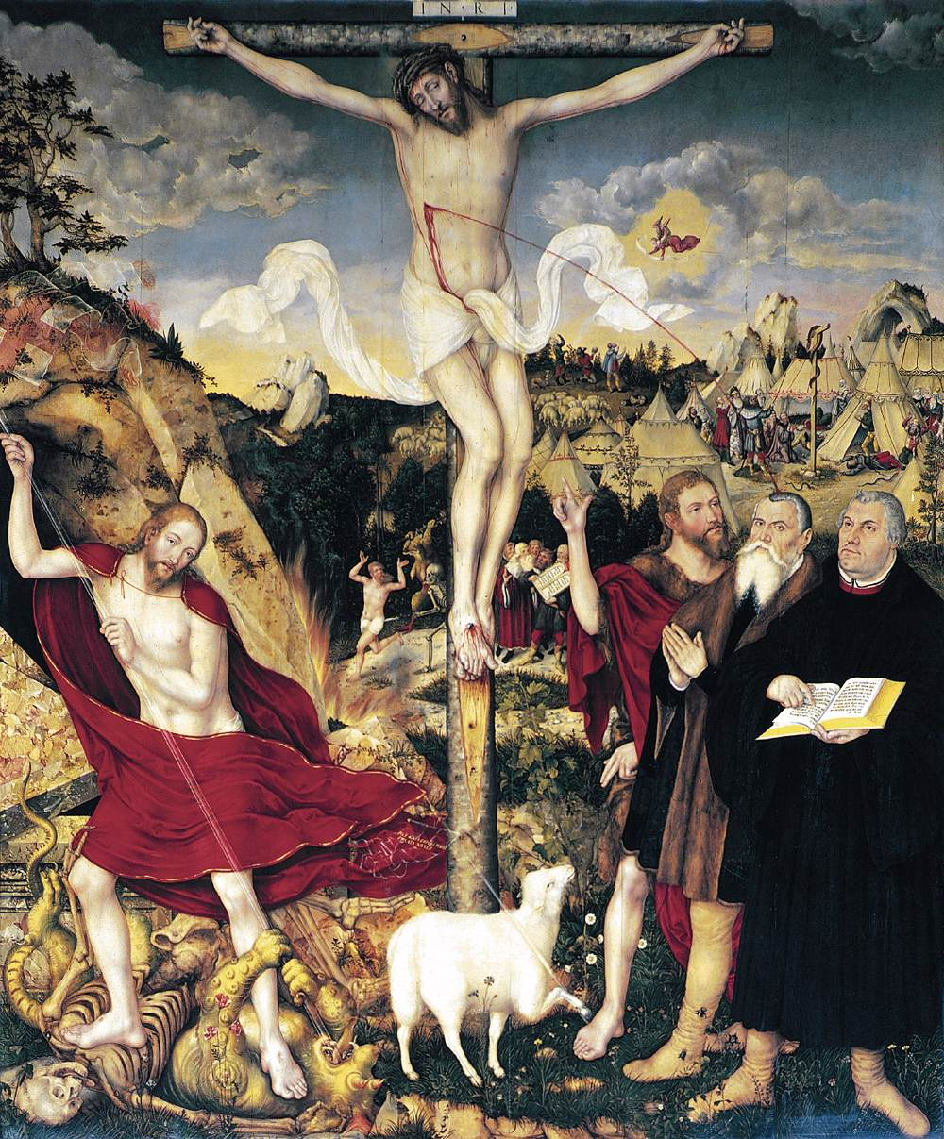
What begins to emerge, then, is the
need to have a better understanding
of “not judging.” If “being tolerant”
is not the opposite of “not judging,”
what is the opposite?
The answer Jesus has already given:
forgiveness!
“If you forgive men their trespasses,
your heavenly Father will also
forgive you” ^{(6:14).}
7:1-12
Judge Not (vv.1-5)

Slide 7
Whereas tolerance tries to get around the Law by ignoring the Law, in the Kingdom of Heaven the Law is triumphed over by the Holy Gospel: “Mercy triumphs over judgment” ^{(James 2:13)}. So the Law stands (not one jot or tittle will pass away), but the Law doesn’t have the only word or the last word. “Not judging” means that the Lord’s Word of Life and Salvation and the forgiveness of all sins has been proclaimed to and heard by you, and then is to be spoken, in love, to your neighbor. You know that the exceeding righteousness and the perfection of the Father has been given to you in spite of your unworthiness; that the Father has withheld, for Christ’s sake, the judgment that you all deserve; that God’s affections and actions toward you are full of love and compassion and mercy and forgiveness, and therefore, as His child, your affections and actions toward your neighbor ought to look the same!
7:1-12
Judge Not (vv.1-5)

Slide 8
On the other hand, if your attitude toward our neighbors reflects harshness and an unwillingness to forgive; that same measure of judgment will be turned onto you by your heavenly Father, “For with what judgment you judge, you will be judged; and with the same measure you use, it will be measured back to you” (v.2). You are not given to be looking for your neighbor’s flaws, “speck hunting,” trying to “help” them by showing them their sinfulness and unworthiness.
7:1-12
Judge Not (vv.1-5)

Slide 9
Jesus uses the parable of the plank and the speck (vv.3-5) to explain. It is the height of foolishness for a man with a plank or a beam stuck in his eye to attempt to help his neighbor dig a speck out of his own eye. This is like the man who goes, uninvited, to help his neighbor fix a leaky faucet while his own basement is flooding! Jesus is in reality commanding that you must attend to your own unrighteousness first! Judge yourself, and then you will find reason for mercy and compassion. All of your judging is to be tempered with mercy.
7:1-12
Judge Not (vv.1-5)

Slide 10
Jesus then commands us not to give the “holy things” to dogs. So far in the Gospel of St. Matthew there has been mention of three things that are holy: The Holy Spirit [1:18,20; 3:11], the holy city (Jerusalem) [4:5], and the Name of the Father (“Hallowed be Thy name”) (6:9). It is especially His name that is not to be thrown to the dogs and cast before pigs. This doesn’t mean that we don’t preach on the farm. “Dogs and swine are those who, after the gospel has been duly preached to them, retain their vicious, filthy nature. All such the disciples are, indeed, to judge and account as they are.” ¹ The holy things and pearls are the pure teaching of the Word of God (His Name).
¹ Lenski, R.C.H. “Interpretation of St. Matthew’s Gospel.” Minneapolis: Augsburg Publishing House, 1961, p. 291.
7:1-12
Pearls Before Swine (v.6)

Slide 11
Jesus again takes up the topic of prayer, and here He promises that all of our prayers will be answered. Luther reassures us of this in his Large Catechism, “We should be all the more urged and encouraged to pray because God has promised that our prayer will surely be answered, as He says in Psalm 50:15, ‘Call upon me in the day of trouble, and I will deliver you,’ and Christ says in Matthew 7:7-8, ‘Ask and it will be given you,’ etc. ‘For everyone who asks receives.’ Such promises certainly ought to awaken and kindle in our hearts a desire and love to pray. For by His Word God testifies that our prayer is heartily pleasing to Him and will assuredly be heard and granted, so that we may not despise or disdain it or pray uncertainly.”
7:1-12
Ask, Seek, Knock (vv.7-12)

Slide 12
As with all true prayer, everything is brought back to the Father. Jesus even takes up the image of an earthly father to express the confidence we should have when we pray. Jesus argues from the lesser to the greater: when a son asks for something needful from their earthly father, that father, even thought he is wicked and evil, still provides his son with every good thing. How much more, then, does our heavenly Father, Who is perfect, takes care of you!
Jesus then concludes this section with a summary statement of His sermon and of all the prophets, “Whatever you want men to do to you, do also to them” ^{(v.12)}. This is our Lord’s summary of the law of love. No one hates themselves [Eph 5:29], we learn what love is when we consider the care we show for ourselves. Notice our loving of the neighbor does not depend on them actually doing the things that we would like them to do. We are forgiving as we are forgiven, or else we are judging as a picture of our own judgment.
7:1-12
Ask, Seek, Knock (vv.7-12)

Slide 13
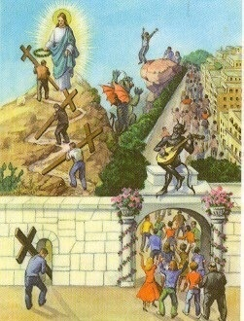
There are always two gates, two ways, two paths, the path to heaven and the one to destruction, to hell. The broad and easy way is the one that leads to hell. The path to the kingdom, on the other hand, is fraught with danger. From the very beginning of Jesus’ teaching, we see this. “Blessed are you when they revile and persecute you and say all kinds of evil against you falsely for My sake. Rejoice and be exceedingly glad, for great is your reward in heaven, for so they persecuted the prophets who were before you” ^{(5:11-12)}. The narrow road is the road of suffering, of reviling and persecutions and bearing the cross.
How many find this narrow path? “Few,” says Jesus,
and this is the great tragedy of this sinful world, “few
will find it.” Most of the people for whose sins the
Lord Jesus suffered and died, walk merrily down the
broad and easy way to destruction.
7:13-14
The Narrow Gate (Way)

Slide 14
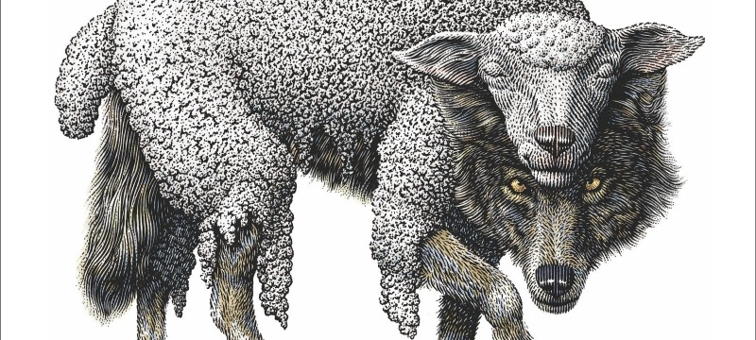
The broad and easy way certainly has its share of teachers and preachers. “False prophets” is what Jesus calls them, and He warns us to beware. In fact in this entire sermon Jesus has been warning us against false teachers and false prophets. Could this be the most disobeyed command of Jesus in the church today?
Looking out for false doctrine and false teaching and the false teachers behind it understood as “mean-spirited, divisive, sectarian, closed-minded, etc.” But even if we didn’t care to look out for false prophets, we don’t have that option. The church is bound to her Lord’s Words, and He has commanded us, “Beware of false prophets.”
7:15-23
False Prophets and Their Fruits

Slide 15
Jesus uses two pictures to warn us of the false prophets and teach us their ways. First, the picture of wolves and sheep, the second is the image of fruit trees. The false prophet comes looking like a sheep, helpless, part of the crowd, everything about them puts us at ease. We don’t worry about having this new sheep around, but all of his kind actions and sweet words were just to break down our defenses so that we are not ready when he gets hungry.
If these wolves are so cleverly disguised, how are we to recognize them? By their fruits; their teachings! The fruits that we are to judge are not merely their outward lives. If this was the case we would judge them to be sheep. “The fruits of the prophet are undoubtedly the doctrines he teaches” ^{(Lenski, 301)}.
Let’s consider Jeremiah 23:9-32
7:15-23
False Prophets and Their Fruits

Slide 16
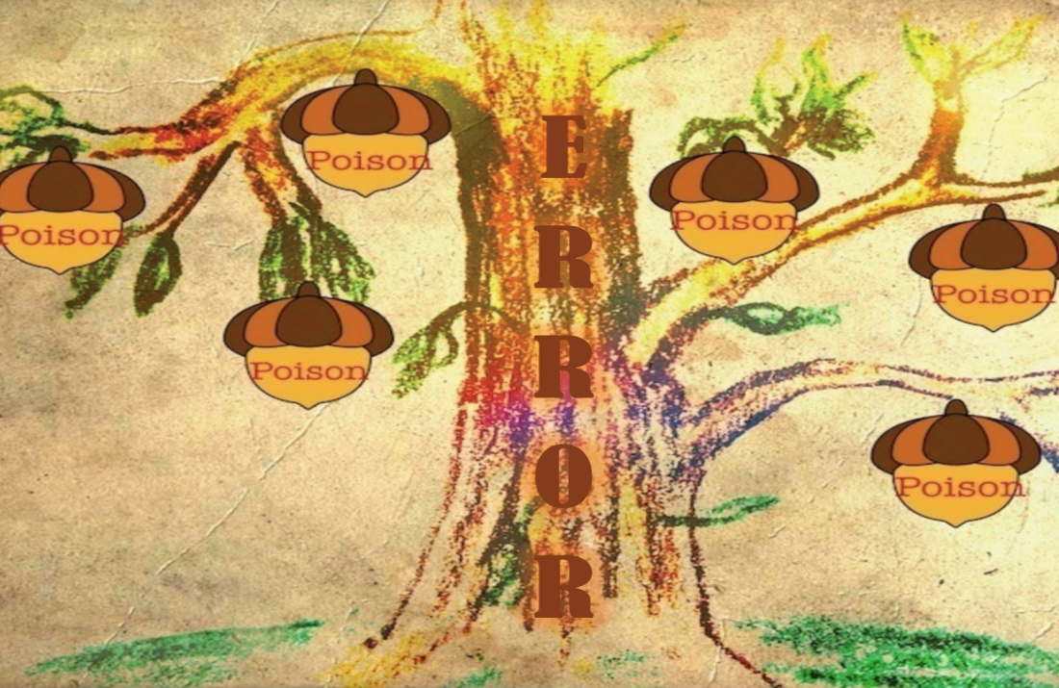
Jesus then puts all in “good” order. The fruit of the tree is the grounds for judgment, but the fruits are only the result of the trees goodness or wickedness. A tree is not good because it bears good fruit, rather a tree bears good fruit because it is good. It will not do to go about trying to do good works to become good. We are first made good by the perfect Word of the Gospel, and then good fruits follow, both in our conversation and life.
It is the false prophet who leads people away from Jesus and His Gospel, and is therefore doomed to judgment. At this point in the sermon, the subject really shifts from the Father to the Son. In verse 21 Jesus, for the first time, calls God “My Father.” This “My” expresses the unique relationship between Father and Son. The disciples and the Lord’s people have God as their Father, but not in the same way as the Son, and this unique relationship is manifest in that the Father has given the judgment of the world into the hands of His Son.
7:15-23
False Prophets and Their Fruits

Slide 17
Not all who speak the name Jesus will enter the kingdom of heaven. There is one requirement for this entry: those who “do the will of My Father in heaven” ^{(v.21)}.
“This ‘doing’ proves that a real connection with Jesus exists, on which He Himself here acknowledges. For ‘the will of My Father’ includes, first of all, repentance and faith (5:6, 25, etc., 48; 6:12, 33; 7:3-11), not the perfection of sinlessness but the righteousness of the remission of sins and thus the power to do works that truly please God. On this gracious, saving will see John 6:29, 39, 40; 1 John 3:23” ^{(Lenski, 305)}.
On Judgment Day everything but the name of Jesus will pass away, and everything upon which His Name is written. It is, therefore, to faith and faithful good works that the Lord is calling us, not to hypocritical acts of piety.
7:15-23
False Prophets and Their Fruits

Slide 18
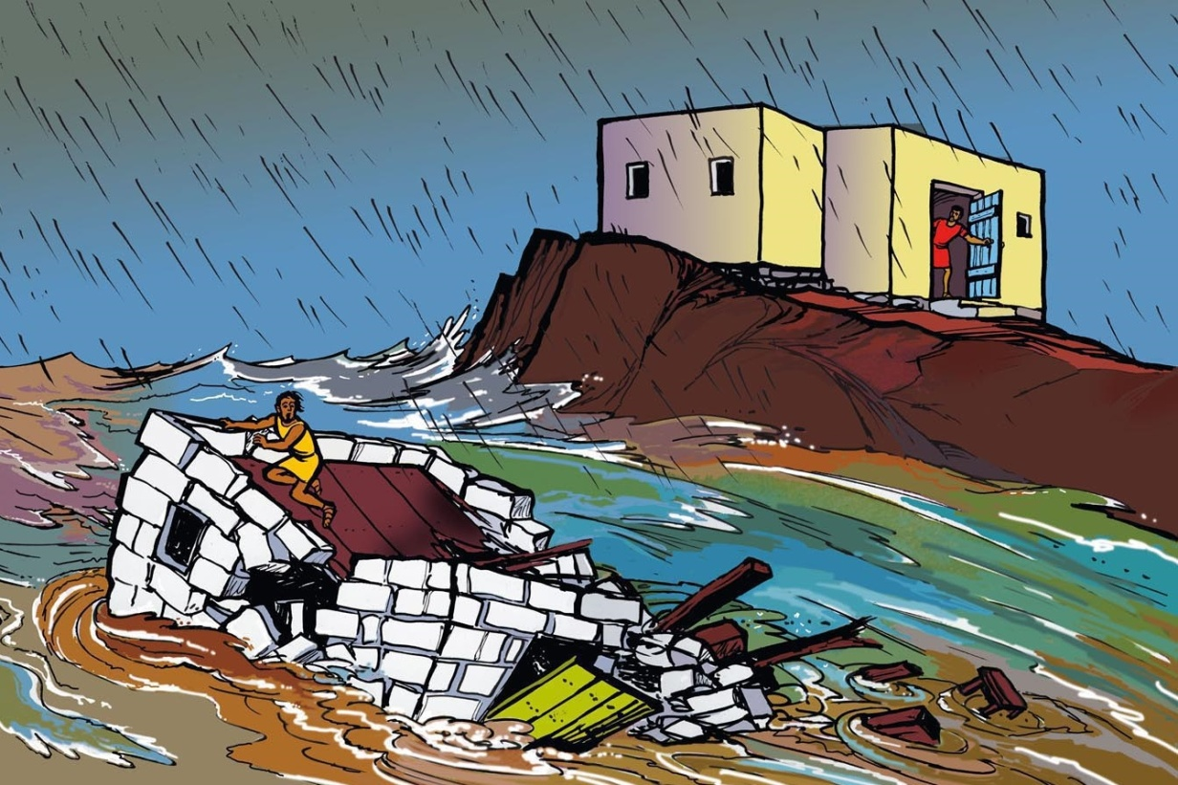
On His Word faith must be built…or it will not stand. Jesus concludes His sermon with the picture of two houses, one which survives the judgment, and on that doesn’t. The surviving house is built on the rock, the man who hears the sayings of Jesus and does them, in faith! The falling house is built on sand, the man who hears the sayings of Jesus, but lacks saving faith! It is no wonder that the people were astonished. Jesus taught with authority! He is God, He is Holy, He is the Judge, and His Word and His Word alone brings life.
7:24-27
Two Builders

Slide 19
St. Matthew concludes the Sermon on the Mount with a final frame that closely corresponds to the narrative that led up to the Sermon (cf. 4:25 – 5:2). Now that The Christ has completed “these words” (v.28), He goes down the mountain. His disciples had come to Him and formed the inner circle to which His teaching was addressed. The crowds, though, were present and Jesus offered to them His teaching also. Note that the crowds were “astonished at His teaching, for He was teaching them with the conviction that He had authority.”
The crowds continued to follow Him; however, they truly did not understand or had not even began to believe in what He was teaching. What they simply were doing was transitional. They heard how Jesus taught and then compared that to the teachings that they had heard from the Priest and Pharisees. They certainly understood that He did not preach and teach like the religious leaders of Israel. Jesus taught in accord with His own authority with unfettered power; with Divine authority, and the crowds were astonished!
7:28 – 8:1
The Narrative Conclusion

Slide 20
III. The Lord’s Ministry in Galilee (4:12 – 14:12)
A. The Beginning of His Galilean Ministry (4:12-25) (2/2)
B. First Discourse: The Sermon on the Mount – Ch 5 (2/9)
C. First Discourse: The Sermon on the Mount – Ch 6 (2/16)
D. First Discourse: The Sermon on the Mount – Ch 7 (2/23)
E. A Collection of Our Lord’s Miracles
1. Chapter 8: In Capernaum & Gadarenes (3/2)
2. Chapter 9: Back in Capernaum (3/9)
F. The Second Discourse: The Commissioning of the Twelve Apostles – Ch 10 (3/16)
G. His Ministry Throughout Galilee (Chapter 11:1 – 12:45) (3/23)
H. The Third Discourse: The Parables of the Kingdom (Ch 12:46 – 13:53) (3/30)
This outline will be undated as we reach successive narratives and the discourses in St. Matthew.
Our Outline of St. Matthew

Slide 21
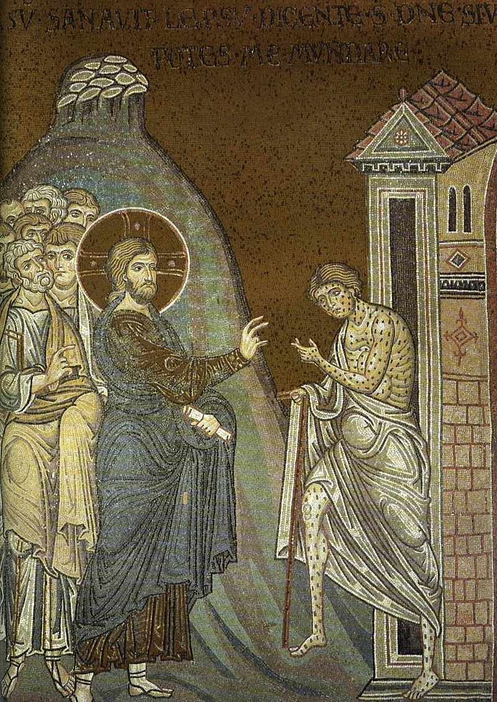
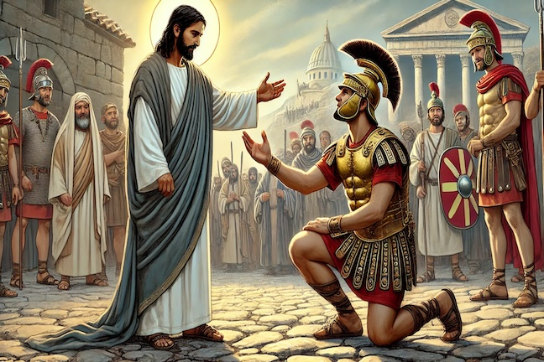
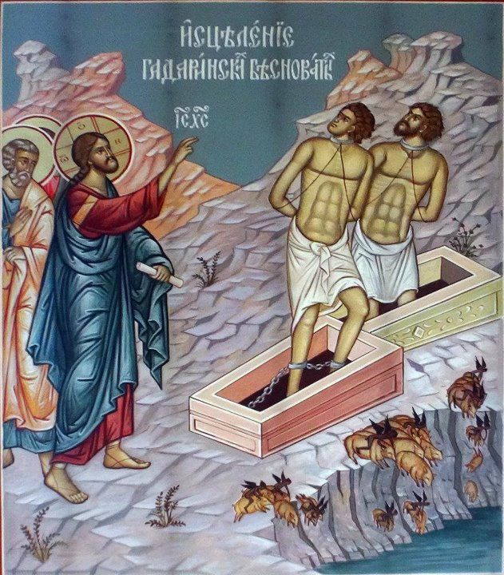
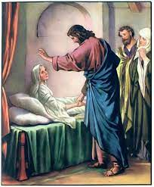
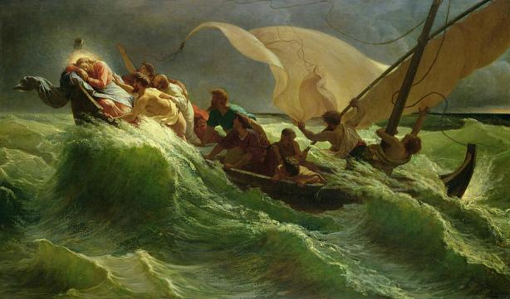
Next
Week
A Collection of Miracles
St. Matthew 8

