Slide 1
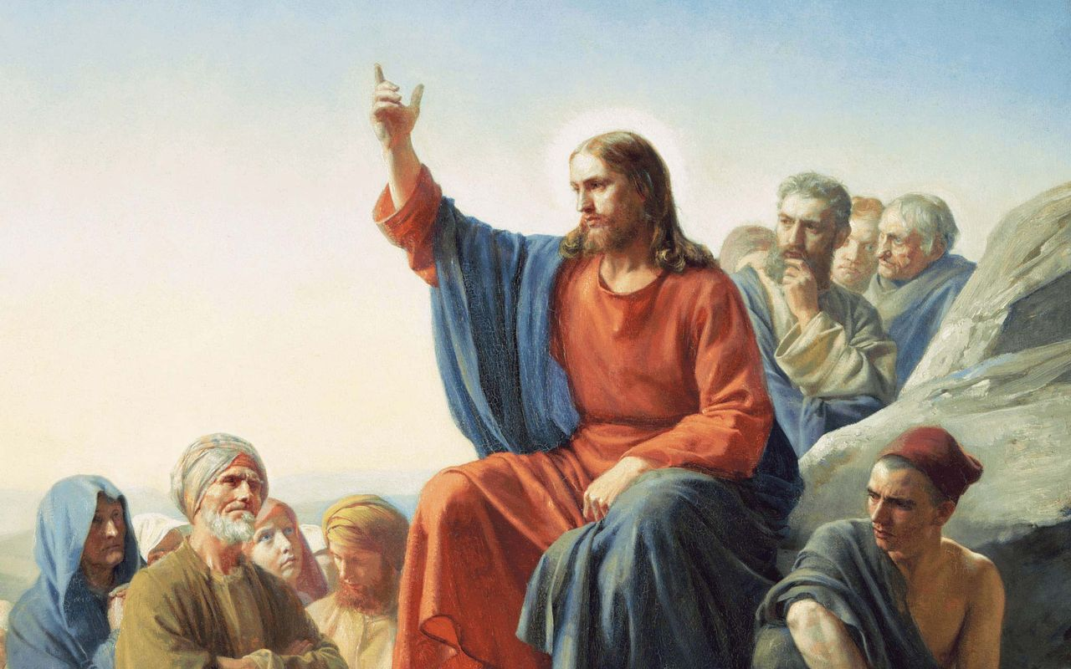
Chapter 6
The Sermon on the Mount

Slide 2
Jesus continues to preach His Sermon on the Mount throughout chapter 6. Jesus continues to teach about true righteousness, the righteousness that exceeds that of the scribes and Pharisees. This is a righteousness that is without hypocrisy and which worships God alone by placing all its trust in Him. In chapter five Jesus dealt with the false teaching of the Pharisees, now He takes up the topic of their false piety. We will divide this chapter into these two sections: “Do Not…As the Hypocrites” (6:1-18) and “A Sermon on Treasure: Trust God Alone” (6:19-34).
Chapter 6
Introduction

Slide 3
Already in chapter 5 we have seen the problem of the righteousness of the scribe and Pharisee, it is a do-able, see-able righteousness. The Pharisees look and act righteous, but their hearts are far from God and their neighbor. All of their good works serve themselves, for they love to receive honor from men. This Jesus calls hypocrisy.
“The hypocrisy of the adversaries consists in the jarring contradiction between what they say and what they do, between the outward appearance and the inward lack of righteousness... in the fact that they are concerned about their status with men rather than their standing before God.”
[Theological Dictionary of the New Testament. VIII. 567, 568]
6:1-18
Do Not…As the Hypocrites

Slide 4
“Take heed that you do not do your righteousness in front of men with a view to be observed by them, else you have no reward with you Father in the heavens” ^{(Matthew 6:1)}. This first verse is a theme verse that will tie together all that follows. Jesus is going to uncover this hypocrisy with three examples: giving alms, prayer and fasting.
Later Jesus will fully rebuke all hypocrisy (all hypocrites), saying at least seven times, “Woe to you, scribes and Pharisees, hypocrites!” [23:13-36]
6:1-18
Do Not…As the Hypocrites

Slide 5
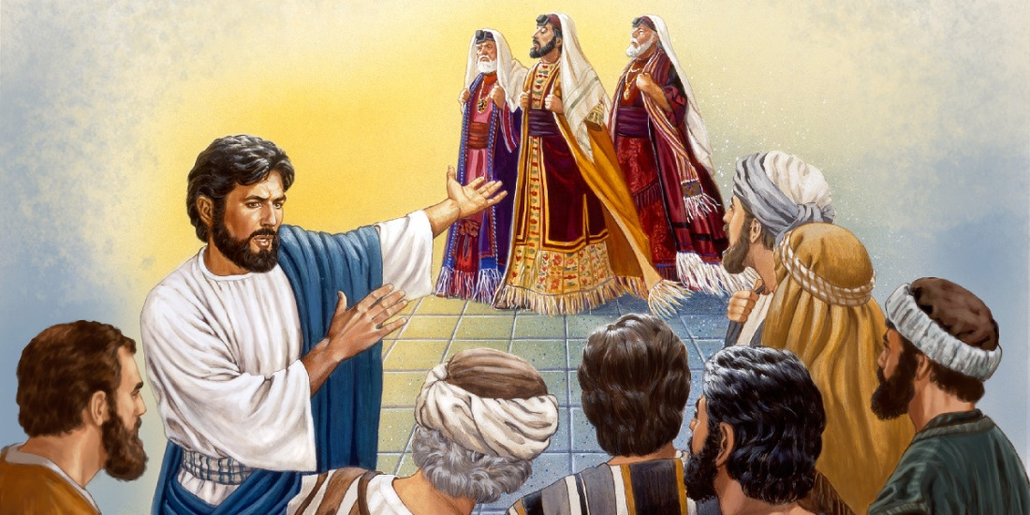
In all of these examples the
question is: who is watching
our pious and devotional
works? Or better, who do you
want to be watching? The hypocrites fashion their acts of devotion so as to assure the biggest audience. They blow the trumpets to herald their righteousness; they stand on the street corner to pray; they mope around when they fast. But the praise of men is all the reward such hypocritical piety will merit, the honor of men and the judgment of God.
6:1-18
Do Not…As the Hypocrites

Slide 6
True piety, on the other hand, is done in secret. The right hand doesn’t know what the left hand is giving; prayers are said in a closet; and a jolly countenance covers the rigors and pain of the fast. Such are the deeds of the children of the Father. Almost every child knows how the desire to please their parents pushes out all other ambition, so it is with the children of the heavenly Father: their one aim and desire is to please Him in all that they do. We see in this text the contrast between the hypocrite and the true child of God!
6:1-18
Do Not…As the Hypocrites

Slide 7
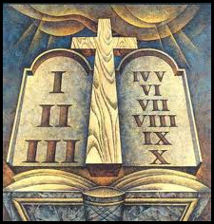
Note that the good works that are mentioned
here are of a different sort than those listed in
chapter 5. It is difficult to reconcile with your
brother when you are in the closet praying.
The good works of chapter 5 regard love for the neighbor, the Second Table of the Law.
The good works of chapter 6 regard faith toward God, the First Table of the Law. Our love for our neighbor is public and should be daily manifest in good deeds. Our faith toward God and our acts of devotion are not things to be outwardly manifest, but cloaked in humility.
6:1-18
Do Not…As the Hypocrites

Slide 8
As our Lord Jesus sweeps out the hypocritical prayers of the heathen, He replaces it with the beautiful gem of the Lord’s Prayer, and teaches us what and how to pray. There is a lifetime of study and devotion in the five verses that compromise the Lord’s Prayer. We will Briefly consider the context of the prayer and make a few passing observations.
There are two wrong ways to pray which Jesus is correcting: the hypocritical prayer and the heathen prayer. First, the hypocritical prayer seeks to be heard not by God…but by men! This is no prayer at all. True prayer is directed toward God who is Our Father. It is He whom we want to hear and answer our prayers. Second, the heathenish prayer which thinks that it is heard by fervor and repetition, as if our prayer is telling God something He doesn’t know and is compelling Him to do that which isn’t in accord with His holy will! Jesus gives us no such prayer.
6:1-18
OUR FATHER

Slide 9
The Lord’s Prayer is not gaudy or wordy and it has no sense of being a sacrifice of desire. Jesus, in these seven petitions, simply tells us that which we need the most, which is also that which the Father most desires to give us. This prayer is also preaching and promising. It preaches to us about our own sinful condition, telling us what we need, and it promises us that it is our Father’s desire to give us these very things. In this way the Lord’s Prayer is bound up to the Beatitudes. There Jesus was “giving into emptiness,” He does the same here. If left to ourselves we would pray the exact opposite of this prayer, “My name be holy, my kingdom come, my will be done,” etc. But His Prayer takes us out of ourselves and teaches us what we really need.
6:1-18
OUR FATHER

Slide 10
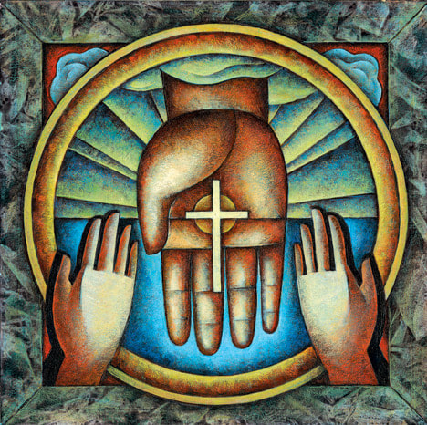
Jesus briefly explains His Prayer as well, pointing to the centrality of the forgiveness of sins, and how our own forgiveness is reflected in our forgiving our neighbor. Jesus teaches more on this in Matthew 18:21-35, the parable of the Unforgiving Servant. Indeed all of the petitions of the Lord’s Prayer will be expounded in our Lord’s teaching in St. Matthew. Who is the Father? What is His name? What is His will? What is His kingdom? What are His gifts?
6:1-18
OUR FATHER

Slide 11
Just as Jesus teaches that all our acts of piety and devotion are directed toward our Father in heaven, that we should also look to Him for every good thing, that we should put our trust and faith in Him, that He will answer our prayer for forgiveness, for daily bread, and for deliverance. Instead of storing up for ourselves treasures on earth (which have no eternal value but are subject, like all of creation, to death), we should store up for ourselves treasures in heaven. This is where our hearts are, bound to the loving heart of our heavenly Father. We single heartedly fix our eyes on Jesus, the Kingdom of Heaven, His righteousness.
6:19-34
A Sermon on Treasure: Trust God Alone

Slide 12
Jesus illustrates this with the example of the eye. If your eyes are directed heavenward toward the light that Jesus brings, then the whole body (all of our actions and affections) will be directed toward that light. On the other hand, if your eyes are directed earthward, toward the sinful and dark condition of your own hearts, then all is darkness [6:22-23].
There are only two choices: light or darkness, heaven or earth, the praise of God or the honor of men, the kingdom of God or your own kingdom, the kingdom of the devil. You cannot serve two masters. Both kingdoms demand total allegiance. You cannot worship the heavenly Father while serving any of this world’s gods, including Mammon, the money-god [6:24].
6:19-34
A Sermon on Treasure: Trust God Alone

Slide 13
True worship and idolatry are the only two options, but they are not equal options. All false gods demand human sacrifice; the worship an idol demands is a pouring out of one’s own life. The heavenly Father, on the other hand, does not demand, but gives. “Do not worry” is then a call away from idol worship to trust in the true God, the Father who loves us and will take care of us as a father cares for his dear children. The only antidote for worry is faith, simple child-like trust that we are the people of the Father’s pasture and the sheep of His hands. “Be anxious for nothing, but in everything by prayer and supplication, with thanksgiving, let your requests be made known to God; and the peace of God, which surpasses all understanding, will guard your hearts and minds through Christ Jesus” ^{(Philippians 4:6-7)}.
Do Not Worry
6:19-34

Slide 14
Faith is what receives the gifts that the heavenly Father gives, without and apart from works.
Consider the lilies and the birds, they do no work, and yet they have, because the heavenly Father provides all as a gift. Does this mean that we give up our jobs and trust that God will provide miraculously? No, for the fact that we have a job is a miracle in itself. The Lord is pleased to provide for our daily bread through the vocations He has given us and our neighbors. The point is that we work hard, but we don’t worship our work. It’s been said that Americans worship at their work, work at their play, and play at their worship. May it not be so among us!
Do Not Worry
6:19-34

Slide 15
Faith sets us free from worry, from the anxieties of the Gentiles (v.32), and now we are set free to seek after the kingdom of God and His righteousness (v.33). What is this seeking? It’s means that you go to the place where Jesus is with His gracious presence! There you receive His gifts of forgiveness and righteousness!
His kingdom and His righteousness come together, and they come to us in the preaching of Jesus on the cross. “He who knew no sin became sin for us, that we might become the righteousness of God in Him” ^{(2 Cor. 5:21)}. And if the heavenly Father is giving us His kingdom and His righteousness, He will given to us all that is good (cf. Romans 8:32).
Do Not Worry
6:19-34

Slide 16
As your Lord Jesus tells you in His concluding proverb (v.34), each day has enough trouble of its own, so why borrow more by worrying about the next day? As a disciple of your Lord Jesus, you have one Master (v.24). When the Word of Jesus teaches you again who the Master is – the Heavenly Father of Jesus, your Redeemer – that Word will empower you to walk in the ways that Jesus Christ has here revealed with authority. And possessions? They ever seek to become your master, god, and curse; yet, they are no longer anything but daily bread (v.11) that the Father, working through His means, will provide to you, so that you may live, move, and seek the reign of God in Christ Jesus!
In Summation
Chapter 6

Slide 17
I. The Birth and Early Years of our Lord (Ch. 1-2)
A. Genealogy (1:1-17) (Jan 5)
B. Birth (1:18 – 2:12) (taught during Dec)
C. His Sojourn in Egypt (2:13-23) (taught during Dec)
II. The Lord’s Ministry Begins (3:1 – 4:11)
A. His Forerunner (3:1-12) (Jan 12)
B. His Baptism (3:13-17) (Jan 19)
C. His Temptation (4:1-11) (Jan 26)
III. The Lord’s Ministry in Galilee (4:12 – 14:12)
A. The Beginning of His Galilean Ministry (4:12-25) (2/2)
B. First Discourse: The Sermon on the Mount – Ch 5 (2/9)
C. First Discourse: The Sermon on the Mount – Ch 6 (2/16)
D. First Discourse: The Sermon on the Mount – Ch 7 (2/23)
Our Outline of St. Matthew

Slide 18
Next
Week
The Sermon on the Mount
St. Matthew 7

