Slide 1
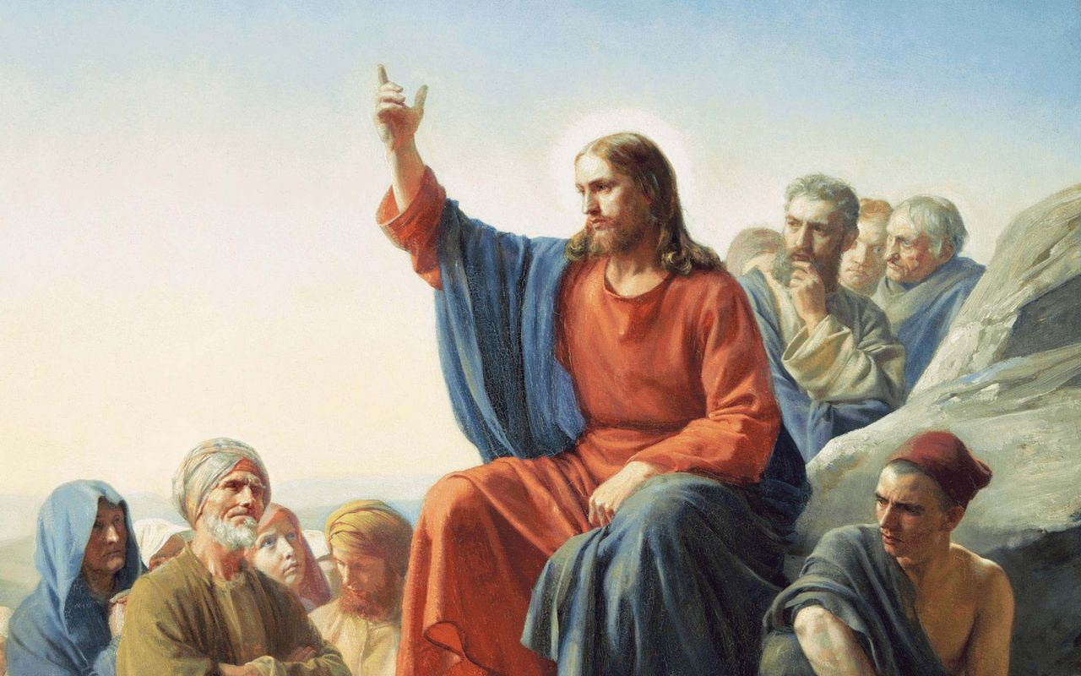
Chapter 5
The Sermon on the Mount

Slide 2
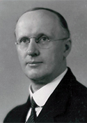
The first of five discourses of our Lord’s teaching in the Gospel according to St. Matthew is the Sermon on the Mount. The sermon extends through three chapters. In His sermon, Jesus lays down the foundation for those teachings which are to follow.
In regards to our Lord’s this sermon, Dr. Kretzmann wrote:
Chapter 5
Introduction

Slide 3
“This section of Matthew’s Gospel included in chapters 5-7 is one of the most beautiful and impressive in the entire New Testament. In the simplest language, but with singular force and pertinency, Jesus here gave a summary of His moral teaching, the doctrine ‘of fruits and good works of a Christian,’ as Luther writes.”
“To awaken and promote the realization and the sense, not only comparative weakness and insufficiency in spiritual matters, but of a total and utter inability to think and speak and act in conformity with the holy will of God; to bring about humiliating, but incidentally the most blessed conviction as to one’s being wretched, and miserable, and naked in spiritual things [Rev 3:17]; and to teach the regenerated that without Him we can do nothing, and thus lead them on the way of true sanctification: that was the object of Christ in delivering this wonderful sermon.”
Chapter 5
Introduction

Slide 4
Perhaps we can best understand the Sermon on the Mount as our Lord’s teaching on the OT. In His temptation Jesus establishes the authority of the prophets by quoting them, especially Moses and his sermon in Deuteronomy. Now, in the Sermon on the Mount, Jesus is unfolding the true understanding of the OT, and in doing so He does (at least) these two things:
1) Jesus shows His own connection to the OT. The OT is, after all, His own words. Jesus is the “Word” who has spoken to His people throughout time, and these words He comes not to destroy but to fulfill [5:17]. When Jesus says, “You have heard it said... but I say to you,” He is not contradicting the OT, but fully explaining what He meant when He originally spoke. So after hearing this sermon the people are astonished, “for He taught them as one having authority” [7:29].
Chapter 5
Introduction

Slide 5
Now, in the Sermon on the Mount, Jesus is unfolding the true understanding of the OT, and in doing so He does (at least) these two things:
2) Jesus is tearing the Scriptures out of the hands of those who had misused and misapplied it for their own advantage, namely the Pharisees. These are they who would say, “We have Abraham; we have Moses; we have the Torah.” But Jesus is here, the kingdom is come, the proud are cast down and the humble are exalted. ²“Talk no more so very proudly; let no arrogance come from your mouth, for the Lord is the God of knowledge; and by Him actions are weighed... ⁵Those who were full have hired themselves out for bread, and those who were hungry have ceased to hunger” ^{[1 Samuel 2:3,5]}.
So Jesus, in the Sermon on the Mount, gives a true understanding of Abraham, Moses, and the OT; and, in doing so, He continues to overthrow the devil’s kingdom which had been established in the teachings of the scribes and Pharisees.
Chapter 5
Introduction

Slide 6
This first sermon of Jesus recorded for us in Matthew sets the tone for the entire Gospel; and verses 1-12 sets the tone for this sermon. Jesus is teaching about His kingdom, the Gospel and Good News of His Kingdom. The beatitudes are promises of what happens in His Kingdom, for the Kingdom of God turns everything on its head. In His Kingdom the mighty are put from their thrones and the humble are exalted [Luke 1:52, the Magnificant]. In His Kingdom, the first are last and the last are first. In His Kingdom, to be glorified is to be lifted up in the shame of the cross.
It is very important for you to understand the beatitudes as promises of God’s grace and mercy. Jesus is placed in the midst of each of the beatitudes; He is the hinge between our humility and Heaven’s glory. It is not the poorness of spirit that earns the kingdom of heaven, but Jesus who gives to the poor that which they do not have. So the beatitudes are not natural, their promises are not disconnected from faith, and their rewards are not severed from the Kingdom of Heaven.
5:1-12
The Beatitudes

Slide 7
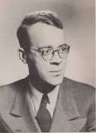
This time, let’s hear from Dr. Martin Franzmann:
“[Jesus] stands before His disciples as the Giver. He is the Messianic Giver. Nine times He calls His disciples “blessed” (5:3-11); that word occurs four times in Matthew outside the Beatitudes, and in all cases it describes man in his relationship to the Messiah - blessed is the man who is not offended at the lowliness of the ministering Messiah (11:6); blessed are the eyes which see in Jesus of Nazareth, in the Sower who goes out to sow, the coming of the reign of God (13:16,17); blessed is Simon [Peter] because the Father has revealed the Messiah to him (16:17); blessed is the servant whom the returning Messiah finds faithful at his post (24:46). As Messianic Giver, He gives absolutely, into emptiness.”¹
¹Follow Me: Discipleship According to Saint Matthew, 36.
5:1-12
The Beatitudes

Slide 8
The beatitudes are fit for a lifetime of study and meditation. Instead of discussing each in turn, may we make a few observations.
First is the use of the word: Blessed (makavrioi). This is a marvelous first word; in it we hear of Jesus’ purpose: “For God did not send His Son into the world to condemn the world, but that the world through Him might be saved” ^{(St. John 3:17)}. “Blessed” is the first word spoken to Adam and Eve, “He blessed them and said…” ^{(Gen 1:28)}. It is the last word spoken in our liturgy, “The Lord bless you and keep you….” It is a word that indicates that a gift is being given.
“Blessed” is also the very first word in the Psalms, “Blessed is the man who walks not in the counsel of the ungodly, nor stands in the path of sinners, nor sits in the seat of the scornful; but his delight is in the law (Torah) of the Lord” ^{(Ps 1:1, 2)}. The blessing of the Torah, the Law, Jesus is now giving Himself.
5:1-12
The Beatitudes

Slide 9
The beatitudes are fit for a lifetime of study and meditation. Instead of discussing each in turn, may we make a few observations.
First is the use of the word: “Blessed” (makavrioi). This is a marvelous first word; in it we hear of Jesus’ purpose: “For God did not send His Son into the world to condemn the world, but that the world through Him might be saved” ^{(St. John 3:17)}. “Blessed” is the first word spoken to Adam and Eve, “He blessed them and said…” ^{(Gen 1:28)}. It is the last word spoken in our liturgy, “The Lord bless you and keep you….” It is a word that indicates that a gift is being given.
5:1-12
The Beatitudes

Slide 10
“Blessed” is also the very first word in the Psalms, “Blessed is the man who walks not in the counsel of the ungodly, nor stands in the path of sinners, nor sits in the seat of the scornful; but his delight is in the law (Torah) of the Lord” ^{(Ps 1:1, 2)}. The blessing of the Torah, the Law, Jesus is now giving Himself.
All of the OT blessings and promises are here in the person of Jesus, “For all the promises of God find their Yes in Him. That is why we utter the Amen through Him, to the glory of God” ^{(2 Cor. 1:20)}.
5:1-12
The Beatitudes

Slide 11
Notice that the promise of the first and last of the beatitudes is in the present tense (is the Kingdom of Heaven), while all the others are future (shall be comforted, filled, etc.). The Kingdom of Heaven is not a far away, distant dream, but a present reality. The preaching of John the Baptist was not, “The Kingdom of Heaven is far away,” but rather, “The Kingdom of Heaven is at hand.” Why? Because Jesus is at hand! Where He is; His Kingdom is! So the poor in spirit have the Kingdom of Heaven because they, by faith, have Christ who does not despise our poverty, but makes Himself poor that we might be rich (cf. 2 Cor. 8:9).
5:1-12
The Beatitudes

Slide 12
In the NT, humility is really despair of self. This is what Jesus is teaching in the Sermon on the Mount. Just like hiking to the summit of Pikes Peak produces an immediate sense of finite weakness (and physical pain), so traveling through this Sermon on the Mount produces humility. Here the Law and the gifts of Jesus, tower so high that there is no room for pride.
Thus the first four beatitudes are a unit, they belong together, for those who are poor, mourning, meek and hungry are the same, they are the humble to whom the Kingdom comes. The last four beatitudes also belong together, for they have in view the works that are brought forth by the arrival of the Kingdom, the fruits that come out of the tree made good. The disciples who take up their cross to follow Jesus reflects the Master that they follow: merciful, pure, peacemakers who are persecuted like the prophets. This is one of the indelible marks of a prophet, and a Christian: persecution!
5:1-12
The Beatitudes

Slide 13
Those to whom the Lord gives His gifts are never the same. Such mercy and love and forgiveness are too bountiful; it overflows, it must. The Lord’s disciples are then the doers of good works. Jesus describes this with two metaphors: salt and light.
Salt flavors and light illuminates,
it can do nothing else. What it
does is bound up into what it is.
Salt without saltiness is sand,
light without light is darkness;
faith without works is dead.
5:13-16
Salt and Light

Slide 14
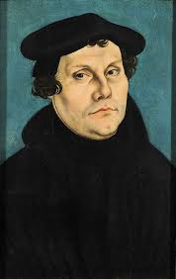
“Faith is a divine work in us that transforms us and begets us anew from God, kills the Old Adam, makes us entirely different people in heart, spirit, mind, and
all our powers, and brings the Holy Spirit with it. Oh,
faith is a living, busy, active, mighty thing, so that it is impossible for it not to be constantly doing what is good. Likewise, faith does not ask if good works are to
be done, but before one can ask, faith has already done
them and is constantly active. Whoever does not perform such good works is a faithless man, blindly tapping around in search of faith and good works without knowing what either faith or good works are, and in the meantime he chatters and jabbers a great
deal about faith and good works. Faith is a vital, deliberate trust in God’s grace, so certain that it
would die a thousand times for it.” [FC, SD, IV, 10]
5:13-16
Salt and Light

Slide 15
Just as Jesus is the “great light” for all who sit in darkness [4:16], so are His disciples. Notice how our light shines before men: our good works. No one can see faith in God, but all can see our love for one another and for our neighbor. St. Peter teaches the same thing when He says: “¹¹Beloved, I beg you as sojourners and pilgrims, abstain from fleshly lusts which war against the soul, ¹²having your conduct honorable among the Gentiles, that when they speak against you as evildoers, they may, by your good works which they observe, glorify God in the day of visitation” ^{(1 Peter 2:11, 12)}.
Already here, at the beginning of His teaching to His disciples, Jesus is preparing them to “Go and make disciples of all nations” ^{(28:19)}.
5:13-16
Salt and Light

Slide 16
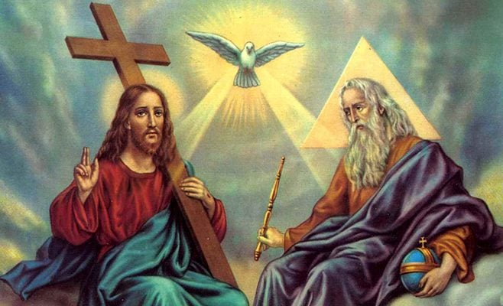
“…your Father who is in heaven.”
This phrase which is used often in Matthew is first used here at the end of verse 16. The peacemakers are God’s sons (v.9), and God is their Father. The Kingdom of God is also the family of God. We are brought into the Kingdom as we are born into the family. It is in your baptism that the Father speaks to you, “You are My beloved son.” In His Kingdom, Jesus is your Master and your Brother; God the Father is your Father and Lord!
5:13-16
Salt and Light

Slide 17
Lest the disciples think that what Jesus is saying is something new, or is meant to abrogate the Law and the Prophets, Jesus says, “one jot (y) or one tittle ( i)will by no means pass from the law till all is fulfilled.” The Kingdom of Heaven is not a throwing off of the OT, nor is the OT, the Law or Torah, fulfilled anywhere else but in Jesus.
Just as our Lord’s baptism fulfills all righteousness, so His teaching and doing (5:19) fulfills the Law and the Prophets. How? Already that filling up of the OT has begun. Seven prophecies are reported for us in Matthew 1-4. By His birth, life, death, resurrection, ascension, Second Advent, and everything else Jesus is the completion of the OT (cf. St. Luke 24:26-27, 44; St. John 5:39).
5:17-48
The Law Fulfilled

Slide 18
Thus Jesus is the Righteous One, the Kingdom is His. This means that the Kingdom is not the Pharisees’. Jesus says, “For I say to you, unless your righteousness exceeds the righteousness of the scribes and Pharisees, you will by no means enter the kingdom of heaven” (v.20). Imagine the insult! If anyone thought that their righteousness had merited them the Kingdom, it was the Pharisees, but this is not enough, it must be exceeded. All of the boasting of the Pharisee is brought to nothing, and there is no hope, but Christ.
Jesus is wresting the Kingdom of Heaven from those who would seek to enter it with their own righteousness. His sermon continues to unwind the Torah from its false teachers and present it purely. His sermon continues with a pure explanation of the Law.
5:17-48
Exceeding Righteousness

Slide 19
The Formula of Concord tells us what Jesus is preaching:
“The mere preaching of the Law without Christ either produces presumptuous people, who believe that they can fulfill the Law by external works, or drives man utterly to despair. Therefore Christ takes the Law into His hands and explains it spiritually [Matthew 5:21ff.; Romans 7:6, 14]; thus He reveals His wrath from heaven over all sinners and shows how great this wrath is. This directs sinners to the Law, and there he really learns to know his sin, an insight that Moses could never have wrung out of him” (FC, SD, Art. V).
5:17-48
Exceeding Righteousness

Slide 20
In the commandments that follow, Jesus shows that keeping the Law is no mere outward rote obedience to the letter, but rather a matter of the inclination of the heart man. To insult is to murder [21-26], to lust is to commit adultery [27-30], and likewise to divorce [31-32]. There is no swearing [33-37], no retaliation [38-42], and no hatred, even toward one’s enemies [43-47].
The whole discussion is concluded with the monumental command: “Therefore you shall be perfect [tevleioi], just as your Father in heaven is perfect” ⁽⁴⁸⁾. Jesus sets the bar high! Throughout the entire chapter, in fact, the bar is continually raised until it reaches this daunting crescendo. The Law requires complete and total obedience, and anything else is damnable and worthy of eternal condemnation!
5:17-48
Exceeding Righteousness

Slide 21
The scribes and Pharisees had taken the Law too lightly; they had made it manageable, doable. Their monumental body of traditions and oral law had not made the Law more difficult, but in actuality…easier! Under the Pharisees, the Law is kept by doing; in the Kingdom of Heaven the Law is kept by repenting: “Repent, the kingdom of heaven is at hand.”
Against this the Reformers said that the preaching of the Ten Commandments in the Sermon on the Mount is for all people, and our Lord’s explanations of the Ten Commandments are enshrined in the Catechism.
5:17-48
Exceeding Righteousness

Slide 22
I. The Birth and Early Years of our Lord (Ch. 1-2)
A. Genealogy (1:1-17) (Jan 5)
B. Birth (1:18 – 2:12) (taught during Dec)
C. His Sojourn in Egypt (2:13-23) (taught during Dec)
II. The Lord’s Ministry Begins (3:1 – 4:11)
A. His Forerunner (3:1-12) (Jan 12)
B. His Baptism (3:13-17) (Jan 19)
C. His Temptation (4:1-11) (Jan 26)
III. The Lord’s Ministry in Galilee (4:12 – 14:12)
A. The Beginning of His Galilean Ministry (4:12-25) (2/2)
B. First Discourse: The Sermon on the Mount – Ch 5 (2/9)
C. First Discourse: The Sermon on the Mount – Ch 6 (2/16)
D. First Discourse: The Sermon on the Mount – Ch 7 (2/23)
Our Outline of St. Matthew

Slide 23
Next
Week
The Sermon on the Mount
St. Matthew 6

