Slide 1
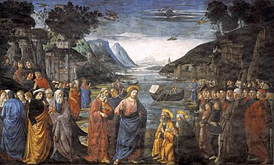
I. The Birth and Early Years of our Lord (Ch. 1-2)
A. Genealogy (1:1-17) (Jan 5)
B. Birth (1:18 – 2:12) (taught during Dec)
C. His Sojourn in Egypt (2:13-23) (taught during Dec)
II. The Lord’s Ministry Begins (3:1 – 4:11)
A. His Forerunner (3:1-12) (Jan 12)
B. His Baptism (3:13-17) (Jan 19)
C. His Temptation (4:1-11) (Jan 26)
III. The Lord’s Ministry in Galilee (4:12 – 14:12)
A. The Beginning of His Galilean Ministry (4:12-25) (2/2)
B. First Discourse: The Sermon on the Mount – Ch 5 (2/9)
C. First Discourse: The Sermon on the Mount – Ch 6 (2/16)
D. First Discourse: The Sermon on the Mount – Ch 7 (2/23)
St. Matthew 4:12-25
The Beginning of His
Galilean Ministry

Slide 2
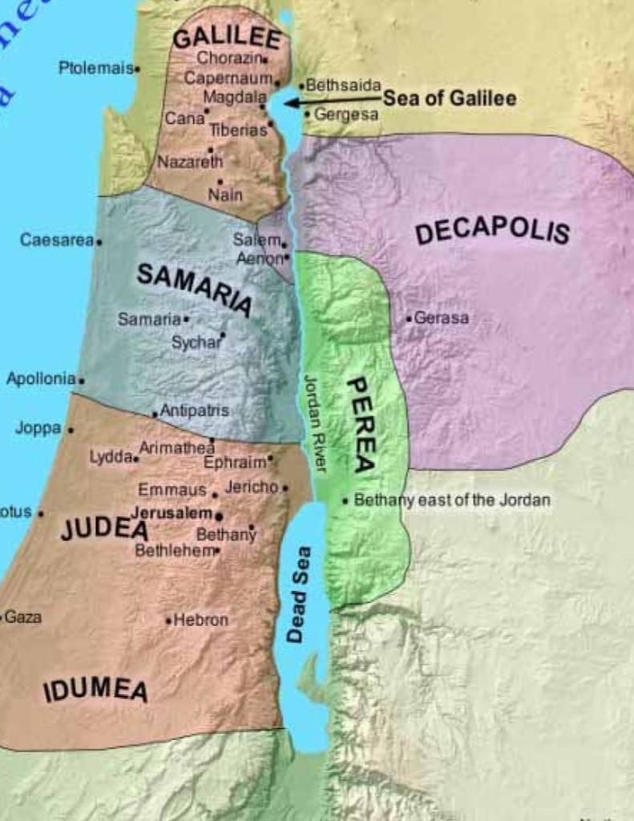
St. Matthew presents our
Lord’s birth, childhood
and early ministry as the
fulfillment of seven
prophetic promises.
Our Lord’s move to Galilee
and His preaching there is
the seventh promise
fulfilled!
St. Matthew
4:12-25
Introduction

Slide 3
St. Matthew reports that our Lord’s move to Galilee, and eventually establishment of His ministerial base in Capernaum occurred after the jailing of John the Baptist. Matthew will later recount the history of John’s arrest and martyrdom in 14:1-12. There is a gap in the history here; about a year passes between the Temptation of our Lord and John’s imprisonment. It important to remember that Matthew doesn’t follow a strict chronological order, but rather, his focus is to present to his Jewish readers that Jesus is their Messiah.
St. Matthew
4:12-17
John the Baptist in Prison

Slide 4
All of the synoptic Gospels (Matthew, Mark and Luke) begin with Jesus’ Galilean ministry. We would know nothing of this year except for John 1:35-4:43.
St. John tells us that our Lord’s first year is in Judea and Jerusalem, that after His temptation Jesus returned to John the Baptist and called His first disciples, Andrew, a disciple of John; and then Peter, Philip and Nathanael (Bartholomew).
St. Matthew
4:12-17
John the Baptist in Prison

Slide 5
Jesus then travels with these disciples to Cana, attending a wedding there [John 2:1-11], and then after a short stay with the Lord’s earthly family in Capernaum [John 2:12], the company returns to Jerusalem where Jesus cleanses the temple [John 2:13-25]. After the late-night discourse with Nicodemus [John 3:1-21], Jesus returns with His disciples to the Jordan where they are baptizing along with John and his disciples [John 3:22-36].
St. Matthew
4:12-17
John the Baptist in Prison

Slide 6
This all happens before John was thrown in prison [John 3:24], for he is able to preach about Jesus [John 3:26-36].
Jesus then travels to Galilee by way of Samaria, and there has the dialogue with the woman at the well [John 4:1-43]. And He then travels to Cana [John 4:46].
St. Matthew
4:12-17
John the Baptist in Prison

Slide 7
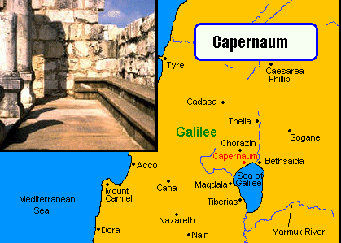
This small city on the western shore of the Sea of Galilee would serve as the Lord’s “base of operations” until He “sets His face to go to Jerusalem” [Luke 9:53].
Capernaum had a synagogue
where Jesus often taught, and is the location of Matthew’s customs office. Matthew reports Jesus’ move to Capernaum as fulfillment of Is. 9:1-2, “The people who sat in darkness saw a great light, and upon those who sat in the region and shadow of death light has dawned.” In the prophecy and its fulfillment we must not miss the strong note of underserved grace. The people were at their lowest ebb, spiritual light had faded, there was little hope or help: then the Lord stepped in and in pure grace sent to them a heavenly gift, the hope of salvation in His Son, Jesus!
St. Matthew
4:12-17
Capernaum

Slide 8
Darkness and light are major themes in the Scriptures.
+ Jesus is the “Light of the World” [John 8:12];
+ “The light shines in the darkness, and the darkness did not comprehend it” [John 1:5];
+ “The Dayspring from on high has visited us; to give light to those who sit in darkness and the shadow of death, to guide our feet into the way of peace” [Luke 1:78-79];
+ He is the “Light of Light” [Nicene Creed].
Into the darkness of our sin and death, Jesus shines as a bright beacon of heavenly light and truth.
In the new heaven and new earth Jesus is the only light. “And the city had no need of the sun or of the moon to shine in it, for the glory of God illuminated it, and the Lamb is its light” [Rev 21:23].
St. Matthew
4:12-17
Light and Dark

Slide 9
Our Lord’s preaching is summarized in the phrase, “Repent, for the kingdom of heaven is at hand” [Matthew 4:17].
This is the same sermon; the same exact words given to John the Baptist, which he preached; and a summary of the Gospel of Matthew and the whole prophetic message. Clearly, Jesus is now continuing the “heralding” of the Gospel!
St. Matthew
4:12-17
Repent!

Slide 10
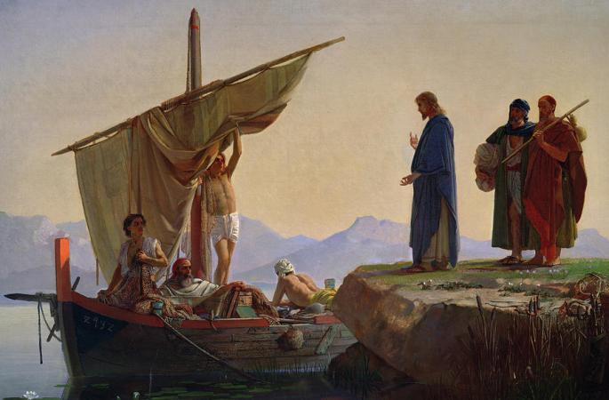
Jesus had already made the acquaintance of Peter, Andrew, James and John [John 1:35-51] and traveled with them from Judea to Galilee and attended the marriage at Cana with them.
It is here, in Matthew 4, that these four men are called to break from their livelihood and follow Jesus as His disciples. “Follow Me,” says Jesus, and after this word there is no going back. “They immediately left their nets and followed Him” [Mt 4:20].
Jesus Calls Peter, Andrew,
James and John
St. Matthew
4:18-22

Slide 11
There is no questioning, hesitating, wondering, only following. Dr. Franzmann highlights the great importance of Jesus’ call of the disciples:
“We have no way of reconstructing with any precision what was in the mind of Matthew at his calling or in the minds of the four men of Galilee when they were called. But the record of Matthew makes one thing clear: when they heard the words “Follow Me,” they had no choice. Whatever degree of knowledge they had then attained; their wills were already claimed... The disciples knew, or surely sensed, that in Jesus' “Follow Me” the great light of God's new creation, the light which brought the life of God to men, was falling across their paths; and they knew too: “We must walk in this light or die.” ... When Jesus said, “Follow Me,” He was confiscating man for Himself. For that word applied to man with personal and inescapable urgency His call to repentance and His annunciation of the Kingdom come. It brought the gift and the claim of the Kingdom to bear on man. The whole Gospel of Matthew is simply the record of the process of progressive Messianic confiscation, the record of how Jesus shaped men in the mold of repentance, of how the Christ created men in His image, Christian men.”¹
¹ Franzmann, Martin H. “Follow Me: Discipleship According to St.
Matthew” St. Louis: Concordia. Publishing House, 1961. p 31-33.
Jesus Calls Peter, Andrew,
James and John
St. Matthew
4:18-22

Slide 12
By His call, Jesus is pulling to Himself hearers who would later be preachers. To these disciples Jesus would add eight more. The list is in Matthew 10:1-5 and we will discuss more fully during our study of that chapter.
Apostle (ajpovstoloV) is a word that is derived from the Greek verb ajpostevllw (apostello) which means to “send forth” or “to dispatch.” It is used in the NT to denote one who is sent on a specific mission or with a particular purpose. However, these newly called apostles, as of yet, are not “sent;” rather, they are called and gathered by Jesus to hear and see His Messianic words and deeds...to “learn” from Him!
Jesus is teaching them, since they “follow” (ajkolouqew) Him; thus this is the first great Seminary of the Church! Just as they lay down their nets on the shores of Galilee, these “seminary students” will be called to lay down their lives for preaching the promise of the forgiveness of all sins.
Jesus Calls Peter, Andrew,
James and John
St. Matthew
4:18-22

Slide 13
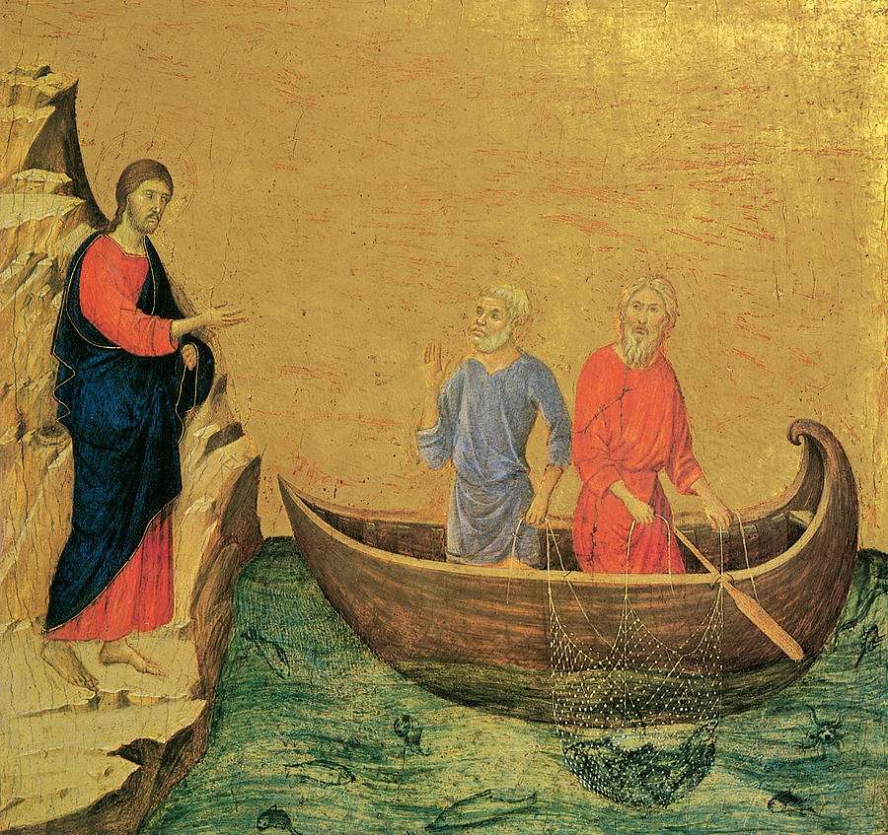
In the first-century Jewish context, following a rabbi or teacher was a common practice. Disciples would leave their homes and occupations to learn from and emulate their teacher. This cultural backdrop highlights the radical nature of our Lord’s
call to follow Him, as it
demanded total allegiance
and often counter-cultural
decisions. The term also
carried connotations of loyalty
and dedication, reflecting the
relationship between a master
and His disciples.
Jesus Calls Peter, Andrew,
James and John
St. Matthew
4:18-22

Slide 14
Matthew concludes this section with a summary of our Lord’s Galilean ministry. Jesus is teaching, preaching the Gospel, healing the sick and casting out demons. An example of His preaching is Luke 4:18-21. His preaching is about Himself, the Kingdom that is present in Himself. He is preaching the Gospel, so He preaches of Himself!
All of our Lord’s healing and casting out demons are always in service of the Word preached, for it is through His Word of Promise that the kingdom comes and faith is given. In these healings, Jesus is delivering the treasure which He won in the wilderness where He overcame the devil and began the toppling of his kingdom.
St. Matthew
4:23-25
Our Lord’s Ministry in Summary

Slide 15
I. The Birth and Early Years of our Lord (Ch. 1-2)
A. Genealogy (1:1-17) (Jan 5)
B. Birth (1:18 – 2:12) (taught during Dec)
C. His Sojourn in Egypt (2:13-23) (taught during Dec)
II. The Lord’s Ministry Begins (3:1 – 4:11)
A. His Forerunner (3:1-12) (Jan 12)
B. His Baptism (3:13-17) (Jan 19)
C. His Temptation (4:1-11) (Jan 26)
III. The Lord’s Ministry in Galilee (4:12 – 14:12)
A. The Beginning of His Galilean Ministry (4:12-25) (2/2)
B. First Discourse: The Sermon on the Mount – Ch 5 (2/9)
C. First Discourse: The Sermon on the Mount – Ch 6 (2/16)
D. First Discourse: The Sermon on the Mount – Ch 7 (2/23)
Our Outline of St. Matthew

Slide 16
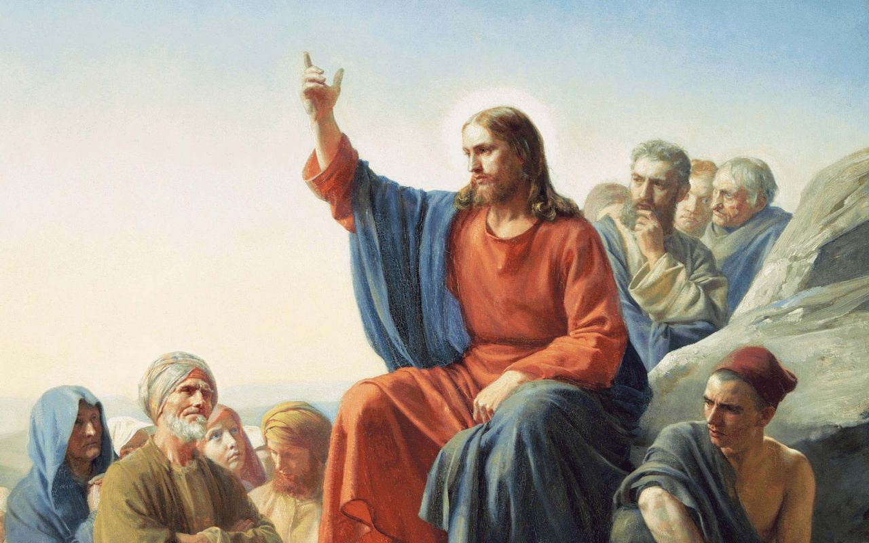
Next
Week
The Sermon on the Mount
St. Matthew 5

