Slide 1
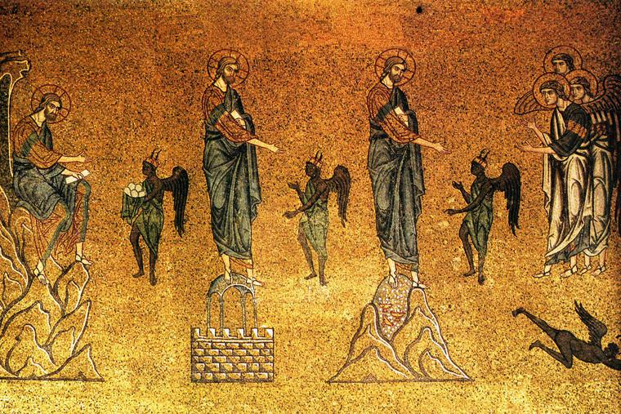
St. Matthew
4:1-11
The Temptation of Our Lord

Slide 2
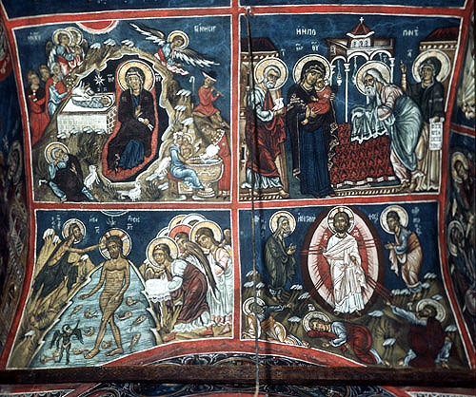
Now we are brought face to face with the great Purpose of our Lord Jesus’ ministry!
+ Epiphany proclaimed who He is!
St. Matthew
4:1-11
The Temptation of Our Lord

Slide 3
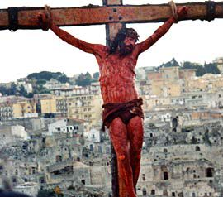
+ Lent tells us what He must do!
St. Matthew
4:1-11
The Temptation of Our Lord

Slide 4
In the “middle” of Epiphany is our
Lord’s Temptation!
St. Matthew
4:1-11
The Temptation of Our Lord

Slide 5
ISRAEL
JESUS
You must understand that our Lord’s temptation is by Divine arrangement! It’s to prove that Jesus is the Son of God; therefore, it is connected to His Baptism!
Both St. Matthew 3:13-17 and 4:1-11 display the Holy Spirit, identify our Lord Jesus as The Son of God, and the typological parallels between Jesus and OT Israel!
God’s “Firstborn”
Called out of
Egypt
Watery baptism
through the Red
Sea
Tested for 40 yrs
in the wilderness
God’s Beloved Son
Called out of
Egypt
Watery baptism
in the Jordan
Tempted for 40
days in the
wilderness
St. Matthew
4:1-11
The Purpose

Slide 6
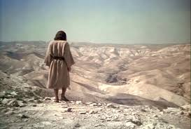
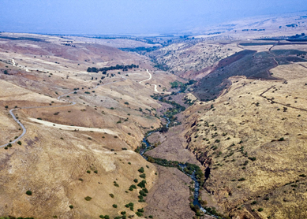
“Then Jesus was led up into the wilderness by the Spirit to be tempted by the devil.”
This verse is the introductory verse and is quite significant. It links 3:13-17 with 4:2-11, remembering that after our Lord came out of the Jordan, He was anointed by the Holy Spirit. The Spirit now leads the Beloved Son into the wilderness to be tempted by the devil. And this is the Father’s good pleasure to humble His Servant-Son!
St. Matthew
4:1
The Temptation of Our Lord

Slide 7
“Then Jesus was led up into the wilderness by the Spirit to be tempted by the devil.”
Secondly, this verse points out the purpose in the Spirit’s leading of the Beloved Son into the wilderness…“to be tempted by the devil.”
Jesus has come vicariously for Israel to be in its place and to repeat and fulfill its history! When Israel when into the wilderness, their faith was tested…and they failed!
Now Jesus, the True and
Beloved Son, has come in
the place of Israel to be
TEMPTED to sin…not
TESTED! Jesus is to prove
that He is the perfect and obedient Son of God in and for Israel. This is because Israel failed the testing; therefore, Jesus must be subject to the tempting in their place…to fulfill what Israel did not…perfect obedience!
St. Matthew
4:1
The Temptation of Our Lord

Slide 8
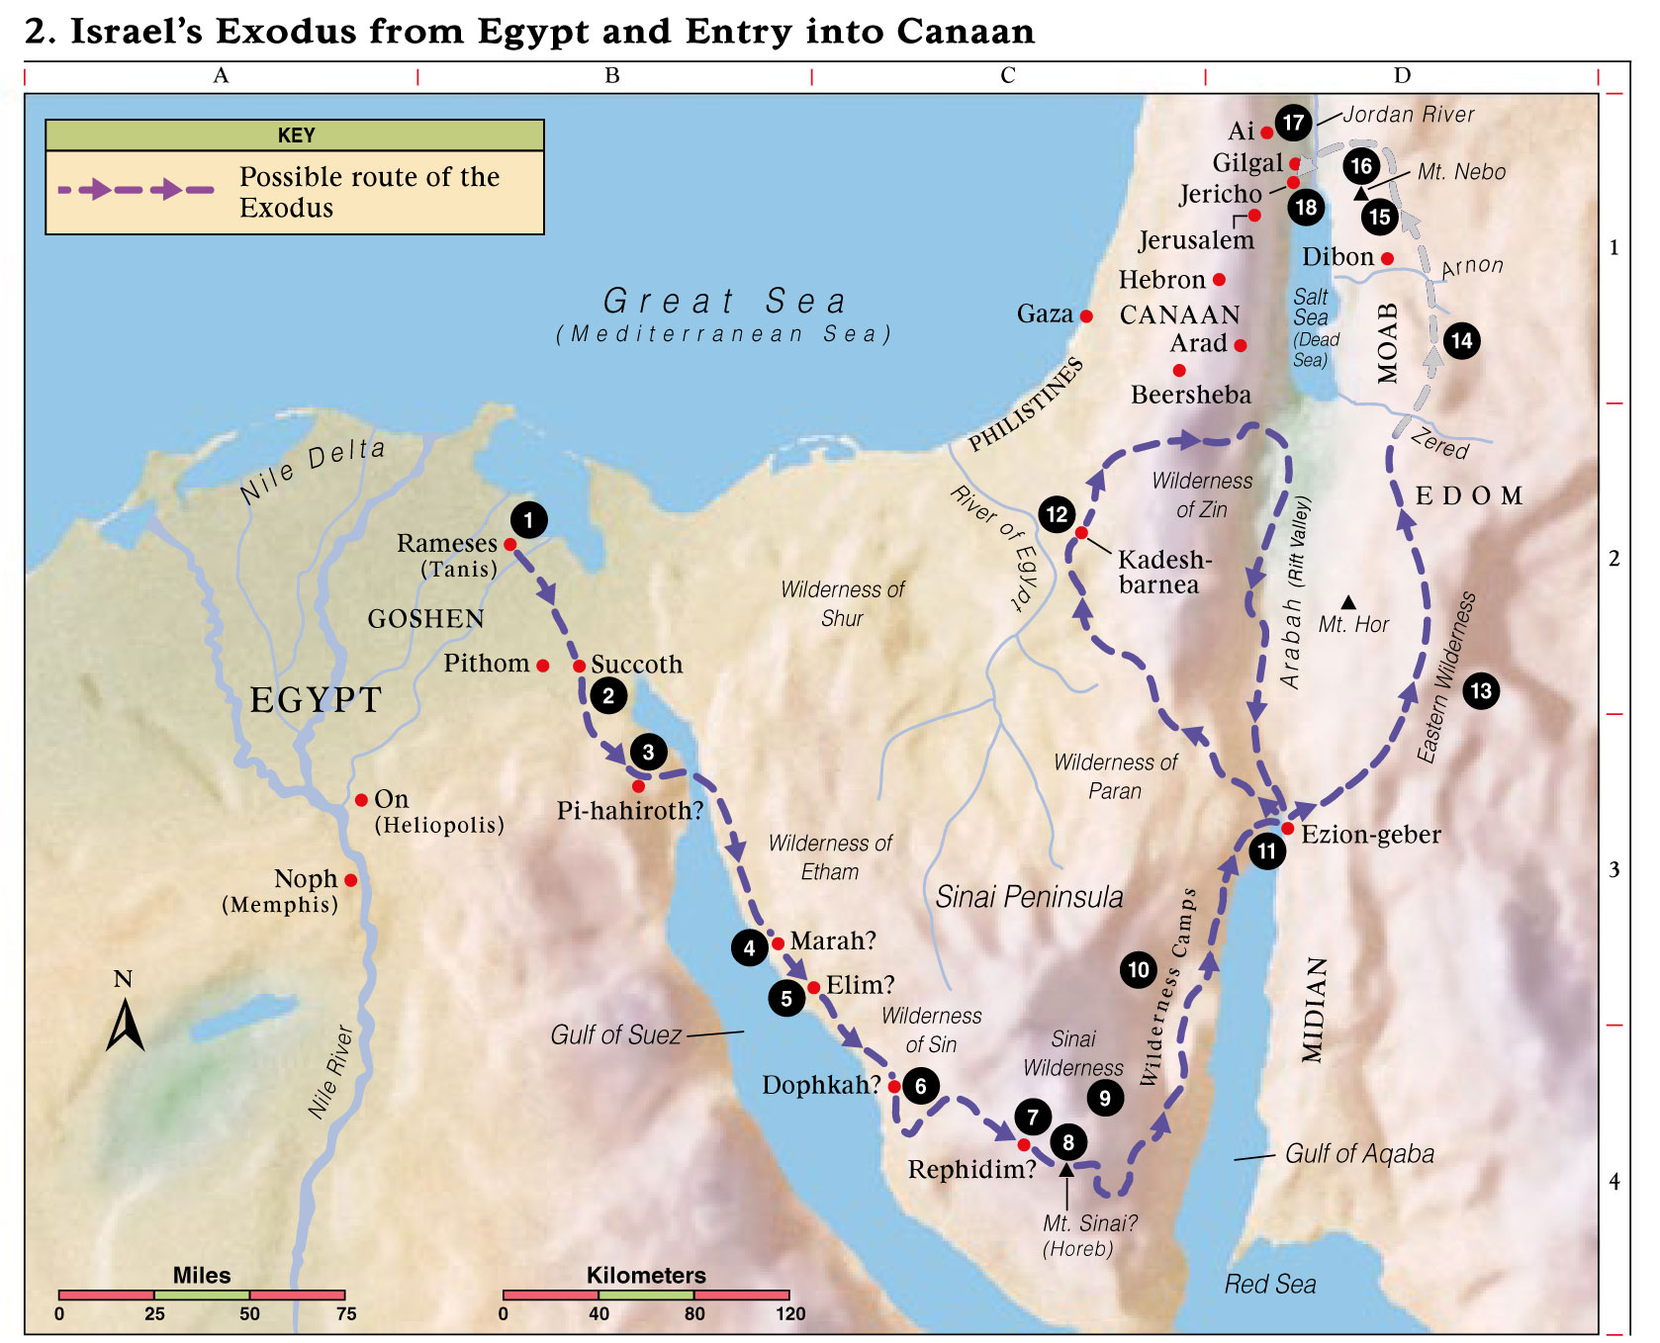
²“And having fasted forty day and forty nights, afterward He was hungry. ³And having come the [one] tempting, he said to Him, ‘If You are [the] Son of God, speak, that these stones, might become loaves of bread.’ ⁴But answering, He said, ‘It has been written: not by bread alone shall man live, but by every word coming out of [the] mouth of God’”
Exodus 16:3
St. Matthew
4:2-4
The Temptation of Our Lord

Slide 9
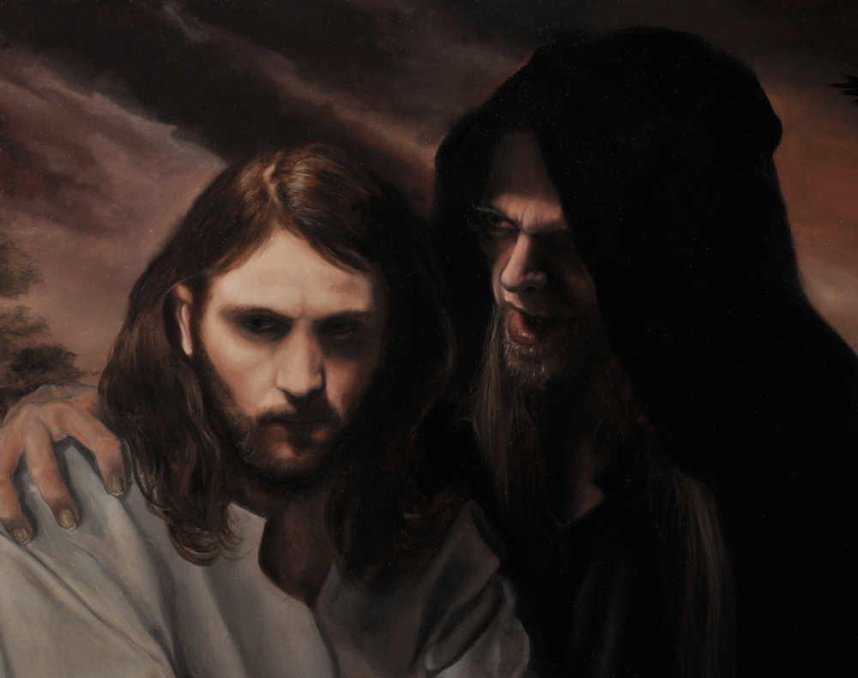
²“And having fasted forty day and forty nights, afterward He was hungry. ³And having come the [one] tempting, he said to Him, ‘If You are [the] Son of God, speak, that these stones, might become loaves of bread.’ ⁴But answering, He said, ‘It has been written: not by bread alone shall man live, but by every word coming out of [the] mouth of God’”
“…to be tempted…”
(peirasqh:nai)
St. Matthew’s use of this passive verb is with a negative force, and Jesus is the target of the temptation!
St. Matthew
4:2-4
The Temptation of Our Lord

Slide 10
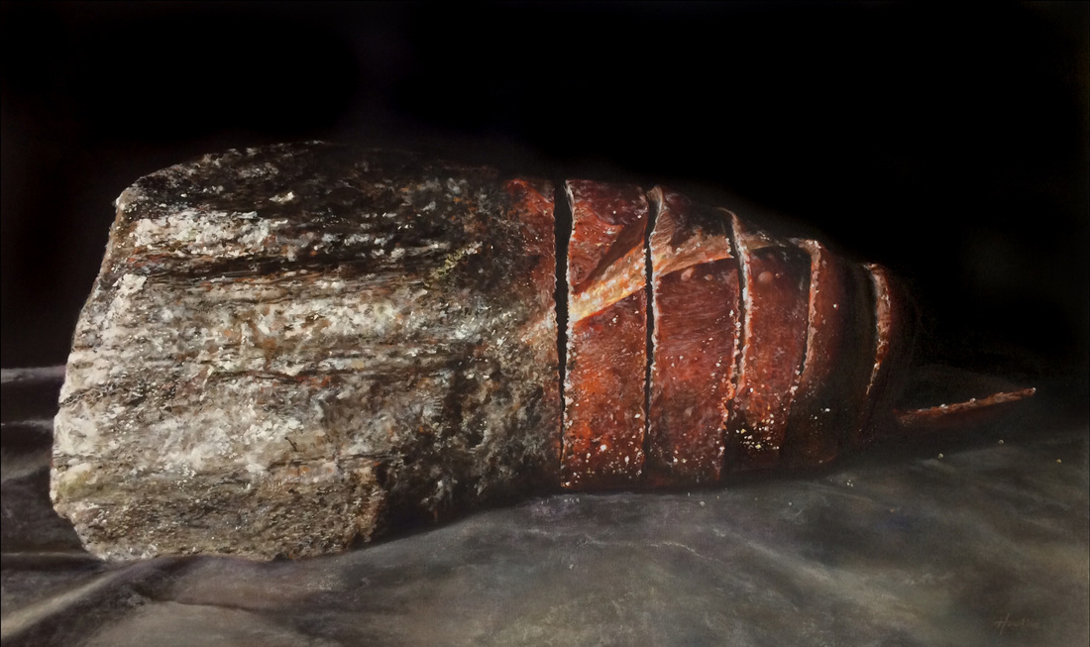
²“And having fasted forty day and forty nights, afterward He was hungry. ³And having come the [one] tempting, he said to Him, ‘If You are [the] Son of God, speak, that these stones, might become loaves of bread.’ ⁴But answering, He said, ‘It has been written: not by bread alone shall man live, but by every word coming out of [the] mouth of God’”
The First Temptation
Note that the devil concedes that Jesus is the Son of God, though he does mock Jesus (and the Father) by saying, “If!” The temptation is that he wants Jesus to be the wrong kind of Son! He wants Jesus to disobey the Father and “grumble” against Him (cf. Dt. 8:3) by changing stones into bread.
A True, Obedient Son…
…or a self-serving, disobedient Son!
St. Matthew
4:2-4
The Temptation of Our Lord

Slide 11
²“And having fasted forty day and forty nights, afterward He was hungry. ³And having come the [one] tempting, he said to Him, ‘If You are [the] Son of God, speak, that these stones, might become loaves of bread.’ ⁴But answering, He said, ‘It has been written: not by bread alone shall man live, but by every word coming out of [the] mouth of God’”
Jesus knows that His Father has already spoken and that He is the Beloved Son. Jesus will not use His Divine power to “grumble” against or reject His Father’s will and purpose, as Israel did in the wilderness!
Jesus overcomes the slanderer, knowing His Father’s will and Word. He is the humble Servant and He now willingly suffers the time of hunger and temptation, obeying His Father!
St. Matthew
4:2-4
The Temptation of Our Lord

Slide 12
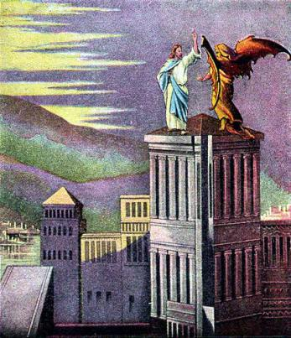
⁵“Then the devil takes Him to the holy city and sets Him upon the pinnacle of the temple, ⁶and says to Him, ‘If You are [the] Son of God, throw Yourself down; for it has been written: to His angels He will give orders concerning You, and in [their] hands will they bear up You, lest ever You strike against a stone Your foot.’ ⁷Jesus said to him, ‘Again it has been written: you shall not test [the] Lord your God.’”
The NT antitype to the OT type is greater and contrasting! Satan cites Ps 91:11-12…in part! Note that he cites God’s Word out of context and omits a key line – “...to keep you in all your ways.”
This Psalm speaks of God’s protection from dangers that approach the righteous; not testing God to see if He will really do what Scriptures promises.
The Second Temptation
St. Matthew
4:5-7
The Temptation of Our Lord

Slide 13
⁵“Then the devil takes Him to the holy city and sets Him upon the pinnacle of the temple, ⁶and says to Him, ‘If You are [the] Son of God, throw Yourself down; for it has been written: to His angels He will give orders concerning You, and in [their] hands will they bear up You, lest ever You strike against a stone Your foot.’ ⁷Jesus said to him, ‘Again it has been written: you shall not test [the] Lord your God.’”
The Second Temptation
Thus, Satan is challenging Jesus to test whether the Word of God is reliable!
“So, Jesus, let’s test the Father and just see if He’ll do what He says!”
St. Matthew
4:5-7
The Temptation of Our Lord

Slide 14
⁵“Then the devil takes Him to the holy city and sets Him upon the pinnacle of the temple, ⁶and says to Him, ‘If You are [the] Son of God, throw Yourself down; for it has been written: to His angels He will give orders concerning You, and in [their] hands will they bear up You, lest ever You strike against a stone Your foot.’ ⁷Jesus said to him, ‘Again it has been written: you shall not test [the] Lord your God.’”
The second temptation, then, differs from the first in that since Jesus is the Son of God, the power of God is available to protect and sustain Jesus! At issue is whether Jesus would trust that promise.
The perfect Son trust perfectly! He will not put His Father to the test!
The Second Temptation
St. Matthew
4:5-7
The Temptation of Our Lord

Slide 15
⁵“Then the devil takes Him to the holy city and sets Him upon the pinnacle of the temple, ⁶and says to Him, ‘If You are [the] Son of God, throw Yourself down; for it has been written: to His angels He will give orders concerning You, and in [their] hands will they bear up You, lest ever You strike against a stone Your foot.’
⁷Jesus said to him, ‘Again it has been written: you shall not test [the] Lord your God.’”
Jesus uses God’s Word from Dt 6:16.
+ Interprets Scripture with Scripture!
+ Jesus does not use His Father’s promise to test Him!
The Second Temptation
St. Matthew
4:5-7
The Temptation of Our Lord

Slide 16
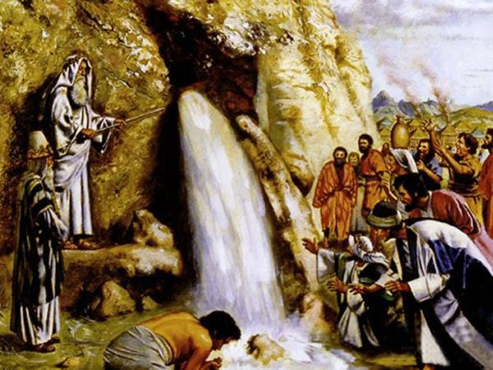
Exodus 17:1-7
St. Matthew
4:5-7
The Temptation of Our Lord

Slide 17
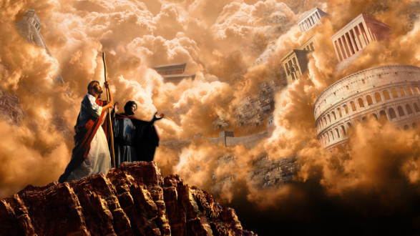
⁸“Again the devil takes Him to an exceedingly high mountain, and shows to Him all the kingdoms of the world and their glory, ⁹and he says to Him, ‘All these things I will give to You, if falling down, You will worship me.’ ¹⁰Then Jesus says to him, ‘Get you away, Satan; for it has been written, [The] Lord your God, you shall worship, and Him alone shall you serve.’”
The third temptation brings to the forefront the key issue in terms of Israel’s relationship with God. God has led His “son” Israel out of bondage in Egypt to worship Him at Mt. Sinai! But Israel did not remain loyal to YHWH! They put other false gods before the Lord’s face (Ex 20:2-3). The golden calf proved Israel’s apostasy…which continued, even in the Promised Land!
The Third Temptation
St. Matthew
4:8-10
The Temptation of Our Lord

Slide 18
⁸“Again the devil takes Him to an exceedingly high mountain, and shows to Him all the kingdoms of the world and their glory, ⁹and he says to Him, ‘All these things I will give to You, if falling down, You will worship me.’ ¹⁰Then Jesus says to him, ‘Get you away, Satan; for it has been written, [The] Lord your God, you shall worship, and Him alone shall you serve.’”
The Third Temptation
To be a “son” and to worship only the Father (YHWH), Israel failed to do! However, Jesus, the Beloved Son, does not fail.
Satan, in a supernatural way, shows to Jesus the glories of earthly kingdoms. He then, vainly, offers them all to Jesus; if only the Beloved Son would fall down before him and worship him!
St. Matthew
4:8-10
The Temptation of Our Lord

Slide 19
⁸“Again the devil takes Him to an exceedingly high mountain, and shows to Him all the kingdoms of the world and their glory, ⁹and he says to Him, ‘All these things I will give to You, if falling down, You will worship me.’ ¹⁰Then Jesus says to him, ‘Get you away, Satan; for it has been written, [The] Lord your God, you shall worship, and Him alone shall you serve.’”
The Third Temptation
Jesus responds with Moses’ words to Israel in Dt. 6:13. Moses spoke these words as Israel was about to enter the Promised Land; yet, they didn’t heed his warning!
So Jesus fulfills what Israel did not! He is about to enter the “land” as He is about to begin His ministry of salvation in and for Israel.
St. Matthew
4:8-10
The Temptation of Our Lord

Slide 20
⁸“Again the devil takes Him to an exceedingly high mountain, and shows to Him all the kingdoms of the world and their glory, ⁹and he says to Him, ‘All these things I will give to You, if falling down, You will worship me.’ ¹⁰Then Jesus says to him, ‘Get you away, Satan; for it has been written, [The] Lord your God, you shall worship, and Him alone shall you serve.’”
The Third Temptation
This last temptation differs from the previous two in a very remarkable way! Satan presumes that the Son will worship and serve…so the devil seeks to turn Jesus aside from wholehearted worship and service to His Father.
Jesus refuses to turn aside. His life and ministry will be a perfect act of worship and service to His Father!
St. Matthew
4:8-10
The Temptation of Our Lord

Slide 21
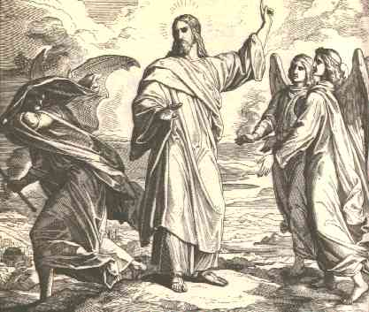
¹¹“Then the devil leaves Him, and behold, angels came and were ministering to Him.’”
Satan departs, he must, he has no power over the Beloved Son. But, he will continue to tempt Jesus in subtle ways, seeking to turn your Lord from His path to Golgotha!
St. Matthew
4:11
The Temptation of Our Lord

Slide 22
¹¹“Then the devil leaves Him, and behold, angels came and were ministering to Him.’”
You should and must be confident, since Your Champion has taken the field! He did not and will not fail; as did Israel. Jesus will win the final victory over the devil.
St. Matthew
4:11
The Temptation of Our Lord

Slide 23
¹¹“Then the devil leaves Him, and behold, angels came and were ministering to Him.’”
It is only after the devil’s temptations are rebuffed do the angels come to Jesus and “minister” (dihkovnoun) unto Him; primarily, in meeting His human need.
St. Matthew
4:11
The Temptation of Our Lord

Slide 24
In Summary
+ Jesus endured the same temptations as you do!
+ Jesus defeated Satan by using…
THE WORD OF GOD!
Ephesians 6:17
James 4:7
St. Matthew
4:1-11
The Temptation of Our Lord

Slide 25
I. The Birth and Early Years of our Lord (Ch. 1-2)
A. Genealogy (1:1-17) (Jan 5)
B. Birth (1:18 – 2:12) (taught during Dec)
C. His Sojourn in Egypt (2:13-23) (taught during Dec)
II. The Lord’s Ministry Begins (3:1 – 4:11)
A. His Forerunner (3:1-12) (Jan 12)
B. His Baptism (3:13-17) (Jan 19)
C. His Temptation (4:1-11) (Jan 26)
III. The Lord’s Ministry in Galilee (4:12 – 14:12)
A. The Beginning of His Galilean Ministry (4:12-25) (2/2)
B. First Discourse: The Sermon on the Mount – Ch 5 (2/9)
C. First Discourse: The Sermon on the Mount – Ch 6 (2/16)
D. First Discourse: The Sermon on the Mount – Ch 7 (2/23)
Our Outline of St. Matthew

Slide 26
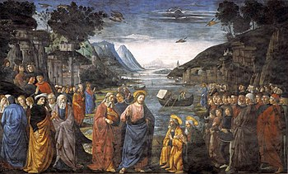
I. The Birth and Early Years of our Lord (Ch. 1-2)
A. Genealogy (1:1-17) (Jan 5)
B. Birth (1:18 – 2:12) (taught during Dec)
C. His Sojourn in Egypt (2:13-23) (taught during Dec)
II. The Lord’s Ministry Begins (3:1 – 4:11)
A. His Forerunner (3:1-12) (Jan 12)
B. His Baptism (3:13-17) (Jan 19)
C. His Temptation (4:1-11) (Jan 26)
III. The Lord’s Ministry in Galilee (4:12 – 14:12)
A. The Beginning of His Galilean Ministry (4:12-25) (2/2)
B. First Discourse: The Sermon on the Mount – Ch 5 (2/9)
C. First Discourse: The Sermon on the Mount – Ch 6 (2/16)
D. First Discourse: The Sermon on the Mount – Ch 7 (2/23)
Next
Week
The Beginning of His Galilean Ministry
St. Matthew 4:12-25

