Slide 1
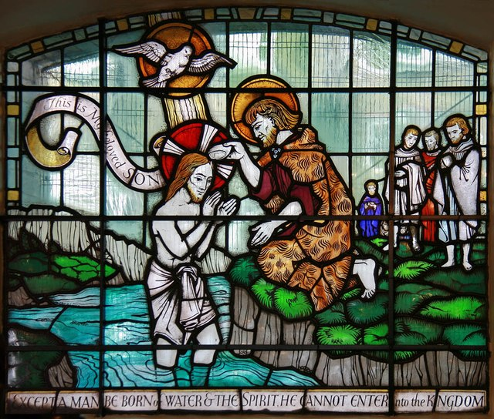
St. Matthew 3:13-17

Slide 2
Introduction
Our Lord’s baptism is very prominent at the beginning of the Synoptics (Mt 3:13-17; Mk 1:9-11; and Lk 3:21-22). Even St. John make a reference to His baptism in 1:29-34!
Each account from the Synoptics is rather brief and here, in Matthew, only five verses. You will notice that Matthew’s depiction is quite orderly: a declaration, an imperative “behold!” Then the opening of the heavens, the descent of the Holy Spirit and then the voice of the Father!

Slide 3
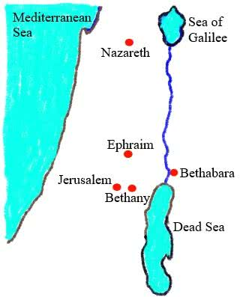
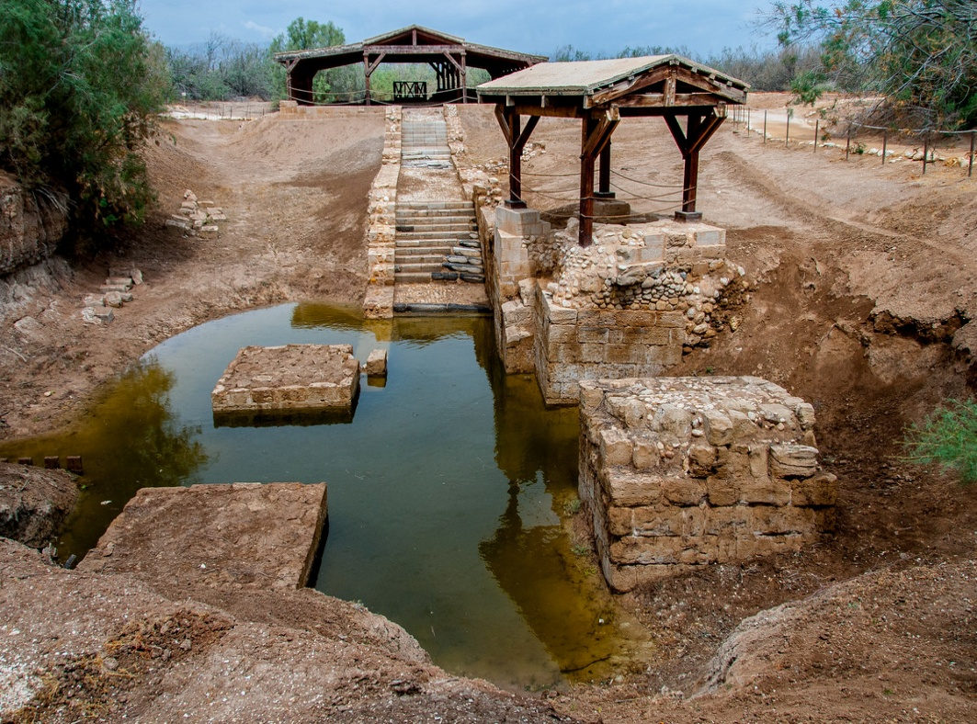
¹³“Then comes Jesus from Galilee to the Jordan, unto John, to be baptized by him. ¹⁴But John was hindering Him, saying, ‘I have need to be baptized by You, and You come to me? ”
Note that St. Matthew begins the Baptism of our Lord by using our Lord’s given name: Jesus! Jesus appears, the One who is “God with us,” who has come to “save His people from their sins” (1:21).
Moreover, Jesus comes to the place where the people are being baptized, to the same man doing the baptizing and for the same purpose “to be baptized by him.”
St. John 1:28

Slide 4
¹³“Then comes Jesus from Galilee to the Jordan, unto John, to be baptized by him. ¹⁴But John was hindering Him, saying, ‘I have need to be baptized by You, and You come to me? ”
However, we heard incredulous words from the baptizer, “John was hindering Him, saying, ‘I have need to be baptized by You, and You come to me? ”
John knew full well the contrast: that between John’s preaching and the intention of Jesus to be baptized by him.

Slide 5
¹³“Then comes Jesus from Galilee to the Jordan, unto John, to be baptized by him. ¹⁴But John was hindering Him, saying, ‘I have need to be baptized by You, and You come to me? ”
John had already proclaimed that the Mightier One would come to baptized with the Holy Spirit and fire (v.11). Yet, now, He has come – not as the One who baptizes, but as a recipient of John’s baptism…for repentance?
Does Jesus need to repent? Does Jesus need to be converted from unbelief to faith? Is Jesus among the lost sheep of Israel? John knows the answers: NO!

Slide 6
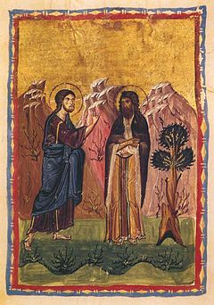
¹³“Then comes Jesus from Galilee to the Jordan, unto John, to be baptized by him. ¹⁴But John was hindering Him, saying, ‘I have need to be baptized by You, and You come to me? ”
The most striking contrast is that John is the voice of the OT prophecy and it is reliable. John is the herald that the Messiah comes in power, bringing His end-times salvation and judgment , and the Messiah is superior to and mightier than himself. John knows that he isn’t worthy to perform this task of baptizing the Messiah!

Slide 7
¹⁵“Answering , however, Jesus said to him, ‘Permit [it] presently, for thus it is fitting for us to fulfill all righteousness.’ Then he permits Him. ^{16a}Having been baptized now, Jesus immediately went up from the water;”
Now we come to the our Lord’s crucial and significant reply to John. Every single word that Jesus speaks is of great importance – to you!
+ “Permit” (a[feV) – indicates that our Lord’s baptism is a concession, an allowance due to His state of humiliation; the sinless Son of God receives the baptism meant for sinners because He shall be the “sin-bearer!”
+ “…fitting…” (prevpon) – a participle that invites a comparison that is answered by the follow phrases on the next slide!

Slide 8
¹⁵“Answering , however, Jesus said to him, ‘Permit [it] presently, for thus it is fitting for us to fulfill all righteousness.’ Then he permits Him. ^{16a}Having been baptized now, Jesus immediately went up from the water;”
+ “…for us…” (hJmi:n) – Matthews uses this dative possessive pronoun in the plural to prevent anyone from thinking of only Jesus’ participation in His baptism; but rather, He includes John.
+ “…to fulfill all righteousness” (plhrw:sai pa:san dikaiosuvnhn) – and this is the key, the heart of the activity that is occurring in the River Jordan. This is being completed by both Jesus and John. However, Matthew uses the “passive” form of “fulfill” (plhrw:sai), which reveals to you why Jesus came to the River Jordan to be baptized by John: “to enact and to participate in the Divine Plan of Salvation!”

Slide 9
¹⁵“Answering , however, Jesus said to him, ‘Permit [it] presently, for thus it is fitting for us to fulfill all righteousness.’ Then he permits Him. ^{16a}Having been baptized now, Jesus immediately went up from the water;”
So let’s put the pieces together!
- Our Lord has come to be baptized by John, to submit to the baptism that sinful Israel is undergoing.
- John objects! Since he knows that Jesus is the One who is the Mighty Savior and Judge – The Messiah!
- Jesus explains that in the present time it is fitting that they together perform the saving deeds of God, now that the end-time reign of God has now broken into history in Himself!
- His fulfilling of all righteousness has begun in an unusual way – baptism of the Humble Suffering Servant!

Slide 10
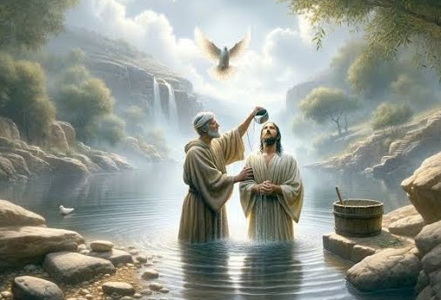
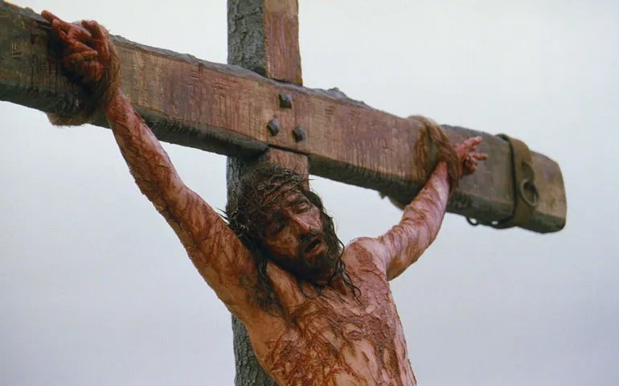
¹⁵“Answering , however, Jesus said to him, ‘Permit [it] presently, for thus it is fitting for us to fulfill all righteousness.’ Then he permits Him. ^{16a}Having been baptized now, Jesus immediately went up from the water;”
So let’s put the pieces together!
- With John’s participation, Jesus will perform “all righteousness,” that is: He will enact God’s saving deeds for the people by standing with sinners, taking the place of sinners, and receiving from John the baptism that sinners receive!
- Ultimately, “all righteousness”
is fulfilled in St. Matthew 26!

Slide 11
¹⁵“Answering , however, Jesus said to him, ‘Permit [it] presently, for thus it is fitting for us to fulfill all righteousness.’ Then he permits Him. ^{16a}Having been baptized now, Jesus immediately went up from the water;”
The first half of verse 16 then explains what occurs after our Lord’s Baptism! Jesus “went up from the water.” This is often used to enforce the idea of the “mode” of baptism. Since Jesus was immersed, all Christians must be baptized in accord with our Lord’s baptism!
+ “went up from the water” (ajnevbh ajpo; tou: u{datoV) – the past tense verb “went up” is very explanatory for us. Literally, it means to “ascend;” to physically go up; or, especially in the spiritual sense, “to ascend to or to draw close to God.” Thus, Jesus now “draws close to God” and is ready to receive from Him…the Holy Spirit and His blessing! Jesus has went up “from” (ajpo) the water.

Slide 12
^{16b}“and, behold, to Him were opened the heavens, and He saw the Spirit of God descending as a dove, and alighting upon Him. ”
The opening of the heavens is a sign…it’s an end-times event! Let’s read Isaiah 64:1-2! This verse boldly proclaims that Jesus is the Servant of God who, in receiving the Holy Spirit, will work and complete the Work of Justification!
Jesus, now with the Holy Spirit upon Him, will preach the Good News to the poor and will comfort all who mourn (Is. 61:1-3; Mt 5:1-12; 11:2-6). This humble, Spirit-endowed eschatological Servant of God, the Messiah, is the One in whose name the Gentiles will hope (Is 42:4; cf. Mt 12:21).

Slide 13
¹⁷“And behold, a voice out of the heavens, saying, ‘This is My Son, the beloved, in whom I was well pleased.’”
Jesus, the Messiah, the Christ, is the Son of God by right of His conception and birth (1:18-25). Yet, Jesus is also the Son of God since He is the summation of God’s entire people…of Israel! Jesus, the Son, embodies the nation and has come in the place of Israel, as the type that underlies the use of Hosea 11:1 in Mt. 2:15, where Matthew so strikingly established!
+ “the beloved” (oJ ajgaphtovV) – this article and adjective modifies the noun “Son” (cf. Gen 22). Thus, Jesus , as God’s Son, will characterize what the Beloved will do by His selflessness and commitment by reflecting the nature of God’s love for all mankind!

Slide 14
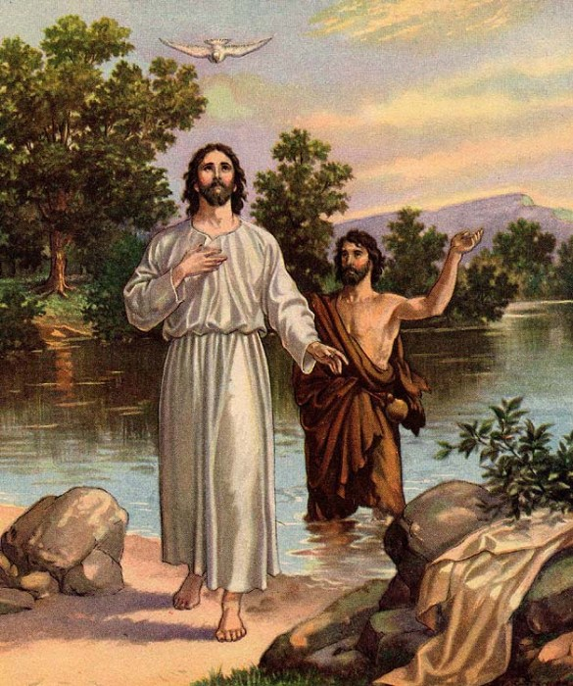
¹⁷“And behold, a voice out of the heavens, saying, ‘This is My Son, the beloved, in whom I was well pleased.’”
In this new, end-times exodus of salvation that God is now inaugurating as His reign is breaking into history, Jesus is God’s Son, the
embodiment of the people, in
their place. He is the Son of God,
both in His person and purpose!
The Father is well-pleased with
His Son for He will suffer and die
in the place of sinners. Then the
Father will reveal His pleasure in
His Son by raising Him from the
dead!

Slide 15
^{Conclusion}
Your Lord Jesus, the Christ, the Son of God, was baptized by John as a sign of the nature and goal of His Messianic Ministry! The Spirit’s descend and the Father’s affirmation of Jesus as the Son of God, confirms that Jesus is the Only Begotten Son, from eternity, and His Suffering Servant! He has come not only for Israel, but also for Gentiles…for you!
So, in light of this, next week, the Spirit leads Jesus into the wilderness to reveal that your Lord’s ministry of perfect, obedient Sonship in the place of Israel (and Adam) means conflict with the great enemy of God (and you), Satan, the tempter!

Slide 16
^{Conclusion}
I. The Birth and Early Years of our Lord (Ch. 1-2)
A. Genealogy (1:1-17) (Jan 5)
B. Birth (1:18 – 2:12) (taught during Dec)
C. His Sojourn in Egypt (2:13-23) (taught during Dec)
II. The Lord’s Ministry Begins (3:1 – 4:11)
A. His Forerunner (3:1-12) (Jan 12)
B. His Baptism (3:13-17) (Jan 19)
C. His Temptation (4:1-11) (Jan 26)
III. The Lord’s Ministry in Galilee (4:12 – 14:12)
A. The Beginning of His Galilean Ministry (4:12-25) (Feb 2)
B. First Discourse: The Sermon on the Mount – Ch 5 (Feb 9)
C. First Discourse: The Sermon on the Mount – Ch 6 (Feb 16)
D. First Discourse: The Sermon on the Mount – Ch 7 (Feb 23)

Slide 17
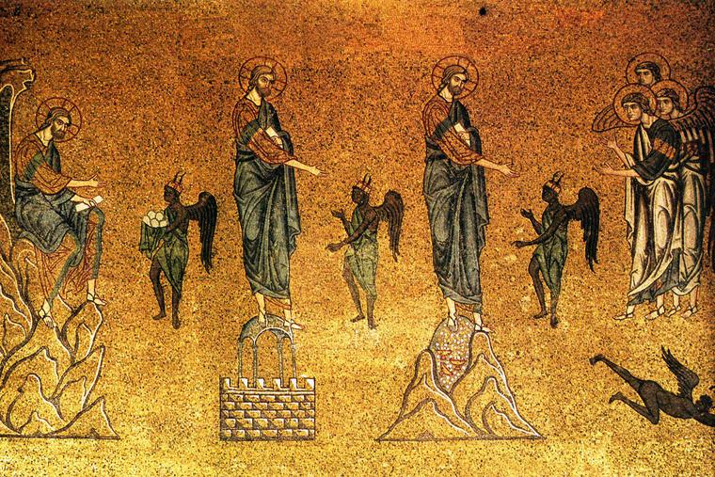
St. Matthew
4:1-11
Next Week
The Temptation of Our Lord

