Slide 1
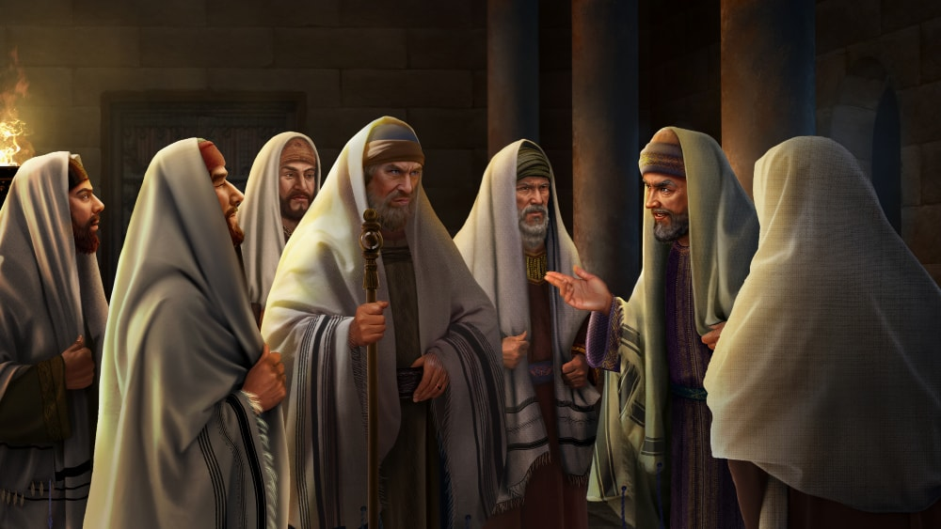
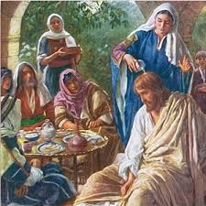
Introduction to the Passion Narrative
St. Matthew 26:2-5
The Passion of our Lord, Part I:
Our Lord’s Anointing
at Bethany
St. Matthew 26:6-13

Slide 2
Our Lord’s teaching ministry has now ended! Now He will bring to fulfillment that to which He was sent [The Plan of Salvation], which stretches back to Gen. 3:15. Yes, His great discourses in St. Matthew have ended; yet, Jesus will continue to speak equally important words even in the midst of His betrayal, suffering, and death!
Nevertheless, our Lord’s voice will diminish as He will cry out in forsakenness (27:46); and then with His last, great, faithful shout (27:50)!
The beginning of this section (v.2) turns your attention back to His unfinished business. As He and His disciples are traveling from the Mt. of Olives to Bethany, Jesus tells His disciples, again, what will soon take place.
Introduction

Slide 3
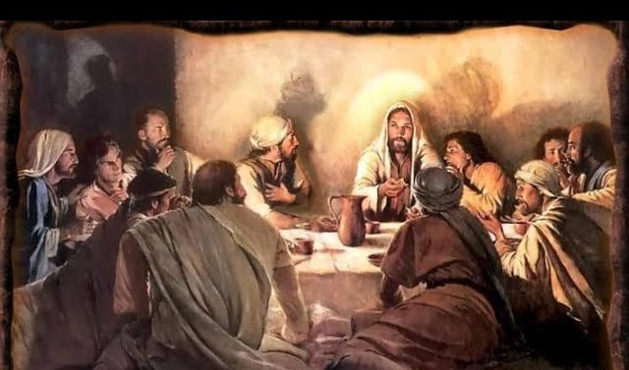
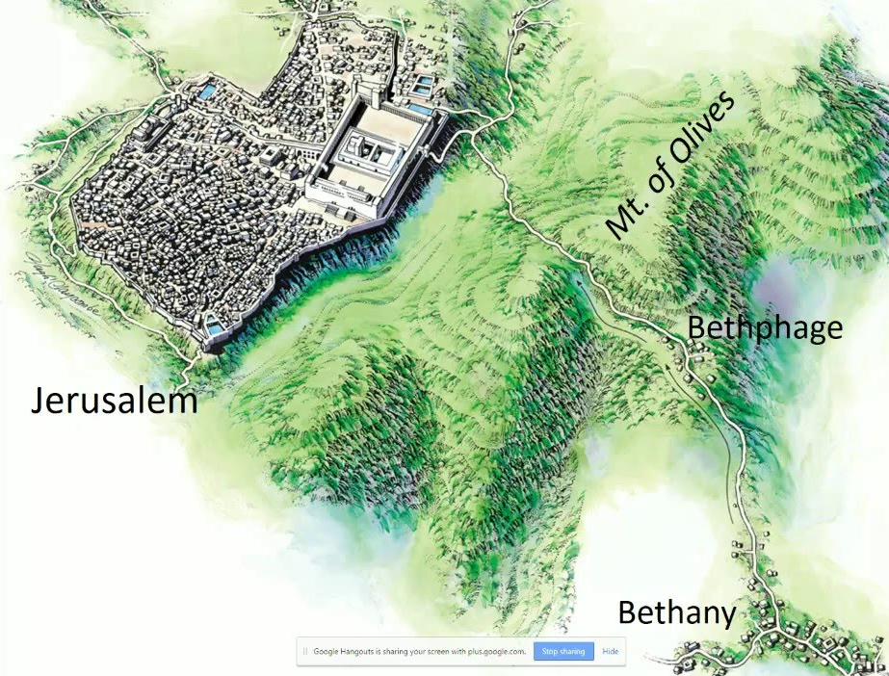
Within two days, the day of the
Passover sacrifice and meal will
occur; yet, there’s so much more!
Jesus will be betrayed and handed
over just as He has prophesied. Now
the disciples should know – well, at least they have heard – what will happen during Passover.
St. Matthew does not clearly reveal where Jesus spoke v.2 to His disciples. Though, in the next section (6-13), we do know that He and His disciples are in Bethany. In reality, it’s a short walk from the Mt. of Olives to Bethany. So whether on the mount or on the road to Bethany, again the disciples hear… but do not comprehend!

Slide 4
Verse 3 begins with an important, though small word tovte, which means “at that time!” Matthew uses this word to gain attention and it signals a change of focus. Jesus has just related what’s about to happen in Jerusalem; though, now, Matthew takes us to those who oppose Jesus and their planning and plotting. It should be clear from the text that Matthew doesn’t give insight into the emotions or thoughts of the plotters; however, it is fair to surmise that they were convinced of the “rightness” of their planning and their ability to carry out their plan!
Introduction to the Passion (vv.2-5)

Slide 5
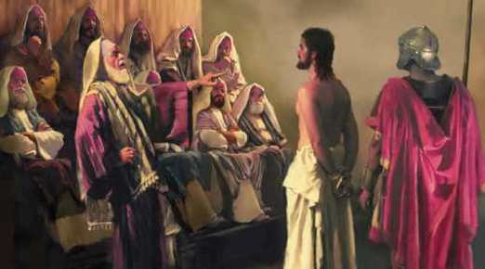
Even so, there is another plan, that of our Lord Jesus, who has already made three predictions of His rejection, suffering, death, and resurrection! Now Jesus names the very day that He will be betrayed and handed over! It may not seem to be fact, yet in a strange and vulnerable way, Matthew is relating that Jesus is in control! What is about to occur is necessary in order to complete God’s plan of salvation.
Under the Lord’s overarching Divine Plan, the plot of the chief priests and elders will take place; all the while, however, their unbelief will prevent them from seeing what is truly happening!
Introduction to the Passion (vv.2-5)

Slide 6
It’s ironic that the Jewish leaders did not want Jesus arrested during Passover or the Feast of Unleavened Bread (seven days that followed Passover)! Why?
They wanted to avoid a riot, which explains, in part, why they acted in deceit. They are truly unsure and even fearful of the pilgrims in Jerusalem and what may happen, since many of them held Jesus in high regard.
The events will transpire, though, just as Jesus predicted. We do see that God’s plan could not be frustrated; even the fact that Pilate was in Jerusalem gives insight in how God was in control!
Introduction to the Passion (vv.2-5)

Slide 7
Our Lord’s Anointing
at Bethany
(vv.6-13)

Slide 8
The structure of this section may be divided into three distinct sections. The central proclamation is the contrast between the disciples’ continued ignorance and our Lord’s steadfast focus on the ultimate goal of His ministry: The Cross!
First: this unit begins by establishing a physical setting and briefly describing a beautiful action by an unnamed woman (vv.6-7);
Second: the beginning of the contrast emerges in the disciples’ angry reaction to the woman’s action. Their rather spiteful words illustrate that they lack any awareness of what is about to transpire to their Lord (vv.8-9);
Third: Our Lord’s words occupy the remainder of this unit (vv.10-13) as He rebukes His disciples (10a-b); explains why He does so (10c), and furthers grounds His rebuke by highlighting His coming sufferings (11) by showing how the woman’s act reveals why they will not always have Him (12). The final “Amen” statement “truly” (13) returns to the woman’s act, affirming that all will remember her everywhere when this Gospel is preached!

Slide 9
Establishing the physical setting and briefly describing a beautiful action by an unnamed woman (vv.6-7)
St. Matthew is clear that Jesus is in Bethany at the home of a (healed, and maybe Jesus was his healer) leper named Simon. Note that Matthew also does not reveal the name of the woman. These two people are not the focus of Matthew’s narrative; rather, His focus is on the ignorance of His disciples!
The woman is following an ancient Jewish custom of offering a guest oil for one’s head as a gesture of welcome! Yet, the disciples focus on the costliness of the oil and not her gift to Jesus. St. Luke describes a like anointing (7:36-50) that shows the great love that another woman had for Jesus. It’s sad that her loving action, results in an angry response by our Lord’s disciples that will be discussed next.

Slide 10
Angry and Clueless: The Disciple’s Pitiful Response to their Lord’s Anointing (vv.8-9)
It truly seems out of character for the disciples to response in such anger; although, they acted this way before! They reacted in like fashion toward James and John at Salome’s request that her sons have a place of honor in glory with Jesus (20:20-24).
They were equally indignant at this woman’s loving welcome to Jesus; but why?
The disciples, sinners like all men, were thinking in purely human terms of ordinary life; rather, than in terms of the unique event that they had just witnessed. It seems that they have completely forgotten about what Jesus has been telling them, and told them again in the preceding section (v.2). Sadly, they were acting as fools as the truth is being communicated by the actions of this loving woman! This leads Jesus to strongly rebuke them and to give them a beautiful explanation in the final section.

Slide 11
Preparing His Body for Burial; Even Before His Death! Our Lord’s Interpretation (vv.10-13)
Note how St. Matthew frames this section as he begins by saying that Jesus “having known” (gnouvV) (10a) and therefore, rebukes in the form of a strongly worded question, “Why are you giving trouble to this woman?” [10b]
First, Jesus “having known” (gnouvV) eliminates that Jesus heard or saw their muttering or actions. Rather, Jesus “having known” (gnouvV) their hearts, which betrayed them and revealed their anger toward this woman. It’s very unlikely that they were shouting at her, especially with Jesus present, since the use of gnouvV would then be improper! Though they may have been grumbling; they were shouting from their sinful, human fallen hearts!
So Jesus counters their anger by first explaining that they must not trouble her, “For she worked a beautiful thing for Me.” [10c] What she is doing is not an utter waste…but a beautiful work of love!

Slide 12
Preparing His Body for Burial; Even Before His Death! Our Lord’s Interpretation (vv.10-13)
Jesus continues by explaining that “…you will always have the poor with yourselves.” [11a] Again, the disciples are thinking in human terms and assuming that a better motive would be to sell the oil and give the money to the poor. What they fail to realize is that they are not living in a normal time. Soon the Passover will come and their Lord’s prophecies will be fulfilled. They are missing the significance of the time, so Jesus tells them, “But you will not always have Me.” [11b]
Jesus explains in v.12 the true importance of this woman’s action! Her act is true to the time and even ahead of time! The Jewish custom was to anoint a dead body prior to burial (cf. St. John 19:40); yet, not before the person has died! Even now, she has anointed her Lord for burial; the future has reached back into the present moment!

Slide 13
Preparing His Body for Burial; Even Before His Death! Our Lord’s Interpretation (vv.10-13)
We must always realize that God’s way does not depend on us, or in this case, the disciples! Despite their ignorance and foolishness, this loving action of an unnamed woman reveals a deeper reality of what Jesus is on this way to do for her, His disciples, for you, and for all mankind!
Therefore, whenever and wherever the Good News is proclaimed, the action of this woman
will always be remembered (v.13)!
As a matter of fact, you and I today have
just remembered her, just as our Lord
Jesus said. Thanks be to Jesus!

Slide 14
…but the righteous into eternal life’”
Next week’s Bible Class will begin Part II of our Lord’s Passion Narrative!
F. Our Lord’s Passion: His Arrest, Trials, and Death (26:14 – 27:66)
1. Prelude to Betrayal (26:14-16) (Nov 9)
2. The Last Supper (26:17-29) (Nov 9)
3. Gethsemane (26:30-56)(Nov 16)
4. Jesus before Caiaphas (Illegal Sanhedrin Trial) (26:57-68) (Nov 23)
a. Peter’s Three Denials (69-75) (Nov 23)
5. Jesus before Pilate (27:1-26) (Nov 30)
6. The Crucifixion of Our Lord Jesus (27:27-44) (Nov 30)

Slide 15
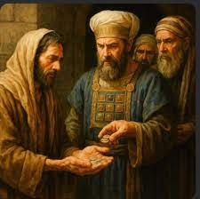
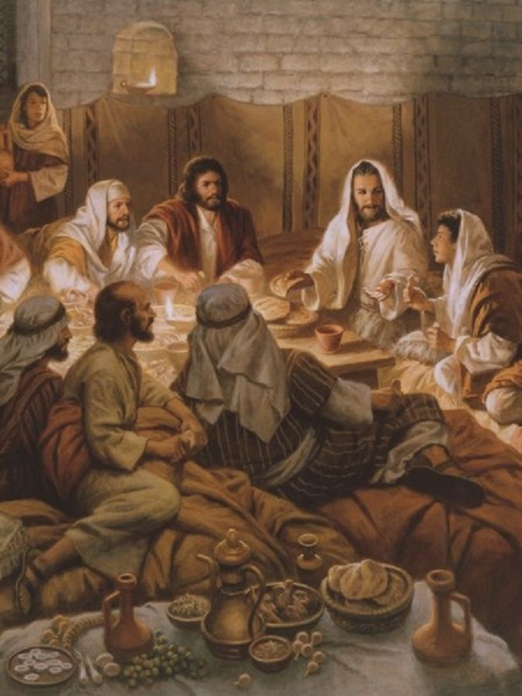
The Passion of our Lord, Part II
Prelude to Betrayal
St. Matthew 26:14-16
The Last Supper
St. Matthew 26:17-29

