Slide 1
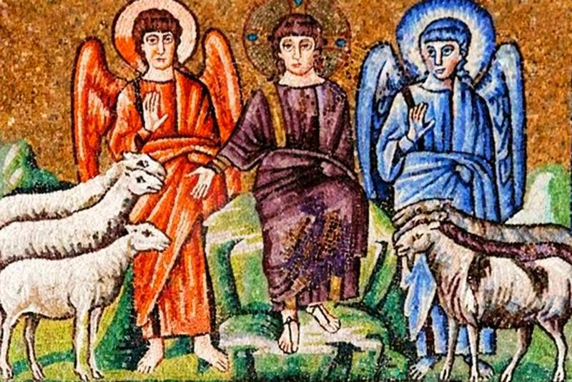
THE Great Judgment
Matthew 25:31- 26:1

Slide 2
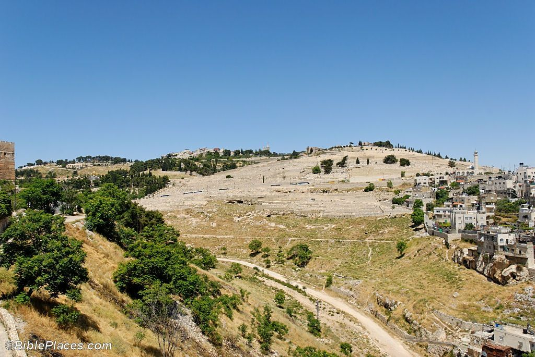
It’s Tuesday of Holy Week, probably the busiest day of Jesus’ life. On Tuesday evening, Jesus and His disciples went out to the Mount of Olives where Jesus delivered His Great Eschatological Discourse found in St. Matthew 24 and 25; St. Mark 13:3-37; and St. Luke 21:8-36.
Our text this morning is one of the most widely known sections of the NT. It is the conclusion of our Lord’s Great Eschatological Discourse!

Slide 3
Sadly, in the 20th and 21st centuries this section has been interpreted incorrectly! The dominate thought is that this section has a “social-ministry” understanding. Thus, this text is or should function as an exhortation to pastors in how they are to minister to the poor and needy wherever they may find them.
This has not been the dominate understanding of this text throughout the centuries! Your pastor is about to argue that this “social-ministry” understanding is false and cannot stand when this text is proper exegeted!

Slide 4
First of all, though you’ve been told for years that this text is a parable of our Lord Jesus; in reality it is NOT a parable! Jesus is telling His disciples, then and today, a direct teaching concerning real events at will occur at the consummation of the age! Thus, you should hear His teaching today and know that what Jesus is telling you will happen!

Slide 5
So, what about the “social- ministry” interpretation and why is it false teaching? The following three comments with Scriptural support will reveal to you the truth of our Lord’s teaching:
1. Jesus never identified Himself with needy people in general or refers to them as His brothers. St. Matthew 12:46-50, especially our Lord’s words in vv.49-50, is not referring to the needy, but to His disciples (His followers) as brothers. Thus, every reference to “brother” (ajdelfovV) in St. Matthew refers to a disciple of Jesus.

Slide 6
2. Jesus never commands His disciples (or anyone) to care for the needy; there is no Scriptural support anywhere in St. Matthew! Certainly, to love one’s neighbor as oneself can apply to caring for anyone in need whom you may meet. However, the notion that the central manifestation of Christian duty and love is to provide for the physical needs of the world (which includes unbelievers) is not found in either testaments!

Slide 7
3. The key word, as you’ll see very soon, is the word “brothers!” This is central, since Jesus is defining His familial relationship that He has established is through faith; rather than human biology! Again, you’ll clearly see in a moment that Jesus is redefining His family in terms of faith (cf. St. Matthew 12:49-50; 28:10; 5:22-24, 47; 7:3-5; 18:15, 21, 35; and especially 23:8)!

Slide 8
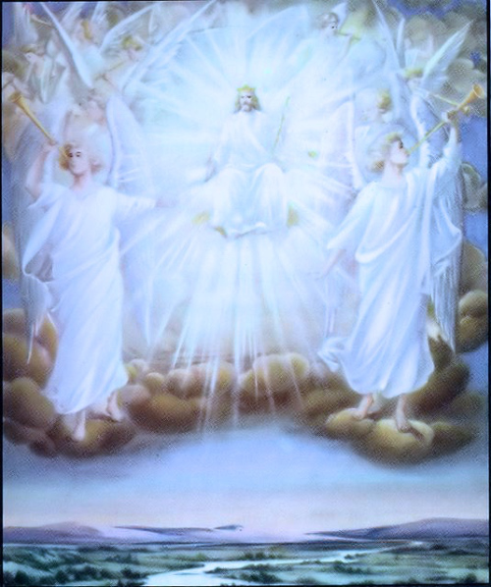
³¹“And when the Son of Man comes in His glory and all angels [come] with Him, at that time He will sit on His glorious throne.”
The only element unknown to us is the day and hour!

Slide 9
ONE MORE PROMISE TO KEEP!
The last sentence of the Apostles’ Creed is the final promise:
“He shall come again to judge the quick and the dead.”

Slide 10

³²“And all the nations will be gathered before Him, and He will separate them from one another, just as [the] shepherd separates sheep from goats.”
“…will be gathered…” (sunacqhvsontai) is a future passive, 3rd person plural verb.
+ The righteous will have no fear!
+ The unrighteous will have no choice!
It’s one meeting from which no human being will be absent!!!

Slide 11
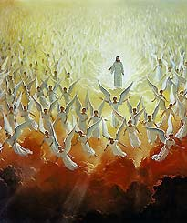
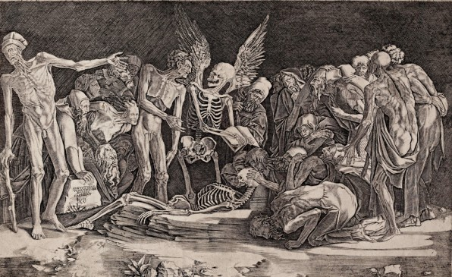
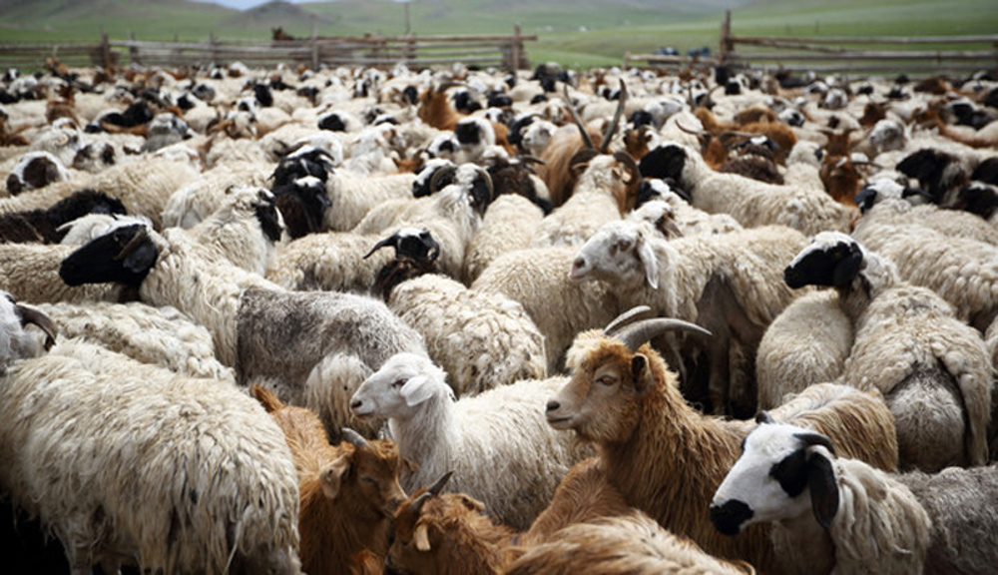
All the holy angels and all human beings gathered into one place!
But no mention is made of the presence of the devil or the demons (cf. Rev. 20:10)
In this life sheep and goats are intermingled. Yet on Judgment Day, sheep and goats will be separated
once and forever.
A great comfort!

Slide 12
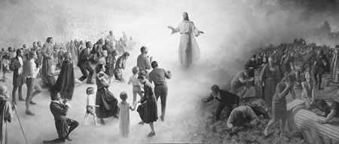
³³“And He will stand, on one hand, the sheep on His right and, on the other hand, the goats on [His] left.”

Slide 13
Sheep represent the righteous
and goats the unrighteous

Slide 14
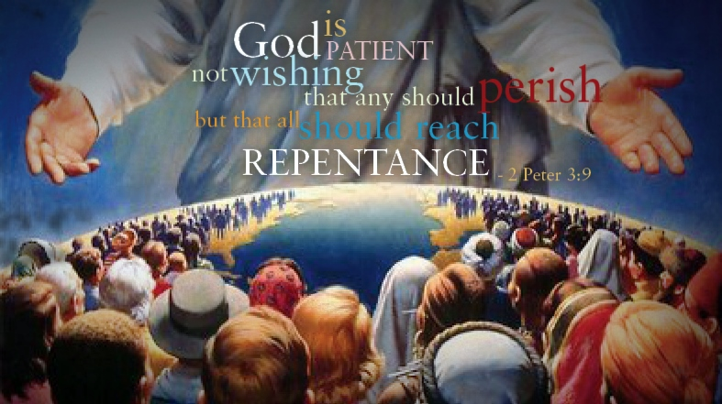
It’s a persistent truth
throughout Holy Scripture that God seriously desires the salvation of all men.

Slide 15
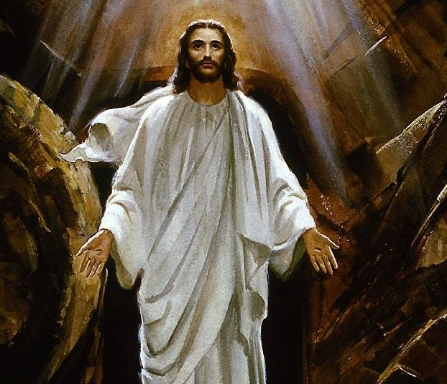
He is a God of life, not of death! Yet, if men reject salvation, His Divine Justice requires adverse judgment.

Slide 16
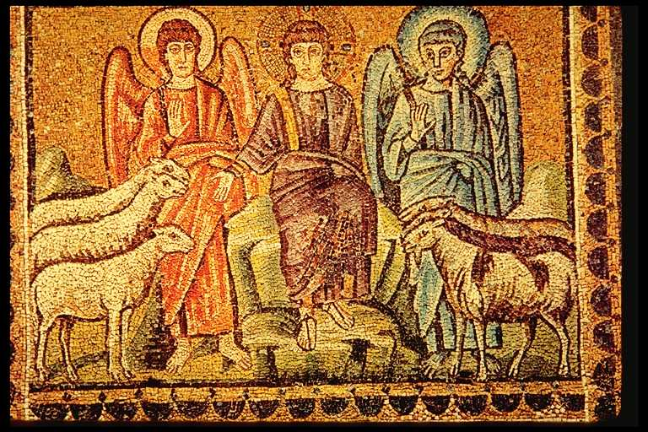
”His right hand” denotes His saving will, ”the left” denotes His just judgment. Notice ”His” with the right hand, and ”the” with the left. This distinction is found in the Greek text! By the way, the Great Last Day will involve only judgment, there is NO trial!

Slide 17
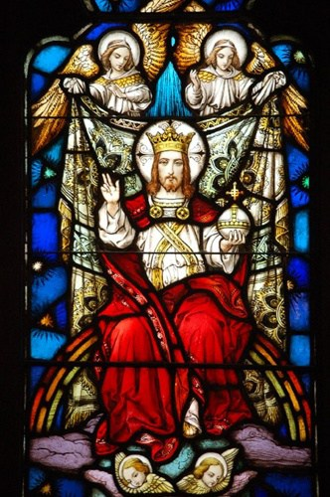
³⁴“Then The King will say to the people on His right, ‘Come, blessed by my Father, inherit the reign prepared for you from the founding of the world.’”
It will be most orderly and plain for all to hear. The Son of Man is called “The King.” In this life only the regenerate willingly regarded Him as The King. But on that great day ALL will see and hear Him as The King.

Slide 18
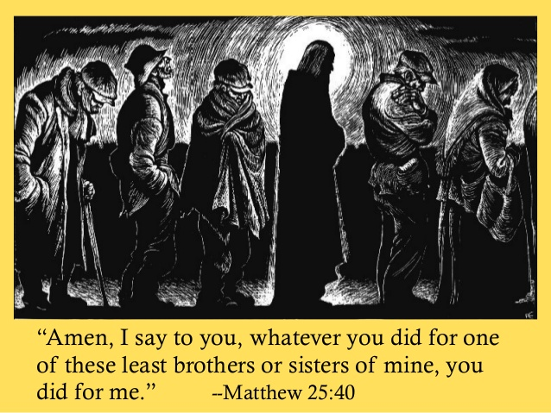
Let’s read vv. 35-40
The works of the blessed were evidence of belonging to Christ.
+ The deeds in verses 35-36 begin with a form “to give.”
+ They were truly godly.
+ Christian love causes giving (service).
+ Christian service is done for God’s glory alone.
Note “me” in the text is clearly referring to Jesus.
+ Jesus is the recipient six times
Three times the righteous say “when?”
+ Christians don’t dwell on their
deeds of love.
+ The Christian’s whole life is
summed up in “…faith which
works through love,” Gal. 5:6.

Slide 19
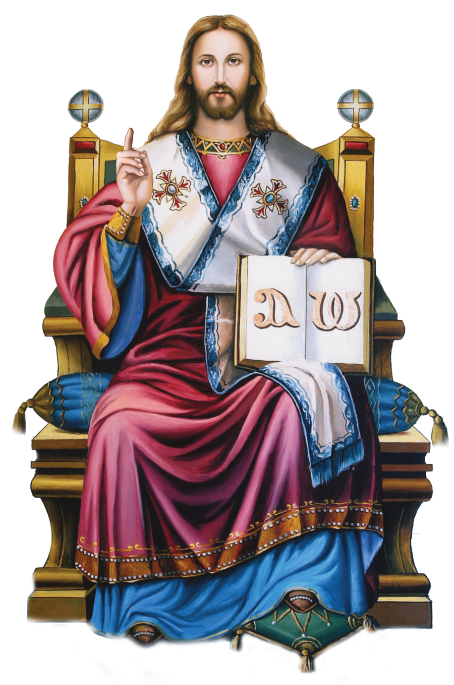
The King replies in v.40:
‘Truly I say to you, as much as you did [it] for one of these least brothers of mine, you did [it] for Me.’
Jesus is called “The King” only when He addresses those who are called the blessed, the heirs, the righteous, His BROTHERS!

Slide 20
“Then he will say to those on his left, 'Depart from me, you who are cursed, into the eternal fire prepared for the devil and his angels. For I was hungry and you gave me nothing to eat, I was thirsty and you gave me nothing to drink, I was a stranger and you did not invite me in, I needed clothes and you did not clothe me, I was sick and in prison and you did not look after me’” (vv. 41-43).
Do you notice an important point?
+ They will not be left without witness, but the
word "King" does not appear!
+ Every tongue will confess that He is Lord, but He
does not regard Himself as The King of
unbelievers.

Slide 21
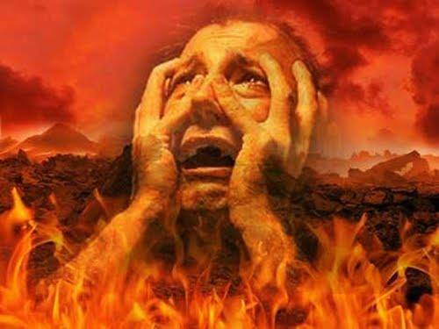
Though condemned, they call Him “Lord.” The only thing which the blessed and the cursed will have in common is the address “Lord.” But Jesus is not called their King!
The condemned ask “when?” only once, in a spirit of reprimand, reproach, and accusation. Many theologians agree, the unrighteous attempt to place the blame on Jesus! They are defiant, even when the Truth is revealed to them!

Slide 22
^{45 ‘}Truly, I say to you, as much as you did not do it for one of these least, neither did you do it for Me.’
Compare Jesus’ answer here and in verse 40: He does not call Himself their King, since He isn’t their King, neither are they His brothers, nor heirs of His Kingdom!
Note the double negatives which are correlative ”not-neither!”
This time Jesus does not say ”my brothers.”

Slide 23
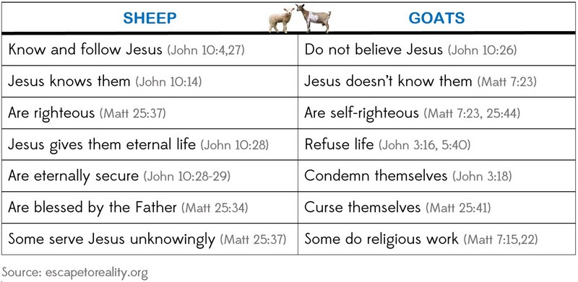
‘And these will depart to eternal torment…,

Slide 24
…but the righteous into eternal life’”

Slide 25
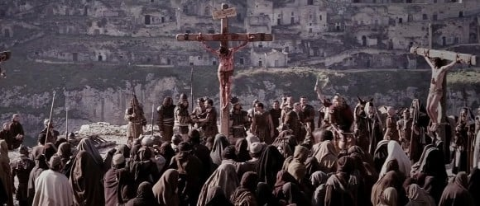
…but the righteous into eternal life’”
26:1 “And when Jesus completed all these words, He said to His disciples…,
This verse is a transitional verse, that ends our Lord’s Great Eschatological Discourse, the Fifth Discourse, and is also the beginning of His Passion Narrative (26:2 – 27:66). Note how St. Matthew submits his transitional verse…it’s extremely abrupt. Thus, the great stretches of teaching by your Lord Jesus has ended. Now His great deeds, to which His ministry have been directed, will ensue!

Slide 26
…but the righteous into eternal life’”
Our next Bible Class together will begin our Lord’s Passion Narrative and here’s our outline through November!
E. The Passion of Our Lord Begins (26:2-13)
1. Jesus Speaks of His Death for the Final Time (26:2-5) (Nov2)
2. His Anointing at Simon the Leper’s Home (26:6-13) (Nov 2)
F. Our Lord’s Passion: His Arrest, Trials, and Death (26:14 – 27:66)
1. Prelude to Betrayal (26:14-16) (Nov 9)
2. The Last Supper (26:17-29) (Nov 9)
3. Gethsemane (26:30-56)(Nov 16)
4. Jesus before Caiaphas (Illegal Sanhedrin Trial) (26:57-68) (Nov 23)
a. Peter’s Three Denials (69-75) (Nov 23)
5. Jesus before Pilate (27:1-26) (Nov 30)
6. The Crucifixion of Our Lord Jesus (27:27-44) (Nov 30)

Slide 27
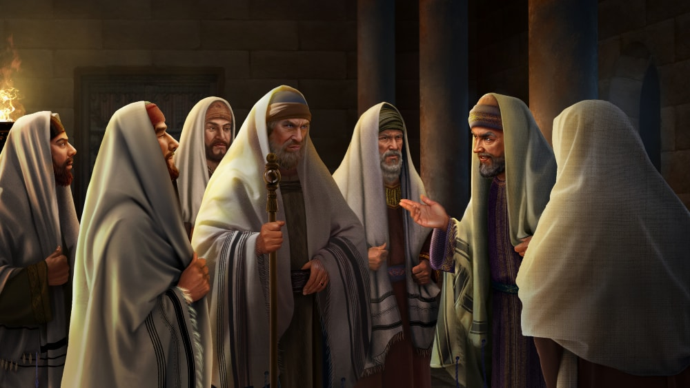
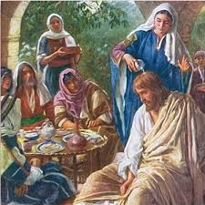
…but the righteous into eternal life’”
Introduction to the Passion Narrative
St. Matthew 26:2-5
The Passion of Our Lord, Part I:
Our Lord’s Anointing
at Bethany
St. Matthew 26:6-13

