Slide 1
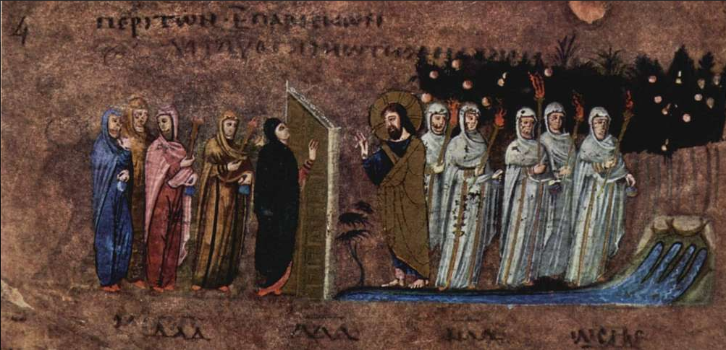
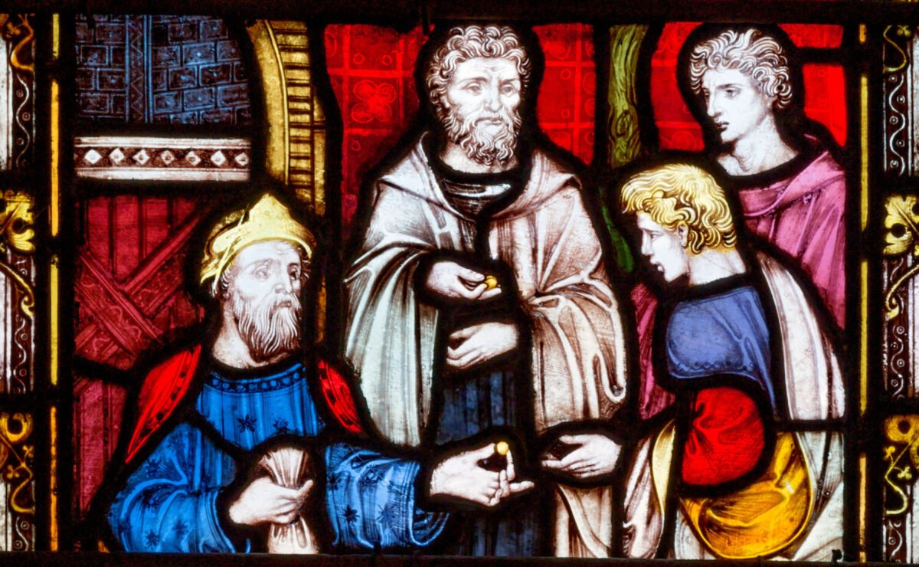
The Parable of the Ten Virgins
The Parable of the Talents
&
St. Matthew 25:1-13
St. Matthew 25:14-30

Slide 2
The Parable of the Ten Virgins
St. Matthew 25:1-13

Slide 3
IT’S VERY IMPORTANT THAT YOU KNOW THE IMPORTANCE OF THE
JEWISH WEDDING!
The Betrothal
The Preparation by the Bridegroom
3. The Return of the Bridegroom
THE JEWISH WEDDING

Slide 4
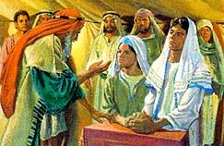
The Betrothal was the religious ceremony that legally bound the couple together as husband and wife.
The Betrothal

Slide 5
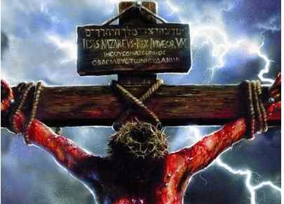
The Groom then gives the purchase price for his Bride; then they are be bound together, forever!
The Betrothal

Slide 6
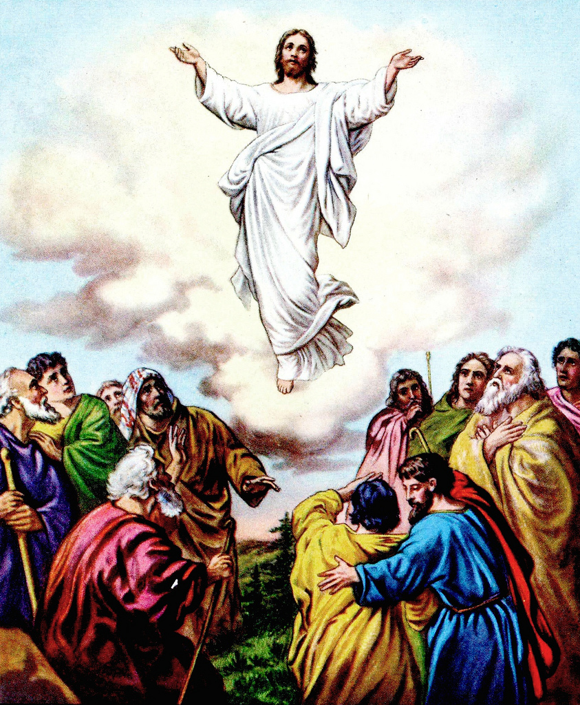
The Bridegroom then returns to his father’s home to prepare an addition or room for his new Bride; he may return weeks, a month, or a year later!
Let’s read John 14:1-3
The Preparation

Slide 7
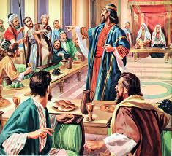
As the Bridegroom is making His preparations, the Father is supervising the preparations for the Wedding Feast, which is to last 7 days!
The Return

Slide 8
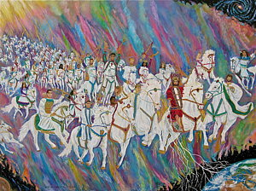
When ALL preparations are completed and with the Father’s approval ; the Bridegroom sends word that He’s returning for His Bride!
The Return

Slide 9
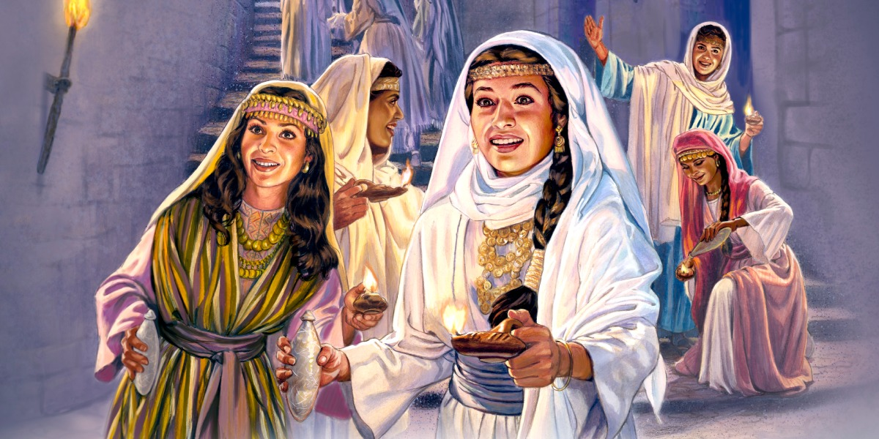
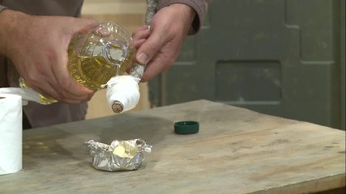
lampavdaV
So our Lord has sent WORD that He is returning…so the Bride and all her attendants must be ready! So…her attendants, take their torches, their oil, and anxiously await the Bridegroom.
The Parable

Slide 10
It’s very easy to see why five of the Bridesmaids were foolish!
- Though they looked like the five wise Bridesmaids…
- They were actually foolish…why?
      No fuel…they were not prepared!
Verses 2-4

Slide 11
They are foolish thinking they
were ready, but are not!
+ They believed for awhile, but fall away!
+ They are lukewarm…only attending
Divine Service for show or out of habit!
+ They refuse to make use of the Means of Grace!
Verses 2-4

Slide 12
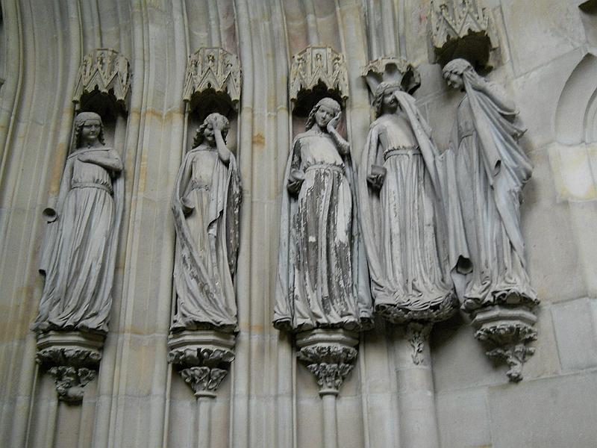
+ They neglect reading God’s Word!
+ They neglect Bible classes!
In short, they neglected the “resupply” necessary…forgiveness/cleansing.
The sad, sad result…
Verses 2-4

Slide 13
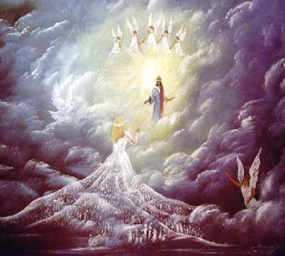
The Bridegroom delays…(cf. 24:48)
…yet He has promised…
The Lord (Divine Bridegroom) will return!
+ Let’s read 1 Thess. 4:16-17
Verses 5-7

Slide 14
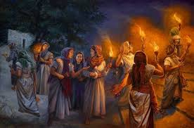
The Bridegroom returns…
…and the foolish realize they are not ready!
Verses 5-7

Slide 15
The wise cannot share…
…since each one is given their own faith!
Verses 8-9

Slide 16
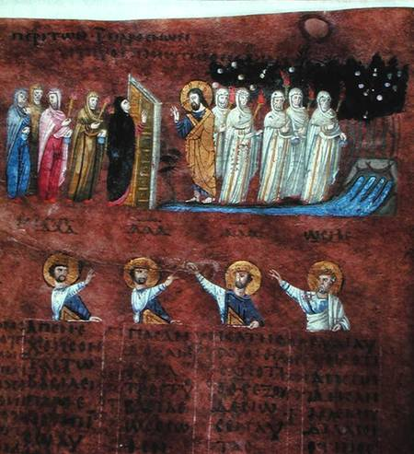
While the foolish are left out in the darkness…
…the wise enter into the Wedding Feast!
Verses 10-12

Slide 17
To be welcomed…
to be known by your Lord is a great comfort
(cf. 2 Peter 1:10-11)!
Verses 10-12

Slide 18
But for Jesus to say that He doesn’t know you…reveals not only your foolishness, but terrible doom!
Verses 10-12

Slide 19
Therefore, WATCH! (cf. 24:42)
+ grhgorei:te - 2nd person plural, present imperative verb.
- Right now, you all must be prepared, watching, ready, vigilant!
We close by reading Hebrews 4:9-11
Verse 13

Slide 20
Jesus will now tell another parable (vv.14-30) and this parable lays aside the theme of suddenness of the parousia, that’s been present from 24:37.
The following parable takes up the theme of what are the disciples to DO as they wait for His return? Even more importantly, what will separate those who serve faithfully from those who do not?
Conclusion of vv.1-13

Slide 21
St. Matthew 25:13-30
The Parable of the Talents

Slide 22
The structure of this parable is rather straightforward. There’s an introduction in vv.14-15 that tells us of the Master giving large sums of His possessions and then He departs. The stage is now set as we hear in Part I (vv.16-18) what the slaves did during the Masters absence. Part II, vv.19-30, is the longest section and it tells of the Master’s return and how He settles accounts with His slaves.
Introduction

Slide 23
We will see that though there are three slaves, in reality, Jesus will use parallelism and contrasting descriptions that reveals that there are TWO kinds of slaves. It’s the way that these two kinds respond to the trust placed on them and why they respond as they do. Their response makes all the difference!
Introduction

Slide 24
Let’s briefly discuss the two parts of the parable:
Part I – Two Kinds of Slaves and Their Response to the Master’s Trust (vv.16-18). The first kind of slave received and “gained” more! The second kind of slave received and did…nothing!
Part II – The Master’s Settling the Accounts. The first kind approached as did the second. The first kind were “entrusted” and “gained”; the third received but no “gain.” Then, the Master’s response: reward/no reward!
Introduction

Slide 25
Jesus sets the scene! He begins by discussing the monetary amounts entrusted to each slave; the amounts are noteworthy!
What is a talent? It’s actually a weight and it was a very large amount of money. A talent was 6,000 denarii and the Master gave in accord to each slaves ability. Remember, in the ancient world these slaves were more household managers and were given great responsibility.
Vv.14-15

Slide 26
So note the amount of money (in weight) given to each slave: The first – five talents that equals 30,000 denarii that equals approximately 102 kg (225 lbs); the second – two talents that equals 12,000 denarii that equals approx. 41 kg (90 lbs); and the last slave received one talent or 6,000 denarii, approx. 20 kg (44 lbs). Just on talent of denarii was worth a wage of 6,000 days (16 yrs).
Vv.14-15

Slide 27
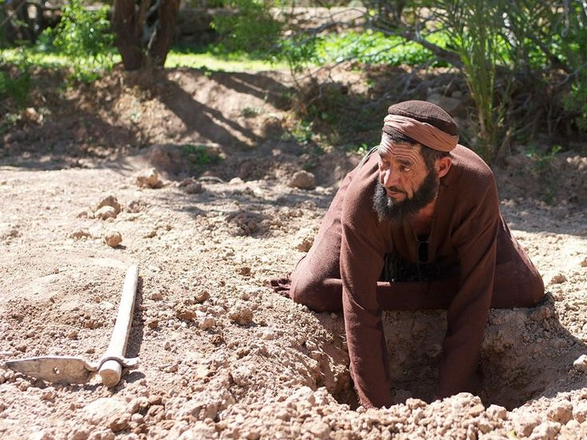
In Part I, we see a distinction made between two types of slaves. The first two are nearly identical in their actions with the only difference being the amount of talents. The second type of slave, though, a single slave, is wholly different and his dealing with is Master’s treasure is markedly obvious.
He does not go, but departed. He
did not work for gain; he dug and
hid. Why the difference? Jesus
gives no answer.
Part I (vv.16-18)

Slide 28
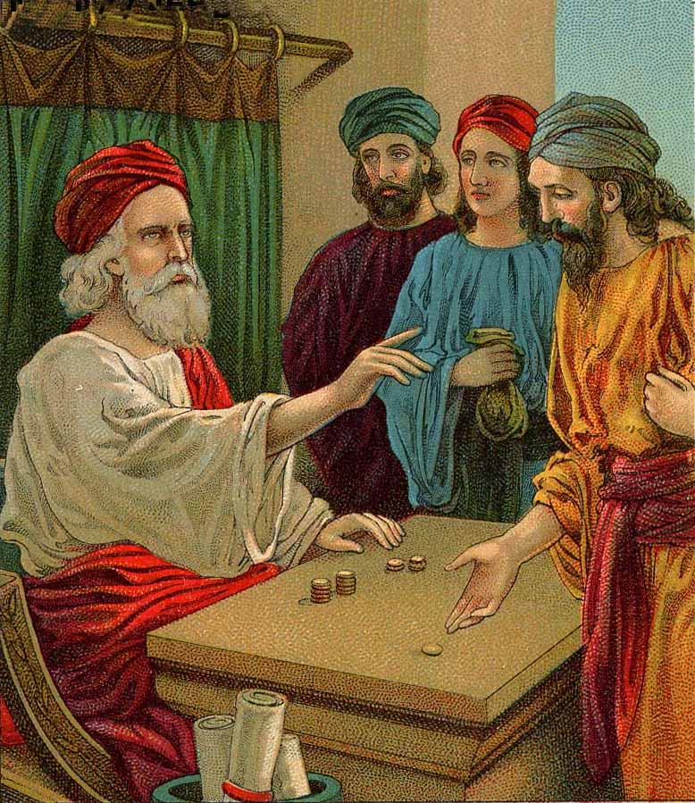
In Part II, Jesus turns the story with the use of a prepositional phrase (“after much time”). Since the talents were entrusted and not given, they remain the property of the Master; now He has returned to settle accounts with the three slaves.
The parallelism is apparent in Part II, especially in regards to the first two slaves. Their approach the Master in similar ways and they speak to Him identically.
Part II (vv.19-30)

Slide 29
Therefore, the Master communication to the first two are the same, His commendation is unqualified, and He promise to both is the same!
However, when the third slaves approaches the Master, he returns the one talent and only one talent… since, that’s all he had! This is important, since he didn’t do less that the first two, in reality he did nothing! He was entrusted in accord with his ability, but his words betray him. Why? Because of fear!
Part II (vv.19-30)

Slide 30
His fear of his Master is actually despising his Master has now been exposed…and now he will be rejected! Since he chose to despise his Master, now he will be deprived of his Master’s presence. He chose to spurn his Master now he will be spurned.
The fate of the third slave is very harsh. The Master’s harshness, however, is simply His response to the slave who has shown himself to be a fool and in being so, he has defamed his Master!
Part II (vv.19-30)

Slide 31
There are four important teachings that Jesus utilizes that should be noted:
The parable gives no indication leading up to the interaction between the third slave and the Master that the Master is cruel…there’s no reason to fear Him;
The Master presents Himself as both generous and trusting. He “entrusted” talents to His slaves and He was confident that they would do right by Him;
The Parable declares that when the Master entrusted the different amounts (weights), He did so according to the slave’s abilities. Nothing burdensome and nothing excessive;
The Master represents Jesus!
Summary

Slide 32
Jesus shapes His parable in order to reveal how the Master is viewed. The third slave appears and lays his unused talent before his Master. To the Jewish and early Christians readers of St. Matthew, this would have sound very insolent and unfair! And the disciples would also know that Jesus is not a “strict” Lord to be so feared to inaction! Rather, the Lord’s “yoke is light” (11:29-30); He saves them as Immanuel (1:23), especially when they are about to drown (14:28-31). Jesus makes it very apparent, and the disciples and Matthew’s later readers would know, that the last slave is a hypocrite.
So this parable is an exhortation to you: Never forget who your Master is and that you are His!
Summary

Slide 33
September Class Schedule
Passion Week (Chapters 21:1 – 27:66)
D. The Fifth Discourse (Chapter 23:1 – 26:1)
1. Woe to the Scribes and Pharisees (23:1-36) (Aug 17)
2. The Lament over Jerusalem (23:37-39) (Aug 17)
3. Prophecy of the Destruction of the Temple (24:1-35) (Sep 7)
4. The Parousia and the End of the Age (24:36-51) (Sep 14)
5. The Parable of the Wise and Foolish Virgins (25:1-13) (Sep 21)
6. The Parable of the Talents (25:14-30) (Sep 21)
7. The Great Judgment (25:31 – 26:1) (Sep 28)

Slide 34
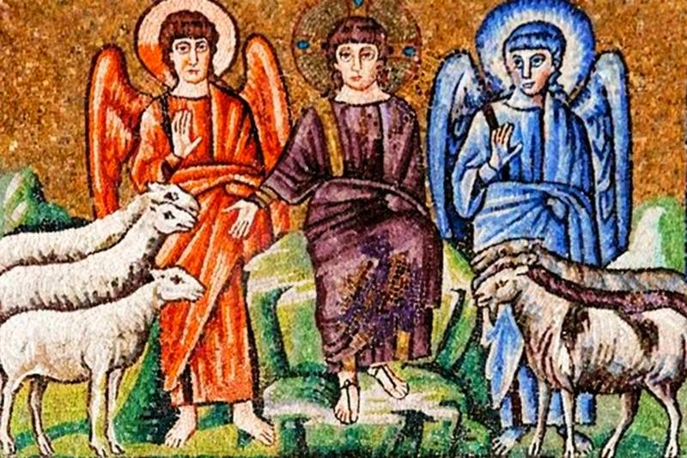
THE GREAT JUDGMENT
The Sheep and Goats
St. Matthew 25:31 – 26:1

