Slide 1
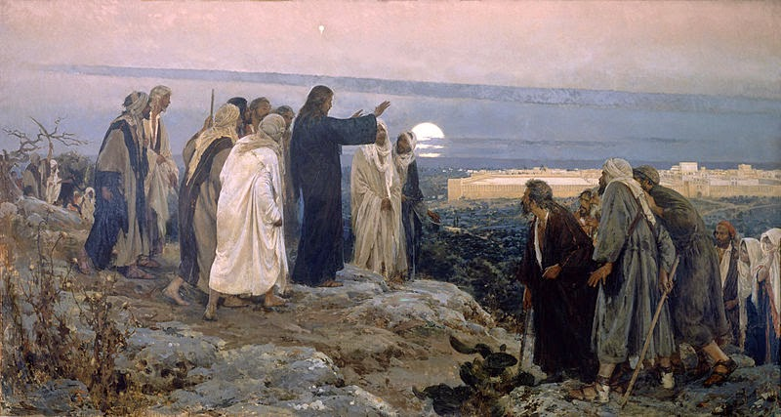
Passion Week
St. Matthew 24:36-51
The Parousia and the Consummation of the Age – The Second Advent
Part II
The Lament Over Jerusalem
(37-39)

Slide 2
Introduction
“Our Lord’s Great Eschatological Discourse continues this morning with a change of focus as Jesus begins to teach concerning the Parousia and the Consummation of the Age! Our Lord’s teaching begins in v.36, ends at 25:46, and then is followed by a narrative conclusion in 26:1.
Jesus is very clear that His parousia and the consummation of the age is unknowable. Therefore, do not be deceived by those who say the “know”; they do not! What, however, is very important for every Christian is to be “watching!”

Slide 3
Part II
WATCH! (vv.36-42)
This section begins with a prepositional phrase (“But concerning that day and hour…”) which is a hinge phrase, where Jesus turns from discussing the fall of Jerusalem and the destruction of the Temple, to the second part of His discourse.
There are three words in v.36 that trouble many people: “…nor the Son…!” You mean…Jesus doesn’t know…but, He is God! How can that be?
In traditional dogmatic terms, Jesus is pointing out His state of humiliation in which He willingly humbled Himself and did not fully use His Divine attributes. Yes, Jesus does possess omniscience; yet, according to His human nature, His knowledge is limited (humiliation).

Slide 4
Part II
WATCH! (vv.36-42)
We see that Jesus employed His divine attributes throughout His ministry in a limited way. In the case of Him not knowing, Jesus is pointing out to His disciples that He, in His humiliation, doesn’t know, along with all the angels. This is truly a mystery how the Divine Son of God cannot know, however, it is a mystery of His Person!
The most important aspect of our Lord’s words in v.36 is that the Father does know! Thus, our Lord’s parousia and the consummation of the age will happen, since the Father will give the command and Jesus and the heavenly host will return as outlined in the Apocalypse of our Lord Jesus (Revelation)! This is our unwavering trust!

Slide 5
Part II
WATCH! (vv.36-42)
In vv.37-41, Jesus uses a very familiar example for His disciples – Noah and the Great Flood! So the period that will lead up to the consummation of the age will be like that period leading up to the Great Flood! Here is the point that Jesus is making: the “suddenness” and the lack of warning (though you have been given signs to discern!).
Jesus merely emphasizes that it was business as usual. Note that He says nothing of the evil of mankind, then and today! Only that mankind will be about their daily and normal patterns of life. In v.39, again, Jesus repeats His most important point…“they did not know!”

Slide 6
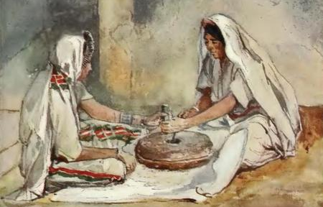
Part II
WATCH! (vv.36-42)
Jesus then begins to speak of a “separation” in v.40 and 41. There are two pairs of people; two men farming and two women grinding flour. In each case, one is separated from the other…one “will be taken” and “one being left.”
So this leads to a natural question, “What doe that mean?” Is “being taken” a positive or is it “being left?” Again, Scripture interprets Scripture! And we shall see that there are three factors that are to be considered!

Slide 7
Part II
WATCH! (vv.36-42)
The first factor is the Great Flood! Contrasting with Noah, Jesus just said that “the flood came and took them all” (v.39). Thus in light of the what Jesus just said, to “be taken” corresponds with judgment (eternal death)!
Secondly, and this is a major theme in the OT, the prophets often spoke of God’s judgment suddenly coming upon Israel in terms of the apostates being taken away into exile, or being taken from the land, and the other’s being left as the faithful remnant!

Slide 8
Part II
WATCH! (vv.36-42)
Lastly, there is no doubt that Jesus often depicts the final judgment as separation! In the scene that are listed here, those who are being judged are being separated and rejected; they are being excluded (we’ll discuss further in 25:11-12); they are told to depart (7:21-23); or they are cast out (8:11-12; 13:41-42, 49-50; also in chs. 22, 24, 25).
Thus, the concept of being “taken away” fits with judgment and condemnation. The bottom line: those taken refers to the fate of the unbelievers; and you, His children…you’ll be left…saved at His parousia!!!

Slide 9

Part II
BE READY! (vv.43-44)
Next, Jesus discusses that which is, again, familiar with the disciples and it actually is a message that is, in general, identical to vv.36-42.
In v.43, the householder stands for any given believer listening to Jesus’ teaching, and the
Lord Jesus compares Himself with a
thief who suddenly appears in the night
to break in and “steal!” This is very
hard to prevent – especially since you
do not know when the thief will appear.
All you can to is to be aware…be ready!

Slide 10
Part II
BE READY! (vv.43-44)
Our Lord’s use of the “thief” metaphor isn’t unusal, especially in the NT. St. Paul uses the same in 1 Thess. 5:2-4 and St. Peter in 2 Pet. 3:10. Jesus says the same to St. John in Revelation (3:3; 16:15. To give this metaphor even more force,
Jesus uses the same noun for “thief “
(klevpthV) and the same verb for “watch”
(grhgorevw) in Rev. 16:15 and here in
v.43 (we’ll also see this same verb in
25:13; 26:38, 40, 41). Again, you must
be ready…WATCH!

Slide 11
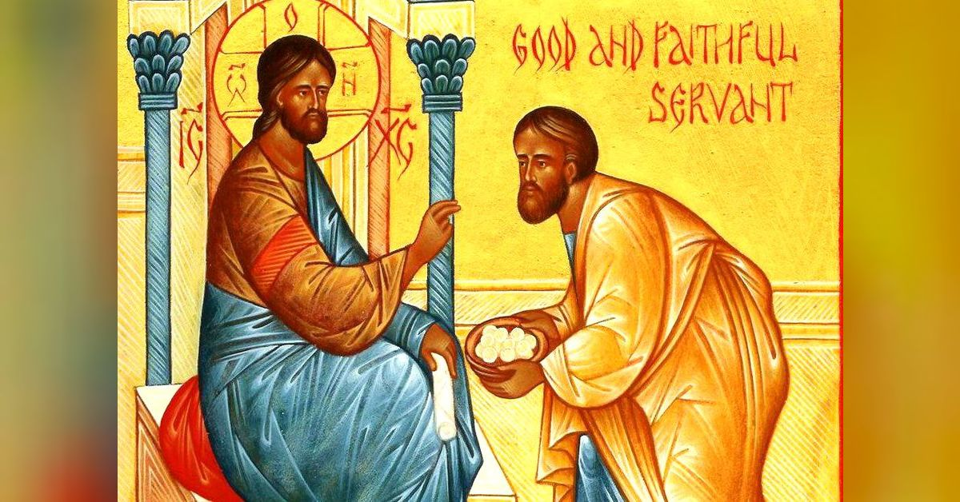
Part II
FAITHFUL OR WICKED (vv.45-51)
Remember…NO ONE knows the day or hour! This is the foundational truth of your Lord’s teaching in 24:36–25:46. Jesus highlights the unknow-ability of His parousia that the now tells a “parable-like” teaching in 45-51 via a wicked slave’s internal monologue. This you must grasp…such a slave will prove to be wrong, dead and eternally wrong!

Slide 12
Part II
FAITHFUL OR WICKED (vv.45-51)
Please note that our Lord’s narration is not told in the past (with aorist (past tense) verbs). Rather, Jesus uses future indicative (or futuristic) verbs and subjunctives (hypothetical situations).
Jesus also uses two complete but contrasting scenarios, rather than a single sequenced narrative.

Slide 13
Part II
FAITHFUL OR WICKED (vv.45-51)
First, Jesus asks who will be found on the Last Day to be a faithful and wise servant! That one will have future blessings!
Secondly, Jesus then offers the opposite scenario. This describes a wicked servant and his result on Judgment Day. This type of teaching differs from how our Lord taught in His parables in St. Matthew.

Slide 14
Part II
FAITHFUL OR WICKED (vv.45-51)
Verses 45-47, The Faithful and Wise Slave
There are a number of important truths that our Lord put forth; first, is that as His disciples wait for Jesus to return, they are to regard themselves as His slaves. Here, then, is the image of ownership! Jesus owns His disciples and they are blessed by their Master. Thus, our lives are not our own! You and I belong to Jesus!

Slide 15
Part II
FAITHFUL OR WICKED (vv.45-51)
Verses 45-47, The Faithful and Wise Slave
Therefore, until our Master returns, we are to be faithful and wise! We remain diligent in the duties given to us (in our various vocations) and we are also to remain viligent, since we do not know when our Master will return to bless eternally!

Slide 16
Part II
FAITHFUL OR WICKED (vv.45-51)
Verses 45-47, The Faithful and Wise Slave
The word “blessed” you’ve heard before (remember, chap 5!). Jesus uses the same verb in the Beatitudes as He does here. As a reminder, “blessed” (makarivoV) is a believer in an enviable (“fortunate”) position from receiving God’s provisions (favor) – which (literally) extend (“make long, large”) His grace (benefits).

Slide 17
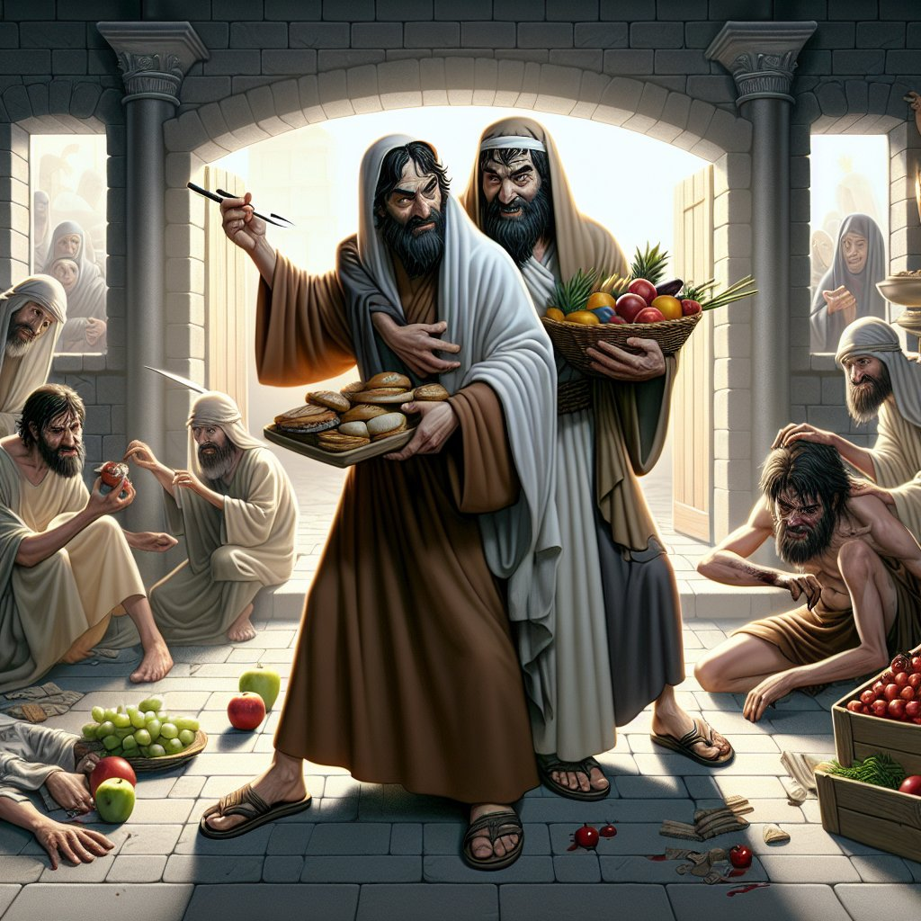
Part II
FAITHFUL OR WICKED (vv.45-51)
Verses 45-47, The Faithful and Wise Slave
Eschatological readiness is blessed: “That slave whom his master, when he comes, will find that the is doing thus will be Blessed” (St. Matthew 24:46; St. Luke 12:37-38, 43).
Now we turn to the second scenario: The wicked slave.

Slide 18
Part II
FAITHFUL OR WICKED (vv.45-51)
Verses 48-51, The Wicked Slave
In this second scenario, Jesus intends to warn all His disciples, exhorting them to repent and to return to right understanding of who we are and of the certainty of His parousia! You may note that this scenario consist of a long conditional sentence: “if___happens, then___will happen.”

Slide 19
Part II
FAITHFUL OR WICKED (vv.45-51)
Verses 48-51, The Wicked Slave
The wicked slave doesn’t deny that he has a Master, a Lord! His error is that he badly misinterprets the significance of the Master’s delay. He takes the interval for granted and as an excuse to disobey his Master and to treat his fellow slaves as if he were the master… and an evil master at that!

Slide 20
Part II
FAITHFUL OR WICKED (vv.45-51)
Verses 48-51, The Wicked Slave
He also loses his way and joins in with other servants who are “drunkards” (mequvw); the implication being that they are no longer clear-minded or self-controlled; they are morally dull and spiritually unprepared. They are so profoundly deceived that they bear the name of the Master’s enemies: “hypocrites!”

Slide 21
Part II
FAITHFUL OR WICKED (vv.45-51)
Verses 48-51, The Wicked Slave
Suddenly, the Master returns and will judge the wicked servant so severely that the punishment stretches our understanding. What does Jesus mean by “cut him in two” (dicotomhvsei)?
Such a punishment is horrific and figurative, though clear: the wicked will be cast out and eternally excluded from the Master’s presence where there will be “weeping and gnashing of teeth!”

Slide 22
Part II
Conclusion
All that has been discussed today, especially concerning being “blessed” is all that God works and reveals. In your Baptism, Jesus has called you to be His and to pickup your cross and follow Him. Bearing your cross (suffering) and following Jesus become especially important after you are confirmed. Then the Holy Spirit works to keep you in the one true Faith and Knowledge that you are who you are and God has worked this, also!
There is a danger, however, if you do not follow Jesus and choose to be a wicked slave; you will be “taken away” and thrown into the outer darkness (Hell). So you must remain awake and Watch! Be ready! Remember, your Master is returning soon! Keep on being READY!

Slide 23
September Class Schedule
Passion Week (Chapters 21:1 – 27:66)
D. The Fifth Discourse (Chapter 23:1 – 26:1)
1. Woe to the Scribes and Pharisees (23:1-36) (Aug 17)
2. The Lament over Jerusalem (23:37-39) (Aug 17)
3. Prophecy of the Destruction of the Temple (24:1-35) (Sep 7)
4. The Parousia and the End of the Age (24:36-51) (Sep 14)
5. The Parable of the Wise and Foolish Virgins (25:1-13) (Sep 21)
6. The Parable of the Talents (25:14-30) (Sep 21)
7. The Great Judgment (25:31 – 26:1) (Sep 28)

Slide 24
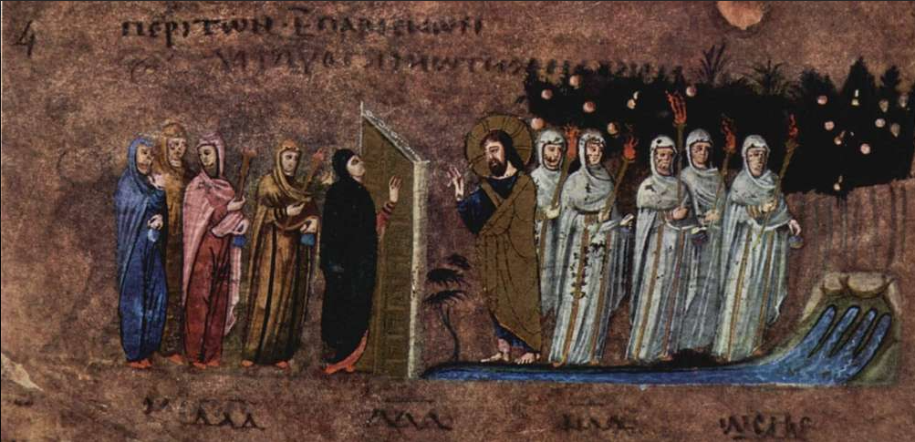
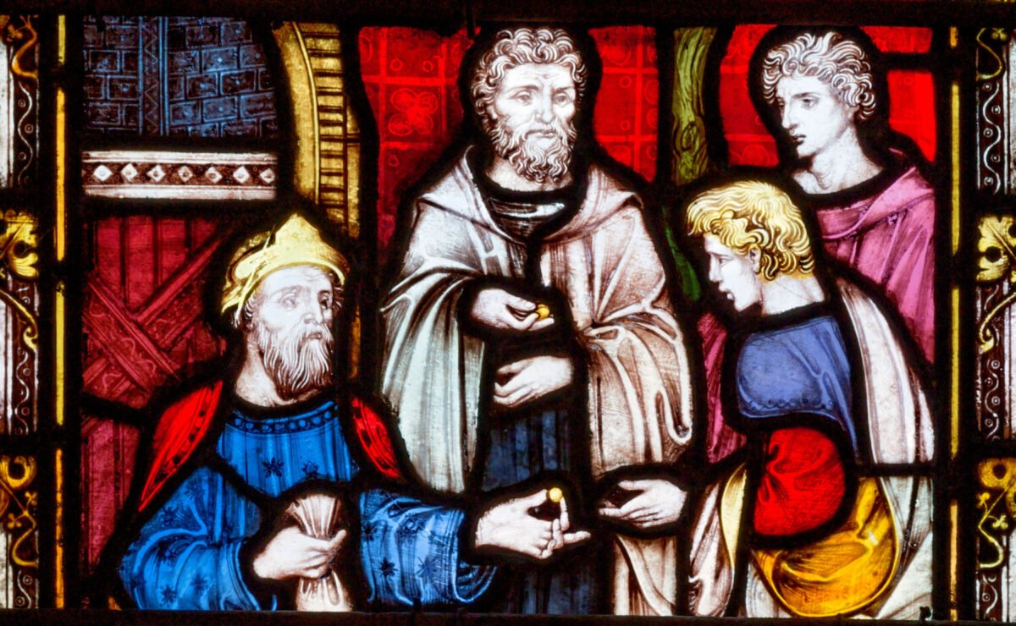
The Parable of the Ten Virgins
The Parable of the Talents
&
St. Matthew 25:1-13
St. Matthew 25:14-30

