Slide 1
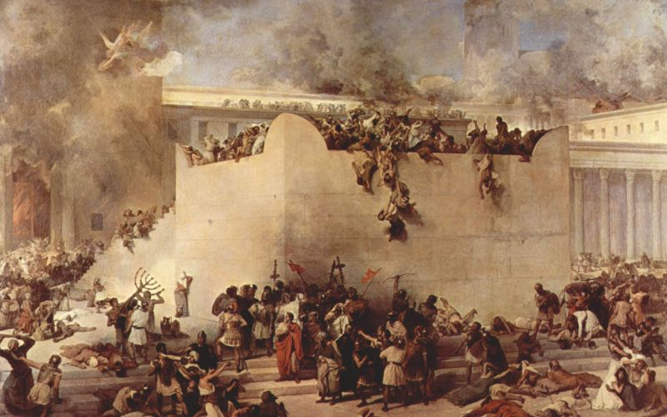
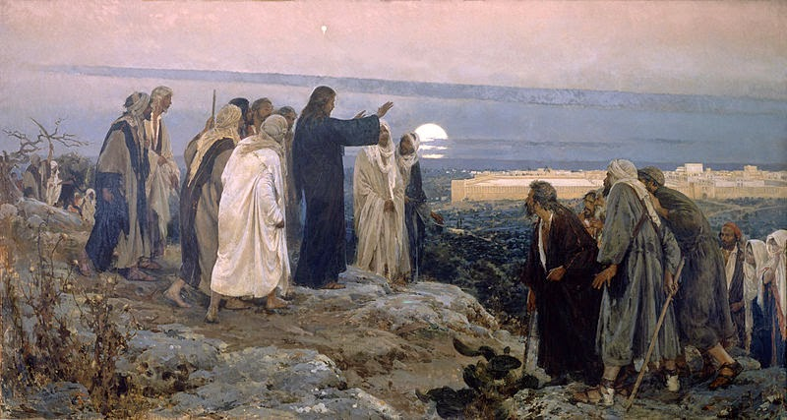
Passion Week
St. Matthew 24:1-35
The Prophecy of the Destruction of the Temple
(vv.1-3)
The Eschatological Discourse
(vv.4-35)
The Lament Over Jerusalem
(37-39)

Slide 2
Introduction
“Confrontation Tuesday” is now coming to its consummation as Jesus leaves the Temple grounds and travels to the Mount of Olives. Please see the outline handout that will, prayerfully, open up this chapter to you and prevent confusion.
Before we begin our study, however, it’s important for you to know what Jesus means by “this generation” (v.34). It’s the Jews living at the time of our Lord’s ministry through the siege of Jerusalem and the destruction of the Temple in 70 AD. It’s the “generation” that rejected the Stone (21:42). As with the obliteration of Israel (N. Kingdom) in the 8 c. BC and the Babylonian captivity of Judea (S. Kingdom) in the 6c. BC; so this generation will also be judged to be apostate!

Slide 3
An Outline of St. Matthew 24:1-51
(So that we will not be overwhelmed!)
Introduction
Our Lord’s great Eschatological Discourse (St. Matthew 24:1 – 26:1) is quite lengthy,
complex (at times) and taught in a manner that makes it difficult to follow with the
Western mind. Therefore, this outline is compiled for you so that you may more easily
follow along and make note of key points along the way.
PART I
I. Our Lord’s Prophecy (vv.1-3)
A. The Royal Son Leaves the Temple (1a)
B. The Confusion of the Disciples (1b-3)
Unit I
(Judea and The Second Advent)
II. Troubles and Tumults Throughout the Age of Grace (vv.4-14)
A. Do Not be Troubled or Misled (vv.4-8)
B. Do Not be Surprised by Persecution because of the Holy Gospel (vv.9-14)
Unit II
(Judea)
III. Read the Signs and Flee (vv.15-22)
A. “When Will These Things Be?”: The Abomination of Desolation (v.15)
B. “When Will These Things Be?”: Troubles in Judea (vv.16-22)

Slide 4
Unit III
(The Second Advent)
IV. Do Not Believe False Prophets (Teachers) (vv.23-28)
A. The Negative Message (vv.23-26)
B. The (Grimly) Positive Message (vv.27-28)
1. Comparison 1: The Thunderstorm (Lightning)
2. Comparison 2: “Vultures”
Unit IV
(Judea)
V. Cosmic Distress and 70 AD (vv.29-31)
A. The Figurative Language of Verse 29
B. Three Declarations; One Event (v.30)
C. The Proclamation of the Good News will Continue (v.31)
VI. Conclusion of Part I (vv.32-35)

Slide 5
PART II
The Parousia and The Consummation of the Age – The Second Advent!
I. WATCH! (vv.36-42)
A. Day and Time are Unknowable (v.36)
B. The Days of Noah (vv.37-42)
1. NO Warning: Suddenly! (v.38)
2. Taken (v.39)
3. Taken and Left (vv.40-41)
C. KEEP WATCHING! (v.42)
II. BE READY! (vv.43-44)
A. The Thief (v.43)
B. BE READY! (v.44)
III. Faithful or Wicked Slave (vv.45-51)
A. Faithful and Wise Slave (vv.45-47)
B. The Wicked Slave (vv.48-51)

Slide 6
Part I
Our Lord’s Prophecy (vv.1-3)
These three verses comprise the narrative introduction to our Lord’s Great Eschatological Discourse. It’s important for you to understand these verses since they will direct you on how to read the entire Discourse.
Jesus leaves the Temple precinct (iJerou:), not the Sanctuary (naovV)! In line with St. Matthew, we can see that our Lord is the One who is the Son of the Vineyard Owner (21:33-46); the King’s Son at the Wedding Feast (22:1-14); and the Son whom David called “my Lord” (22:41-46). The Anointed One is leaving the Temple and city, but will return to reign…from the Throne of His Cross! Then He will rise to eschatological Life as The Son who shares The Name with His Father and Spirit!

Slide 7
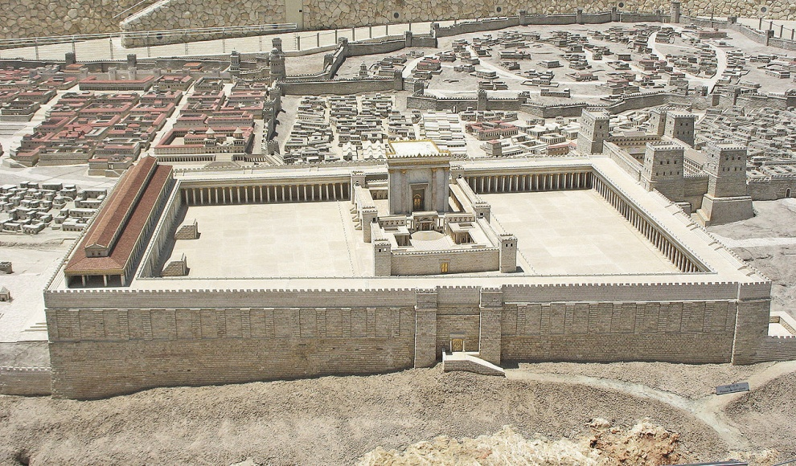
Part I
Our Lord’s Prophecy (vv.1-3)
As the Royal Son leaves the Temple precinct, His disciples approach Jesus “to show” Him all the grand structures that comprise the Temple precinct.
Jesus responds to their “showing” with a strong “telling!” Jesus is recounting for them 23:38 – “Behold, your house is left desolate to you.” “Desolate” (e[rhmoV) is the logical outcome of rejecting God and His presence! As a matter of fact, to this day, large stones can still be seen heaped up, still resting there after the Romans pushed them off of the Temple Mount in 70 AD.

Slide 8
Part I
Our Lord’s Prophecy (vv.1-3)
After our Lord’s prophecy, they
travel to the Mount of Olives
and, presumably, as Jesus
and the disciples are looking
out over the Temple precincts,
they come to Him to ask Him a questions in two parts (v.3).
Note that their question(s) are quite faulty! There are two features that we should explore:
1. The “approaching of Jesus” was always for two purposes:
a. To question for information or guidance;
b. To question from a faulty faith!
2. They ask a question with two parts; though, only the first part one connects to what Jesus has been saying to them!

Slide 9
Part I
Our Lord’s Prophecy (vv.1-3)
There is an interesting word that
the disciples used that we don’t
hear to often: “parousia”
(parousivaV). This word was used
in the East as a term for a royal
visit of a king or emperor. This word literally means “to bring beside,” thus, “the Personal Presence of the King!” Hence, the disciple believe that the two-parts of their question go together; that the destruction of the Temple and the consummation of the age go hand-in-hand!
The approach of the disciples and their two-part question actually anticipates the two-part structure of our Lord’s Eschatological Discourse. Jesus will teach them, first, about events leading up to the destruction of the Temple; and, then about the consummation of the age as He stresses the importance of not confusing them.

Slide 10
Part I, Unit I
Troubles and Tumults (vv.4-14)
Jesus responds to their questions by telling them, “Keep watching, lest someone deceive you” (v.4)! His response is telling, since it’s quite clear that they have been deceived! Therefore, this first Unit will direct the disciples not to be confused by what is about to take place (in AD 70), especially the troubles and tumults in Judea and Jerusalem. All these troubles and tumults do NOT signal the end of the age. So don’t be deceived! Additionally, these troubles and tumults will persist throughout the Age of Grace until His Second Advent.

Slide 11
Part I, Unit I
Troubles and Tumults (vv.4-14)
Jesus, in v.5, describes false “Christ” or false “Messiahs” that will appear throughout the span of world history until His parousia. The sad reality is that they exist today, as they have in the past, and they do destroy the faith of many people!
The ravages of sin that creates anger and hatred (war) are not the only signs of brokenness; there will be famines, earthquakes (various natural disasters) that will remind the Lord’s disciples (then and today) that this world is fallen; that nature, too, is corrupted.

Slide 12
Part I, Unit I
Troubles and Tumults (vv.4-14)
Even though the reign of God has begun in Christ Jesus, His reign will reach its climax in His death and resurrection, still the world will remain broken until the day of the Wedding Feast of the Lamb!
Please note that Jesus, twice, (in vv. 6, 8) denies that these troubles and tumults have any chronological significance as historical markers that would enable anyone to “time” the consummation of the age. As bad as the troubles and tumults may become, it’s not the End…not yet! All these are just the “beginning of the birth pangs” (v.8). Again, do NOT be deceived!

Slide 13
Part I, Unit I
Troubles and Tumults (vv.4-14)
In verses 9-14, Jesus narrows His focus! He speaks directly about persecutions that will happen to His disciples. The reason they will be persecuted (and martyred, except for St. John) is because they will be making disciples of all nations (28:16-20). The devil and the world cannot stand the proclamation of the Holy Gospel (then and today), so they will attempt to thwart and destroy, even putting the disciples to death. All this will be on account of our Lord’s name (v.9), that is, because your Lord Jesus’ disciples (you) will be active in proclaiming His blessed Holy Gospel!

Slide 14
Part I, Unit I
Troubles and Tumults (vv.4-14)
Verses 10-13, are quite clear. What our Lord speaks of in 10-12, you are quite familiar with…if you are paying attention to our society today! It’s happening now! Your Lord is always true!
So, then, v.14 and when many read this verse they think it’s a way to perceive the parousia! They wonder how many “people-groups” there are and whether the Gospel has been (or hasn’t been) proclaimed to them. Yet, as soon as they can calculate that the Holy Gospel has been preached to them…then Jesus has to return! This is misguided thinking! What your Lord is teaching is that His Church is a missionary Church!

Slide 15
Part I, Unit I
Troubles and Tumults (vv.4-14)
To summarize this first unit, Jesus separates what the disciples had joined together, namely, their two-parts of one question! And, then, the troubles and tumults that His original disciples will experience are but a piece of all troubles and tumults that will run through world history up to the consummation of the age.
Then, and now, the message is the very same; you must NOT be deceived! All the troubles and tumults of this life are but “signs” of the brokenness of humanity and of this fallen world. Yet, you must not fear; Jesus has overcome the world!

Slide 16
Part I, Unit II
Read the Signs and Flee (vv.15-22)
In Unit II, Jesus brings His disciples back to the events that are about to occur in Judea, and Judea only! What our Lord will be discussing only refers to the first part of their two-part question: “…when will these things be?” [The destruction of the Temple]
In v.15, Jesus begins to talk about “the abomination of desolation” and then St. Matthew writes “let the reader understand” are references to what is about to occur in Jerusalem. So that you can understand, let’s discuss just what is “the abomination of desolation?”

Slide 17
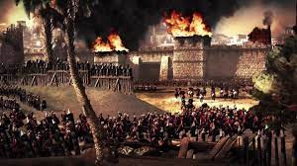
Part I, Unit II
Read the Signs and Flee (vv.15-22)
The Abomination of Desolation must be understood in light of Dan. 9-12. Then, with Scripture interpreting Scripture we must then add St. Luke 21:20-21.
St. Luke reports that when armies (legions) are seen surrounding the city, know that her desolation is near. The citizens of Judea must flee to the mountains. Luther advised that vv.15-22 must be interpreted in light of St. Luke’s text. The Abomination of Desolation = the Roman legions under the command of Titus.

Slide 18
Part I, Unit II
Read the Signs and Flee (vv.15-22)
The following three points are important:
1. Jesus is prophesying about events that will occur in the lifespan of “this generation” (23:36; 24:34), which happened in AD70;
The sign of this coming judgment would be visible, discernible: “When YOU shall the abomination…!”
The abomination also has a spiritual and theological character. It will be used to purge, to depopulate, to devastate. The Temple (no longer necessary) will be removed! This is their judgment for killing the Royal Son!

Slide 19
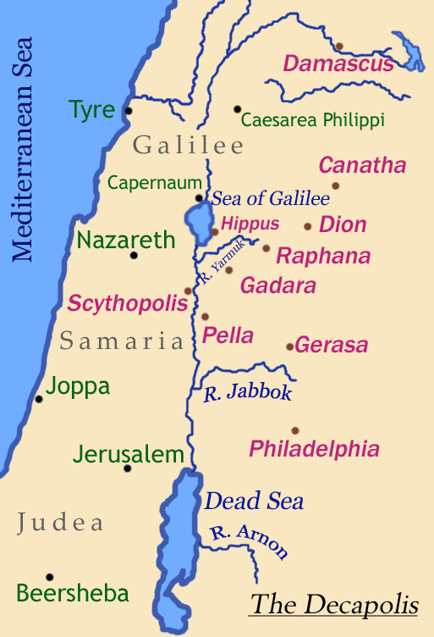
Part I, Unit II
Read the Signs and Flee (vv.15-22)
Jesus lists the results of the abomination of desolation and what the citizens of Judea (Jerusalem) must and should do in vv.16-22!
All that Jesus is describing is local
and limited. And for those who
were discerning, they did “flee to
the mountains” with a majority
fleeing east into the area of the
Decapolis.

Slide 20
Part I, Unit II
Read the Signs and Flee (vv.15-22)
If Jesus were talking about the consummation of the age (Judgment Day), then all that He is commanding would make no sense; especially fleeing, which would be futile (cf. Rev 6:12-17; 20:11-15).
Finally, and to summarize and paraphrase our Lord’s prophecy: Pray that you do not have to flee during difficult conditions, since a horrific catastrophe is about to fall upon the people of Judea. It will be the worse trouble that they will ever encounter. No one would have survived, if God had not intervened for the sake of the elect (those Jews who believed in Jesus as the Messiah).

Slide 21
Part I, Unit III
Do Not Believe False Prophets (vv.23-28)
You should remember that Jesus (though God) is also a Jewish Rabbi; therefore, He teaches in accord with the traditional ancient eastern style that we know as circular teaching. This is what we see in Unit III as Jesus “circles” back to His warning about eschatological confusion and false teachers.
Jesus is taking His disciples (then and today) forward to the consummation of the age and His parousia. And His warning is clear…do Not believe false teachers who teach about His parousia that isn’t in harmony with His Holy Word! And we have a plethora of that today!

Slide 22
Part I, Unit III
Do Not Believe False Prophets (vv.23-28)
Specifically, Jesus is taking direct aim at those who desire to predict the Second Advent of our Lord (there are also those who have predicted that He has already returned). The message our Lord has is both negative (vv.23-26) and [grimly] positive (vv.27-28).
Negative (vv.23-26): When anyone claims to know that the Christ has returned (or is returning on a certain day); even if they seemingly have supernatural power – never believe them! You’ve been warned – in advance!

Slide 23
Part I, Unit III
Do Not Believe False Prophets (vv.23-28)
The Positive (vv.27-28): The parousia of the Son of Man will be known to all when it does happen.
With this positive message there are two comparisons that our Lord uses:
1. The analogy of a thunderstorm! Everyone knows when a t-storm is approaching…it’s not a secret! Thus, when our Lord’s Second Advent occurs, all will know…it won’t be a secret! So, all those who claim a “special” knowledge or have a private revelation are false teachers!
DO NOT BELIEVE THEM!!!

Slide 24
Part I, Unit III
Do Not Believe False Prophets (vv.23-28)
The Positive (vv.27-28): The parousia of the Son of Man will be known to all when it does happen.
With this positive message there are two comparisons that our Lord uses:
2. The second comparison in found in v.28 and it’s rather grim! Jesus uses the example of eagles and other large birds (“vultures”) which feed on carrion. You know that they are about to feed, since they can be seen high in the sky circling the carcass. No one has to tell you what’s about to happen!
DO NOT BE DECEIVED!

Slide 25
Part I, Unit IV
Cosmic Distress and AD 70 (vv.29-31)
And now our Lord “circles” back to Judea! Yes, He returns to His prophecy concerning the events about to occur in Jerusalem!
Verses 29-31 are quite difficult and many theologians have their understanding of it. May I propose the following:
First, the language that our Lord is using is highly symbolic and figurative. He seems to be alluding to the type of language found in Isaiah 13. We see the same type of allusions in Psalm 18 and Habakkuk 3:10-11.

Slide 26
Part I, Unit IV
Cosmic Distress and 70 AD (vv.29-31)
Secondly, leading up to these verses, the language of “fleeing” (v.20) and “tribulation” (21) applies to events that will happen in Judea in the 1st c. After these verses, there’s the warning that “this generation will surely not pass away until all these things happen” (v.34), which most certainly pertain to Judea!
Thus, I propose that this section pertains to the events about to occur in Judea in the 1st century, which includes the events surrounding and including the Roman siege of Jerusalem and the destruction of the Temple.

Slide 27
Part I, Unit IV
Cosmic Distress and 70 AD (vv.29-31)
(v.29) – The language that Jesus uses is most certainly figurative, which describes the laying waste to Jerusalem and the destruction of the Temple Mount. We see similar language in the judgment of Israel by the Assyrians in 8th c. BC. Also the same with the Babylonian captivity of Judah. The language is figurative, but the destruction (judgment) was literal and produced by God.

Slide 28
Part I, Unit IV
Cosmic Distress and 70 AD (vv.29-31)
(v.30) – is comprised of three independent clauses. It’s important to understand them as our Lord’s prophecy:
Clause #1: “…and at that time the sign of the Son of Man in heaven will appear….” This is His succession to power and assumption of all authority and is seen in His crucifixion and resurrection on the Third Day!
Clause #2: “…all tribes of the earth will mourn….” In context with “this generation”, this would be the mourning of the lost sheep of Israel. This generation will continue in their apostasy and rejection of Jesus. Desolation will come upon them and they will mourn! Note that Jesus doesn’t speak of contrition or repentance!

Slide 29
Part I, Unit IV
Cosmic Distress and 70 AD (vv.29-31)
(v.30) – This verse is comprised of three independent clauses. It’s important to understand them as our Lord’s prophecy:
Clause #3: “…and they will see that the Son of Man is coming on the clouds of heaven with power and much glory….” This is a strong allusion to Daniel 7. To paraphrase: Jesus says, “They will see Me as the figure of Daniel 7:13-14, the Son of Man, and that I have been presented to the Ancient of Days and have received authority, power, dominion, might and an universal, everlasting, unconquerable reign.”

Slide 30
Part I, Unit IV
Cosmic Distress and 70 AD (vv.29-31)
(v.31) – Jesus declares that He will continue to send messengers, not to Israel; but to the Gentile nations of the 1st c. This process of sending and gathering will continue until the consummation of the age. Jesus is clear that His messengers will be gathering. After the destruction of the Temple, messengers will be sent to gather people from every nation unto Himself. We see similar language in 22:9-10.
By contrast, the activity on the Day of Judgment will be gathering and separation. But those sent to all nations (28:16-20) involves only gathering.

Slide 31
Part I, Unit IV
Cosmic Distress and 70 AD (vv.29-31)
(v.31) – What about the trumpet blast? Well, in the OT, there are two main uses of trumpets. First, there use in war or two sound an alarm. Secondly, and fittingly for this verse, is there use to gather…to gather for worship, for liturgical events and gatherings.
Thus, missionaries will be sent to gather throughout the Age of Grace those who heed the trumpet call of Law and Gospel. Once they are gathered, they will worship the Lord and He will come to them and serve them in Divine Service!

Slide 32
Part I, The Conclusion
(vv.32-35)
Jesus concludes the first part of His Eschatological Discourse by using another analogy – the Fig Tree! This would have been quite familiar to the disciples. It’s important that they discern the signs and not be deceived. Thus, when the events that Jesus has described to them begin to occur in Judea…they will know!
Our Lord closes with v.35 that essentially means that His Words are always true. His Word gives important grounding and confidence to His disciples. Though trouble and tribulations will come, they can 100% count on what He has said to them!

Slide 33
September Class Schedule
Passion Week (Chapters 21:1 – 27:66)
D. The Fifth Discourse (Chapter 23:1 – 26:1)
1. Woe to the Scribes and Pharisees (23:1-36) (Aug 17)
2. The Lament over Jerusalem (23:37-39) (Aug 17)
3. Prophecy of the Destruction of the Temple (24:1-35) (Sep 7)
4. The Parousia and the End of the Age (24:36-51) (Sep 14)
5. The Parable of the Wise and Foolish Virgins (25:1-13) (Sep 21)
6. The Parable of the Talents (25:14-30) (Sep 21)
7. The Great Judgment (25:31 – 26:1) (Sep 28)

Slide 34
Passion Week
St. Matthew 24:36-51
The Parousia and the Consummation of the Age – The Second Advent
The Lament Over Jerusalem
(37-39)

