Slide 1
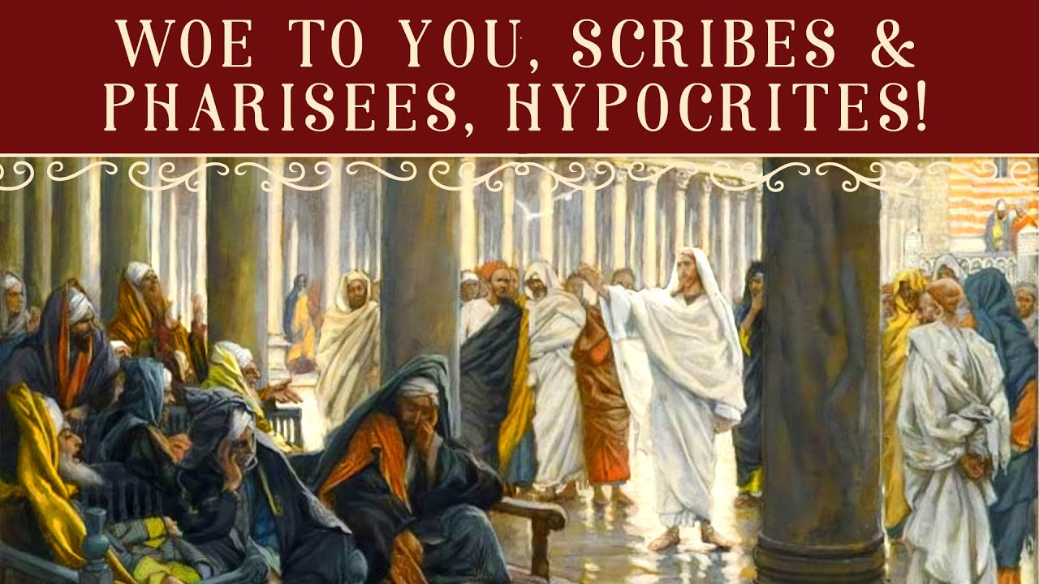
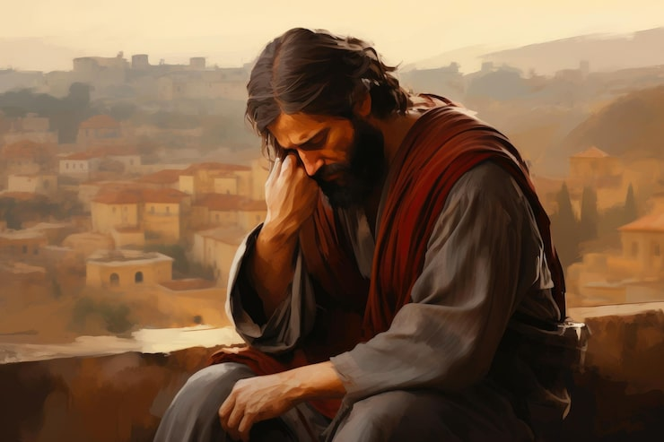
Passion Week
St. Matthew 23:1-39
The Seven Woes
(1-36)
The Lament Over Jerusalem
(37-39)

Slide 2
Introduction
“Confrontation Tuesday” in Chapter 23 takes a different tone as our Lord addresses a number of different audiences. This chapter can be laid out in three sections:
1. (vv.1-12): an introductory warning by our Lord against being like the scribes and Pharisees;
2. (vv.13-36): seven woes that are spoken against the scribes and Pharisees; and,
3. (vv.37-39): the lament over Jerusalem.
These three sections correspond to the audience(s) to whom Jesus is directly addressing, which we will identify throughout our study this morning!

Slide 3
Matthew 23:1-12
St. Matthew begins, in v.1, by being quite explicit as to who Jesus is addressing, “…to the crowds and to His disciples.” Thus, St. Matthew is clear that the crowds, the people of Jerusalem, and especially all the pilgrims have been present from the beginning of “Confrontation Tuesday!”
The Lord’s address shifts in v.8a, “You, however, shall not be called rabbi….” The “you” is a second person plural and is being directed to His disciples; especially as He ends His admonition in v.8c,, “…you all now are brothers.” His address to His disciples continues through v.12.

Slide 4
Matthew 23:1-12
St. Matthew begins, in v.1, by being quite explicit as to who Jesus is addressing, “…to the crowds and to His disciples.” Thus, St. Matthew is clear that the crowds, the people of Jerusalem, and especially all the pilgrims have been present from the beginning of “Confrontation Tuesday!”
Our Lord’s address shifts in v.8a, “You, however, shall not be called rabbi….” The “you” is a second person plural and is being directed to His disciples; especially as He ends His admonition in v.8c,, “…you all now are brothers.” His address to His disciples continues through v.12.

Slide 5
Matthew 23:1-12
So let’s go a little deeper into this pericope. Verse 1 is a general introduction; followed by vv.2-3 that offers an initial description; vv.4-7 detailed what was said in vv.2-3. This short section of the whole gives to the crowds and the disciples a complete description of the scribes and Pharisees. In summary: “This is what they are like!”
Tied together, Jesus is clearly rejecting the piety of the scribes and Pharisees! Such behavior, then and today, serves no purpose…and has zero spiritual validity! Being a spiritual leader is not about prestige or power; in reality, such an attitude comes from the devil!

Slide 6
Matthew 23:1-12
Verses 8-12 is a clear exhortation to His disciples; yes, then and today! There are three prohibitions in verses 8a, 9a, and 10a. And Jesus “grounds” these prohibitions in verse 8b-c, 9b, 10b by declaring that there is only One who is Teacher and Instructor and only One Father.
Again…, Jesus is clearly rejecting the piety of the scribes and Pharisees! Such behavior, then and today, serves no purpose…and has zero spiritual validity! Being a spiritual leader is not about prestige or power; in reality, such an attitude comes from the devil!

Slide 7
Matthew 23:1-12
Application: Jesus is exhorting His disciples, then and today, to never put another on a “pedestal.” First, because no sinful human belongs on a pedestal. And, secondly, when a sinful human is placed on a pedestal it is dangerous…how so?
It will lead to deadly HYPOCRISY! Evil does lurk in the hearts of every Christian leader (lay and clergy!). Every Christian should always reject any attempt to elevate leaders over and above other Christians! We are ALL brothers under One Teacher who reveals and brings us near to our One heavenly Father!

Slide 8
Matthew 23:13-36
Now we come to the middle pericope of Chapter 23. There’s no clear structural arrangement here by St. Matthew, although we can group the seven woes into small units.
The first two woes (vv.13, 15) are connected due to their theme: leading others astray. The next five (16-22, 23-24, 25-26, 27-28, and 29-33) can be treated as small units within the whole.
The first two woes pronounce judgment upon the scribes and Pharisee because they are leading others astray. They do this via their false teachings concerning God’s Word. Again…, how so?

Slide 9
Matthew 23:13-36
The underlying issue of the first two woes is that the scribes and Pharisees are teaching falsely about the Messiah! Since they oppose and reject Jesus as their Messiah, this is why and how they are closing the door, preventing others from entering and creating twice-over sons of Gehenna (v.15). Jesus is using strong eschatological language!
False teacher’s will be condemned as culpable! Those who claim to know God’s holy Word; yet, wrongly teach His Word will not be acquitted. Yes, this is a warning to all Christians…and especially to pastors! As St. James wrote, “…let not many of you become teachers, my brothers, because you know that we receive a greater judgment” ^{(St. James 3:1)}.

Slide 10
Matthew 23:13-36
The next woe(vv.16-22) is our Lord’s teaching concerning vows and oaths. This was a serious matter in 1st c. Israel. Thus, Jesus is saying that anyone who swears any oath invokes eternal, divine realities. And anyone who inflates oneself and their word has, in reality, forgotten how important are the words that come out of the mouth!
Note that Jesus calls the scribes and Pharisees “blind guides.” As teachers and leaders in Israel, they are failing to properly lead the people since they continue to falsely interpret Scripture as seen in 15:1-20 (hand washing, the practice of Korban, and caring for one’s parents).

Slide 11
Gehenna
Historical Background
Gehenna draws its name from the Valley of Hinnom (Hebrew: בֶּן־הִנֹּם גֵּיא (ge ben-Hinnom: valley of (the son of) Hinnom) south-west of Jerusalem. In the Old Testament, the ravine became infamous for child sacrifices to Molech (2 Kings 23:10; Jeremiah 7:31-32; 19:6). After King Josiah defiled the site, Jewish tradition remembered it as a cursed place. By Second Temple times, it had become a refuse dump where fires continually smoldered, and so it served as a vivid image for eschatological judgment. When Jesus and St. James employ the term, their listeners already associated it with divine retribution and uncleanness.
Usage in the New Testament
Gehenna appears twelve times in the Greek New Testament—eleven times from the lips of our Lord Jesus and once by St. James. The distribution highlights three major themes:
1. Personal moral accountability (St. Matthew 5:22, 29, 30; 18:9). Even “every careless word” and “looking with lust” can lead to being “thrown into hell.”
2. Ultimate divine judgment (St. Matthew 10:28; St. Luke 12:5). Jesus contrasts human power to kill the body with God’s authority “to destroy both soul and body in hell.”
3. Condemnation of hypocritical religion (St. Matthew 23:15, 33). Religious leaders who corrupt others become “sons of hell” and face the judgment they deny.
Mark 9:43-47 gathers these strands into a solemn warning: “It is better for you to enter life crippled than, having two hands, to go into hell, into the unquenchable fire.” St. James 3:6 applies the image to the tongue’s destructive power: “The tongue is set on fire by hell.” The constant factor is Divine, not human, retribution.

Slide 12
Gehenna (con’t.)
Relation to Other Biblical Terms
Unlike Sheol (Heb) and Hades (Gr), which describe the realm of the dead in general, Gehenna always points to final punishment. Revelation later depicts the same reality as “the lake of fire” (Rev. 20:14-15). Gehenna, therefore, stands at the terminus of moral history, not the temporary intermediate state.
Theological Significance
1. Reality of eternal punishment: Jesus treats Gehenna as an objective destiny, not a metaphorical state.
2. Holistic judgment: Both body and soul are subject to destruction (St. Matthew 10:28); countering notions that only the soul is accountable.
3. Justice and mercy: The repeated warnings serve a pastoral purpose—divine justice motivates repentance and underscores the costliness of God’s mercy in Christ Jesus.
Old Testament Roots and Prophetic Echoes
Isaiah 66:24 speaks of corpses where “their worm will not die, and their fire will not be quenched,” language Jesus cites in St. Mark 9. Jeremiah 7 and 19 anticipate a future when the Valley of Hinnom becomes “the Valley of Slaughter,” foreshadowing the eschatological application found in the New Testament.
Warnings and Exhortations
St. Matthew 23:33 challenges complacency: “You snakes! You brood of vipers! How will you escape the sentence of hell?” The rhetorical force is remedial; Christ’s rebuke invites repentance before final judgment is sealed.
Summary
Gehenna functions in Scripture as the definitive symbol and reality of God’s retributive justice. Rooted in a historical valley of idolatry and fire, it becomes in our Lord’s teaching the ultimate destiny of unrepentant sin and hypocrisy. Its twelve New Testament occurrences offer sober warnings, undergird gospel proclamation, and shape holy living. The doctrine of Gehenna therefore magnifies the holiness of God, the seriousness of sin, and the gracious deliverance provided through the cross and resurrection of Jesus Christ, your Redeemer from sin, death and the power of the devil!

Slide 13
Matthew 23:13-36
In the four succeeding woes (vv.23-33), Jesus rebukes these “blind guides” because they have lost their focus! In their desire to specify and even to build a hedge around the Law, they have ended up majoring in minors!
As we look at all the categories that the scribes and Pharisees have subjected to the Law; they have lost sight of the true purpose of the Law: “love God with all your heart, soul, and mind; and to love your neighbor as yourself.”

Slide 14
Matthew 23:13-36
Jesus, in vv.34-36, addresses the result of the woes and what will occur to “this generation!” God will continue to proclaim His Words of grace and judgment to “this generation.” His purpose is clear, that they repent and be “gathered under the wings of the Messiah!”
Even so, there is also a more tragic and painful purpose, that may sound strange! The Lord will send missionaries to “this generation” so that the complete history of innocent, righteous blood might come upon them for judgment!

Slide 15
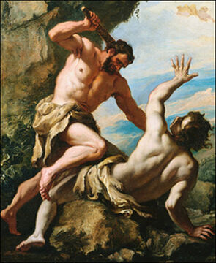
Matthew 23:13-36
Jesus use two examples: Abel and Zechariah the son of Berechiah.
Remember from Gen. 4:8-16 is the first
Murder; that of Abel the younger brother
of Cain. God said that “your brother’s
[Abel’s] blood is crying to Me from the
ground.” This cry elicits a curse that
rebounds from the ground and has very
dire consequences for Cain.

Slide 16
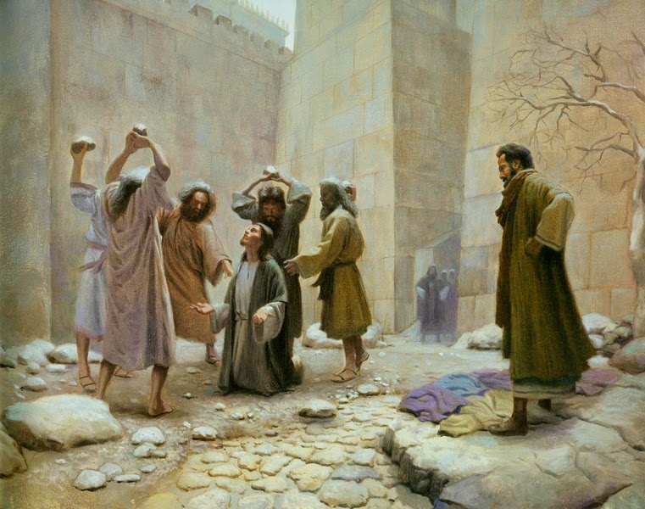
Matthew 23:13-36
The final example is more obscure. Jesus is describing the last murder recorded in the OT that of Zechariah the son of Berechiah.
This account is found in 2 Chr 24:20-22.
And what our Lord is teaching does present
some issues for us. Yet, we must remember
that God, our Lord, does not lie. What He is
doing is referring to a well known account
and “legend” at the time of our Lord.
It centers around the murder, as ordered by
King Joash, of a priest named Zechariah.
Jesus is using a patronymic, two men with
the same name that is used to reach a
spiritual conclusion.

Slide 17
Matthew 23:13-36
Thusly, Jesus is linking two very well known murders and brought defilement upon Israel. Their defilement will continue as God will continue to send missionaries to Israel and as Israel has done in the past, they will do in the future.
Judgment for an entire history of innocent blood will then come upon “this generation.” The judgment is limited to “this generation” since “this generation” will commit an even more horrendous murder…the murder of their Messiah! The result will be destruction and subjugation. Jerusalem and the Temple will be torn down as our Lord will now prophesy in vv.37-39.

Slide 18
Matthew 23:37-39
The final pericope of Chapter 23 is our Lord’s lament over Jerusalem. His time in Jerusalem is nearly over and He knows what is about to occur. Even so, we see in this pericope glimpses of grace, mercy, and hope. Jesus is lamenting over Jerusalem, not because He is about to die for their sins, and the sins of the entire world, but that Jerusalem refuses to repent
and believe that He is their
Messiah!
So let’s take a closer look at
all three verses.

Slide 19
Matthew 23:37-39
In verse 37, Jesus gives the first glimpse of grace, mercy and hope. There is a parallelism here, especially seen in the Greek. Literally, from the Greek, Jesus says, “How often I would have gathered together your children…and you were not willing.”
What our Lord wanted to do so often they did not want! Jerusalem’s unwillingness to
be gathered is actually the
main point of this chapter.
Even so, there is a note of
grace as Jesus “would have
gathered together....”

Slide 20
Matthew 23:37-39
The second glimpse of grace, mercy, and hope is found in the final statement of verse 39 where we’ll “round out” this pericope then. In the meantime, Jesus will make a solemn declaration in v.38, “Behold, your house is left desolate to you.”
The reference to “house” is
referring to the Temple.
This is a veiled rebuke and
a foretelling of the
destruction of the Temple
by the Romans in70 AD.

Slide 21
Matthew 23:37-39
Lastly, the last glimpse of grace, mercy, and hope is found in our Lord’s final statement, “For I say to you, you shall not see Me from now until you say, ‘Blesses [is] the [One] coming in [the] name of [the] Lord.’” There is hope for Israel if they would only shout the words of Ps. 118 and acknowledge that Jesus is their Messiah.
Jesus and His disciples now
depart the Temple courts and
make a short journey,
through the Kidron Valley, to
the Mount of Olives.

Slide 22
Conclusion
Next week we will be studying a section of St. Matthew that is alarming, confusing, and comforting! What we will hear is one of the most dominate discourses in St. Matthew. Our Lord will be teaching very crucial truths concerning the Kingdom of God and His reign.
As they arrive on the Mount of Olives and they are looking down on the Temple Mount, His disciples, once again, show that they have little understanding as to what He has been teaching. So Jesus will teach them, and us, about a coming judgment in the first century that portents of the final judgment at our Lord’s Second Advent and the Consummation of the Age.

Slide 23
August Class Schedule
Passion Week (Chapters 21:1 – 27:66)
D. The Fifth Discourse (Chapter 23:1 – 26:1)
1. Woe to the Scribes and Pharisees (23:1-36) (Aug 17)
2. The Lament over Jerusalem (23:37-39) (Aug 17)
3. Prophecy of the Destruction of the Temple (24:1-3) (Aug 24)
4. The End of the Age (24:4-51) (Aug 24)
5. The Parable of the Wise and Foolish Virgins (25:1-13) (Aug 31)
6. The Parable of the Talents (25:14-30) (Aug 31)
7. The Great Judgment (25:31 – 26:1) (Sep 7)

Slide 24
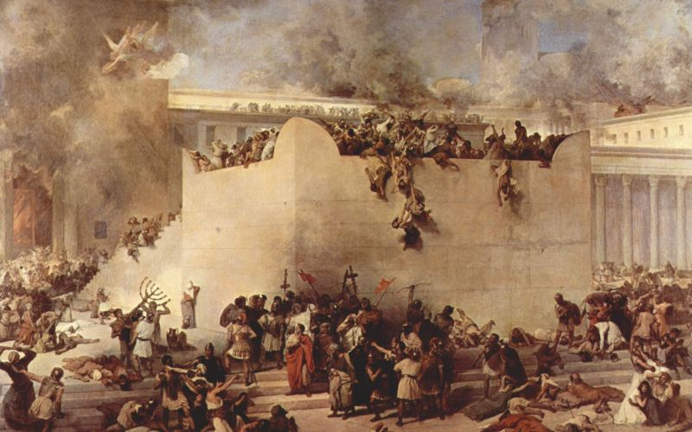
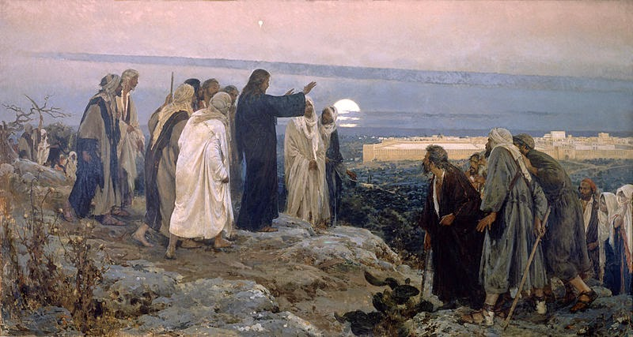
Passion Week
St. Matthew 24:1-51
The Destruction of the Temple
(1-3)
The Eschatological Discourse
(4-51)
The Lament Over Jerusalem
(37-39)

