Slide 1
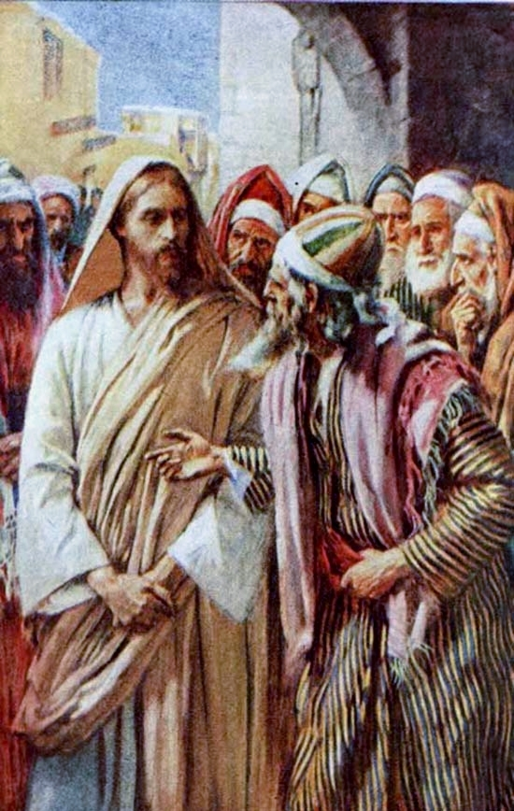
Passion Week
St. Matthew 22:34-46
The Greatest Commandment
(vv.34-40)
and
David’s Son
(vv.41-46)

Slide 2
Introduction
“Confrontation Tuesday” is about to reach its crescendo as a final question is asked of our Lord and, then, Jesus “turns the table” on the Pharisees with His final challenge concerning the Messiah!
St. Matthew 22:34-46 are often separated by many commentators. However, there are good reasons to treat this section as one distinct unit. First, some think there’s no challenge here by the scribe (lawyer). Yet, v.35 is quite clear that his question was asked in order to “tempt” Jesus. The Greek verb is: peiravzwn: to tempt with purpose; to entrap!
Secondly, the Pharisees are still present, gathered together “as one” with the continued purpose to discredit Jesus. The demand is to know how Jesus reads the Law of Moses. Thus, this is a single, two-part unit!

Slide 3
Matthew 22:34-40
³⁴And the Pharisees having heard that He had silenced the Sadducees, were gathered together as one. ³⁵Then one of them, a lawyer, questioned Him, testing Him, ³⁶“Teacher, which is the great commandment in the law?”
³⁷And He said to him, “‘You shall love [the] Lord your God with all your heart, with all your soul, and with all your mind.’ ³⁸This is the great and first commandment. ³⁹[The] second also [is] like it: ‘You shall love your neighbor as yourself.’ ⁴⁰On these two commandments, hangs all the law and the Prophets.”

Slide 4
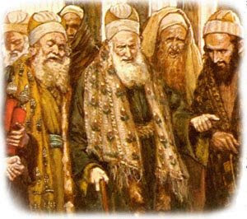
Matthew 22:34
³⁴And the Pharisees having heard that He had silenced the Sadducees, were gathered together as one.
It seems that the Pharisees, still gathered together or gathered “as one,” are quite impressed that Jesus has silenced the Sadducees (and we hear nothing of the Sadducees again!).
So, once again, they are embolden to ask another “gotcha” question concerning the Law.

Slide 5
Matthew 22:35-36
³⁵Then one of them, a lawyer, questioned
Him, testing Him, ³⁶“Teacher, which is the
great commandment in the law?”
One of their number, a lawyer, which St.
Mark calls a scribe, acts as their spokesman.
This man, a nomiko;V, that is, a man who was
a supposed “expert” in the Law of Moses
steps forward to “test” Jesus. These men
specialized in interpreting the OT and applying the teachings of established rabbis. Thus, the “test” is to ascertain our Lord’s orthodoxy! Was this Nazarene rabbi properly trained and could He rightly read the Law.

Slide 6
Matthew 22:35-36
³⁵Then one of them, a lawyer, questioned
Him, testing Him, ³⁶“Teacher, which is the
great commandment in the law?”
Another way to ask this questions is: “What
kind of commandment is great in the Law?”
The basis of the lawyer’s question is rather
obscure today, but it’s based on the 613
commandments of the Pharisees (248 –
positive; 365 – negative). Among so many commandments some would be less important than others! So the question is actually a “test” to see if Jesus agreed with them; or with the Sadducees who rejected all the 613 Pharisaic laws!

Slide 7
Matthew 22:37
³⁷And He said to him, “‘You shall love [the] Lord your God with all your heart, with all your soul, and with all your mind.’
They never learn! Jesus, again, goes to the heart of the Law. He recites back the most famous section of the Law that every Jew was taught from childhood: The Shema (Dt. 6:4-5). You are to totally love (ajgaphseiV – a future 2p, that denote a continuing, purposeful love with one’s whole being!).
The Lord your God (Kuvrion to;n Qeovn sou) is very profound and very important!

Slide 8
Matthew 22:37
³⁷And He said to him, “‘You shall love [the] Lord your God with all your heart, with all your soul, and with all your mind.’
The Lord your God (Kuvrion to;n Qeovn sou) literally means: The Lord The God of you! Jesus is using a phrase that was revered and well known amongst the Jews. YHWH is the “Eloheka,” the God of power and might. His Name is the great Name and embodiment of the Holy Gospel. These combined Names of YHWH denotes Love and Grace shown to all mankind! Thus, in NT wording, as our Father in Christ Jesus love us with the Divine Love of Fatherhood, so we are to love Him as His devoted children in Christ Jesus!

Slide 9
Matthew 22:37
³⁷And He said to him, “‘You shall love [the] Lord your God with all your heart, with all your soul, and with all your mind.’
All are to love the Lord your God: with all your heart, with all your soul, and with all your mind.’ The HEART is the very center of personality; here dwells the SOUL “the Life” of a person; and from there functions the reason, thoughts, ideas, and convictions of the MIND.
Since this is God’s commandment, spoken by The God-Man, we have a psychology of man as it is conceived by your Creator who certainly knows man (you) better than man (you) can possibly know oneself (yourself)!

Slide 10
Matthew 22:38-39
³⁸This is the great and first commandment. ³⁹[The] second also [is] like it: ‘You shall love your neighbor as yourself.’
(38) By its very quality it completely outranks all commandments (the Pharisaic 613)! The lawyer knew this, as did the Pharisees, and they can’t possibly contradict Jesus!
Our Lord’s point in quoting the second commandment, v.39, is the fact that God is love and His children are to love as He does. Thus, we are to love God, first and foremost; and then our neighbor (all people)! So the Law has two commands and they are the touchstone for everything else that God requires!

Slide 11
Matthew 22:40
⁴⁰On these two commandments, hangs all the law and the Prophets.”
The word “hangs” (krevmatai) is very important for us to know and fully appreciated in what our Lord means by the use of this verb.
Only once does this verb appear figuratively with no reference to physical execution and it’s here in v.40! Jesus is proclaiming that the moral fabric of the OT is portrayed as literally hanging from the twin beams of love for God and neighbor! This single statement affirms both continuity with the Law and its fulfillment in Christ’s love from the cross! There is Scriptural unity, OT and NT, in both commands (cf. Gal. 3:13)!

Slide 12
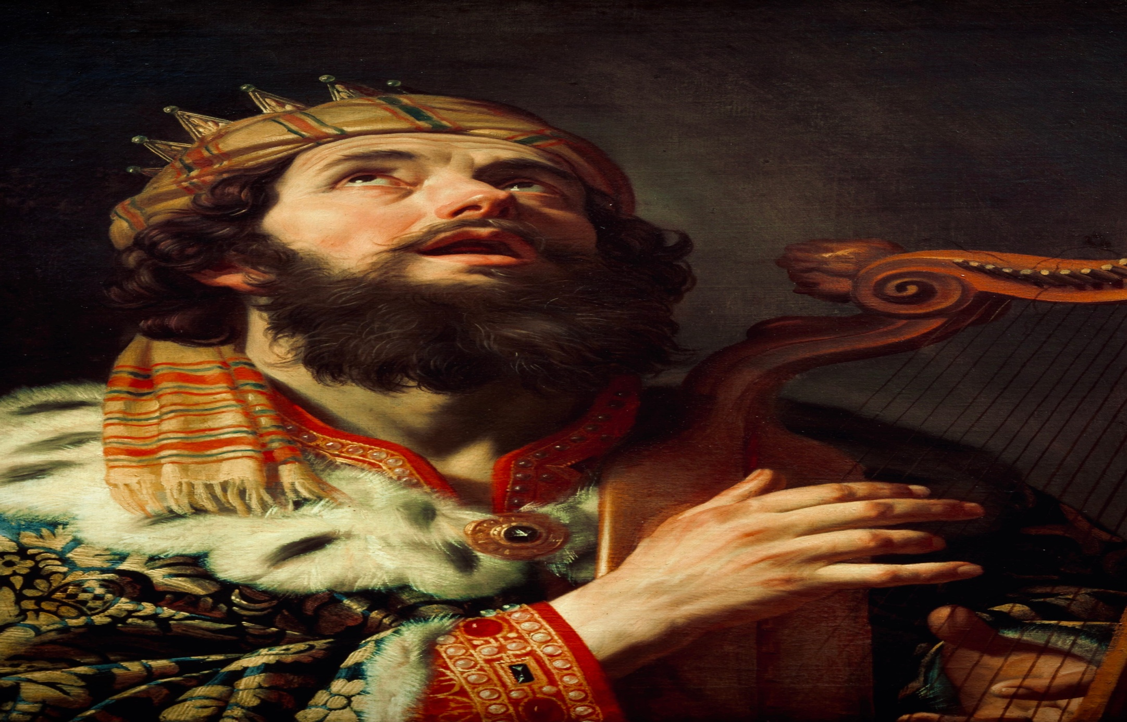
David’s Son (vv.41-46)
⁴⁰On these two commandments hangs all the Law and the Prophets.”
The word “hangs” (krevmatai) is very important for us to know and fully appreciated in what our Lord means by the use of this verb.
Only once does this verb appear figuratively with no reference to physical execution and it’s here in v.40! Jesus is proclaiming that the moral fabric of the OT is portrayed as literally hanging from the twin beams of love for God and neighbor! This single statement affirms both continuity with the Law and its fulfillment in Christ’s love from the cross! There is Scriptural unity, OT and NT, in both commands (cf. Gal. 3:13)!

Slide 13

David’s Son (vv.41-46)
Jesus now makes a dignified inquiry of the Pharisees and also of the pilgrims, every one present. He is asking them, point blank: Who is the Messiah?
Jesus has entered on Sunday to great rejoicing and the shouting of the Messianic title; even by young boys! So Jesus is asking…about Himself!
The Greek term that Jesus uses for Himself is: Cristou:! It’s a genitive noun…literally “God’s Christ” or “God’s Anointed One” or “God’s j1yv3m2”

Slide 14
David’s Son (vv.41-46)
Jesus has one purpose in asking… His great desire is that the Pharisees repent and believe that He, Jesus, is their Messiah!
He has expounded on the great and first Commandment and now ask about David’s Son and David’s Lord. Both are now linked together as your Lord’s motive is clear: His love of the great and first commandment… and His love is even being extended to those who desire His death!

Slide 15
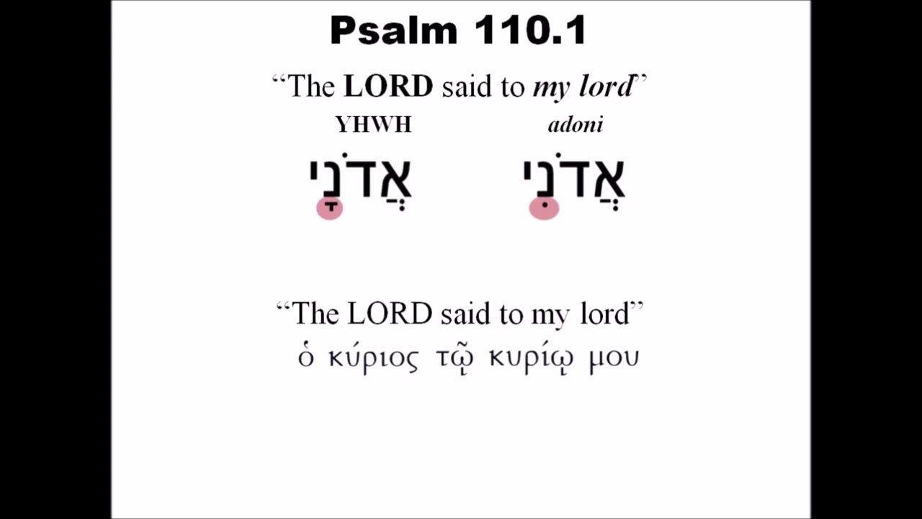
David’s Son (vv.41-46)
Jesus quotes from Ps. 110:1.
The first LORD is YHWH! The question as to the identity of second lord (adoni) is the basis of our Lord’s questions.

Slide 16
David’s Son (vv.41-46)
Note that Jesus is not rejecting the view of the OT that the Messiah would be the greater “Son of David.” The expectation is well grounded from 2 Sam 7 and is one of the most dominate themes in the OT’s proclamation of the Coming Anointed One, the Deliverer! Jesus is confirming that the Messiah IS the Son of David!

Slide 17
David’s Son (vv.41-46)
Secondly, our Lord’s citation of Ps 110:1 makes it clear that it’s not sufficient to say, as the Pharisees have, that only the Messiah is “David’s son! This is not adequate, since Jesus has come to be the Son of David in ways that completely contradict the expectations of the Jews! Also, this royal Son of David will fulfill that role in ways that neither His enemies nor His disciples can even comprehend (cf. 16:16-23).

Slide 18
David’s Son (vv.41-46)
Lastly, in quoting this Psalm, Jesus is claiming that God’s plan and God’s Son will not be opposed, forever, with impunity! The rejection of the Son will itself be rejected, and God’s Son will be glorified and exalted in a way that is barely able to be understood – by all men!
Thus, the Father speaks to His Messiah, His Son, inviting Him to the place of highest honor, repose, and vindication! Yet, His enemies will be forever subjected to disgrace and condemnation.

Slide 19
David’s Son (vv.41-46)
And no one was able to answer Him a word! The Pharisees, the pilgrims, and even His disciples were silent! Any unbelief and all opposition to our Lord had made them like a rotten tree that were unable to bear good fruit.
The Pharisees had accused Jesus of casting out demons in connection with Beelzebub. They truly are rotten to the core, as the inside of the tomb is filled with death. In the most profound sense, they, and all. could not give response. So Jesus will now turn in Ch 23 to warn His disciples and the crowds concerning the Pharisees.

Slide 20
August Class Schedule
Passion Week (Chapters 21:1 – 27:66)
D. The Fifth Discourse (Chapter 23:1 – 26:1)
1. Woe to the Scribes and Pharisees (23:1-36) (Aug 17)
2. The Lament over Jerusalem (23:37-39) (Aug 17)
3. Prophecy of the Destruction of the Temple (24:1-3) (Aug 24)
4. The End of the Age (24:4-51) (Aug 24)
5. The Parable of the Wise and Foolish Virgins (25:1-13) (Aug 31)
6. The Parable of the Talents (25:14-30) (Aug 31)
7. The Great Judgment (25:31 – 26:1) (Sep 7)

Slide 21
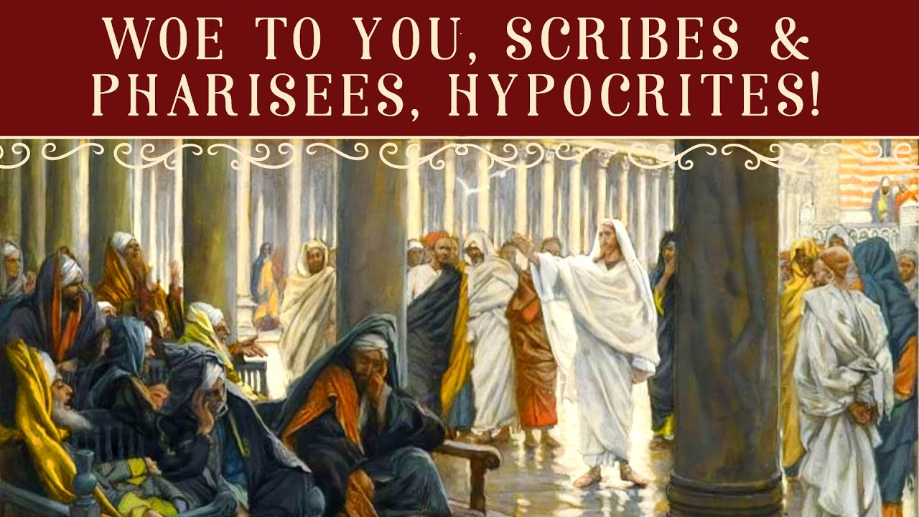
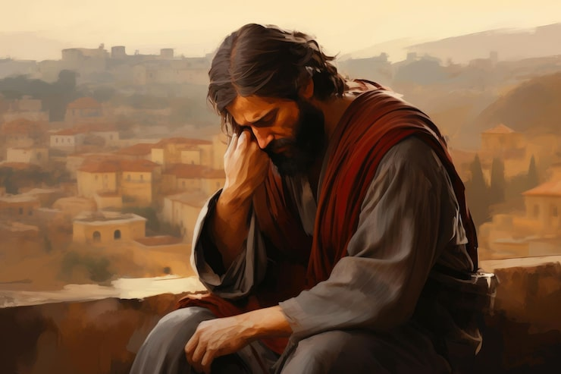
Passion Week
St. Matthew 23:1-39
The Seven Woes
(1-36)
The Lament Over Jerusalem
(37-39)

