Slide 1
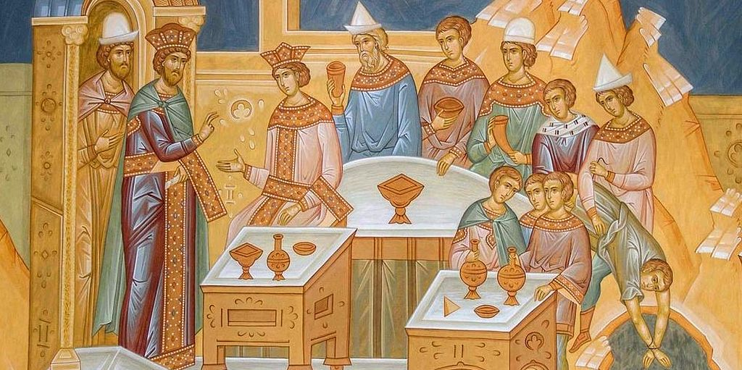
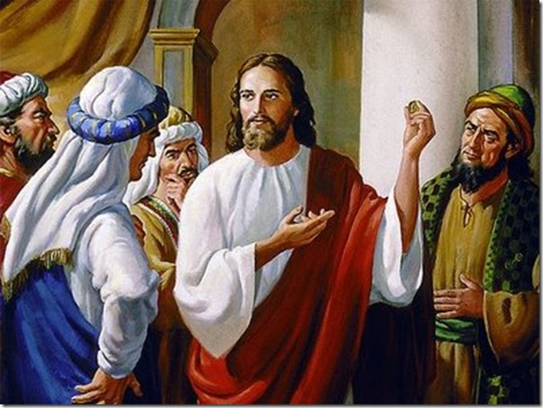
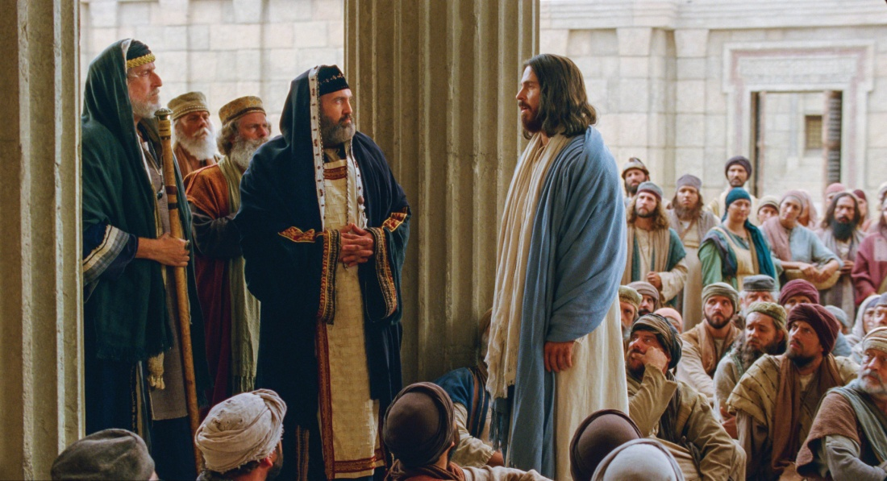
Passion Week
St. Matthew 22:1-33
Parable of the
marriage feast
Paying taxes to Caesar
Questions about the resurrection

Slide 2
Introduction
“Confrontation Tuesday” continues after a short pause as Jesus then speaks another parable addressed to the Sanhedrinists and the pilgrims.
St. Matthew 21:23-22:14 lists a series of three parables. It is our Lord’s final answer to the arrogant question asked of Him in 21:23. The threat that the kingdom of God “would be given to a nation to bring forth the fruits thereof” (21:43) is followed by a parable which repeats the truth. It is a reply to the hostile thoughts and plans of His enemies, warning them that, unless they cease their enmity, judgment will come upon them.
In His great patience and mercy, Jesus heaps parable on parable as a final call of repentance to His enemies and their followers.

Slide 3
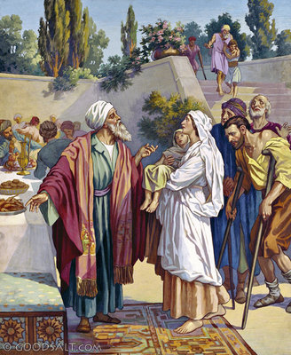
Parable of the Wedding Feast
Matthew 22:1-14

Slide 4
Parable of the Wedding Feast
(V.1) Jesus spoke to them again in parables, saying:
Jesus responds, not to something the Sanhedrists had said, but obviously to what they were thinking. This verse indicates our Lord’s Divine Omniscience. “Again,” though they harbored murderous thoughts, He added another parable. Why use the plural for one parable? Evidently because in this parable there are many points of comparison. Perhaps we might paraphrase: “in extensive parabolic language.” “Them” are His enemies mentioned in 21:45, but very likely includes those that are also their followers.

Slide 5
Parable of the Wedding Feast
(V.2) “The kingdom of heaven is like a King who prepared a wedding banquet for His Son.”
Here “the Kingdom of Heaven” denotes the grand sweep of the preaching of the Holy Gospel among both Jews and Gentiles until the end of time.
“A King” denotes God the Father. “A wedding feast” includes the Atonement, the means of grace and the work of the Holy Spirit applied equally to all men. “His Son” is the incarnate Son of God.

Slide 6
Parable of the Wedding Feast
(V.3) “He sent His servants to those who had been invited to the banquet to tell them to come, but they refused to come.”
“He sent” denotes a sending with a special commission; does “His servants” include the prophets? No, Jesus is referring to His Apostles (sent ones). “To tell,” of the Holy Gospel of which they will soon receive by commission (cf. St. Matthew 28:19, 20). The “them” are those who hear the Gospel and are “the invited.” The Apostles called those who had already been invited. This invitation is in keeping with Eastern custom.

Slide 7
Parable of the Wedding Feast
(V.3) “He sent His servants to those who had been invited to the banquet to tell them to come, but they refused to come.”
Indeed, this is actually the second invitation! Distinct amongst the Jews was the fact that they would not attend a wedding feast till the invitation had been given twice! In fact, this is the second invitation, via the Holy Gospel, since the Jews had already been invited under the OT from the many prophets and promises of the King!

Slide 8
Parable of the Wedding Feast
(V.3) “He sent His servants to those who had been invited to the banquet to tell them to come, but they refused to come.”
In this banquet, proper etiquette is not overlooked, as not to offend even the rich and powerful of the invited guests! Throughout the OT, and especially when Christ came, God, in Christ, humbled Himself and treated the Jews most courteously in the Gospel. That is the point!
But they were refusing to come as Jesus pointedly said in St. John 5:40: “…yet you do not wish to come to Me to have life.”

Slide 9
Parable of the Wedding Feast
(V.4) “Then He sent some more servants and said, 'Tell those who have been invited that I have prepared my dinner: My oxen and fattened cattle have been butchered, and everything is ready. Come to the wedding feast!’”
The King has great patience! Under ordinary circumstances a king would certainly not have extended another invitation after the first had been rejected. “More servants” are more apostles (e.g., St. Paul), missionaries, evangelists, pastors! The parable is heightened by the fact that the messengers are given the very words which they are to say. Thus, this parable embraces the history of the Church! “My oxen and fattened cattle have been butchered, and everything is ready” is the fullness of the Gospel. Then the second Gospel invitation: “Come to the wedding feast!”

Slide 10
Parable of the Wedding Feast
(V.5) “But they paid no attention and went off--one to his field, another to his business.”
Note that we have two classes of people, one in this verse and one in verse 6. The first shows total disinterest, the second hostility. “Paid no attention” is variously translated: “made light of it, merely laughed, paid no attention, were not interested, took no notice.” In other words, they mocked the Gospel!
This group is divided into two subgroups. Both denote sophisticated people of earthly means. The point is that they are sunken in mere material and earthly matters; materialists who care little about anything, but self!

Slide 11
Parable of the Wedding Feast
(V.6) “The rest seized His servants, mistreated them and killed them.”
Here we have the second group. “His servants” are, again, the Apostles, missionaries, evangelists, pastors…and you! It’s all those sent to announce/proclaim the Feast of the Gospel! Note that all three verb forms are violent: “seized,” “mistreated” (in an insulting manner), and “killed.” We think immediately of the Baptist, Stephen, James, Peter, and all martyrs! All the Apostles died a violent death, with the exception of St. John. The Book of the Acts of the Apostles is not only an account of the Apostles preaching justification by faith; but, also, an account of how God’s servants were treated – with violence and death!

Slide 12
Parable of the Wedding Feast
(V.7) “The King was enraged. He sent His army and destroyed those murderers and burned their city.”
God the Father was “enraged.” He was filled with wrath! The violent verbs in verse 6 are met with the King’s stern justice. Here we have another form of “send” that of justice, not a sending of the Gospel, but the Law!
This is a prophecy of the coming destruction of Jerusalem by Titus 70 A.D. The destruction of Jerusalem was recorded by Josephus. and it’s an awful account.
“Those murderers” are those whom God had invited again and again! “And burned [down] their city” is a very precise prophecy, which is exactly what occurred under Titus. The Jews developed factions in besieged Jerusalem and began burning each other's grain supply. They were so violent that they helped to bring about God’s judgment upon themselves!

Slide 13
Parable of the Wedding Feast
(V.8) “Then He said to His servants, 'The wedding banquet is ready, but those I invited did not deserve to come.’”
“Then” signifies a turning point. Note that the King does not cease to send missionaries. God did not abandon the marriage feast of His Son. Man’s indifference toward the Holy Gospel or even his persecution of God’s servants in no way inhibits or stops the progress of the Gospel. In fact, it’s the opposite! Remember, you do NOT labor in vain.
“[B]ut those I invited did not deserve to come.” Lets read Acts 13:46-47. What caused the unworthiness? Luther answers, “He is truly worthy and well-prepared who has faith in these words ‘Given and shed for the remission of sins.’” Faith in the promises of God makes you worthy…rejection (unbelief) makes you unworthy.

Slide 14
Parable of the Wedding Feast
(V.9) ‘Go to the street corners and invite to the feast anyone you find.’
In view of the rejection, the King orders that His servants “Go…invite” that reminds us of St. Matthew 28:19, 20. It’s a present imperative referring to the NT era.
“Street corners” or “highways, main highways, where the roads leave the city, street corners, thoroughfares, main streets, crossroads, main thoroughfares.” It means “where people are congregated.” “Anyone” means literally who ever you find.

Slide 15
Parable of the Wedding Feast
(V.10) “So the servants went out into the streets and gathered all the people they could find, both bad and good, and the wedding hall was filled with guests.”
The turning point came on the Day of Pentecost! Now, there is no more a distinction to be made between Jews and Gentiles.
“Both bad and good” from the human standpoint. But Romans 3:23-24 tells us how it is from God’s standpoint: “…for all have sinned and fall short of the glory of God, being justified freely by His grace through the redemption that is in Christ Jesus…,”
The original guests who rejected the invitation did in no way frustrate the final purpose of the King. The hall was filled with guests.

Slide 16
Parable of the Wedding Feast
(V.11) “But when the King came in to see the guests, He noticed a man there who was not wearing wedding clothes.”
According to Eastern custom, guests were furnished with robes when they arrived at the feast. Furthermore, people who had been invited indiscriminately could hardly have furnished their own robes in every case. And, finally, “everything is ready” in v.4 indicates that even in the case of people who knew in advance that they were invited, robes were provided by the King.

Slide 17
Parable of the Wedding Feast
(V.12) ‘Friend, He asked, how did you get in here without wedding clothes?' The man was speechless.”
“Friend” is never used in a “friendly” manner, it’s a criticism. The question: ”How did you get in here without a wedding garment?” does not mean that judgment will take place inside heaven. In application, Jesus is talking about a hypocrite. He seemed to accept the invitation, but not in faith!
“He was speechless” is a passive verb! Lutheran commentators are unanimous in saying that the text is speaking of the righteousness of faith, not the righteousness of life (cf. Phil 3:7-14). First, St. Paul speaks of the righteousness of faith which leads to everlasting life, then of the righteousness of life.

Slide 18
Parable of the Wedding Feast
(V.12) ‘Friend, he asked, how did you get in here without wedding clothes?' The man was speechless.”
It’s true what Jesus said in St. Matthew 5:20 where He speaks of the righteousness of life. It’s also true that St. Paul could speak of both the righteousness of faith and the righteousness of life in one verse (cf. Gal 2:20). And the Formula of Concord points out, that good works are necessary, not as requirement of merit, but as a fruit of justifying faith as does our Lord in St. John 15:1-15. Even good works are a gift of God in Christ Jesus (Eph 2:8-10).
The “wedding clothes” was a gift from the King. A Christian would not say that it is of his own making (work)! Our righteousness is as filthy rags. But Christ Jesus is our garment of righteousness (Rom. 13:14; Gal 3:27; Is 61:10). Without imputed righteousness, all will be “speechless” on Judgment Day!

Slide 19
Parable of the Wedding Feast
(V.13) “Then the King told the attendants, ‘Bind him feet and hands, and throw him outside, into the darkness, where there will be weeping and gnashing of teeth.’
In vv.3, 4, and 8, the human messengers are “servants.” Here the “attendants” are His angels. The figure of “binding” both “feet and hands” denotes the total loss of freedom, total helplessness, imprisonment! The imagery is stark! Furthermore, the “outer darkness,” is the total lack of all light, the end of mercy!
This is hell, in contrast to the “wedding feast.” The weeping and gnashing of teeth is strong imagery for the remorse of the damned. Jesus is speaking of the damnation of the hypocrite, the person who passed among people as a Christian, but was not! Jesus does not mean that there is only one hypocrite. In view of v.14, there are many! Jesus mentions only one as an example.

Slide 20
Parable of the Wedding Feast
(V.14) “For many are invited, but few are chosen.”
This verse is quoted only once in the Book of Concord, Formula of Concord, Solid Declaration, Art. XI, Election, paragraphs 14-32, where Chemnitz beautifully discusses the doctrine of election. The doctrine of election, truly taught and truly understood and believed, is a most comforting doctrine. Election is purest Gospel. It should never be presented as an arbitrary decree or as fate. It should never be pitted against the universal atonement. It should always be presented to the believer as the blessed assurance that what has happened to YOU in time (conversion/regeneration through the Means of Grace) is of God’s eternal purpose and grace in Christ Jesus to preserve YOU in the true faith unto eternal life!!!
This verse tells us that more will be lost than those who are saved. Why? Because they rejected what God, in Christ Jesus, had done for them.

Slide 21
Parable of the Wedding Feast
(V.14) “For many are invited, but few are chosen.”
In summary, v.14 applies to the entire parable. Vv.1- 7 applies to the Jews. The majority of their leaders and the people who followed them rejected the call to repentance. But the elect were found among them, both leaders and people. Vv.8-13 applies to both Jews and Gentiles. The elect were and are still found among both Jews and Gentiles.
Therefore, to reject the invitation (vv. 2-7) is eternally fatal! To be a hypocrite, to appear to have accepted the King’s invitation, but to reject the imputed righteousness of Christ (vv. 8-13), is likewise eternally fatal! There are hypocrites in the visible Church! They will be exposed on the Great Day of Judgment!

Slide 22
Paying Taxes to Caesar

Slide 23
Paying Taxes to Caesar
In this pericope (15-22), the Pharisees and Herodians collaborate against Jesus in a most diabolical, sinister and hypocritical fashion. It’s truly remarkable that they use our Lord’s (good) tactics in an evil way. As Jesus had done (21:28) they ask: “What do you think?” This is followed by a diabolical “either-or” question which is intended to trap Him.
The Pharisees send a group of their keenest students to go with the Herodians to catch Jesus with the dilemma about paying tribute to Caesar, a live question in current politics and theology. They offered Jesus the alternative of popular disfavor or of disloyalty to the Roman government. Jesus had asked an “either-or” question for their own good. Then He said: “What do you think?” and they had to answer their question, but refused. However, Jesus answers their “either-or” question in a most remarkable and Divine way!

Slide 24
Political Background
In 63 BC, Palestine was conquered by Rome, ending about 80 years of Jewish independence;
Following two generations under Jewish client rulers, in 6 AD the Romans sent in their own governors; and,
In 30 AD, at the time of our Lord’s ministry, this governor was Pontius Pilatus (Pontius Pilate).

Slide 25
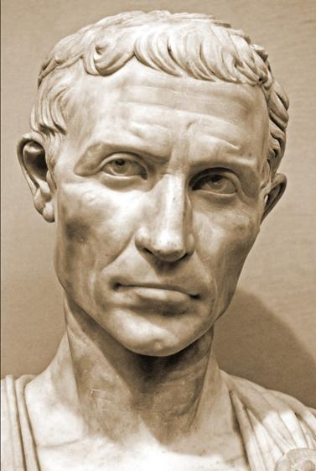
Pontius Pilatus
        According to Holy Scripture and Josephus, Pilate was an very insensitive ruler.
        He had tried to bring the Roman army’s standards into Jerusalem, in spite of their having pagan symbols on them.
  He had appropriated Temple money to build an aqueduct.
  He had used violence against suspected rebels, even in the Temple.

Slide 26
Jewish Reactions
This varied among the people and the diverse Jewish groups, but was generally negative:
    The Sadducees were the most favorable, as they profited from Roman rule.
    The Herodians were apparently next, though they preferred that Herod’s family rule.
    The Pharisees were anti-Roman, but cautious.
    The Zealots were fiercely anti-Roman, willing to assassinate opponents & to revolt.

Slide 27
Religious Background
Since Augustus’ time, the Roman emperor had often been worshiped in the Roman Empire.
Pontius Pilate had put a picture of the pagan priest’s staff (lituus) on copper coins minted for use in Judea.
Silver and gold coins had a picture of the emperor on the front, with inscriptions & symbols that were offensive to Jews.

Slide 28
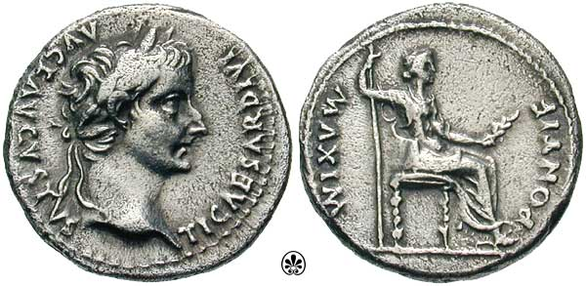
The Denarius
Front: An icon of Tiberius, with text: “Tiberius Caesar Augustus, Son of the Divine Augustus”
Rear: An icon of Tiberius as the priest: “Pontifex Maximus” (the chief priest of the Roman religion).

Slide 29
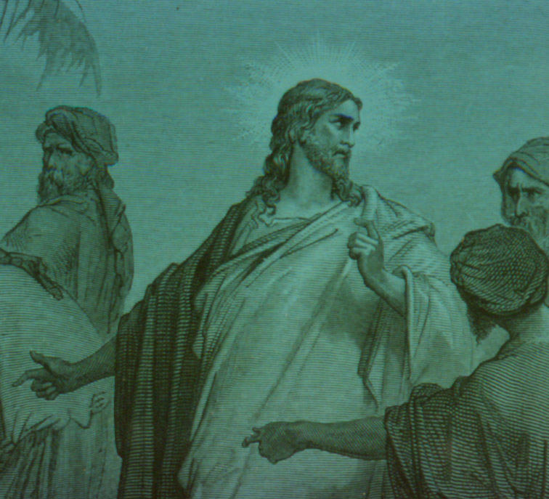
The Confrontation
The Pharisees figured they had devised the perfect plan to discredit Jesus:
If Jesus said to pay taxes, then:
  They could accuse Him of tacitly accepting idolatry and Roman rule.
  This would ruin His influence with the people.
If He said not to pay taxes, then:
  The Herodians would accuse Him to Pilate.
  He could be executed for sedition.

Slide 30
The Confrontation
Jesus sees through their plan, asks them for a coin of the taxation (a denarius).
They may have thought that Jesus was stalling for time, so they provide a denarius!
But in doing this, they inadvertently admit that they are using such coins themselves!
From then on, the rest of Jesus’ answer leaves them shot down, with nothing to use to accuse Him, either to the people or the Romans!

Slide 31
The Confrontation
Jesus asks them whose picture & inscription is on the coin.
They answer “Caesar’s”
As is often seen on coins of this period, the name of the ruler is given in the genitive case, meaning “belonging to…”
So Jesus tells them to give back to Caesar what belongs to him; then to give back to God what belongs to Him!

Slide 32
The Summation
Our Lord’s answer took them by surprise; they had no choice be to leave Him. They attempted to set a trap for Jesus, but fell into their own trap!
Thus, when we adhere diligently to the Word of God and to our Lord, in true repentance, the traps which others set for us will become their undoing, rather than ours.
The true evil is this: Though they went away “licking their wounds” their hearts had not been changed!

Slide 33
Questions Concerning the Resurrection
Verses 23-33

Slide 34
Questions Concerning the Resurrection
St. Matthew begins this pericope with a clear statement that the Sadducees came to Jesus “on that day” (Tuesday). Thus, confrontation continues even though the Pharisees and Herodians have departed!
As we have discussed, the Sadducees are found primarily in an around the Temple and were seen as arrogant and not friendly of the people.
Theologically, they disavowed the Pharisees, did not believe in angels or spirits, and openly stated that they did not believe in the resurrection of the dead.

Slide 35
Questions Concerning the Resurrection
The question that they ask our Lord
concerns levirate marriage (Dt. 25:5).
The idea behind this law was not to let
a dead childless brother’s line die out.
Yet, there real question follows in vv.25-28!
Their argument is completely absurd, though they thought that they had Jesus on the “horns of a dilemma.” They are truly an example of learned men who study God’s Word by mean of their own logic as they attempt to show the irrationality of the resurrection in light of Dt. 25:5.

Slide 36
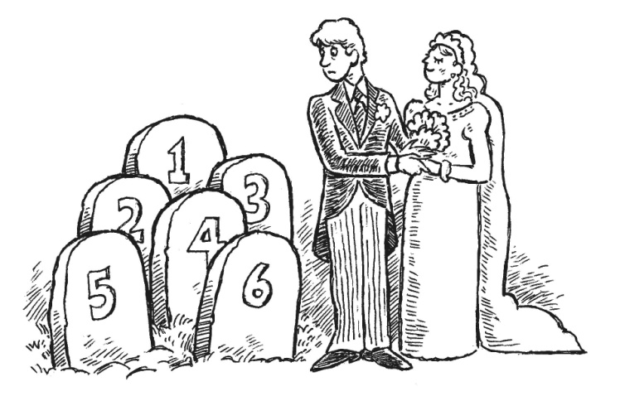
Questions Concerning the Resurrection
The Sadducees want to know of the seven brothers, which one will be the husband of the woman?
Since they do not believe in the resurrection, and that Moses confirmed such in Deuteronomy, and that no one has overthrown their logic; they were certain that Jesus would fail their test!
Jesus answers and “pops their bubble,” “You are deceiving yourselves, not having known the Scripture neither the power of God!” Our Lord declares that the OT reveals the resurrection, even the power of God in the way in which He will raise the dead!

Slide 37
Questions Concerning the Resurrection
The supposed horns of dilemma on which Jesus was to impale Himself suddenly disappears! “For in the resurrection neither do they marry (men), nor are they given in marriage (women).” Thus, as God’s heirs, we will never die in His Kingdom; so, marriage will not be necessary since procreation will not be necessary!
Clearly, the Sadducees had falsely appealed to the Scriptures (as did Satan in 4:6); Jesus crushes their appeal by His correct use of the Scriptures! Scriptures are the true court of appeal!

Slide 38
August Class Schedule
Passion Week (Chapters 21:1 – 27:66)
C. The Last Controversies with the Jewish Leaders (21:18 – 22:46)
1. Cursing of the Fig Tree (21:18-22) (7/27)
2. Authority of our Lord is Questioned (21:23-32) (7/27)
3. The Parable of the Tenants (21:33-46) (7/27)
4. The Parable of the Marriage Feast (22:1-14) (Aug 3)
5. Paying Taxes to Caesar (22:15-22) (Aug 3)
6. Questions about the Resurrection (22:23-33) (Aug 3)
7. The Great Commandment (22:34-40) (Aug 10)
8. David’s Son (22:41-46) (Aug 10)
D. The Fifth Discourse (Chapter 23:1 – 26:1)
1. Woe to the Scribes and Pharisees (23:1-36) (Aug 17)
2. The Lament over Jerusalem (23:37-39) (Aug 17)
3. Prophecy of the Destruction of the Temple (24:1-3) (Aug 24)
4. The End of the Age (24:4-51) (Aug 24)
5. The Parable of the Wise and Foolish Virgins (25:1-13) (Aug 31)
6. The Parable of the Talents (25:14-30) (Aug 31)
7. The Great Judgment (25:31 – 26:1) (Sep 7)

Slide 39
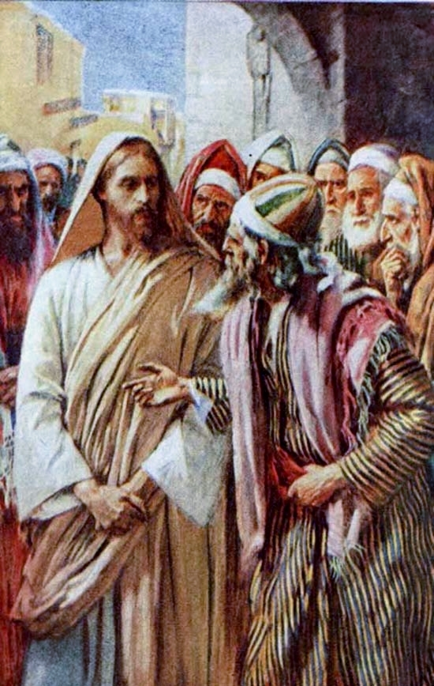
Passion Week
St. Matthew 22:34-46
The Greatest Commandment
(34-40)
and
David’s Son
(41-46)

