Slide 1
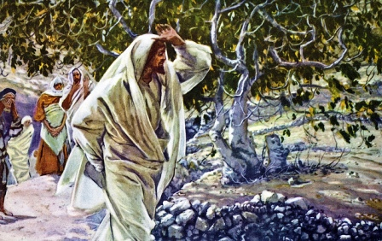
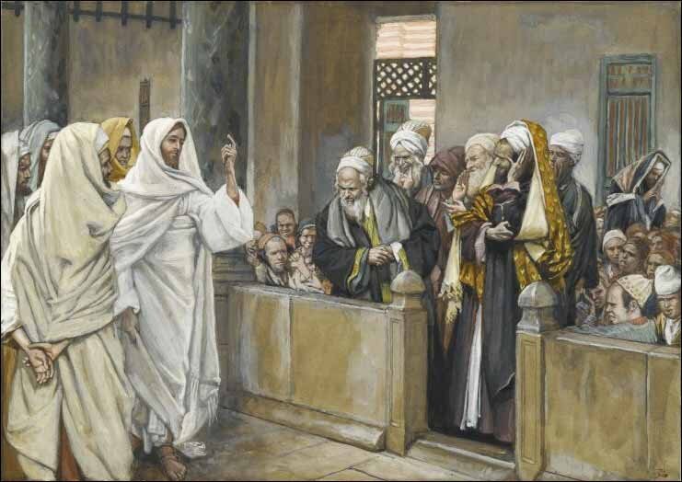
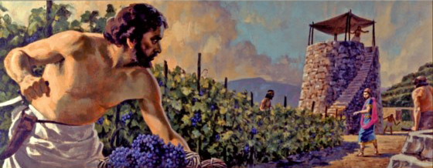
Passion Week
St. Matthew 21:18-46
Cursing of the Fig Tree
His Authority Questioned
The Parable of the Tenants

Slide 2
Introduction
As we heard last week, Jesus departed Jerusalem and probably stayed the night at the home of Lazarus in Bethany.
The next morning (Monday; cf. St. Mark 11:12) Jesus returns to Jerusalem (vv.18-19).
Verse 20 will immediately move us to Tuesday of Holy Week. It’s commonly called “Confrontation Tuesday” and we will take an in-depth look at all that Jesus taught on this very important day (scheduled to concluding on Sep 7!)!

Slide 3
St. Matthew 21:18-19
“Monday of Holy Week (Fig Monday)”
Once again, St. Mark does not allow us to guess (cf. 11:12). There is a fact that St. Matthew reports that no one can explain: “…returning to the city, He was hungry.”
And now, v.19, and it is important to know that this fig tree was “by the road” (ownerless). But, why this particular tree?

Slide 4
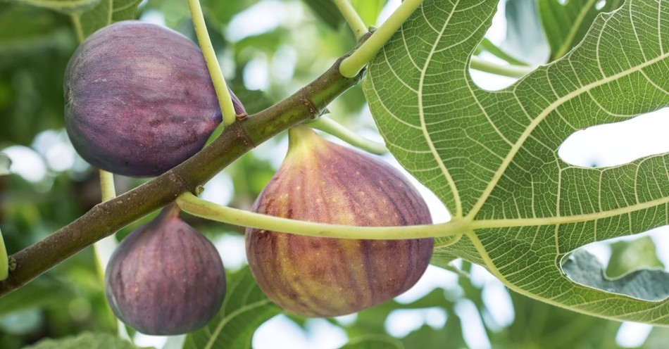
St. Matthew 21:18-19
“Monday of Holy Week (Fig Monday)”
Fig trees produce tree crops: One in June; the second in August; and the last in December. Thus, the tree wasn’t yet producing! So why did our Lord curse this tree?

Slide 5
St. Matthew 21:18-19
“Monday of Holy Week (Fig Monday)”
Jesus found only leaves…no fruit! Note this is April…and the tree is in full foliage. Thus, Jesus was expecting to find fruit…but none…only leaves! Grand foliage…no fruit…a deceit!
Jesus tells us why He curses the tree, “No more shall there be fruit from thee forever” (v.19). The tree, though in full foliage, begins to “wither” (paracrh:ma). But not before their very eyes…the tree began to dry up from its roots!

Slide 6
St. Matthew 21:20-22
“Tuesday of Holy Week (Confrontation Day)”
St. Matthew, again, isn’t interested in chronology, but the essential…Jesus is the Messiah! So he immediately takes us to Tuesday morning.
+ We know it’s Tuesday, since St. Mark tells us (11:20). Note that the disciples “saw it” (ijdovnteV).
+ Thus it was dark when they return to Bethany on Monday night; verse 20, therefore, is on Tuesday morning.
+ The Fig tree is dead! So they ask, “how?”

Slide 7
St. Matthew 21:20-22
“Tuesday of Holy Week (Confrontation Day)”
Jesus answers their “how” in verse 21. We have to be careful how we exegete our Lord’s response!
+ First, He say “…have faith” that’s made clear by “do not doubt!” Faith must be continuous; yet, just a little doubt prevents faith!
+ In v.21, Jesus uses two important “passive” verbs: “You be taken away” (a[rqhti) and “you be thrown” (blhvqhti). These two verbs have an agent, since they are passives, God! And “faith” and “prayer” are the keys!

Slide 8
St. Matthew 21:20-22
“Tuesday of Holy Week (Confrontation Day)”
The purpose behind this pericope is to teach that pretense will be judged. The “false” fig tree represents unbelieving Israel (Pharisaic Judaism). It withered due to the judging word of God (cf. Is 63:7 – 64:12).
True, Jesus had not come to judge men, but to seek and save (see also St. John 3:17)! However, judgment will come in due time (St. John 5:27; and the imagery that the Baptist uses in St. Matthew 3:10).

Slide 9
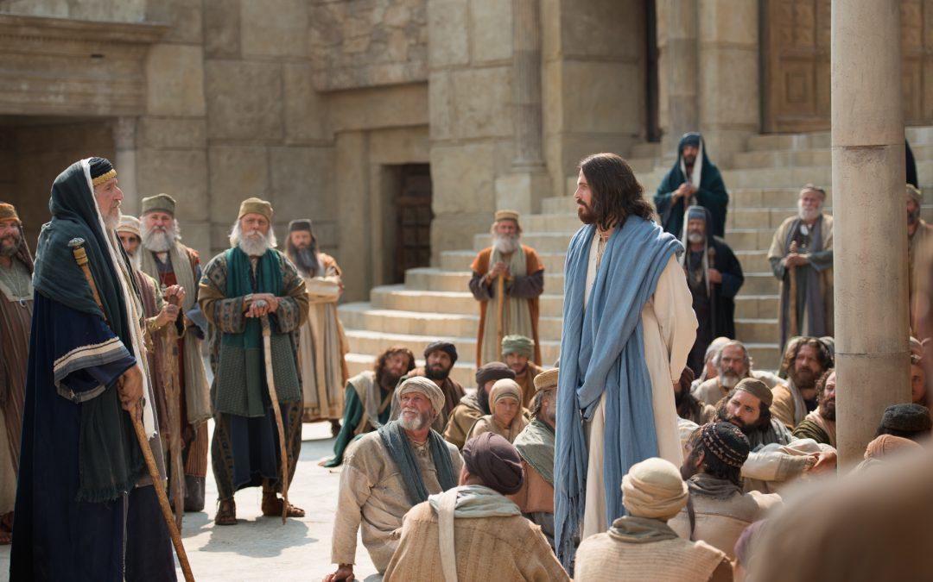
St. Matthew 21:23-27
“Tuesday of Holy Week (Confrontation Day)”
Our Lord has now come to the
Temple. The Jews have been
waiting for a time in which to
confront Jesus. Remember,
this has been “brewing” since
Sunday. Yet, in fear of the
Pilgrims they exercise some
restraint.
Note how they begin their challenge; it’s quite mild, in the form of one question with two parts. There challenge has to do with what “authority” and from whom does Jesus do “these things.”

Slide 10
St. Matthew 21:23-27
“Tuesday of Holy Week (Confrontation Day)”
“[T]hese things” refer to His royal entry and the miracles that He worked on Sunday; the cleansing of the Temple on Monday, and even His “authority” as a rabbi!
Let’s go back to the beginning of our Lord’s ministry and read St. John 2:18.
+ They were, essentially, asking the very same question(s) again! Over the past three years, they had not advances an iota beyond their first challenge! Unbelief never, ever makes progress!

Slide 11
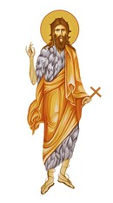
St. Matthew 21:23-27
“Tuesday of Holy Week (Confrontation Day)”
The Jews knew from where Jesus received His authority; however, they refused to accept and therefore denied Jesus this authority; since, to acknowledge, would mean acceptance of Jesus as their Messiah.
Jesus now counters their question with His
own. He is not evading; He is turning the
table…: John’s authority…from heaven…or
from men?

Slide 12
St. Matthew 21:23-27
“Tuesday of Holy Week (Confrontation Day)”
So if John’s authority to baptize is from heaven then John had Divine authority; however, if from men, his authority amounts to nothing!
Our Lord’s point…the authority of John the Baptizer and His are Divine! The correct answer about John is the correct answer concerning His authority.

Slide 13

St. Matthew 21:23-27
“Tuesday of Holy Week (Confrontation Day)”
John’s baptism was either from heaven or it was from men; either with Divine authority or not! Now the Scribes and Pharisees are on the horn of a dilemma!
DIVINE
NOT DIVINE

Slide 14
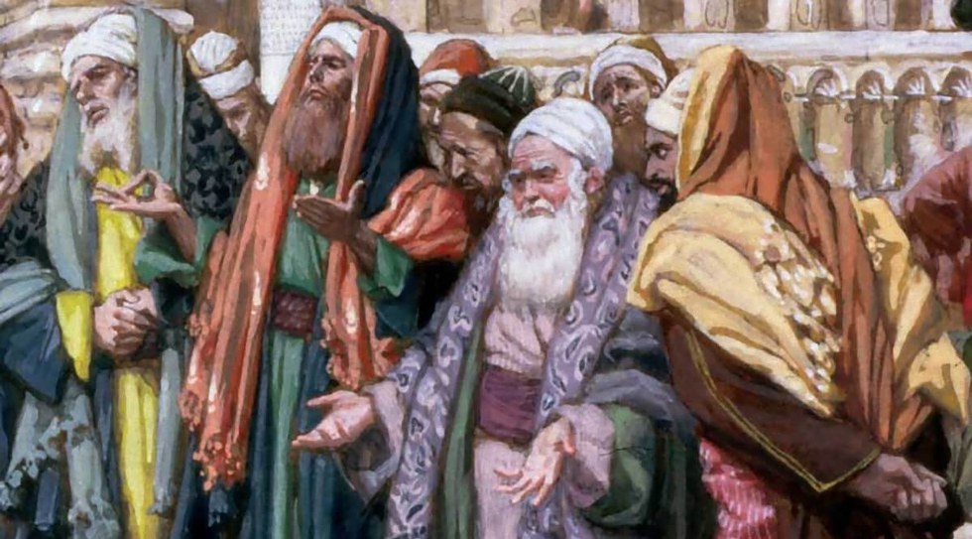
St. Matthew 21:23-27
“Tuesday of Holy Week (Confrontation Day)”
So since there’s no way out…what do evil men do???
“We do not know!”
LIARS!

Slide 15
St. Matthew 21:23-27
“Tuesday of Holy Week (Confrontation Day)”
There is a further sin, though not stated, but implied. From St. Mark 11:18 and St. Luke 19:47, which happened on Monday, tell us that the chief priests and the scribes were trying to destroy Jesus. Note how these unbelievers are following the devil as he is described in St. John 8:44. The devil causes unbelief, deceit, lies and murder. Yet, the Light of God’s Word exposes his evil and so he flees.

Slide 16
St. Matthew 21:23-27
“Tuesday of Holy Week (Confrontation Day)”
So while these liars stand before Him, thoroughly defeated, Jesus will now speak a very lucid, simple parable that will end in a question that can be answered only one way! By means of His question, and the Jews answer, He exposes the wickedness of their unbelief…these supposed religious leaders of Israel!

Slide 17
St. Matthew 21:28-32
“Tuesday of Holy Week (Confrontation Day)”
The Parable of the Two Children!
Jesus is now going to leave the whole matter to them: “How does it seem to you?”
Let’s summarize:
+ A man has two “children” (tevkna) – denotes filial love!
+ He asks his first child (tevknon), which is a very tender address, to work in the vineyard; the child answers with a shocking response that’s very disrespectful, “I will not!”
+ Later, this wicked child has regret (metamelhqei;V).
+ In his regret, he is obedient and goes to work!

Slide 18
St. Matthew 21:28-32
“Tuesday of Holy Week (Confrontation Day)”
The Parable of the Two Children!
+ He asks his second (tevknon) in the same way. His response is enthusiastic & respectful, “I will, lord!”
+ However, this wicked child didn't go!
+ His enthusiasm is false and his character is clear.
Now our Lord has them…only one plausible answer is possible! Note Jesus asks which child “did” the will of their father! And the Jews have to say the first! In their answer, they condemn themselves.

Slide 19
St. Matthew 21:28-32
“Tuesday of Holy Week (Confrontation Day)”
The Parable of the Two Children! The Divine Conclusion
The Jews are right in commending the first child; these publicans and harlots who at first openly refused to be obedient; yet, later in regret of their wickedness, believed and obeyed!
And the Jews are also right to condemn the second child – but this child pictures them! At first, they were enthusiastic and obedient; however, it was false, a lie! They are false children (a false fig tree) of the father. They confess with their lips, but deny by their lives!

Slide 20

St. Matthew 21:33-46
Parable of the wicked tenants

Slide 21
St. Matthew 21:33-46
This parable is also found in St. Mark 12:1-12 and St. Luke 20:9-19. St. Luke’s is abbreviated, in comparison with Sts. Matthew and Mark. But all three say essentially the same and do not contradict each other. Our Lord addresses the people, although His words are aimed directly at the Sanhedrin who definitely hears what He is saying.

Slide 22
St. Matthew 21:33-46
The imagery of this Parable is very similar to that of Is. 5:1-7.
+ What do they have in common?
    A vineyard, a tower, a wine press.
    God had done everything for Israel.
    God is patient and long-suffering.
    Isaiah condemns Israel;
    But Jesus condemns her rulers!

Slide 23
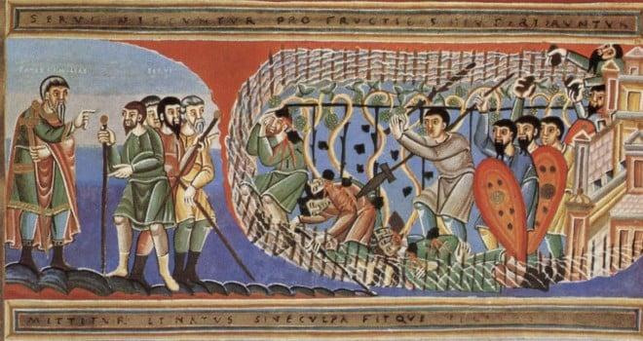
“Master of the House” is addressed not only to the people but also the Sanhedrin who were still present. It’s clear that Jesus is talking about His Father! The vineyard is the O.T. theocracy.
V.33

Slide 24
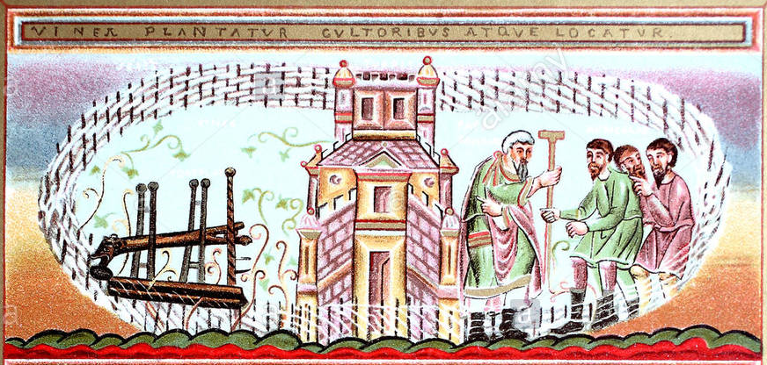
The fence is the Law and the covenant. It surrounded Israel and separated the Jews from the Gentiles.
V.33

Slide 25
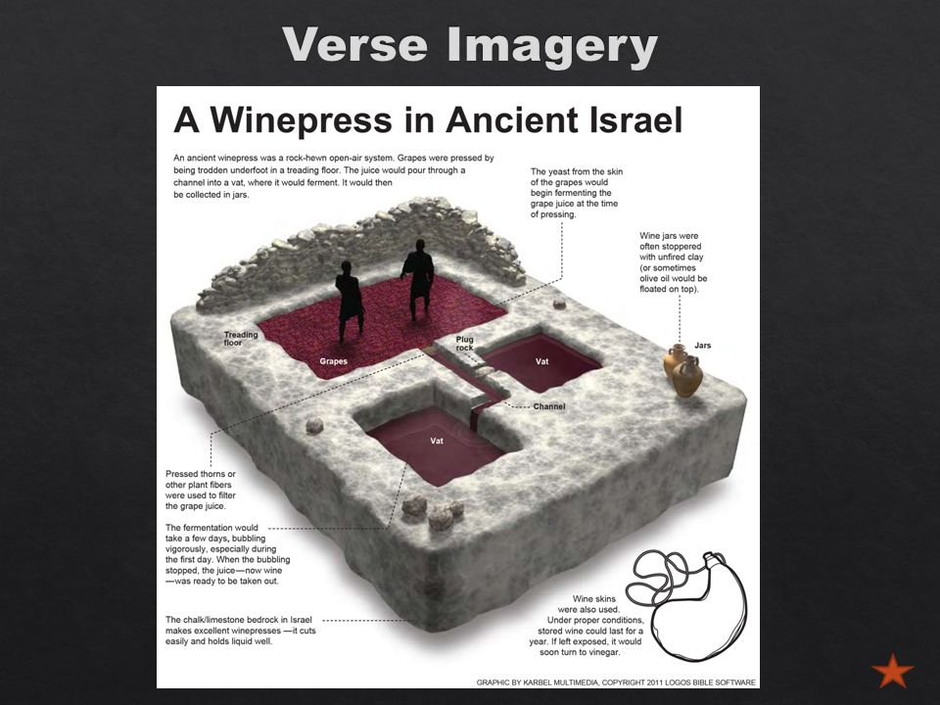
The wine-press is the Temple with its rituals and sacrifices foreshadowing the supreme sacrifice of the promised Messiah for the sins of all men. Essentially, the place where the fruits were concentrated. Again, the point is that the vineyard lacked absolutely nothing.
Note that God is the Owner. He leased it to the vine growers. Leasing does not mean that God removed Himself or that He did not care; rather, that He entrusted everything to Israel, especially, the Priests as responsible recipients of the covenant. He trusted them!
V.33

Slide 26

At harvest time, He sent servants with a specific commission.
+ “Servants” are God’s emissaries…the Prophets.
+ All the fruits are God’s.
The fruits denote
repentance, obedience, and
faith. In two words,
spiritual obedience.
V.34

Slide 27
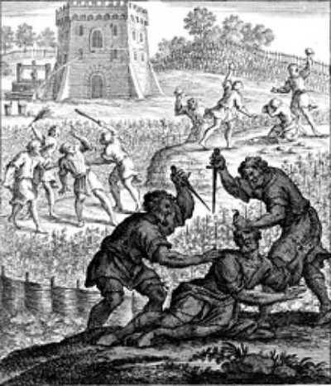
This verse denotes the opposite of the Lord’s will. His servants were sent to receive the fruits. But the workers violently abuse them.
In an mounting climax, the last is the most appalling; since blasphemers were stoned. They treat God’s Prophets as blasphemers!
V.35

Slide 28
Under usual conditions, no landowner would send more after what happened in v.35.
“Again” and “more than” clearly portrays God’s mercy and long suffering.
The period of the “sent servants” lasted
from Moses through John the Baptist.
A period from 1500 B.C. to the Birth of Jesus, fifteen centuries!
The heaviest concentration of prophets was from 900 B.C. to c. 600 B.C., thirteen prophets: Elijah to Obadiah. The more wicked Israel became, the more
prophets were sent.
V.36

Slide 29
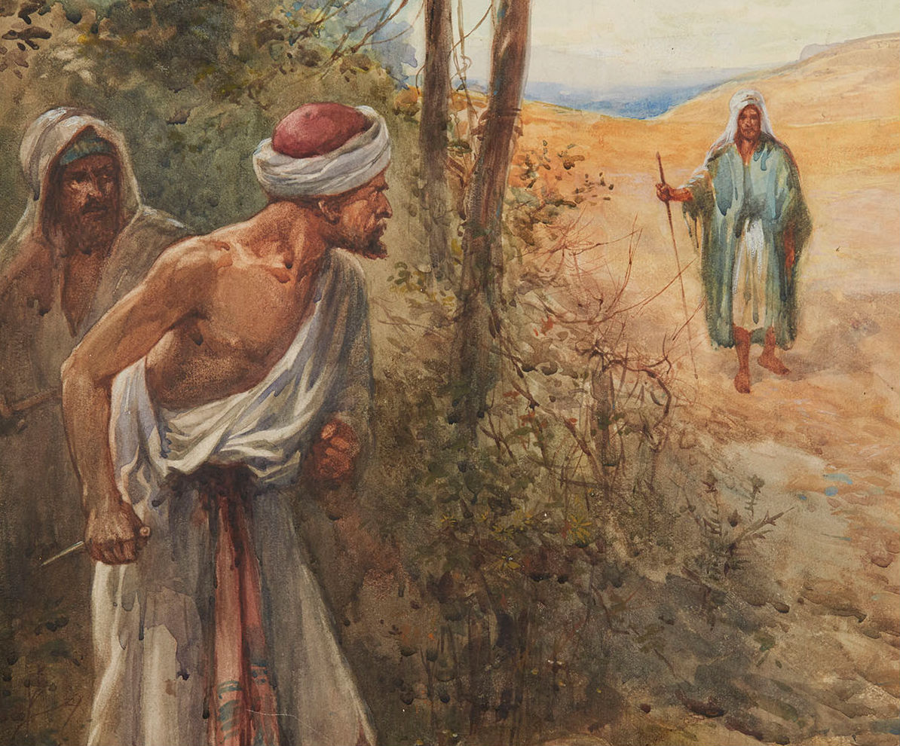
Again, no ordinary landowner would have allowed this. The patience of God is pictured in unusual imagery, especially in the word, “finally.”
The Son is the greatest of those sent by God.
V.37

Slide 30
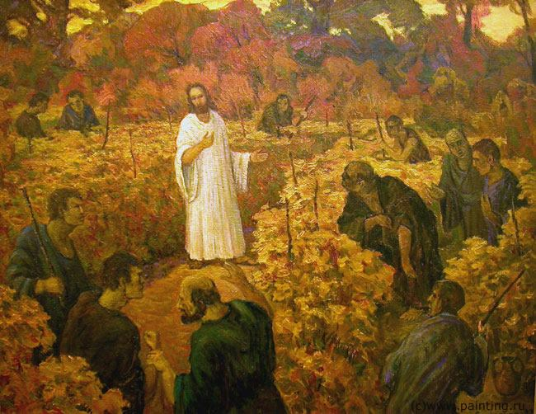
They knew precisely who He was, though they denied Him. They sinned against better knowledge. It was unanimous. They knew the heir. Jesus is truly the Heir of all things. Through Him, they already were heirs; but they rejected their inheritance. The point is that they wanted the Kingdom on their own terms!
V.38

Slide 31
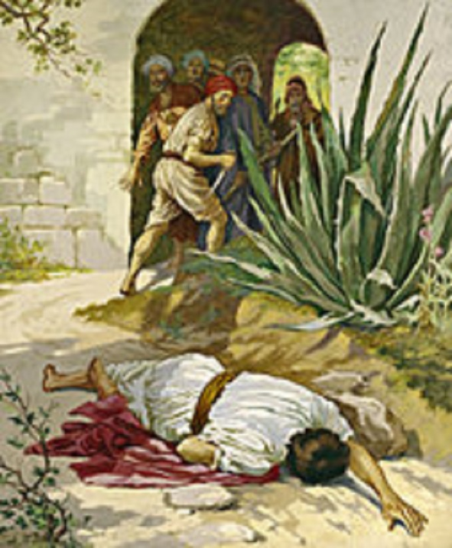
There is nothing quite so foolish and diabolical as the violence of those who reject God, His Word, and His Son.
V.39

Slide 32
Jesus is speaking about two things:
1. The impending destruction of Jerusalem (by the Romans); and,
2. The Day of Pentecost, when the Gospel was preached to all, whether Jew or Gentile.
Jesus foretells, in the second part of the verse, that those to whom the vineyard, the Kingdom, is given, will render the fruits to Him when the opportune time for those fruits comes.
In each generation since Pentecost this has happened. That does not mean, however, that there were no believers among the OT people. Hebrews 11 clearly teaches
that there were.
Vv.40-41

Slide 33
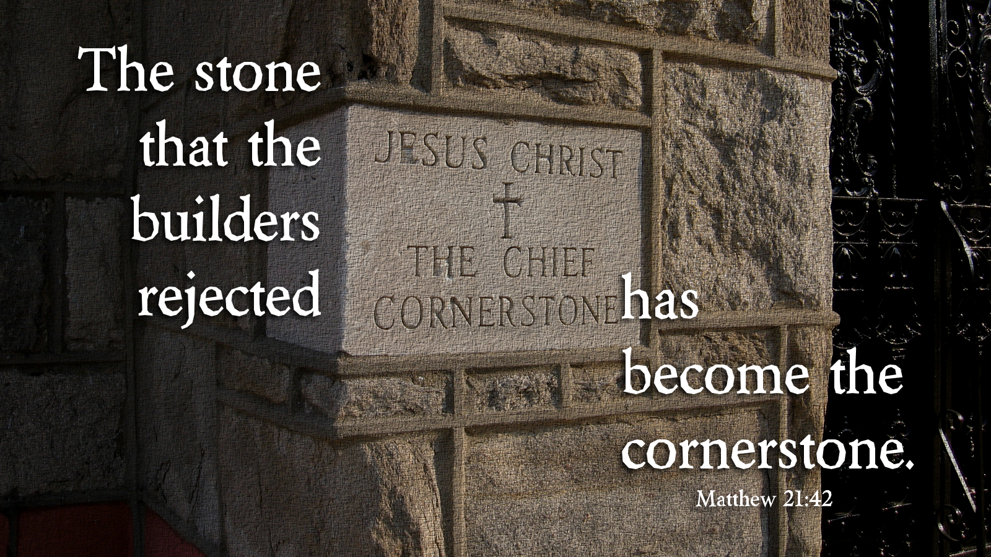
The Lord allowed the rejection but this is wonderful to our eyes. God turned evil into good. By being cursed, Jesus accomplished universal blessing. This is truly wonderful in our eyes.

Slide 34
Jesus speaks with divine authority. “The Kingdom of God” is the preaching of the Holy Gospel of Christ. The Jewish authorities rejected it by rejecting the Christ and throwing Him out as unworthy. Thus, the Kingdom “…will be taken from you.” The rejecters will be rejected, since they have rejected the gift of the Kingdom!
“A nation” should not be limited only to Gentiles. The NT Church is comprised of both Jews and Gentiles.
Vv.43-46

Slide 35
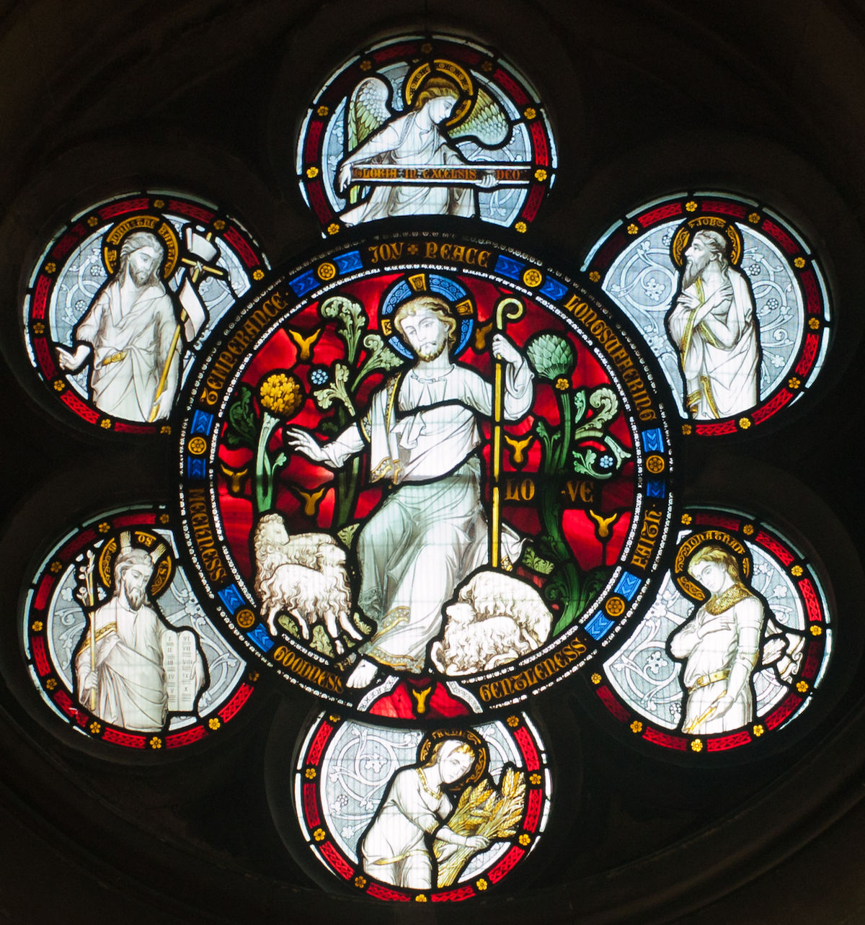
Vv.43-46
SELF-CONTROL
PEACE
What are the fruits?
Repentance,
Obedience,
and Faith!
JOY
GENTLENESS
LOVE
PATIENCE
GOODNESS
FAITHFUL-NESS
KINDNESS

Slide 36
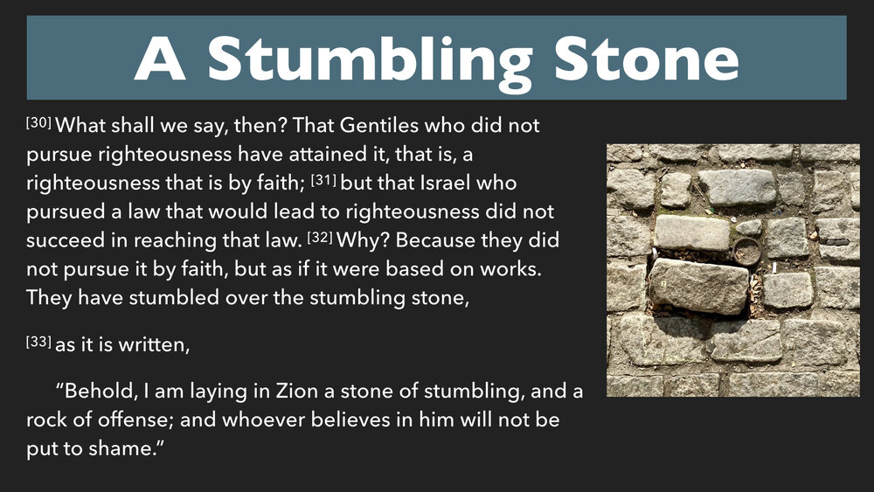
Vv.43-46
Romans 9

Slide 37
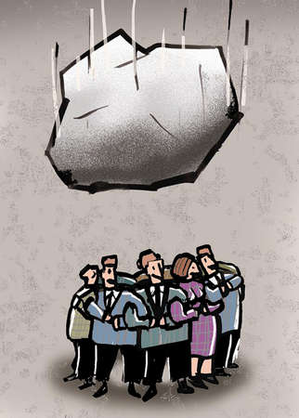
Vv.43-46
“…shall be crushed (broken)” - calling Himself the Stone, Jesus claims Messianic authority and Deity. Those who “fall” on Him may experience painful contrition, but that “brokenness” should lead to repentance and salvation.

Slide 38
Vv.43-46
likmhvsei = to grind to powder; to crush into pieces; to pulverize!
JESUS GIVES A STARK EXAMPLE
OF JUDGMENT!

Slide 39
August Class Schedule
Passion Week (Chapters 21:1 – 27:66)
C. The Last Controversies with the Jewish Leaders (21:18 – 22:46)
1. Cursing of the Fig Tree (21:18-22) (7/27)
2. Authority of our Lord is Questioned (21:23-32) (7/27)
3. The Parable of the Tenants (21:33-46) (7/27)
4. The Parable of the Marriage Feast (22:1-14) (Aug 3)
5. Paying Taxes to Caesar (22:15-22) (Aug 3)
6. Questions about the Resurrection (22:23-33) (Aug 3)
7. The Great Commandment (22:34-40) (Aug 10)
8. David’s Son (22:41-46) (Aug 10)
D. The Fifth Discourse (Chapter 23:1 – 26:1)
1. Woe to the Scribes and Pharisees (23:1-36) (Aug 17)
2. The Lament over Jerusalem (23:37-39) (Aug 17)
3. Prophecy of the Destruction of the Temple (24:1-3) (Aug 24)
4. The End of the Age (24:4-51) (Aug 24)
5. The Parable of the Wise and Foolish Virgins (25:1-13) (Aug 31)
6. The Parable of the Talents (25:14-30) (Aug 31)
7. The Great Judgment (25:31 – 26:1) (Sep 7)

Slide 40
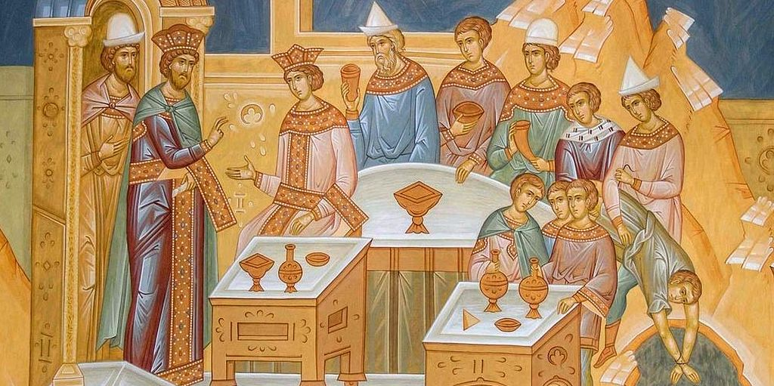
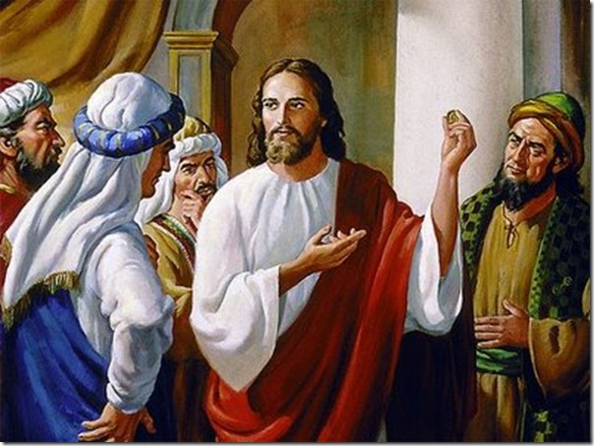
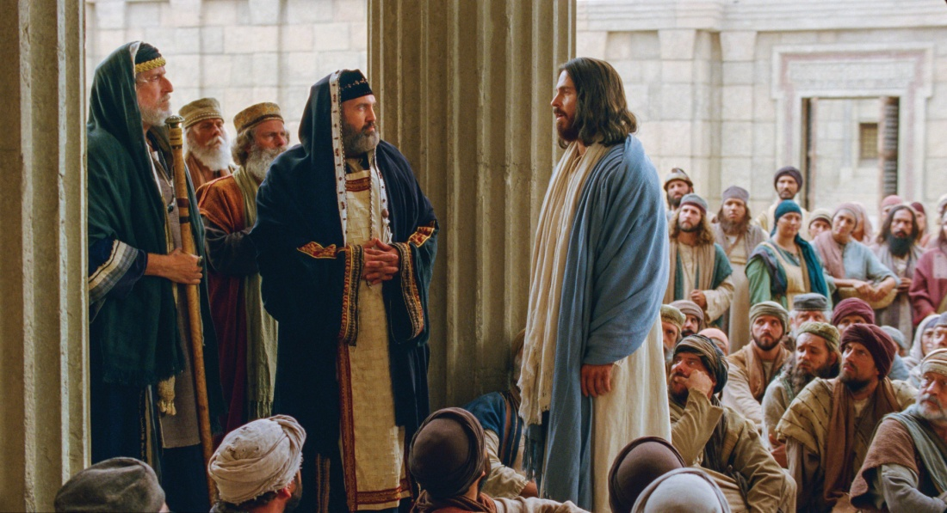
Passion Week
St. Matthew 22:1-33
Parable of the
marriage feast
Paying taxes to Caesar
Questions about the resurrection

