Slide 1
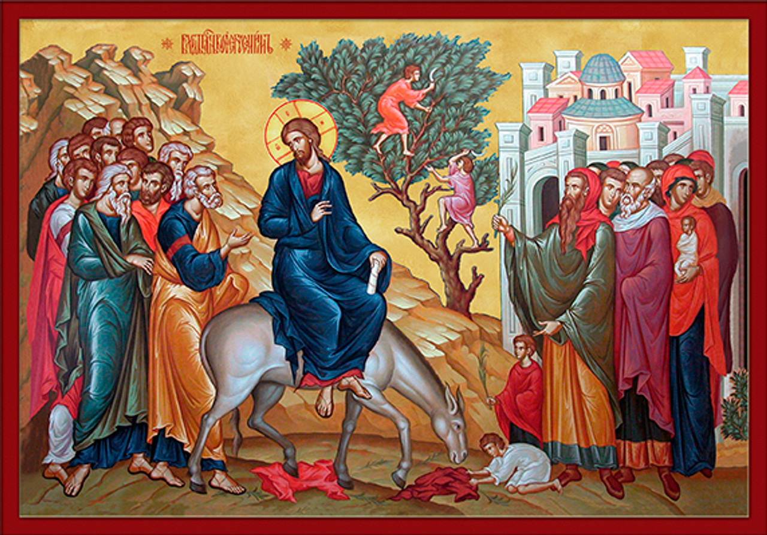
Passion Week
The Triumphal Entry & Cleansing of the Temple
St. Matthew 21:1-17

Slide 2
Introduction
St. Matthew now moves us quickly to the vicinity of Jerusalm in chapter 21. In St. John 12:1, we know that the Triumphant Entry is six days prior to the Passover (which would be Sunday or the “first day of the week”). John also relays that there are actually two multitudes; one, with Jesus, and the other that when out to meet Him (St. John 12:9-12).
According to St. Mark and St. Luke, Bethphage and Bethany where two villages that were quite close to each other.

Slide 3
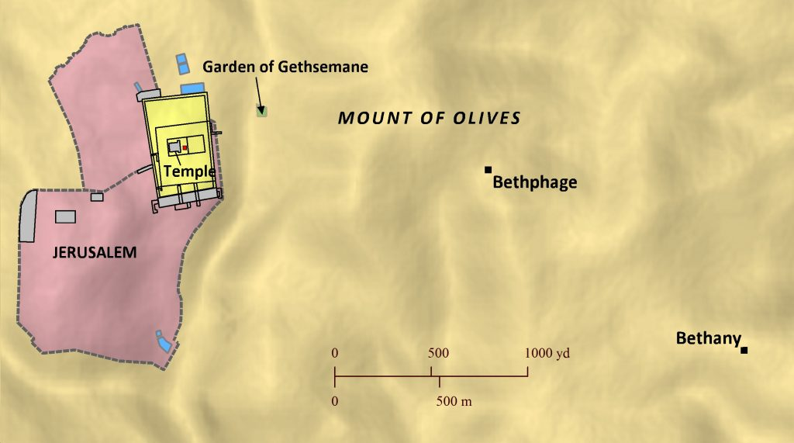
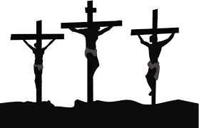
Introduction
Thus, as they were leaving Bethany, Jesus tells two of His disciples to go ahead to Bethphage. There they will find a dam with colt. They are to bring them to Jesus. It’s the colt that’s never been ridden that Jesus rides as He entering into Jerusalem.
It is possible that the owner knew the disciples and that what they said to him would mean that the owner is also familiar or may have even known Jesus.
Approx. 1 mile
Home of
Annas(?)
About 9 tenths of a mile
Antipas’
Palace
Praetorium
The Upper
Room (?)

Slide 4
St. Matthew 21:1-11
“The Triumphant Entry”
Everything that you have heard in verse 1-5 is fulfillment of OT prophesies. Specifically, “Say you to the daughter of Zion” ^{(Is. 62:11)}; and the remainder of v. 5 is written in Zechariah 9:9.
In verse 4, the phrase: “…having been spoken” is very important. St. Matthew uses a aorist passive participle: rJhqe;n. Therefore, the Divine agent that speaks through the prophet (Isaiah & Zechariah) is YHWH.

Slide 5
St. Matthew 21:1-11
“The Triumphant Entry”
Let’s briefly exegete the prophecy from Isaiah & Zechariah:
+ “Say (you all) to the daughter of Zion” – this is a reference to Jerusalem, who is to be told the following prophecy from Zechariah. The underlying thought is that when she is told, she is to rejoice; since, what she is told is Good News! By the way, the poetic title “daughter of Zion” can now be transferred to the NT Church!

Slide 6
St. Matthew 21:1-11
“The Triumphant Entry”
+ “Behold, your King comes to you,” – Pay Attention! Hello!!! Wake Up! Your King is coming to you! Jerusalem is to be attentive and awaken from their indifference and unbelief; thus, be ready to welcome your great King!
- Note that the King is coming to you (Jerusalem). This phrase is to remind her of the Kings Messianic title: oJ ejrcovmenoV – The One Coming!
- The One Coming is coming to you…for your salvation! This King comes…and He gives…Himself!

Slide 7
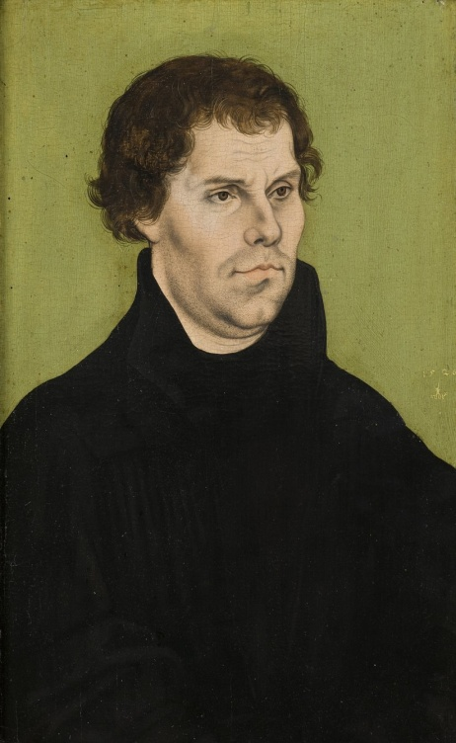
St. Matthew 21:1-11
“The Triumphant Entry”
+ Here is a great quote from Luther:
“He is a peculiar King. You do not seek Him, He seeks you; you do not find Him, He finds you; for the preachers come from Him, not from you; their preaching comes from Him, not from you; your faith comes from Him, not from you, and all that your faith works comes from Him, not from you.”

Slide 8
St. Matthew 21:1-11
“The Triumphant Entry”
+ “…gentle and mounted upon a donkey, even upon a colt, [the] foal of a beast of burden” – The Messianic King appears in an unexpected form and conducts Himself contrary to all expectations, not as One armed and exercising force, not in regal attire or armor and riding a warhorse!
This prophecy from Zechariah was used by the Jews to refer to the Messiah, The One Coming! Is it not clear, that they all missed the fulfillment of this prophecy…even His disciples!

Slide 9
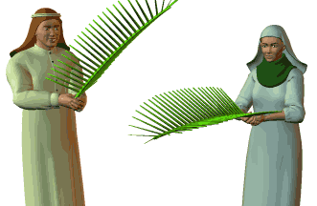
St. Matthew 21:1-11
“The Triumphant Entry”
St. Matthew continues in vv. 6-8 by describing the event after the dam and colt was brought to Jesus. What they put on the dam and colt were their iJmavtia – their loose, long outer robes. And note that the multitudes did the same, though they laid their robes on the dusty road (cf. 2 Ki 9:13). This is a sign of submission with the bestowal of the very highest of honors. And the palms,
a sign of peace and victory…and
worship (cf. Rev. 7:9).

Slide 10
St. Matthew 21:1-11
“The Triumphant Entry”
In vv. 9-11. both multitudes now begin to acclaim Jesus with “Hosanna….” In Hebrew, it’s “Hoshi’ ah-nna’” – grant salvation or save now.
Then added to the Hosanna is “to the Son of David” (see 20:30, 31). This title is both royal and Messianic. Thus, Jesus enter Jerusalem as the divinely prophesied Messiah-King and He accepts their jubilant applause and praise.

Slide 11
St. Matthew 21:1-11
“The Triumphant Entry”
Added to His great royal Messianic title is the welcoming phrase: “Blessed the One Coming in the Lord’s [YHWH’s] name!” Thus, the multitudes enthusiastically acclaim Jesus as being blessed by YHWH (cf. 6:9).
Lastly, “Hosanna, in the highest” indicates that this One Coming has come from the abode of God, from heaven…and He has come to save!

Slide 12
St. Matthew 21:1-11
“The Triumphant Entry”
In vv.10 and 11, St. Matthew clearly reveals that Jerusalem was now “stirred up” in the sense that the many pilgrims who have come for the Passover were now asking just who is this Man!
And the multitudes, especially the group that came with Jesus from Bethany, kept reminding everyone that this Coming One is the known prophet from Galilee, Jesus of Nazareth!

Slide 13
St. Matthew 21:12, 13
“The Cleansing of the Temple”
The Timing: The first aspect to address is the time of this account! As we compare St. Matthew to St. Mark (11:13-26), it looks as if there is a contradiction!!
St. Matthew is being factual and pointing out, as is the purpose of his Gospel that Jesus is the Messiah. This is why he places the triumphant entry and the cleansing of the Temple side by side; to point out Jesus’ Messianic greatness!

Slide 14
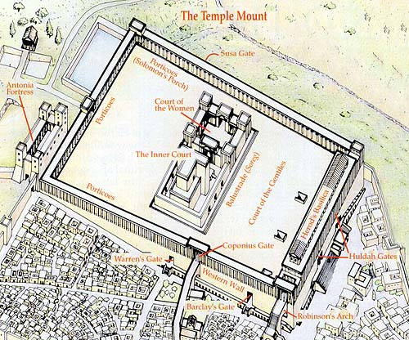
St. Matthew 21:12, 13
“The Cleansing of the Temple”
The Day: Again, compared to St. Mark (11:13-26), it looks as if there is a contradiction since St. Mark tells us that the cleansing occurs on Monday, the day after the Triumphant Entry!
Again, St. Matthew is being factual and not chronological. He also relates to us that this events occurs on the Temple grounds (iJerovn); as distinguished from the Sanctuary (naovV). So, let’s take a look at it visually!
TEMPLE MARKETPLACE

Slide 15
St. Matthew 21:12, 13
“The Cleansing of the Temple”
The First or Second Cleansing? Many confuse this account in St. Matthew with the first cleansing in St. John 2:13-22. Nope! It’s the second cleansing and, again, St. Matthew has a Messianic purpose.
Both cleansings resemble each other, though there are differences.
1. In St. John, Jesus is confronted by the authorities; here, there’s no confrontation;
2. In St. John, Jesus speaks to the authorities; here, He speaks to the sellers and changers; and,
3. In St. John, Jesus speaks by His authority; here, He quotes God’s Word.

Slide 16
St. Matthew 21:12, 13
“The Cleansing of the Temple”
The Purpose of the Cleansing?
+ A House of Prayer;
+ A House of Worship;
+ A House of True Religion!
  It’s Sacred!!!
    Not for Marketing;
    Not for Profit or Gain;
    Not for Political Speech;
    Not for Entertainment!

Slide 17
St. Matthew 21:14-17
“The Work of Grace”
Even as our Lord faces His pending suffering and death; still, He is compassionate and full of grace. Verse 14 is a powerful verse inserted by St. Matthew which is used to show the work of the Messiah. His work is completely lost to the “high priests and the scribes” ^{(v.15)}. Whenever St. Matthew uses this term, he is speaking of the Sanhedrin.
Note how they see our Lord’s miracles as “marvels;” since, to them, that’s what they are; but, not works of the Messiah as we have previously discussed.

Slide 18
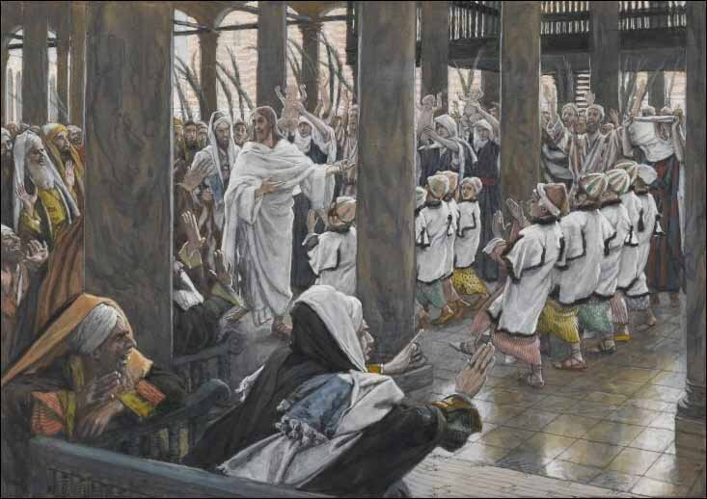
St. Matthew 21:14-17
“The Work of Grace”
The “marvels” of our Lord had a profound impact on boys in the Temple courts. These lads, probably twelve years old and over, had come to Jerusalem with their fathers, as did our Lord with Joseph, for their obligatory attendance at the Passover. They are singing praises to Jesus for the miracles they had seen… “Hosanna to the Son of David!”

Slide 19
St. Matthew 21:14-17
“The Work of Grace”
And, as you can see from the painting, this is intolerable to the Sanhedrists; yet, there’s nothing that they can do!
All they can do is to confront Jesus and demand that He stop this “disorder.” Ironically, the “disorder” of the buyers and seller along with the horrible stench of the livestock on the Temple Mount was acceptable to them!

Slide 20
St. Matthew 21:14-17
“The Work of Grace”
Jesus quickly replies, “Yes, did you [all] never read: ‘Out of [the] mouth of babes and sucklings, You have prepared for Yourself praise.’”
Jesus is quoting from Ps. 8:2 and He knows that the Jews know this verse; after all, they have undoubtedly sung the words of Psalm 8 in the Temple!

Slide 21
St. Matthew 21:14-17
“The Work of Grace”
Therefore, a mighty chorus of the young boys (even babes and sucklings) rise like a bulwark before which the roaring of the Lord’s enemies sink into silence! The enemies of our Lord (and also your enemies) will rave in their hatred; yet, even the young babe in Divine Service cooing or crying reveals the Lord’s greatness and His glory!

Slide 22
St. Matthew 21:14-17
In closing, Jesus now departs from the Temple and Jerusalem and travels back to Bethany. Undoubtedly, He lodges at the home of Lazarus.
Palm Sunday, the first day of the week, is now over. Tomorrow morning, Jesus will continue His great work during the most momentous week of world history!

Slide 23
July Class Schedule
VII. Our Lord’s Ministry in Judea and Perea (19:3 – 20:34)
  Teaching on Marriage and Divorce (19:3-12) (7/6)
  Teaching Concerning Little Children (19:13-15) (7/6)
  The Rich Young Man (19:16-30) (7/6)
  The Parable of the Workers in the Vineyard (20:1-16) (7/13)
  Prophecy of His Death (#3) (20:17-19) (7/13)
  Salome’s Request (20:20-28) (7/13)
  Restoration of Sight at Jericho (20:29-34) (7/13)
Passion Week (Chapters 21:1 – 27:66)
A. The Triumphal Entry (21:1-11) (7/20)
B. The Cleansing of the Temple (21:12-17) (7/20)
C. The Last Controversies with the Jewish Leaders (21:18 – 22:46)
1. Cursing of the Fig Tree (21:18-22) (7/27)
2. Authority of our Lord is Questioned (21:23-32) (7/27)
3. The Parable of the Vineyard (21:33-46) (7/27)

Slide 24
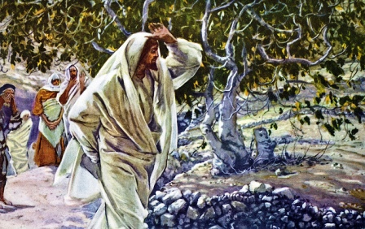
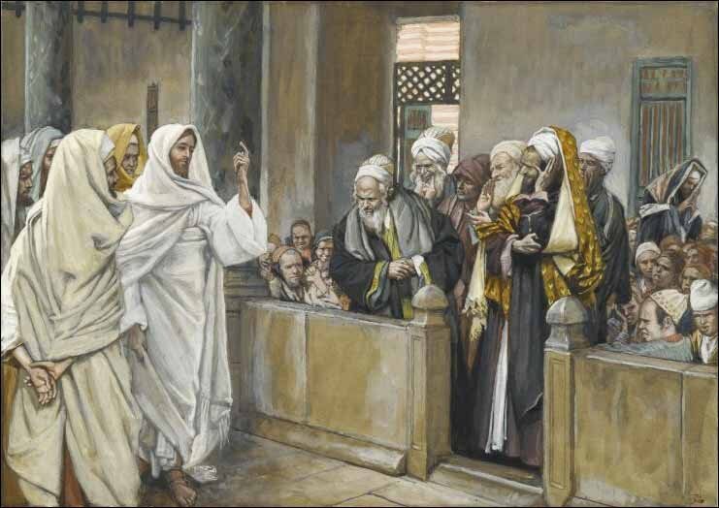
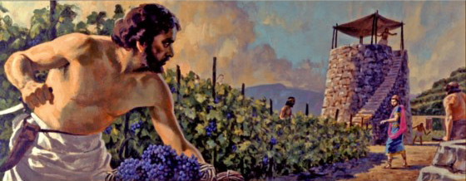
Passion Week
St. Matthew 21:18-46
Cursing of the Fig Tree
His Authority Questioned
The Parable of the Vineyard

