Slide 1
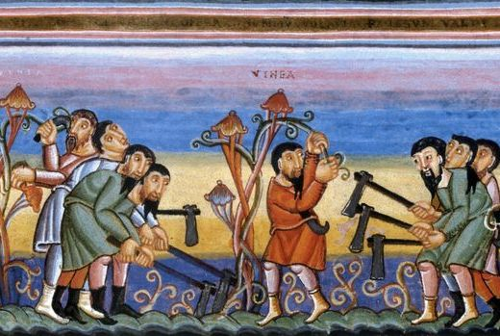
Our Lord’s Ministry in Judea and Perea
St. Matthew 20:1-34

Slide 2
Introduction
This chapter begins with an important “for” (gavr) that connects to 19:27-30. You’ll soon note that this “seals” this connection as St. Matthew repeats 19:30 in 20:16. Jesus then begins to explain what the kingdom of God “is like.”
Our Lord explains the “is like” by the use of a parable that He uses to reveal the true nature of His kingdom; that is, the kingdom of God is the rule and operation of God’s grace!
This Parable of the Workers in the Vineyard is quite familiar to us, so let’s only summarize.

Slide 3
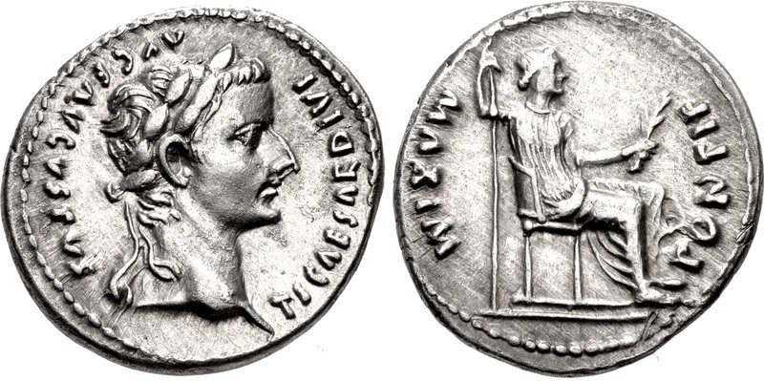
St. Matthew 20:1-16
“The Parable of the Workers in the Vineyard”
Jesus uses a familiar figure to His disciples and it’s an OT figure: A vineyard. Note that Jesus saying nothing about the vines or the harvest of grapes. His point is the dealing of the owner with his laborers.
First, the owner is seen as being very wealthy. He hires laborers and He does no work in the vineyard.
He hires the workers for a
standard wage of a denarius.

Slide 4
St. Matthew 20:1-16
“The Parable of the Workers in the Vineyard”
All that the owner does is out of grace. We see in this parable that God’s grace is His most noblest attribute. He always vindicates His exercise of grace! And any grace, which is unearned favor, is absolutely within the will and power of Him who grants His favor. Lastly, no man dare dictate to Him what He must or must not do in any case of bestowal of grace. His grace is always and truly sovereign!

Slide 5
St. Matthew 20:1-16
“The Parable of the Workers in the Vineyard”
In closing and to summarize our Lord’s Parable of the Vineyard; to all those who receive His grace, rejoice! Since in the bestowal of grace is eternal life.
Yet, those who object to His grace, who attempt to stipulate that so much work done must be compensated according to their standard; they will be the last in the kingdom of God. Thus, to accuse and condemn His grace is the surest way to lose His grace!

Slide 6
St. Matthew 20:17-19
“Prophecy of His Death – #3”
As we now come to v.17, St. Matthew provides an important marker: “And, while going up to Jerusalem…!” Our Lord has now left Perea by crossing over the Jordan River and He and His disciples are now traveling on the road that leads through Jericho to Jerusalem.
Along the way, Jesus takes His disciples aside, away from the rest of the party that is traveling with them, in order to give them another prophecy of what is to happen in Jerusalem.

Slide 7
St. Matthew 20:17-19
“Prophecy of His Death – #3”
The verb tenses in our Lord’s prophecy are all future; thus, what is about to happen in Jerusalem shall occur and occur without fail.
This time, Jesus adds more information for His disciples. He has revealed that He will be “handed into the hands of men” (17:22); however, now, He says that He will be “delivered to the high priests and scribes.” As you may remember, this is the Sanhedrin, the ruling council of Israel.

Slide 8
St. Matthew 20:17-19
“Prophecy of His Death – #3”
It will be the Sanhedrin who will condemn Him to death and “shall deliver Him to the Gentiles….” Why must they hand Jesus over to the Romans?
The Sanhedrin does not have the power of capital punishment.
Note that St. Matthew includes the spitting upon in mockery and states the actual mode of death that Jesus will suffer. Only Matthew uses the Greek word: staurw:sai (to crucify). Yet, additionally, Jesus will also be scourged (mastigw:sai).

Slide 9
St. Matthew 20:17-19
“Prophecy of His Death – #3”
Jesus will therefore be “doubly” punished by staurw:sai (to crucify) and by the scourge (mastigw:sai). While it is true that the scourge was used prior to crucifixion (but not always); scourging was often a separate form of punishment (cf. 10:17; 2 Cor. 11:25; and Heb. 11:36) that also was designed to inflict maximum pain, suffering, and ultimately, death via blood loss.
Even with all this, Jesus continues to add the glorious assurance: “and the third day He will rise again.”

Slide 10
St. Matthew 20:20-28
“Salome’s Request”
St. Mark (10:35) records for us that James and John make the request; however, St. Matthew reveals that it was their mother, Salome, who was the “prime mover!”
Thus, along the road to Jericho; Salome, James, and John find an opportunity to approach Jesus with a “special” request. They what a supreme honor; so Salome does the speaking. She begins, as was the custom, by paying obeisance, since she was about to make a great request of her King.

Slide 11
St. Matthew 20:20-28
“Salome’s Request”
Here’s the problem! They, especially James and John, were not listening to Him. And Salome was also blinded by her assumption of Jesus as the political Messiah of Israel. In Acts 1:6, they (the disciples) still believe that Jesus will establish an outward earthly Messianic kingdom. So when His kingdom becomes “reality,” Salome desires that her sons have the highest places of honor.

Slide 12
St. Matthew 20:20-28
“Salome’s Request”
Note that Jesus doesn’t resist her; He actually wants her to state her request, which will then lead Him to an explanation to her and to her sons. Salome does assume that in His kingdom Jesus can do all that He desires. It’s interesting that His disciples expected to little of Him; thus, Jesus often call them “little faith-ones.” However, Salome expects too much of Jesus, which does reflect a great faith…though a misplaced faith.

Slide 13
St. Matthew 20:20-28
“Salome’s Request”
In v.22, Jesus addresses James and John. He bluntly states that they do not know what they are asking for; their request is out of ignorance as to how His kingdom actually is established.
So Jesus, in His Divine way, enlightens them! Are they able to drink His “cup?” His “cup” is the cup of suffering (St. John 18:11; St. Matthew 26:39, 42). To drink His cup means to accept and to endure suffering! Therefore, the way to greatness in His kingdom isn’t the way that they are thinking; rather, it’s through suffering – humiliating suffering! And they agree – they are able!

Slide 14
St. Matthew 20:20-28
“Salome’s Request”
James and John’s answer is actually given in ignorance, again! They truly do not know what His cup and it’s drinking entails!
They will drink of His cup and they will suffering in this life…as do you! However, the cup that our Lord is about to drink…to the dregs…only He can drink! Our Lord’s suffering and death was exceptional, since it was expiatory (death) and atoning. The disciples’ suffering, then and today, is only confessional!
Thus, Jesus doesn’t reveal who will be seated to His right or left…only that the Father has already prepared so!

Slide 15
St. Matthew 20:20-28
“Salome’s Request”
Verse 24-28 are still connected to Salome’s request and how the others heard isn’t revealed. So let’s explain this way, by verse:
24: The other felt wronged; as many feel the same at the success of others today;
25: Jesus intervenes and explains that they all are misconceiving His kingdom as He points out the faults of earthly rulers, which they and we know well;
26: However, greatness is not measured according to pagan standards. In His kingdom, it about sacrificial service;
27: Thus, heavenly greatness is measured by service, not power and authority!

Slide 16
St. Matthew 20:20-28
“Salome’s Request”
The summation of the preceding verse is given by our Lord in verse 28:
+ Jesus came to serve – this is all that He did from conception to crucifixion!
+ He sacrificed His life (St. John 10:17-18)!
+ His “life-giving” is a ransom (luvtron) – a ransom that the many could never pay! His ransom was His life that freed all from bondage to sin, death, and the power of the devil. And also is the redemption from guilt and penalty. Thus, the blood of the Lamb of God, The Only-begotten Son, exceeds the calculation of a price. Thus, as we confess:

Slide 17
St. Matthew 20:20-28
Jesus, “purchased and won me from all sin, from death, and from the power of the devil, not with silver or gold but with His holy, precious blood and with His innocent suffering and death!”

Slide 18
St. Matthew 20:29-34
“Restoration of Sight at Jericho”
Jesus and His disciples are now traveling through Jericho on their way to Jerusalem. This is a major thoroughfare and heavily traveled. The nuances of this account, as found here in St. Matthew and St. Luke, are not contradictory!
Once again, St. Matthew gives us an interjection: And lo! (Kai; ijdou;), literally, “And you (singular) behold!” Matthew uses this interjection for the purpose of pointing out an exceptional healing, mainly because of the addressing of Jesus by His Messianic title!

Slide 19
St. Matthew 20:29-34
“Restoration of Sight at Jericho”
Yes, this is an example of our Lord compassion and mercy; even as He is on His way to prove His compassion and mercy at Golgotha! Note that in v.31, the crowd attempts to silence the beggars. So they become even louder! Their cry: “Son of David!”
They are addressing Jesus by His Messianic title! In His hearing, Jesus stops and He is filled with compassion (splagcnisqei;V: literally, “having been filled with compassion”). This word is an aorist passive participle – thus, a Divine compassion that touched and immediately healed two blind men!

Slide 20
July Class Schedule
VII. Our Lord’s Ministry in Judea and Perea (19:3 – 20:34)
  Teaching on Marriage and Divorce (19:3-12) (7/6)
  Teaching Concerning Little Children (19:13-15) (7/6)
  The Rich Young Man (19:16-30) (7/6)
  The Parable of the Workers in the Vineyard (20:1-16) (7/13)
  Prophecy of His Death (#3) (20:17-19) (7/13)
  Salome’s Request (20:20-28) (7/13)
  Restoration of Sight at Jericho (20:29-34) (7/13)
Passion Week (Chapters 21:1 – 27:66)
A. The Triumphal Entry (21:1-11) (7/20)
B. The Cleansing of the Temple (21:12-17) (7/20)
C. The Last Controversies with the Jewish Leaders (21:18 – 22:46)
1. Cursing of the Fig Tree (21:18-22) (7/27)
2. Authority of our Lord is Questioned (21:23-32) (7/27)
3. The Parable of the Vineyard (21:33-46) (7/27)

Slide 21
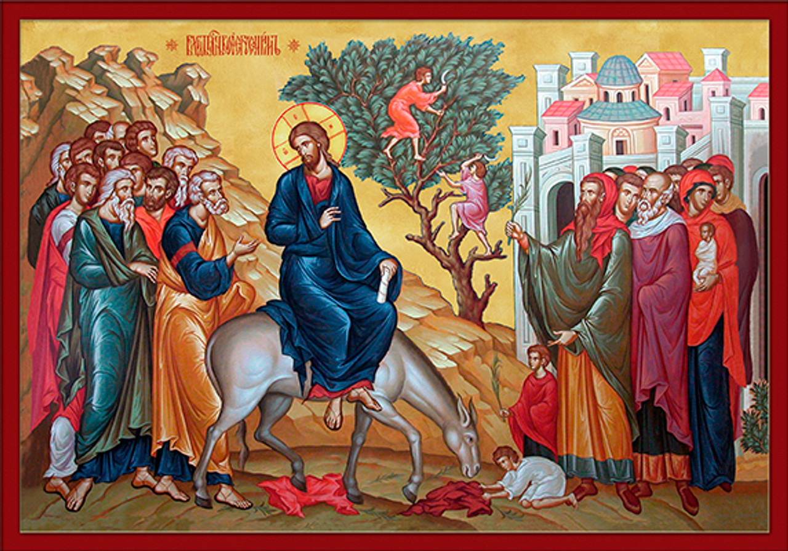
Passion Week
The Triumphal Entry & Cleansing of the Temple
St. Matthew 21:1-17

