Slide 1
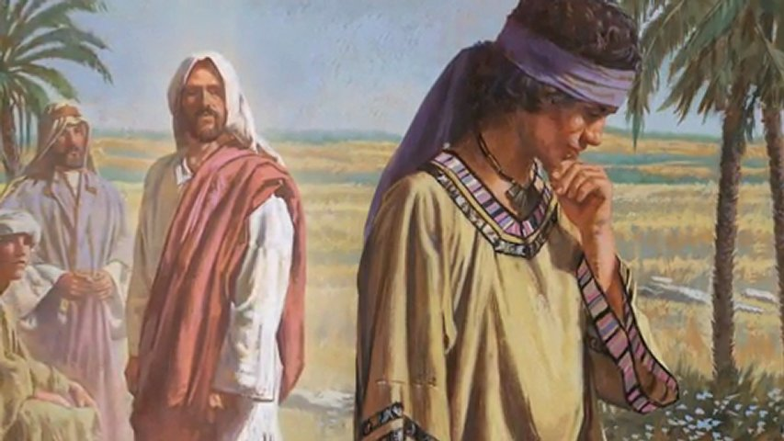
Our Lord’s Ministry in Judea and Perea
St. Matthew 19:3-30

Slide 2
Introduction
As we recall from last week, Jesus has travelled from Galilee and has begun to teach in a region east of Judea known as Perea, which St. Matthew calls “beyond the Jordan.” It was about 20 miles east of Jerusalem…down hill!
I seems that as soon as our Lord arrives, He is, once again, confronted by Pharisees. Their modus operandi is to discredit Jesus before the people by tempting Him to say anything that would violate the Law! This leads us to verse three and their question concerning…

Slide 3
St. Matthew 19:3-12
“Marriage and Divorce”
The question that is raised by the Pharisees was a question that was debated even by Jewish Rabbis. There were two schools of thought:
1. Of Shammai – that taught that Dt. 24:1 meant that a man cannot divorce his wife unless he can prove that she has committed an indecent act (violated God’s Law; esp. the 6th Commandment).
2. Of Hillel – that taught that Dt. 24:1 meant that a man can divorce for any reason…even burning his supper!

Slide 4
St. Matthew 19:3-12
“Marriage and Divorce”
Thus with these two schools of thought; one strict and the other lax, which is easier, to be strict or lax?
Since it is much, much easier to be lax…Hillel’s views were followed by the Jews! Therefore, this is the temptation of the Pharisee’s question. Do you, Jesus follow Hillel or Shammai?
Thus, if Jesus says He supports Hillel (lax), they will immediate support Shammai’s teaching and accuse Jesus of being morality lax!

Slide 5
St. Matthew 19:3-12
“Marriage and Divorce”
However, if He sided with Shammai’s teaching (strict), then they could accuse Him of being shameful in His interactions with sinners (not a rabbi – a fraud)!
Thirdly, and this is the position of which they are actually hoping, if our Lord says He does not support either school; then they could charge Jesus with contradicting the Law (Dt. 24:1)! They were probably quite sure of themselves that they have finally entrapped Jesus into an impossible position!

Slide 6
St. Matthew 19:3-12
“Marriage and Divorce”
Before we discuss our Lord’s response in verses 4-6; it’s important for you to know that the Pharisees consider marriage/divorce as a matter of legislation (“is it lawful?”). They are hoping that Jesus will enter into a debate concerning Dt. 24:1. So, let’s re-read verses 4-6.
Do you see how Jesus’ response is a rebuke?
He destroys their temptation by asking His own question concerning Gen 1:27…and then extends it to Gen 2:24! In the creative act is the institution of marriage…and Gen 2:24 interprets Gen 1:27! Verse 5 is our Lord’s interpretation of marriage!

Slide 7
St. Matthew 19:3-12
“Marriage and Divorce”
What exactly is Jesus teaching? Our society doesn’t like hearing this, but this is what marriage means to the Creator!
+ Physical sexual union consummated in marriage
makes the “one flesh” of the two!
+ This union is permanent!
+ What God has done in marriage (joined together);
man has no authority to separate!
+ When man does separate, they oppose God and His
holy will!

Slide 8
St. Matthew 19:3-12
“Marriage and Divorce”
The Pharisees now respond in v.7 with a false idea. They present their idea as though Moses “did command.” Thus, divorce was originally contemplated by God for a sufficient cause, since Moses allowed a writ of divorce.
So Jesus immediately corrects their false idea (v.8)! Moses’ writ of divorce was only a permission and nothing more. It was because something intervened…sin! Sin, thus, wreaks havoc in the marriage relationship established by God. So the writ of divorce was a concession to man’s evil, hard heart!
Do you want to know God’s will concerning marriage… Gen 1:17 & 2:24!

Slide 9
St. Matthew 19:3-12
“Marriage and Divorce”
Jesus now corrects the Pharisaic perversion of Dt. 24:1 in verse 9! And He, again, goes back to Creation (Gen. 1:27/2:24). Jesus is very clear that if a man divorces his wife for any reason other than adultery (fornication) he commits a grave sin against God, against his wife, and the other man, if she remarries! [By the way, this also pertains to the wife (cf. St. Mark 10:11-12)]. Yes, this is all law and for good reason, since Jesus is correcting the false and evil perversion of God’s institution of marriage.

Slide 10
St. Matthew 19:3-12
“Marriage and Divorce”
So let’s be clear and honest: What is it that destroys marriage? Sin, a selfish, hard heart of either the husband or the wife (usually both)! Therefore, this is a sin against God (His Word and will)!
But now…the Gospel!
As regards to the disruption, the guilt of either husband, wife, or both; the way of repentance is open to both! Remember, divorce is NOT the unforgiveable sin!

Slide 11
St. Matthew 19:3-12
“Marriage and Divorce”
Verses 10-12 are the same subject, but a change of venue. The disciples are now alone with Jesus (St. Mark 10:10). They come to the conclusion that it would then not be useful for a man to marry, which reveals that the disciples are still under the influence of Jewish ideals.
Today, and over the span of history, divorce has been used improperly…certainly due to sin! Yet, divorce for any and every reason is not in accord with our Lord’s institution of marriage or will!

Slide 12
St. Matthew 19:3-12
“Marriage and Divorce”
Moreover, Jesus most emphatically declared that marriage is by God’s institution, by His creation, who was made male and female! “…[T]his saying…” which our Lord refers, isn’t v.10 or v.12; but, rather, He is taking the disciples back to what He has just said to the Pharisees (vv.4-9). It’s also clear that the disciples do not have room in their hearts to submit!

Slide 13
St. Matthew 19:3-12
“Marriage and Divorce”
Verse 12 is a verse that many take out of context and attempt to make it say that it’s expedient to never marry! Thus, that would make our Lord Jesus a hypocrite by asserting that He is contradicting His Word. Yet, note that He say, “on account of the kingdom of [the] heavens.”
In other words, Jesus is pointing out that there is a “special calling” in the kingdom. Our Lord is not speaking about “charism” (a special spiritual gift such as celibacy!).

Slide 14
St. Matthew 19:3-12
“Marriage and Divorce”
Rather, Jesus is speaking of the believer’s self-control. The Greek noun is ejgkravteia. Literally, it encapsulates Spirit-enabled discipline that brings thoughts, emotions, and actions under Christ’s rule. Though appearing only four times in the NT, its reach encompasses every aspect of discipleship. Grounded in Christ’s example and essential for personal holiness and public witness, self-control remains a vital virtue for the Church until the day perfect conformity to Christ renders it instinctive.

Slide 15
St. Matthew 19:3-12
“Marriage and Divorce”
What Jesus is pointing out are those who have made themselves “eunuchs” in a spiritual sense; on account of the kingdom of [the] heavens! As they have done with their other natural desires, so they have put their sexual desires under complete subjection (via self-control) due to their spiritual life in the kingdom. And, yes, this is only possible due to the work of the Holy Spirit in the believer’s heart.

Slide 16
St. Matthew 19:3-12
“Marriage and Divorce”
The bottom line:
In marriage, the believer will remain the master of his sexual life, submitting this, too, completely to the Lord and to the Kingdom. Again, it’s clear that this self-control is by grace (to whom it has been given)!

Slide 17
St. Matthew 19:13-15
“Little Children”
First marriage, now children…a fitting order! So that you’ll understand, and as Scripture interprets Scripture; St. Mark 10:10 places this pericope in the house. To “tie” this together, Jesus is in the house and some of the disciples are outside. As parents are bringing their children to Jesus, they are rebuking them, which Jesus doesn’t “see.”
In v.14, Jesus then becomes “aware” and He rebukes His disciples. They are not to restrain the children! There is a very important aspect to “stop restraining.”

Slide 18
St. Matthew 19:13-15
“Little Children”
The command is to bring the children to Him. The coming of the children has the same purpose…reception of Jesus, the Messiah, and His Messianic salvation! The need of the children is the same as the adult which is due to inborn (original) sin!
Please note that these babes is not accomplished without means…their parents…they must be brought to Jesus! The coming of the children is “for of such is the kingdom of [the] heavens.”

Slide 19
St. Matthew 19:13-15
“Little Children”
As Lutherans, we know that the St. Mark text (10:13-16) is used for the Sacrament of Holy Baptism. Whereas St. Mark tells us that Jesus took the children up into His arms, blessed them, and laid His hands upon them; St. Matthew records only the latter. These are the essentials!
Thus, our Lutheran conclusion is justified; children (babes – infants) are to receive baptism. The early church father, Tertullian makes of this account as a validation of Infant Baptism is evidence that long prior to his [Tertullian’s] time the Church understood our Lord’s words and actions as a command of Holy Baptism!

Slide 20
St. Matthew 19:16-22
“The Rich Young Man”
St. Matthew continues with an important interjection: “Lo (ijdou;)!” He uses this to show us that now a young man approaches Jesus and what this young man does is quite remarkable. St. Luke (18:18-30) tells us that he is a ruler; and St. Mark (10:17-31) that he came running and then kneeling.
It is clear that this young man regards Jesus as a teacher (rabbi) due to the question that he poses to Jesus. Thus, he is expecting a great answer from Jesus. Note that his question is not how he may obtain eternal life; he thinks he know, but he wants to know what he must do!

Slide 21
St. Matthew 19:16-22
“The Rich Young Man”
The young man’s question is twisted and wrong! So Jesus answers by taking him to the Law! Then Jesus immediately corrects his wrong ideas: “One is [The] Good!”
However, if he truly desires to have eternal life by way of his own doing, then what good thing he must do has long been established as written in God’s Word – keep the Law! Thus, Jesus is NOT a teacher (rabbi) who instructs men as to how to obtain salvation by their own efforts or “good” works. God has already told man what he must do to be saved…keep the Law!

Slide 22
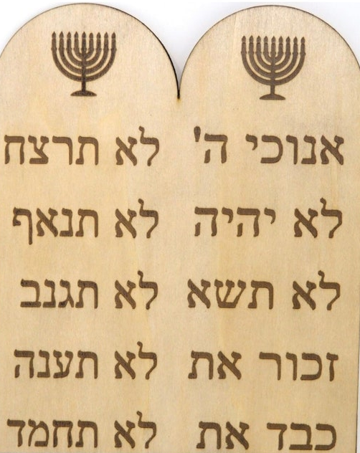
St. Matthew 19:16-22
“The Rich Young Man”
In v.18, Jesus now intends to pile
one commandment upon another!
St. Matthew uses the regular
order: Fifth to the Eighth.
St. Mark adds the Ninth & Tenth.
In v.19, Jesus list the Fourth, and
after that the sum of the entire
Second Table of the Law!
Why only the Second Table? It’s
because he thought that he can
keep the Second Table of the Law!

Slide 23
St. Matthew 19:16-22
“The Rich Young Man”
With out blinking an eye, the rich young man confirms that he has kept the Second Table. The Law has no terror for him; he has fulfilled the Law! And
this is due to his Pharisaic training!
Such an attitude nullifies what God
intends the Law to produce: a
broken and contrite heart! Thus,
what we have here is a self-righteous
young man. And he makes it even
worse by saying to Jesus, “As to
what am I yet behind?”

Slide 24
St. Matthew 19:16-22
“The Rich Young Man”
Jesus agrees with him! He does lack, he is behind! Due to our Lord’s love for him, Jesus tells him! The answer is quite surprising to the young man, and
it’s no different than today!
What he lacks begins with discovery
and thus with the realization that
what he needs is completely an
inward change! And this change,
our Lord Jesus explains – in detail!

Slide 25
St. Matthew 19:16-22
“The Rich Young Man”
When Jesus tells this self-righteous young man to go and sell his possessions and give to the poor…Jesus is clearly revealing to him the chief sin in his heart – the love of his god, Mammon!
Thus, Jesus is telling him that the condition of his heart is the sin…therefore…he must repent, there must be a change of heart a metavnoia!
Jesus isn’t telling him to take a vow of poverty or to live an ascetic life! Rather, He is pointing to that which is in clear violation of the First Commandment! Repent!

Slide 26
St. Matthew 19:16-22
“The Rich Young Man”
Thus, true repentance will be evident by his outward change! Sell and follow! And the result?
Jesus struck the “heart” of the matter and the rich young man “…went away, being aggrieved….”
This self-righteous, Pharisaic young man slinks away from our Lord; yet, the Word of the Lord went with him. The Gospels do not tells us the final result!

Slide 27
St. Matthew 19:23-30
“The Rich Young Man - Epilogue”
What Jesus says to His disciples cannot be separated from vv. 16-22. Both treat the way of salvation, and both deal with the one great obstacle, the one great “stumbling” block – Mammon! However, Jesus is clear…
God’s grace alone is able to save this
rich young man. Though a camel
cannot pass through the eye of a
needle; God, in His grace and mercy,
is able to save the self-righteous!

Slide 28
St. Matthew 19:23-30
“The Rich Young Man - Epilogue”
Lastly, vv. 27-30, is another example of the “little-faith one” Peter, speaking in behalf of the other eleven! The disciples are looking for the reassurance that they will not only be saved, but that they will have a place of prominence in the Kingdom. Sadly, here in another example of the old spirit of work-righteousness…the more WE do, the more WE earn, and the more God OWES us!

Slide 29
St. Matthew 19:23-30
“The Rich Young Man - Epilogue”
Yes, Jesus, in His grace, reassures the Twelve with a promise; then in v.30, a necessary warning. The proper understanding of what Jesus is saying to His disciples, then and today, is of vital importance. Our Lord purpose is to show how so many first will be last; that is outside the Kingdom. And the last; will be first in the Kingdom.
This all ties back to what Jesus has said to the rich young man and the condition of one’s heart!

Slide 30
July Class Schedule
VII. Our Lord’s Ministry in Judea and Perea (19:3 – 20:34)
Teaching on Marriage and Divorce (19:3-12) (7/6)
Teaching Concerning Little Children (19:13-15) (7/6)
The Rich Young Man (19:16-30) (7/6)
The Parable of the Workers in the Vineyard (20:1-16) (7/13)
Prophecy of His Death (#3) (20:17-19) (7/13)
Salome’s Request (20:20-28) (7/13)
Restoration of Sight at Jericho (20:29-34) (7/13)
Passion Week (Chapters 21:1 – 27:66)
A. The Triumphal Entry (21:1-11) (7/20)
B. The Cleansing of the Temple (21:12-17) (7/20)
C. The Last Controversies with the Jewish Leaders (21:18 – 22:46)
1. Cursing of the Fig Tree (21:18-22) (7/27)
2. Authority of our Lord is Questioned (21:23-32) (7/27)
3. The Parable of the Vineyard (21:33-46) (7/27)

Slide 31
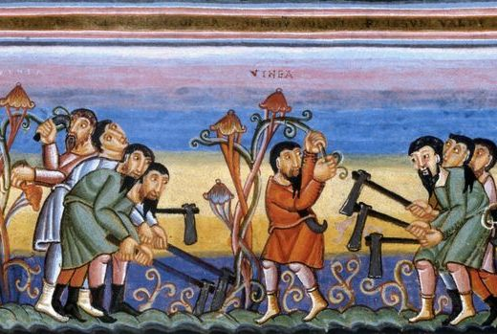
Our Lord’s Ministry in Judea and Perea
St. Matthew 20:1-34

