Slide 1
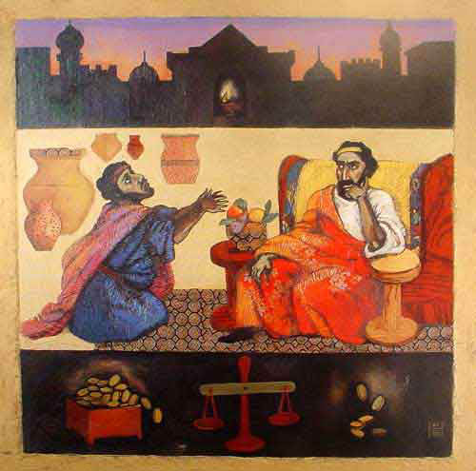
St. Matthew 18:1 – 19:2
The fourth discourse:
life in the kingdom

Slide 2
Introduction
This chapter is the Fourth Discourse of St. Matthew and is an extended and corrective teaching of Jesus after His second passion prophecy. Closely joined to the Fourth Discourse, is our Lord’s teaching in which He reveals that He and His disciples need not pay the Temple tax; since, by right, He is the Son of God and His disciples, by faith, are God’s sons (17:24-27).
After His teaching, the disciples approach Jesus “in that hour” (18:1) and our Lord will, therefore, define greatness as lowly, childlike neediness and will invite His disciples, both then and now, to a radically different way of thinking and living!

Slide 3
St. Matthew 18:1-6
“True Greatness”
Our Lord, contrary to His disciples misguided question, declares that the person who acknowledges his utter dependence on God is greatest in their present situation. Thus, if a disciple receives positively, because of our Lord’s name, as a lowly child who needs support and nurture, then that disciple is actually receiving the Lord Jesus!

Slide 4
St. Matthew 18:1-6
“True Greatness”
Jesus is proclaiming that the greatest in the Kingdom of God is the one who is, in fact, in a condition of lowly powerlessness and who willingly acknowledges his own emptiness and utter inability in spiritual things.
This sense of “to humble oneself” or “to be humbled” is the more common one in the NT (cf. St. Luke 14:11; 18:14; Phil 4:12; James 4:10; 1 Peter 5:6 and also 2 Cor. 12:21).

Slide 5
St. Matthew 18:1-6
“True Greatness”
The Holy Spirit, through James (2:1-7) and 1 Cor. (12:12-26), reinforces our Lord’s teaching by using two examples that you should be of aware and even practice.
(James 2:1-7): James castigates his readers for giving preferential treatment to the very wealthy in the congregation and, thus, dishonor Jesus.
(1 Cor. 12:12-26): St. Paul combats the Corinthians’ error about the status and power and calls them to give greater honor to the members of the body that are, by worldly standards, the least honorable and the weakest!

Slide 6
St. Matthew 18:1-6
“True Greatness”
Therefore, in congregations today, the greatest in the reign in heaven are the newest and least catechized beleivers, those subject to the gravest of life’s crises, and those who are struggling with temptation and fear. To receive such and to care for them is the most important work of all; it is to receive and care for Jesus!

Slide 7
St. Matthew 18:1-6
“True Greatness”
Verse 6 is a transition verse that Jesus uses to lead His disciples into His next teaching! This verse is often misused, so let’s briefly discuss.
Jesus uses the Greek verb skandalivsh/ that is followed by a conditional relative sentence: “that a donkey millstone be hung around his neck and that he be drowned in the depth of the sea is better for him.”
Thus, the kind of worldly, comparing , judging attitude that produced the disciples’ original question in v.1 can, if unchecked, inflict devastating spiritual damage on other Christians!

Slide 8
St. Matthew 18:7-9
Warnings of Hell
Note that Jesus does say that causes for stumbling are “a certainty” (v.7). Yet, this isn’t an excuse and there is no hiding place, even the depth of the sea, for the Christian who causes the spiritual destruction of another Christian! Jesus makes His point by using the Greek word oujai; “woe” twice!
Jesus follows His warning by using an exhortation in vv.8-9. Jesus reminds His disciples that all must live vigilantly as they follow in His way! They must always be aware that they too will encounter causes of stumbling!

Slide 9
St. Matthew 18:10-14
Lost Sheep
Verse 10 is used by our Lord as a summary and also to capture the spirit of His teaching in vv.6-9. What is very distinctive about this verse is His phrase: “for I say to you that their angels constantly see in the heaven the face of my Father who is in heaven.”
The easiest conclusion to draw is the most important! His teaching in this verse clearly says that the Father’s heart is always open to the most vulnerable, to those most in need and who cannot provide of themselves.

Slide 10
St. Matthew 18:10-14
Lost Sheep
It must be said that every disciple (yes, each of you) is a little one; all of you are poor in spirit in relation to the Lord (cf. 5:3) and equally in need of His blessing!
Additionally, it must also be noted that Jesus gives this teaching in response to the question in v.1 that illumines the error of the disciple’s thinking. Thus, greatest isn’t in according with worldly thinking…it not a competition. God’s thinking and heart is quite different and must be understood by His children: the most vulnerable are not to be despised!

Slide 11
St. Matthew 18:10-14
Lost Sheep
Does Jesus teach that each of us has a “guardian angel?” Note that Jesus says, “their angels.” This is the only Biblical support for this concept; no where in Holy Scripture does the Holy Spirit tell us that there is a particular angel assigned to guard you. So what is Jesus really saying?
We must confess that that we know nothing definitive beyond this text that could help us flesh out what our Lord Jesus is teaching. What is more important is that our Lord Jesus watches over us and as He has promised, “Lo, I am with you always, to the close of the age” ^{(28:20b)}.

Slide 12
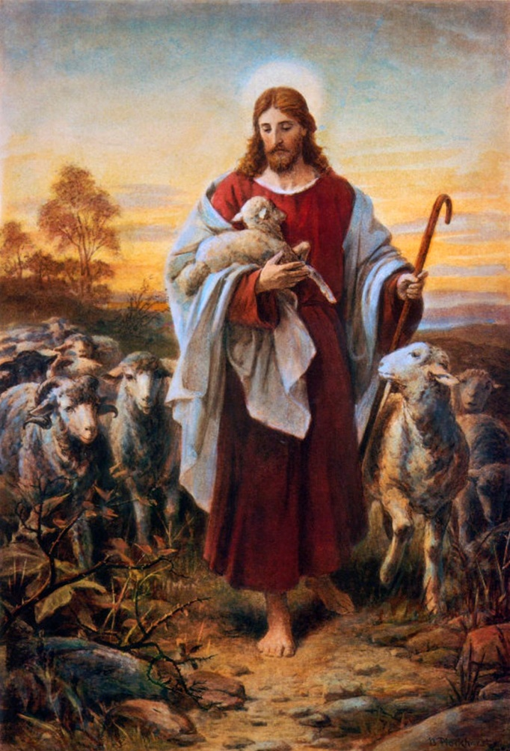
St. Matthew 18:10-14
Lost Sheep
The last section of this pericope concerns “straying sheep.” Please remember the context; Jesus is teaching in connection with not
bringing harm to or neglecting those
who are “little ones” in their faith.
St. Matthew’s purpose is show that
Jesus IS the Shepherd of Israel (2:6;
9:36; 26:31), primarily for pastoral
purposes and as an exhortation that
fellow disciples should also care for
the little ones in their midst.

Slide 13
St. Matthew 18:15-20
Discipline
The structure of this section can be depicted as such:
(vv.15-17) – Five conditional sentences in rapid order.
1. “…if your brother sins against you…”
2. “…If he hears you…”
3. “…If he does not hear [you]…”
4. “…if he ignores them…”
5. “…if he even ignores the church…”
This section is dominated by second person singular pronouns and verbs; the emphasis being upon person-to-person interaction.

Slide 14
St. Matthew 18:15-20
Discipline
The second part of this unit (18-20) consists of two major promises that undergird the conditional sentences :
(vv.18-20) – Two major promises.
1. “…truly I say to you…”
2. “…again I say to you…”
Note that this section is dominated by second person PLURAL pronouns and verbs. This second part makes it abundantly clear that the human actions that are described in part one are not human actions only! The promise of the Father’s answers to prayer and of our Lord Jesus’ presence binds heaven and earth together.

Slide 15
St. Matthew 18:15-20
Discipline
This pericope is (don’t gasp) NOT primarily about executing church discipline! Neither is it a “checklist” that need to be followed with dealing with flagrant sinners! And even less, it’s not about how to “weed out” or removing inactive members.
Instead, this pericope is about one thing only: caring for a needy, wandering, sinner brother or sister in Christ. Thus, we are not called to abuse our Lord’s teaching in legalism or apathy. Rather, we are to look out for each other in Christian love for one another! We are to be concerned if a fellow Christian is lapsing into unbelief!

Slide 16
St. Matthew 18:21-35
Forgiveness
This concluding pericope of the Fourth Discourse is the crescendo of caring for the greatest in the reign of heaven! Once again, it’s Peter, in his “smallness” of faith and understanding raises this issue (v.21). Jesus, however, tells an extensive and Divinely crafted Parable of the Unforgiving Servant (23-35). Your Lord’s purpose is to reinforce His teaching on greatness and forgiveness; additionally, He also provides the context of truth and reality that can actually enable you to begin to carry out His teaching on forgiveness!!!

Slide 17
St. Matthew 18:21-35
Forgiveness
So Peter ask a question of Jesus concerning forgiveness! Peter is willing to count of to seven; however, Jesus totally destroys Peter’s perceived willingness to forgive seven-fold! Jesus declares that forgiveness eschews all moral arithmetic and keeping of ANY record. Now Jesus says that, in effect, there can be NO limit to the forgiveness given and received between those who are His disciples.
Jesus reveals His meaning in one of His most “famous” parables. We are familiar with this parable, so let summarize it:

Slide 18
St. Matthew 18:21-35
Forgiveness
The Parable of the Unforgiving (Steward) Servant
Jesus introduces the parable in verse 23 and gives a concluding interpretation in verse 35. In between are three intriguing scenes:
1. The Master’s compassion for a hopelessly indebted servant (24-27);
2. The forgiven servant’s refusal to show mercy (to forgive) an indebted fellow servant who had a very small debt (28-30); and,
3. The Master’s angry reaction to His forgiveness and the subsequent punishment of the unforgiving servant.

Slide 19
St. Matthew 18:21-35
Forgiveness
The Parable of the Unforgiving (Steward) Servant
A Summary
First, God (the Master) takes the initiative, in Christ Jesus! Thus, God’s forgiveness is always first and foundational. His forgiveness is never, ever earned or merited!
Second, the decision to forgive another and the internal emotion(s) that a Christian may or may not experience in relation to another. To forgive (ajfivh/mi) has to do with releasing! To forgive is to release someone else from the retribution and retaliation that, according to human relationships, and even God’s Law, may very well be deserved!

Slide 20
St. Matthew 18:21-35
Forgiveness
The Parable of the Unforgiving (Steward) Servant
A Summary
Second, the decision to forgive another and the internal emotion(s) that a Christian may or may not experience in relation to another. To forgive (ajfivh/mi) has to do with releasing! To forgive is to release someone else from the retribution and retaliation that, according to human relationships, and even God’s Law, may very well be deserved!
The above can only be accomplished by the believer, via the power of the Holy Spirit! In other words, forgiveness can only be readily seen as a Spirit-led choice; an act of a regenerated will of a disciple of Christ Jesus! Yes, the emotion of anger and hurt that lasts is actually an “unnecessary” distress! Why? God’s forgiveness cannot be “trumped” by emotions!

Slide 21
St. Matthew 18:21-35
Forgiveness
The Parable of the Unforgiving (Steward) Servant
A Summary
Third, God’s Holy Word is filled with assurances that when the Lord forgives, He forgives completely: Ps. 103:11-12!
Although our consciences and acquaintances may keep reminding us of our sin against someone else, there is absolutely NO need for our Lord God to forgive that sin over and over again; Christ Jesus died once for all time. Let’s review Romans 6:10 and Hebrews 7:27!
Lastly, to steadfastly refuse to forgive is unjust, wicked and will be punished! This is the final warning that Jesus gives in verses 34-35!

Slide 22
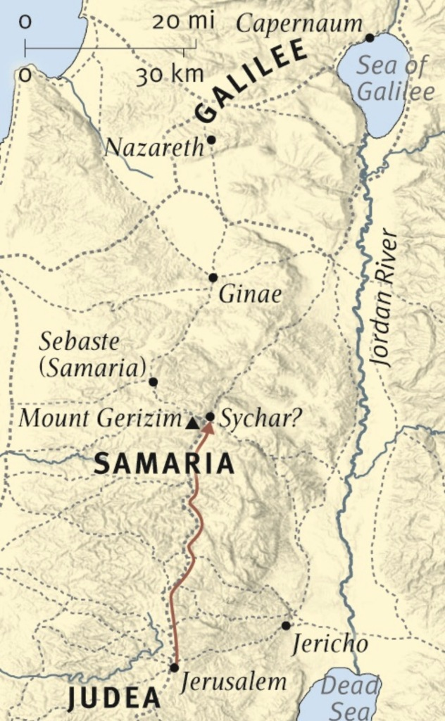
Jesus Travels to Judea, Beyond the Jordan (19:1-2)
Verses 1 and 2 introduce that Jesus has now left Galilee, for the final time, and has crossed the road “beyond the Jordan” as He now begins His journey to Jerusalem, Golgotha, and His glorious resurrection!
St. Matthew give this information for the benefit for Jews who knew the geography very well and also knew that Jews of Galilee would avoid travelling through Samaria.
So next Sunday we will begin to study: Our Lord’s Ministry in Judea and Perea

Slide 23
July Class Schedule
VII. Our Lord’s Ministry in Judea and Perea (19:3 – 20:34)
Teaching on Marriage and Divorce (19:3-12) (7/6)
Teaching Concerning Little Children (19:13-15) (7/6)
The Rich Young Man (19:16-30) (7/6)
The Parable of the Workers in the Vineyard (20:1-16) (7/13)
Prophecy of His Death (#3) (20:17-19) (7/13)
Salome’s Request (20:20-28) (7/13)
Restoration of Sight at Jericho (20:29-34) (7/13)
Passion Week (Chapters 21:1 – 27:66)
A. The Triumphal Entry (21:1-11) (7/20)
B. The Cleansing of the Temple (21:12-17) (7/20)
C. The Last Controversies with the Jewish Leaders (21:18 – 22:46)
1. Cursing of the Fig Tree (21:18-22) (7/27)
2. Authority of our Lord is Questioned (21:23-32) (7/27)
3. The Parable of the Vineyard (21:33-46) (7/27)

Slide 24
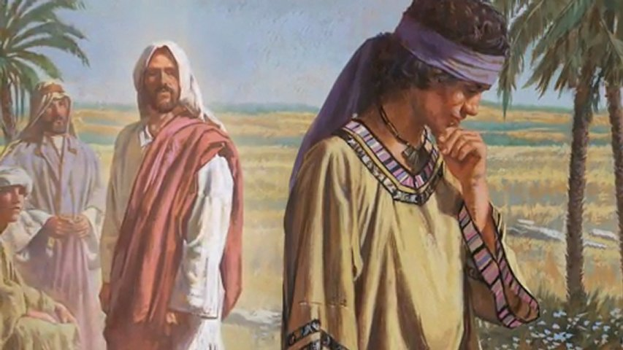
Our Lord’s Ministry in Judea and Perea
St. Matthew 19:3-30

