Slide 1
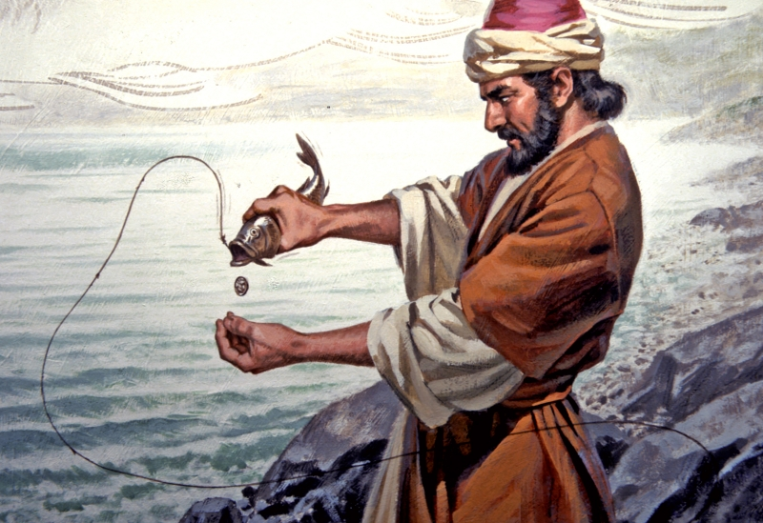
Our Lord’s Last Ministry in Galilee (17:22-27)
His Passion Foretold - #2
and
The Temple Tax

Slide 2
Introduction
Our Lord Jesus and His disciples now return from Caesarea Philippi to Galilee. As St. Luke 9:52 tells us, “Now it came to pass, when the time had come for Him to be received up, that He steadfastly set His face to go to Jerusalem!”
Note that St. Matthew does not tell us where Jesus announces, for the second time, His impending arrest, suffering, death, and resurrection. All that we are told is that they are now back in Galilee. So let’s take a closer look at His Second Passion Prophecy and the paying of the Temple tax.

Slide 3
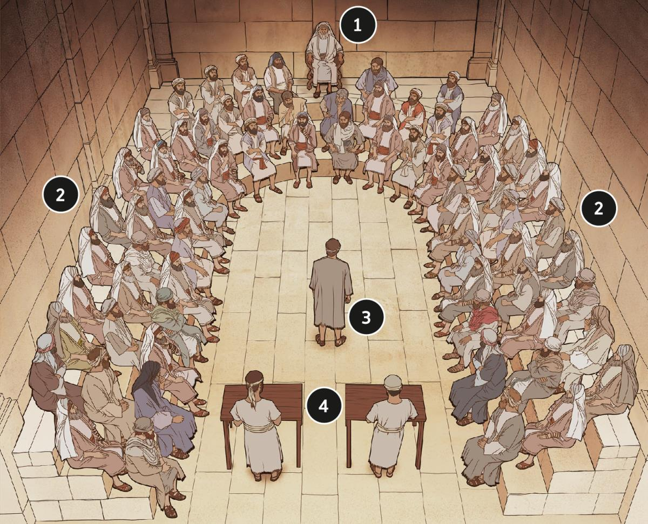
St. Matthew 17:22-23
The High Priest
Jesus repeats His announcement from 16:21, although, this time He calls Himself, “the Son of Man” and says that “he is about to be delivered into the hands of men,” which He named in 16:21, the Sanhedrin (elders and chief priests and scribes).
35 Members
35 Members
The Accused
The Clerks

Slide 4
St. Matthew 17:22-23
Literally, Jesus says that He “is about to be betrayed into the hands of men.” This is an interesting statement since the Greek verb that’s used is: paradivdosqai. It is a passive verb and passive verbs in the Greek must have an agent, one who is to do the action of…handing over or betraying Jesus “into the hands of men”…the Sanhedrin. That agent was…

Slide 5
St. Matthew 17:22-23
Such an announcement, again, plunges the disciples into despair. St. Mark (9:32) reports that they were so distraught that “…they were afraid to ask Him” what His prophecy meant. To the last, their minds struggled against the plain meaning of what Jesus was speaking to them. Thus, what they did not want to know they actually did not understand.
We, on this side of our Lord’s crucifixion and resurrection, cannot properly understand the raw emotion of the disciples; especially, since their perception of who the Messiah is to be, was in total contradiction to what Jesus is saying!

Slide 6
St. Matthew 17:24-27
They now arrive in Capernaum, though we will see that their stay will be brief! This will be the last time that our Lord Jesus visits His city, His “mission base.” Note that the subject matter of this section stands alone: offenses are to be avoided, and after they occur they are to be removed rightly.
As they come into the city, it seems that Jesus isn’t present when Peter is approached by the collectors of the Temple tax. The Temple tax was required by every Israelite from the age of twenty (cf. Ex. 30:13-14; II Chr. 24:6; Neh. 10:32; and II Ki. 12:4). The price was a double drachma (divdracma) .

Slide 7
St. Matthew 17:24-27
What’s the premise of their question to Peter?
Well, did you know…that the priest were exempt from the Temple tax? It seems that the collectors of the tax, may have thought that Jesus was also exempt. Thus, their question was not an accusation; but rather, a desire for information.
Peter knew that Jesus paid the yearly tax, so He answers, “Yes!” Yet, as he comes into the house (probably his home), Jesus speaks to him about the conversation he has just had with the collectors! Undoubtedly, Peter must have been surprised and that Jesus would immediately ask for his opinion!

Slide 8
St. Matthew 17:24-27
What’s our Lord’s meaning in vv.25-26?
Kings do not make their children (sons) pay taxes, since the royal family is supported by taxes paid by their subjects. The king will collect taxes from outsiders (the commoners!), which is what Jesus means by “strangers.”
The Greek words that Jesus used “toll ” and “tribute” are those taxes that are levied by kings. Taxes on wares and goods (toll) and taxes that are a tax on the person (tribute).

Slide 9
St. Matthew 17:24-27
What’s our Lord’s meaning in vv.25-26?
Therefore, the Sonship of Jesus and His disciples in no way originates from or depends on the Temple in Jerusalem (thus, “the sons are free”). The spiritual sons of the great King Yahweh are, therefore, “free;” no one has the right to levy any Temple tax (or any tax) upon them!
Since Jesus intends to pay the Temple tax, as He has been doing, He wants Peter and the other disciples to understand that by doing so, He is not placing Himself and His disciples on a level with the Jews!

Slide 10
St. Matthew 17:24-27
So why pay the Double Drachma?
The principle that our Lord follows in consenting to pay the Temple tax is the same employed in 3:15; 5:17; and indicated in 8:4!
“Permit it to be so now, for thus it is fitting for us to fulfill all righteousness” (3:15).
“Do not think that I came to destroy the Law or the Prophets. I did not come to destroy but to fulfill” (5:17).
“See that you tell no one; but go your way, show yourself to the priest, and offer the gift that Moses commanded, as a testimony to them” (8:4).

Slide 11
St. Matthew 17:24-27
It is the consideration for others as imposed by their great mutual calling that prompts Jesus also in this matter, “we not offend them” (mh; skandalivswmen aujtouvV) . The use of this important Greek verb goes beyond the idea of causing someone to stumble, but actually means to “entrap” in the sense of being fatal.
Thus, if our Lord and His disciples refuse to pay the tax, the people would not understand and conclude, falsely, that Jesus and His disciples despise the Temple and its worship! They would thus reject Jesus, and His disciples, and their Gospel message!

Slide 12
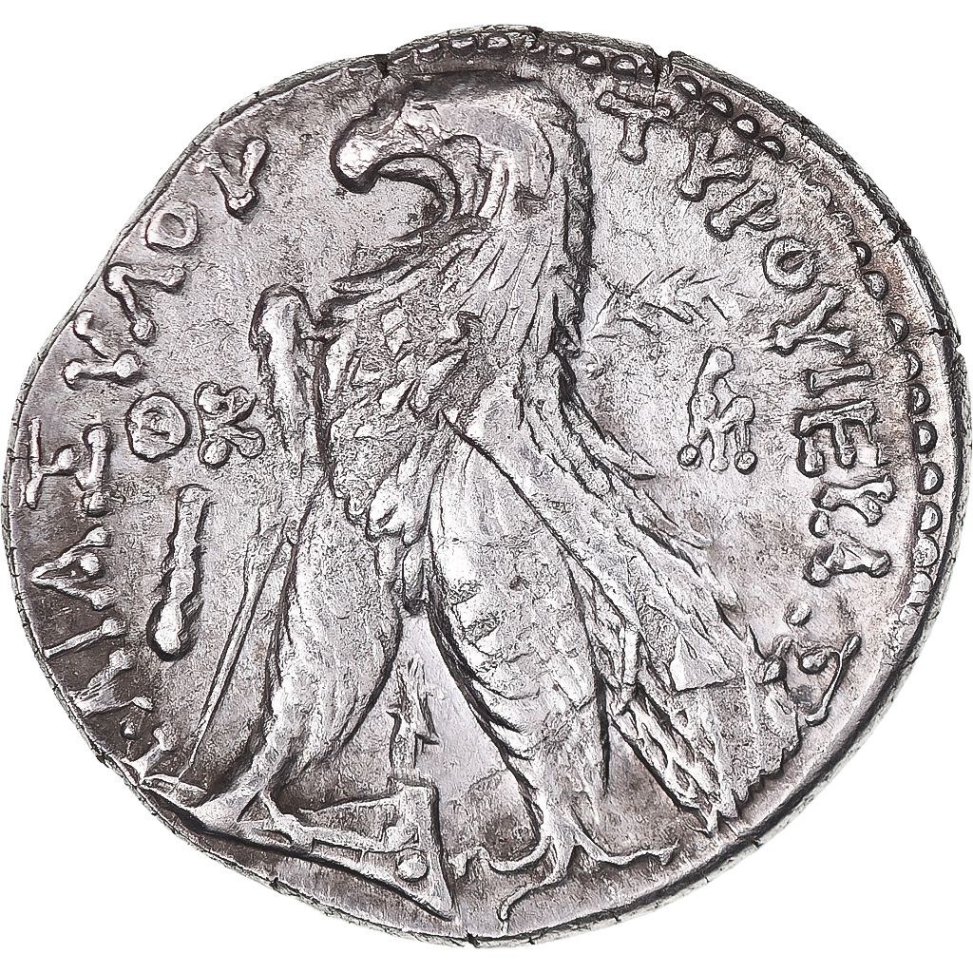
St. Matthew 17:24-27
Pay the Double Drachma!
The method that our Lord uses to pay the Double Drachma is miraculous! How our Lord provides the money, once again, proves His Divine Sonship as well as the connection of Peter and the other eleven.
Peter is to only catch one fish with “a hook,” not a net! The fish that Peter is to catch will have a “stater” in its mouth. A “stater” (stath:ra) is equal to four drachma, hence it is also called a “tetradrachmon” (a four drachma coin), that is the exact tax for two people.
An imprint of a Phoenician Eagle from Tyre. A Greek coin allowed by the Romans for the Jews to pay the Temple tax. The inscription reads: “ΤΥPΟΥ ΙΕΡΑΣ ΚΑΙ ΑΣΥΛΟΥ”
(TYRE: HOLY AND SAFE)

Slide 13
Conclusion
Peter caught the fish and used the “stater” to pay the Temple tax as directed by Jesus. Note that St. Matthew does not need to elaborate, proving that his audience would clearly know the subject matter (remember this Gospel letter was written to the Jews). The bottom line of this pericope is that disciples of our Lord Jesus are to obey the law and pay one’s taxes in order to not give offense (to the Lord; to His Church and to the state).
Next week, the disciples approach Jesus with their next question that will lead us to
The Fourth Discourse!

Slide 14
VI. The Fourth Discourse: Life in the Kingdom (18:1 – 19:2) (6/29)
A. Sayings on Humility and Forgiveness (18:1-35)
1. True Greatness (1-6)
2. Warnings of Hell (7-9)
3. The Lost Sheep (10-14)
4. Discipline (15-20)
5. Forgiveness (21-35)
B. Jesus Travels to Judea, Beyond the Jordan (19:1-2)

Slide 15
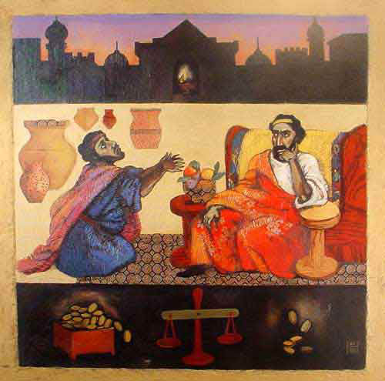
St. Matthew 18:1 – 19:2
The fourth discourse:
life in the kingdom

