Slide 1
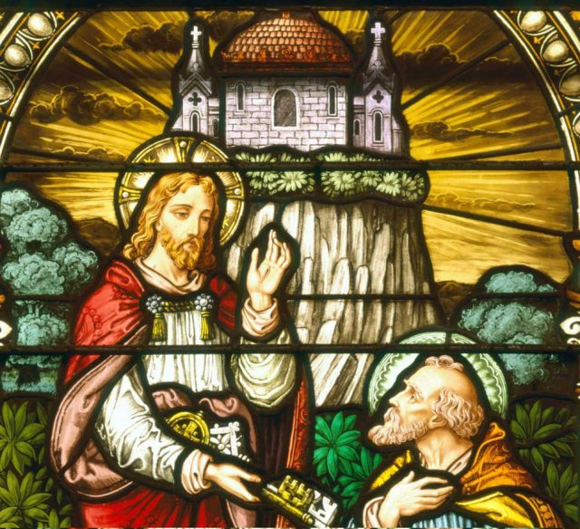
Matthew 16:13 – 17:21
To Caesarea Philippi

Slide 2
Caesarea Philippi
Jesus has now come into the area of Caesarea Philippi, named in honor of the Caesar and Herod Philip.
St. Mark tells us that He and His disciples are in an outlying village ^{(St. Mark 8:27)}.
Why would Jesus ask this question? (v.13)
He desires to have the disciple answer since they haven’t exactly distinguished themselves by displaying a firm grasp of the truth of their Lord!

Slide 3
Who is Jesus?
John the Baptist, who has come back?
Elijah, the herald of the Messiah?
Jeremiah, the great Prophet?

Slide 4
Who do You say I am?
The YOU is a plural personal pronoun…so in Texan… “Who do Y’all say I am” (v.15)?
Jesus is asking that they EACH make a…
CONFESSION!
Jesus knows your confession, since He knows your heart…
I know your confession…by your words and practices!

Slide 5
Peter replies…
“You are THE CHRIST, THE Son of God the Living” (v.16).
+ THE CHRIST (oJ Cristo;V) = The Messiah, The Anointed One…as Anointed by God (cf. St. Matthew 3:16)!
+ “THE Son of God the Living” = Jesus is the Second Person of the Holy Trinity…as proven by His Life, Words, and Deeds!

Slide 6
“THE Son of the Living God”
Jesus is THE Son of the Living One!
+ The Only God Who has Life and Power in Himself!
+ God is the exact opposite of all other “gods” who are lifeless, powerless…DEAD!
In Jesus, God attests of Himself as THE Living One! Through Jesus, He is the One and Only Source and Fountain of Life for sinful man.

Slide 7
“THE SEAL OF APPROVAL”
Jesus confirms Peter’s Great Confession, by accepting and approving his confession.
+ To confess Who Jesus is…is a blessing!
+ How so?
- Peter, and we, are blessed since this confession comes from the Father, by the power of The Holy Spirit; never by our human reason or emotion!

Slide 8
“Your Confession”
“I believe that I cannot by my own reason or strength believe in Jesus Christ, my Lord, or come to Him.”

Slide 9
“THE SEAL OF APPROVAL”
Note that Jesus does not tell the disciple to keep their confession silent! Rather, they are not to reveal that He is the Christ (v.20).

Slide 10
“Part II”
The second part of this pericope consists entirely of our Lord’s words to Peter (17-19). Now that the Lord has declared that Peter is “blessed” and explains why; Jesus now makes three future (Divine) promises:
1. Jesus will build His Church upon “this rock” (18a);
2. No evil power will ever be able to win ultimate victory over His Church (18b);
3. Jesus will give the Keys of the reign of heaven to Peter, this is, to bind and loose on earth things that are bound and loosed, because they have already been bound or loosed in the presence of God (19)!

Slide 11
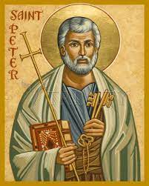
“Peter?”
The first point that must be made about verses 17-19 is that Jesus is speaking directly to Peter! All the “you(s)” are singular. Though, as a disciple, we must conclude that Peter is no better or no worse than the others.
Then our Lord makes His first two promises:
1. “Now I also say that You are Peter (PevtroV), and upon this rock (pevtra) I will build My Church,” ^{(18a)};
2. “and Hades’ gates will not win the victory over it” ^{(18b)}

Slide 12
“Peter?”
If our Lord had desired that Peter be separate and distinct from the other eleven; why did He not make it clear? He could have said to Peter, “You are Peter, and upon You [Peter] I will build My church!” Or, “You are PevtroV, and upon you, PevtroV , I will build My church!” Jesus does not say either one!
In the Greek, it’s very clear that the language that Jesus did use makes a clear distinction by switching from “Peter” (PevtroV) (a small stone or rock) to “this rock” (bedrock; rock formation) (au[th hJ pevtra) !
Lastly, in St. Matthew 28:16-20, is Peter singled out?

Slide 13
“Promise #2”
No evil power will ever be able to win ultimate victory over His Church (“…and [the] gates of Hades will not prevail against it”) (18b)).
This is an acknowledgment that while our Lord is building His Church upon the apostles and their confession of Him as the Son of God, His Church will find itself under assault! Even so, the forces of evil will not win the victory!

Slide 14
“Promise #3”
Our Lord’s third promise is: “I will give you the keys of the reign of heaven” (19a).
The image of “keys” suggest that ability to either lock or unlock! Thus, to allow entrance into an area or realm; or to deny entrance. In this case, the area or realm is “the reign of heaven.”
There is an interesting parallel in St. Matthew 23:13. Here Jesus is being explicit is saying the scribes and Pharisees bar access to the reign of heaven via their destructive teachings!

Slide 15
“Promise #3” & Lutherans
In our Lutheran tradition, the Office of the Keys is understood in more specific terms as the Pastoral Office to retain the sins of the impenitent and to forgive the sins of the penitent (cf. The Small Catechism, 27; AC XXV 2-4, XXVIII 5-8; Ap XI 2; XII 4-10, 39-40; SA III IV; III, VII; and III VIII)!
Additionally, The Holy Spirit, in 16:17-19, preeminently has in mind the proclamation of Christ Jesus and the teaching of His doctrine. The modern application refers most expressly to the vocation of pastors – men entrusted with teaching the Lord’s Word (doctrine) and to faithfully exercise their office within the Lord’s assembly.

Slide 16
“Promise #3” & v.19
Lastly, and importantly, we must look at the Greek grammar of verse 19. The construction of this verse is a future perfect passive: “will have been bound… will have been loosed.” Our Lord does not say that whatever “you bind or loose.” Thus, binding and loosing is not temporal.
Yes, the binding and loosing happens on earth, but is accomplished by the power of His Word…not Peter’s or your pastor’s! No one can force God’s hand. The Lord will, however, extend His hand by means of Peter and the apostles, later pastors, by bringing the power of His binding and loosing on the life of His child(ren).

Slide 17
v.20
St. Matthew closes this section with our Lord, once again, reiterating that His disciples not: “…say that He is the Christ.” The title of “Christ” in first century Israel had eschatological expectations that actually ran counter to the true reign of God that Jesus was now showing in Israel!
As we will see momentarily, Peter’s actions in vv.21-28 will perfectly illustrate the meaning and purpose of our Lord’s life and work as The Messiah that are scandalous and spiritually offensive to Peter! Thus, for the time being, it is best that the truth of Yahweh’s Messiah be kept secret!

Slide 18
The First Passion Prediction
(vv.21-28)
With v.21, our Lord will effect a remarkable change in St. Matthew’s Gospel, as He will now make His first prophecy concerning His death and resurrection, which will dominate the rest of this Gospel.
Our Lord’s teaching is reinforced in a two-fold manner:
1. “From then” (ajpo; tovte)
“Jesus began” (h[rxato oJ jIhsou:V)
St. Matthew used the same formula at the beginning of our Lord’s ministry in 4:17. And he will use it again in regards to Judas Iscariot’s actions in chapter 26!

Slide 19
The First Passion Prediction
(vv.21-28)
This pericope can be divided into two sections:
First, vv.21-23, details how our Lord begins to reveal the goal and purpose of His ministry. Then follows Peter’s rather evil response to Jesus; the Lord’s retort renounces Peter’s plan/perspective and reinforces the way of the cross.
Second, vv.24-28, extends and applies our Lord’s new teaching to the lives of His disciples. Properly, v.24 is the call to deny self, take up the cross, and follow Him. Then vv.25-28 explain why it must be this way for His disciples (followers).

Slide 20
Peter’s Response
(v.22)
Peter’s rebuke of Jesus is telling and important for us today! Jesus has revealed the Divine Plan of Salvation; that the Son of Man must be rejected by the religious leaders of Israel; that He must suffer; and then be executed!
Yet, for Peter, and apparently, for virtually all Jews, these two phrases do not match: “Messiah” and “suffer and death!” As a matter of fact, the later Jewish Targum of Isaiah actually removes the theme of the Messiah’s vicarious suffering and death from Isaiah 52:13-53:12!

Slide 21
Peter’s Response
(v.22)
Peter’s words have shown that his stand against the Lord and against His Messiah are in fulfillment of Ps. 2:2! Thus, there are two way to consider God’s activity in the world; and Peter chose to think of “the things of men” and not “of the things of God”(v.23).
Therefore, there’s only one course of action! Those who attempt to make the Messiah stumble into disobedience must leave His presence. This is the way of Satan and his followers; not the way of those who think of the “things of God.”

Slide 22
It’s NOT About You!
(vv.24-28)
Peter, the other disciples, and all follower of Jesus must understand what discipleship entails. So Jesus turns to them and begins “corrective” teaching: “…if someone wants to come after Me, let him deny himself and take up his cross and so continue to follow Me” (v.24).
This verse is the heart and summary of your Lord’s teaching, and the rest of this section is His supporting material.

Slide 23
It’s NOT About You!
(vv.24-28)
The Christian faith is about Jesus…not about you! What is necessary is for you to be obedient, as He is obedient, even unto death, death upon a cross! Jesus, The Christ, The Messiah, has now brought the cross into plain sight! His disciples, then, reacted by being stupefied and resistant to His new revelation about His life and ministry. Therefore, will you also be stupefied and resistant; or will you deny (not your desires or your will) self and follow (be fully obedient and submit to His will) Him.

Slide 24
The Transfiguration of Our Lord; Elijah; John; and Faith!
(17:1-21)
The Transfiguration of Our Lord (vv.1-8) is a very familiar pericope…so let’s briefly summarize:
1. The chief purpose is to proclaim the true identity and glory of Jesus!
2. The primary message is the same as our Lord’s Baptism; He has come to fulfill the Plan of Salvation by defeating sin, death, and the power of the devil at the cross!

Slide 25
The Transfiguration of Our Lord; Elijah; John; and Faith!
(17:9-13)
On the way down the mountain, Jesus instructs the three (Peter, James, and John) not to tell anyone about His transfiguration until He is resurrected from the dead! It was quite clear that the people, including the disciples, had wrong ideas about the nature of our Lord’s kingdom and those wrong ideas would only be misinterpreted.
Then they asked about Elijah’s appearance on the Mount and if this meant that the Messiah would now reestablish His kingdom.

Slide 26
The Transfiguration of Our Lord; Elijah; John; and Faith!
(17:9-13)
So Jesus explained to them, again, that John the Baptist was the promised second Elijah, just as He had told them on a previous occasion (cf. 11:14).
The Baptist was recognized as a great prophet; then he was arrested, imprisoned, and beheaded by Antipas. In a similar way, Jesus would be recognized and is the Great Prophet, and He also would not be accepted as the Son of God and the Promised Messiah! As with John, Jesus would be arrested, suffer, and be put to death!

Slide 27
The Transfiguration of Our Lord; Elijah; John; and Faith!
(17:14-21)
Once Jesus and the other three have come down the mountain, they are confronted by a crowd, the other nine, and a distraught father! This man had brought his son to the nine, asking them to cast out a demon that afflicted the boy with epileptic seizures; these seizures were so violent that he would fall into fire or water.
Jesus cast out the demon and later the nine ask Him why they failed? Once again, Jesus reminds them that it’s due to them being “little-faith ones!”

Slide 28
The Transfiguration of Our Lord; Elijah; John; and Faith!
(17:14-21)
Jesus, figuratively, tells them that faith as small as a mustard seed can move mountains! We must remember that faith is always related to a specific promise. When your Lord makes a promise and you, in faith, believe His Word, that promise will be fulfilled (in accord with His Divine Will)!
Let’s review 1 Cor. 10:13. With Faith in His promise, you will triumph over all your hardships and suffering! Remember His promises always, cling to Him and be richly blessed in His eternal Kingdom!

Slide 29
The Transfiguration of Our Lord; Elijah; John; and Faith!
(17:21)
Lastly, a note on verse 21. This verse is found in a majority of manuscripts and commentaries about St. Matthew. The early church fathers, Origen and Jerome, assume and comment on it. It is a close parallel to St. Mark 9:29.
On the other hand, there are a number of major manuscripts that do omit this verse. It’s unknown as to why. It’s a possibility that later scribes (probably unintentionally) imported a saying from St. Mark 9:29 into St. Matthew’s Gospel by what is known as “harmonization.”

Slide 30
V. Our Lord’s Last Ministry in Galilee (17:22-27) (6/15)
A. His Passion Foretold - #2 (17:22-23)
B. The Temple Tax (17:24-27)
VI. The Fourth Discourse: Life in the Kingdom (18:1 – 19:2) (6/22)
A. Sayings on Humility and Forgiveness (18:1-35)
1. True Greatness (1-6)
2. Warnings of Hell (7-9)
3. The Lost Sheep (10-14)
4. Discipline (15-20)
5. Forgiveness (21-35)
B. Jesus Travels to Judea, Beyond the Jordan (19:1-2)

Slide 31
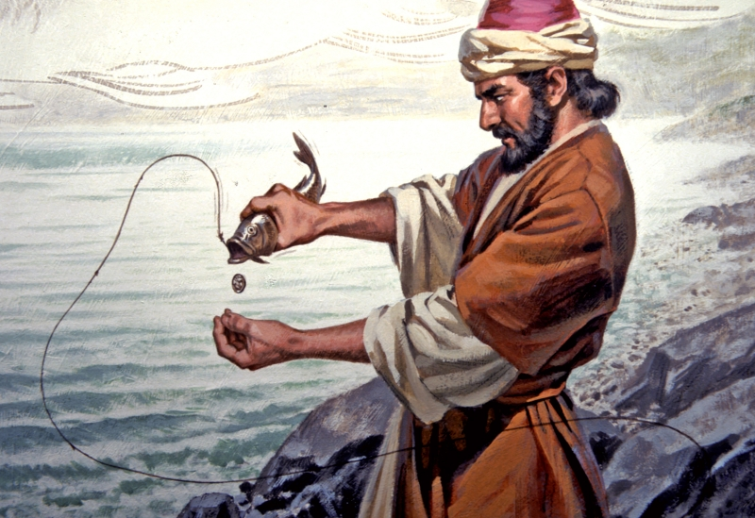
Our Lord’s Last Ministry in Galilee (17:22-27)
His Passion Foretold - #2 (17:22-23),
and;
The Temple Tax (17:24-27)

