Slide 1
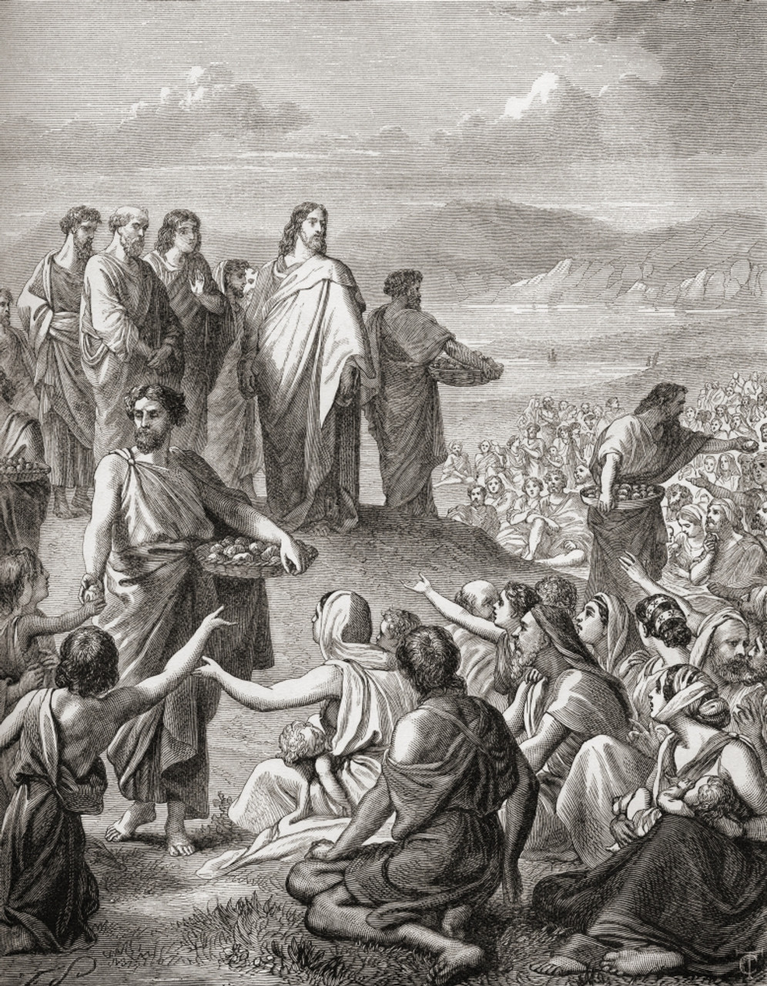
To the Decapolis & Magadan
St. Matthew 15:29 – 16:12

Slide 2
What We’ve Covered!
Jesus is now in the final stages of His Galilean ministry:
St. John 6:66 marked the great turning point;
Jesus has confronted the Pharisees & Scribes and withdrew to Syro-Phoenicia;
We have heard of the Canaanite woman with a marvelous faith;
Now Jesus travels to Decapolis (15:29ff.)

Slide 3
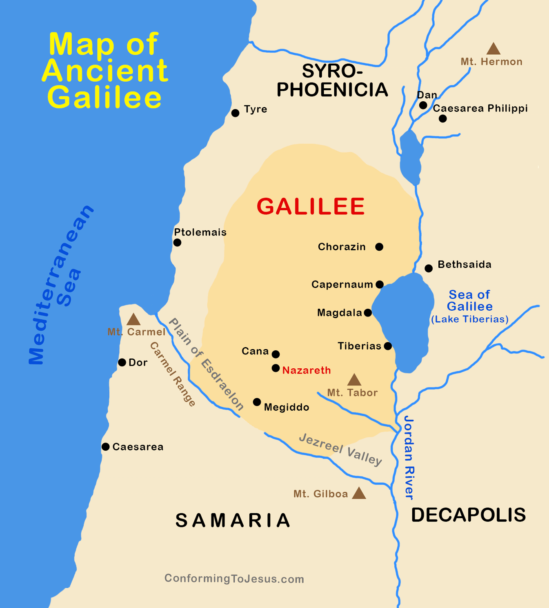
What We’ve Missed!
Magadan

Slide 4
To The Decapolis!
In the area of the Decapolis, Jesus feeds the 4,000 (15:30-38);
He then sails to the area of Magadan (15:39);
There Jesus is, again, confronted by the Pharisees and, now, Sadducees; Jesus gives the Sign of Jonah (16:1-12).

Slide 5
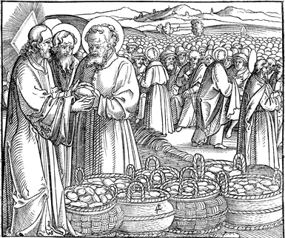
To The Decapolis!
In the area of the Decapolis, Jesus feeds the 4,000 (15:29-38).
+ Our Lord’s healing ministry, followed by the feeding of 4,000, is meant to convey the same theology of comfort and hope as the parallel account of Ch. 14.
+ These two accounts conclude
with virtually the very same language,
the chief difference being the total
number (5,000 v. 4,000; 12 baskets
v. 7 hampers)

Slide 6
To The Decapolis!
The one major difference in this account, vs. the feeding of the 5,000, is that Jesus begins by declaring that He has “compassion” on the crowds; and, He tells His disciples in advance that He will not send them away (v.32)!

Slide 7
To The Decapolis!
It has been common since the time of St. Augustine (354-430 AD) to emphasize that this second miraculous feeding occurs in a mixed Jewish-Gentile territory (The Decapolis). Though, it should be pointed out that both St. Matthew and St. Mark do not give an exact location.

Slide 8
To Magadan (15:39 – 16:4)
As you may recall our previous map, the exact location of Magadan is uncertain, though there are ruins of a small fishing village just North of Magdala.
Many commentators suspect that St. Matthew, or a later scribe, miswrote Magadan for Magdala. Yet, there is no evidence for this “mistake!”

Slide 9
To Magadan
St. Matthew is the typical Jewish teacher, since he employs repetition as he again reports a parallel incident as Jesus arrives in Magadan.
Jesus is confronted by Pharisees and, for the first time, Sadducees. Their “demand” is nearly the same as recorded in 12:38 – “…show them a sign from heaven.”

Slide 10
To Magadan
There are three major features that stand out in this encounter:
In 16:1, St. Matthew overtly states that the religious leaders’ purpose is “…in order to tempt…” Jesus;
Note that there is an unusual “alliance” with Pharisees and Sadducees approaching Jesus. St. Matthew is now beginning to show that opposition to our Lord is growing amongst ALL the religious leaders;

Slide 11
To Magadan
There are three major features that stand out in this encounter:
The solidarity of these religious leaders who blindly oppose Jesus is made even more reprehensible by our Lord’s acknowledgment of their ability to discern signs of the weather; but not His identity and mission!

Slide 12
To Magadan
The Sign of Jonah will serve as the validation of Jesus and all that He has claimed and done! Only when the stone is rolled away from the tomb and the angel has announced the new creation in Jesus’ resurrection to eternal life – only then will the Divine stamp of validation and approval be given publicly for all to see!
Against all expectations, and with NO human participation or contribution whatsoever, God, by His grace, has acted to reign mercifully in Jesus. God the Father raised Him from the dead. When all else was untrustworthy, His resurrection is the definitive sign:
He is risen, indeed!

Slide 13
To Magadan
The Warning of the Leaven (16:5-12)
It seems that the disciples forgot to buy and bring bread with them to Magadan, which our Lord uses for a teaching point! This interaction between Jesus and His disciples borders on the ludicrous!
What Jesus tells them concerning the Pharisees and Sadducees is completely misunderstood by the disciples. They were thinking like “hungry” men – physically; yet, Jesus is talking about the false teachings of these religious leaders!

Slide 14
To Magadan
It should be noted that Jesus is not specifically warning them about the oral tradition of the Jews or about how they interpret the Scriptures.
Remember, they were attempting to tempt Jesus into making a “religious” mistake; so that, they could accuse Him and He would then lose favor with the people.
The “leaven” is their evil and false view of Jesus!

Slide 15
To Magadan
With our Lord’s warning now ringing in their ears, they depart Magadan and travel to the far north, to the region of Caesarea Philippi.
Jesus, there, will question the disciples about what matters more than anything:
“Who is the Son of Man?”

Slide 16
IV. Our Lord’s Withdrawals from Galilee (14:13b – 17:20)
D. To Caesarea Philippi (16:13 – 17:21) (6/8)
V. Our Lord’s Last Ministry in Galilee (17:22-27) (6/15)
A. His Passion Foretold - #2 (17:22-23)
B. The Temple Tax (17:24-27)
VI. The Fourth Discourse: Life in the Kingdom (18:1 – 19:2)
A. Sayings on Humility and Forgiveness (18:1-35)
1. True Greatness (1-6)
2. Warnings of Hell (7-9)
3. The Lost Sheep (10-14)
4. Discipline (15-20)
5. Forgiveness (21-35)
B. Jesus Travels to Judea, Beyond the Jordan (19:1-2)
(6/22)

Slide 17
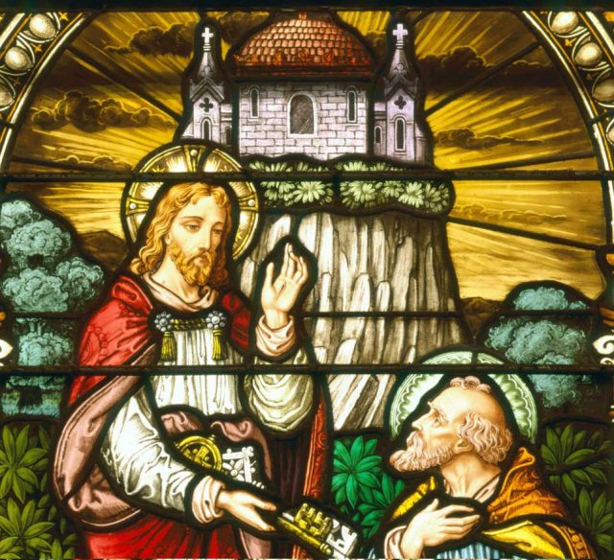
Matthew 16:13 – 17:21
To Caesarea Philippi

