Slide 1
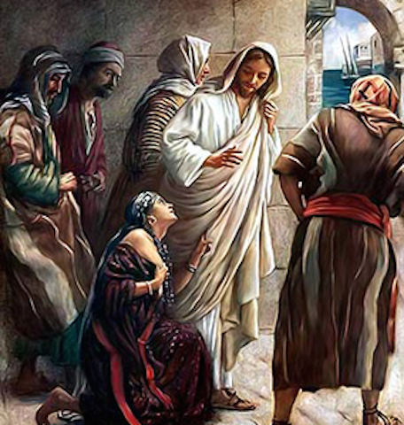
Matthew 15:21-28
EXTRAORDINARY FAITH: JESUS AND THE CANAANITE WOMAN

Slide 2
Background & Context
Our Lord Jesus continues His way to the Cross, which is about 1 year away!
+ He has just confronted the Pharisee
about what’s CLEAN and UNCLEAN.
+ The “tradition of the elders” were “human laws” added to the God’s Holy Commandments, which were onerous rules and regulations.
+ Jesus goes North for a Divine Purpose!

Slide 3
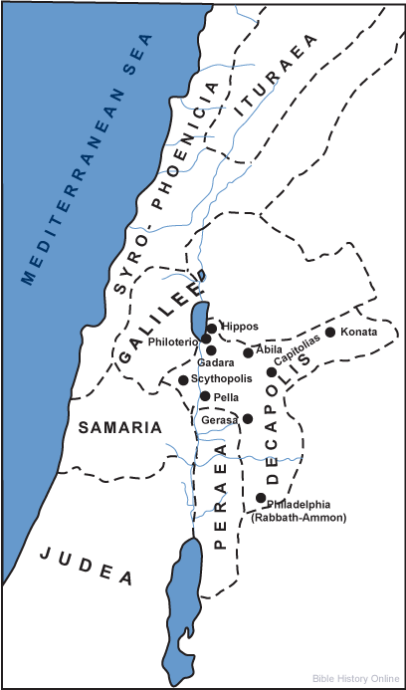
Background & Context
After this confrontation, Jesus, along with His disciples, withdraw to the far north…an area known as, in Jesus’ time:
Syro-Phoenicia

Slide 4
The Text – vv.21, 22
St. Matthew tells us that Jesus has “withdrew” (ajnacwrevw)to the region of Tyre and Sidon. Jesus has spoken extremely harsh words to the Pharisees; so, again, He makes a “Divine” withdraw!
+ This Gentile region had never been a part of Israel and was dominated by Phoenicians since OT times.
SIDON
TYRE

Slide 5
The Text – vv.21, 22
St. Matthew uses the OT term “Canaanite” for the woman's nationality.
+ Remember, St. Matthew is writing to Jews.
+ St. Mark, who writes to Gentiles, uses the Greek term, Syrophoenician! [St. Mark 7:26]

Slide 6
The Text – vv.21, 22
St. Matthew uses a very important word in v.22, (ijdou;)…Behold!
+ This Greek term draws attention to the fact that the one crying out is a woman, a Canaanite woman!
+ A Canaanite woman (and her daughter) are the least likely to elicit mercy from a Jewish Teacher and the most unlikely to acknowledge His true identity: “Lord, Son of David!”

Slide 7
The Text – vv.21, 22
St. Matthew is making a valuable point to his Jewish readers:
+ “Lord, Son of David” “Lord” is a Jewish title that comes from faith! Note that she calls Jesus “Lord” three times (vv. 22, 25, 27)!
+ Even more astounding is that she refers to Jesus as “Son of David!” That is, as the Messiah of Israel who fulfills the OT promises!

Slide 8
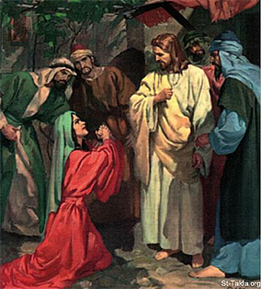
The Text – vv.21, 22
The woman, and a loving mother, cries out to Jesus for mercy; not only for herself…but her most pressing need is that Jesus show mercy to her demon-possessed daughter!

Slide 9
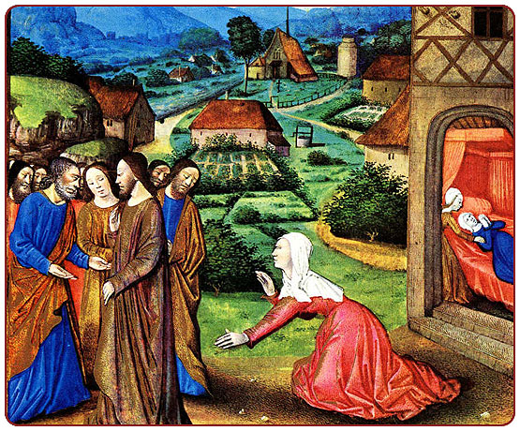
The Text – v.23
This verse troubles many people, but you should keep it in context and understand what Jesus is doing.
+ Jesus gives no reply and just keeps walking.
+ The woman will not be deterred; she keep crying out (e[krazen) as she trails behind them.

Slide 10
The Text – v.23
So as Jesus and His disciples walk on, she trails behind…calling out for mercy!
Our Lord’s disciple finally have had enough and they urge Jesus to “send her away!”

Slide 12
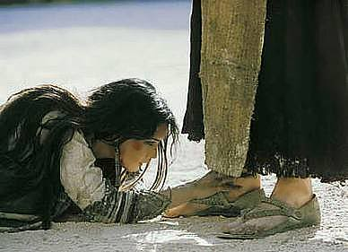
The Text – v.25
The woman now runs to Jesus, prostrates herself and begs Jesus…
prosekuvnei
“Lord, help me!”

Slide 13
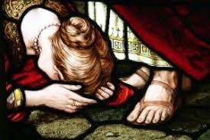
The Text – v.26
And answering, He said, “It is not good to take the bread of the children, and
cast it to the
dogs (bl6K6).”¹
This verse is
theological!
¹Let’s read Rev. 22:14-15

Slide 14
The Text – v.26
“It is not proper to take the bread of the children, and cast it to the dogs.”
The Bread is the Ministry of Jesus that is meant only for the Jews;
The Gospel is to be a blessing for Israel;
Any hearing of the Gospel by Gentiles will be incidental [cf. Romans 1:16].

Slide 15
The Text – V.27
The depth of her faith is astounding!!!

Slide 16
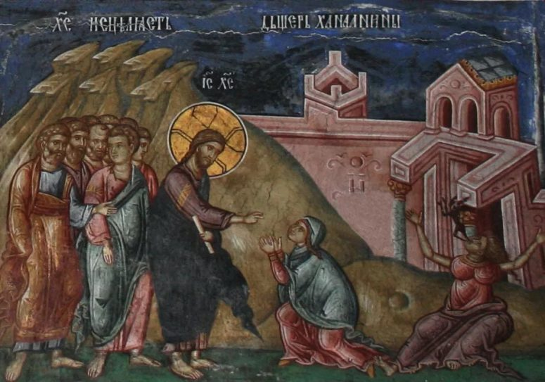
The Text – v.28
Our Lord rewards the woman’s great faith…a faith that was holding fast to Jesus’ Words of Promise.
As Jesus spoke, her daughter was healed!

Slide 17
In Closing
These questions arise, “How did she know? Who taught her about Israel’s Messiah?
And the only reply: “It’s unknown!”
How did she come to faith…that’s clear; the Father revealed to her. She’s similar to the Magi and the Roman Centurion before her, all unlikely candidates for faith in the Messiah! Yet…that’s God’s way!

Slide 18
IV. Our Lord’s Withdrawals from Galilee (14:13b – 17:20)
A. To the Eastern Shore of the Sea of Galilee (14:13b – 15:20)
1. The Feeding of the Five Thousand (14:13b -21) (5/11)
2. Jesus Walks on the Water (14:22-36) (5/11)
3. The Tradition of the Elders (15:1-20) (5/18)
B. To Phoenicia (Tyre and Sidon) (15:21-28) (5/25)
C. To Decapolis & Magadan (15:29 – 16:12) (6/1)
D. To Caesarea Philippi (16:13 – 17:21) (6/8)
V. Our Lord’s Last Ministry in Galilee (17:22-27) (6/15)
A. His Passion Foretold - #2 (17:22-23)
B. The Temple Tax (17:24-27)
VI. The Fourth Discourse: Life in the Kingdom (18:1 – 19:2)
A. Sayings on Humility and Forgiveness (18:1-35)
1. True Greatness (1-6)
2. Warnings of Hell (7-9)
3. The Lost Sheep (10-14)
4. Discipline (15-20)
5. Forgiveness (21-35)
B. Jesus Travels to Judea, Beyond the Jordan (19:1-2)
(6/22)

Slide 19
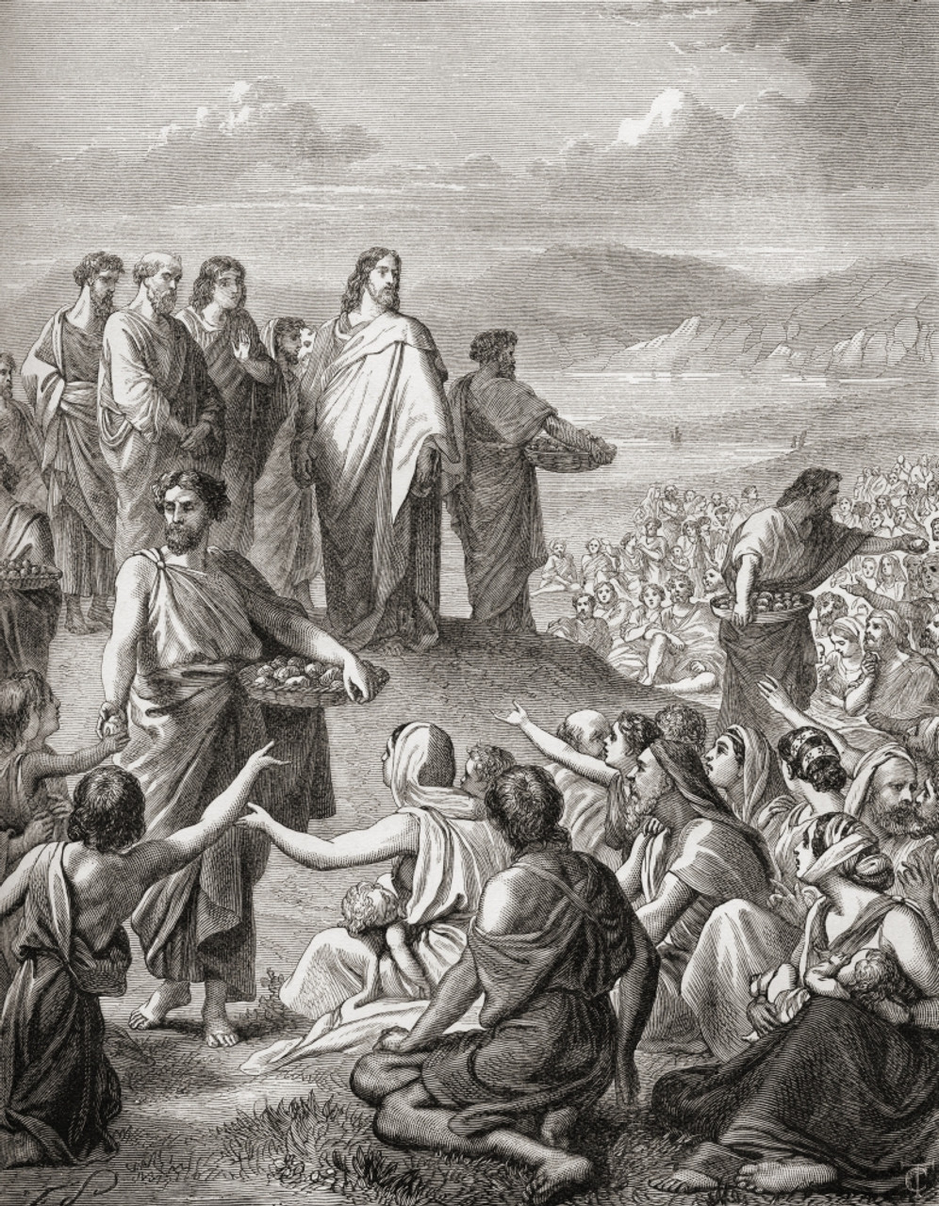
To the decapolis & Magadan
St. Matthew 15:29 – 16:12
June1st

