Slide 1
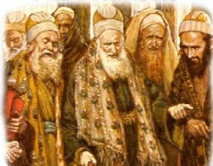
Tradition of
the Elders
TODAY!
St. Matthew 15:1-20

Slide 2
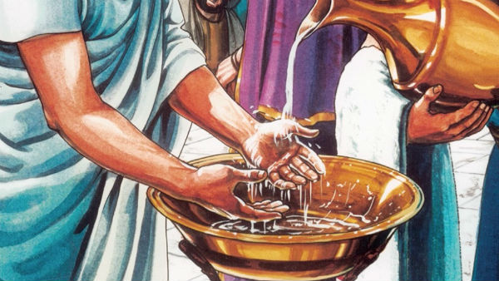
The structure of 15:1-20 can be explained by understanding vv. 1-2 and 20. This pericope begins and ends with the issue of whether it is uncleanness for the disciples to eat without having first washed their hands in accord with the tradition of the elders. After the beginning two verses, St. Matthew writes of two different units of teaching, which ends
with the final verse (v.20).
St. Matthew 15:1-20
Introduction

Slide 3
In the first unit of teaching (15:3-9), Jesus begins by turning the tables on the Pharisees and scribes by challenging their entire understanding of the tradition of the elders. St. Matthew shows this by way of a parallelism by using accusation and declaration:
The Pharisees and scribes accusation: (v.2a) “Why do your disciples break the tradition of the elders?” And Jesus’ accusation: (v.3) “Why do you (pl.) break the commandment of God on account of your tradition?
The Pharisees and scribes
declaration: (v.2b) “For they do not
wash their hands when they eat bread.”
And Jesus’ declaration: (v.4) “For God
commanded….”
St. Matthew 15:3-9
The First Unit

Slide 4
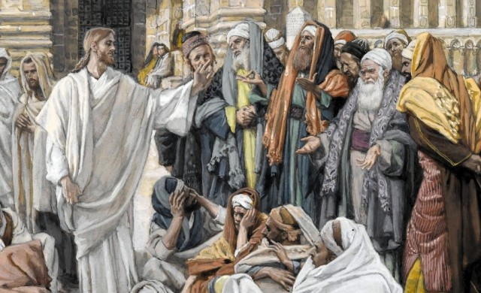
Jesus is confronting the Pharisees and scribes by accusing them of using their traditions and their obedience to them to overrule the Commandments of God; in this case, the Fourth Commandment! Jesus declares that they are like the generation condemned in Isaiah’s prophecy (29:13) that go through the motions of true worship, but fail to hold fast to God whom they claim to worship. In this first unit of teaching, Jesus avoids the issue that is so very important to the Pharisees and scribes – what make a person unclean.
St. Matthew 15:3-9
The First Unit

Slide 5
St. Matthew now moves to the second unit of teaching. This unit is very important since Jesus will address what actually makes a person unclean. Matthew first describes how Jesus summons the crowds and implores them to hear and understand His teaching (vv.10-11). Jesus
gives the crowds two contrasting
statements about what truly
defiles all humans. It is not what
goes into the mouth; rather, it is
what comes OUT of the mouth!
St. Matthew 15:10-20
The Second Unit

Slide 6
Within the second unit, Jesus also interacts with His disciples in vv. 12-20. They express their concern that their Master’s bluntness has offended (ejskandalivsqhsan) the Pharisees and scribes. The form of this verb is passive, meaning that Jesus caused the offense by His teaching. Jesus gives no apology; rather, He teaches further by denouncing these religious leaders in even more harsh terms: they are plants destined to be uprooted and blind guides who are leading other blind people into a pit (bovqunon) ^{(vv.13-14)}. The concept of a pit is found in the OT, often associated with Sheol, the realm of the dead, or a place of destruction. This connection underscores the gravity of the metaphor, linking the idea of a pit with ultimate separation from God; of being cast out into the outer darkness where there is weeping and gnashing of teeth!
St. Matthew 15:10-20
The Second Unit

Slide 7
Peter, again, acting as the disciple’s spokesman, ask for an explanation of this parable(?). And, again, Peter’s statement reflects the apostles’ still are not able to grasp the Lord’s teaching; they continue to come up short! Our Lord’s response is proof of that fact ⁽¹⁶⁾. Jesus is teaching that true and deep spiritual defilement, uncleanness, is not produced by anything as superficial as food that goes into the mouth, into the stomach, and then is cast out into the latrine (ajfedrw:na) ⁽¹⁷⁾! Defilement comes from within; out of the heart. Therefore, those who are so concerned about clean or unclean in the sight of God should, rather, concern themselves not with food or drink, but with the condition of their heart!
St. Matthew 15:10-20
The Second Unit

Slide 8
1. The Pharisees and scribes that travel from Jerusalem are there to challenge Jesus; to attempt to discredit Him before the people. The gist of their accusation is pure legalism. They make it sound like OT dietary laws are being violated by Jesus’ disciples, therefore, an attempt to discredit Him. However, that’s not the chief issue! Rather, it is whether Jesus’ disciples, in violating the tradition of the elders and the guidelines on ritual cleansing, have caused themselves to become ritually unclean. Since Jesus interacts with them, then He also is unclean!
St. Matthew 15:1-20
Points to Ponder!

Slide 9
2. The whole topic of actions and habits that supposedly would render a person either “clean” or “unclean” was a major issue for debate throughout our Lord’s ministry. We should remember that it is hard to exaggerate the significance of ritual purity for the Pharisaic ideology, which the majority of the scribes supported, and which became the basis of later rabbinic orthodoxy. Note that Jesus does not overturn these ideologies then; however, after the resurrection, they were!
St. Matthew 15:1-20
Points to Ponder!

Slide 10
3. This may be surprising to you, but there are NO OT Laws that give such an injunction to Israel to ritually wash before meals. What the Pharisees did was to extrapolate the OT regulations about the ritual washings required of the Priesthood (cf. Ex 30:17-21); and then applied those regulations to the everyday life of the Jew.
St. Matthew 15:1-20
Points to Ponder!

Slide 11
4. What we see with these Pharisees and scribes, as we do today with many in the Church, are an outwardly universal tendency to say more that what God has actually said! Practices readily become habits. Habits readily become traditions. Traditions readily, and all too often, become man-made laws that are excessive and repressive! Therefore, we must and should examine ourselves; our thinking; our words; our traditions, to see if they, too, have lead us to become neo-Pharisees – teaching as doctrines the commandments of men!
St. Matthew 15:1-20
Points to Ponder!

Slide 12
5. The law of qorban is being addressed by Jesus in vv. 5 and 6. Jesus is showing His disdain for a custom (tradition) of funding the Temple. Donors to the law of qorban could take a vow that devoted a least some or a large portion of their possessions to God and His purposes. Such a vow was apparently regarded as binding and in no way able to be broken, even if fulfilling it meant that the donor would no longer have sufficient resources to support needy parents, especially in their old age. Jesus taught that this is in violation of the Fourth Commandment (Ex. 20:12; Dt. 5:16).
St. Matthew 15:1-20
Points to Ponder!

Slide 13
6. In the misguided zeal of the Pharisees and scribes, specifically, their practice of oaths, reveals them to be far from God; the generation to which Isaiah directed his prophecy. This is our Lord’s final word to these Pharisees and scribes who have travelled from Jerusalem. Essentially, Jesus will have nothing to do with them; unless and until, they acknowledge their sin and in repentance, abandon their tradition of the elders. And by the way, you may have noticed that Jesus does not call the tradition, the tradition of the elders, but rather, your (the Pharisees) tradition.
St. Matthew 15:1-20
Points to Ponder!

Slide 14
7. Jesus declares in vv.13-14 that not every plant growing in Israel was planted by the Father. His counsel to His disciples is not to have regard for them (Pharisees and scribes) as long as they remain ensconced in their tradition. He then reminds the disciples that they are blind ones leading blind ones…which we have discussed in Chapter 12.
St. Matthew 15:1-20
Points to Ponder!

Slide 15
The Pharisees and scribes, and too many Christians today, were and are guilty of majoring in minors! They elevate their traditions, laws, and rituals over and above God and His holy Word. They warp God’s holy Law; and make a mockery of His Holy Gospel. Take heed! Traditions, which can become man-made laws, are of no value in the matter of what is clean or unclean. The solution to the problem must be dealt with within the depth of the heart!
St. Matthew 15:1-20
Epilogue

Slide 16
IV. Our Lord’s Withdrawals from Galilee (14:13b – 17:20)
A. To the Eastern Shore of the Sea of Galilee (14:13b – 15:20)
1. The Feeding of the Five Thousand (14:13b -21) (5/11)
2. Jesus Walks on the Water (14:22-36) (5/11)
3. The Tradition of the Elders (15:1-20) (5/18)
B. To Phoenicia (Tyre and Sidon) (15:21-28) (5/25)
C. To Decapolis (15:29 – 16:12) (6/1)
D. To Caesarea Philippi (16:13 – 17:21) (6/8)
V. Our Lord’s Last Ministry in Galilee (17:22-27) (6/15)
A. His Passion Foretold - #2 (17:22-23)
B. The Temple Tax (17:24-27)
VI. The Fourth Discourse: Life in the Kingdom (18:1 – 19:2)
A. Sayings on Humility and Forgiveness (18:1-35)
1. True Greatness (1-6)
2. Warnings of Hell (7-9)
3. The Lost Sheep (10-14)
4. Discipline (15-20)
5. Forgiveness (21-35)
B. Jesus Travels to Judea, Beyond the Jordan (19:1-2)
Our Outline of St. Matthew

Slide 17
The next section of the Holy Gospel according to St. Matthew (vv.21-28) will feature surprising words spoken from the heart of a Gentile woman. Although she (like her daughter) was “unclean” from the Jewish perspective, Jesus responds to her plea and words of great faith by healing (thereby cleansing) her demon-possessed daughter. So, next week, a pericope of which we are quite familiar, the Canaanite (or Syrophoenician) Woman, as our Lord takes His ministry to the region of Tyre and Sidon.
St. Matthew 15:21-28
To Tyre and Sidon

Slide 18
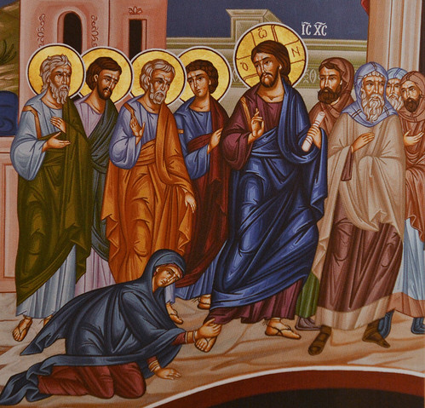
To Tyre
And sidon
Next
Week
St. Matthew 15:1-20

