Slide 1
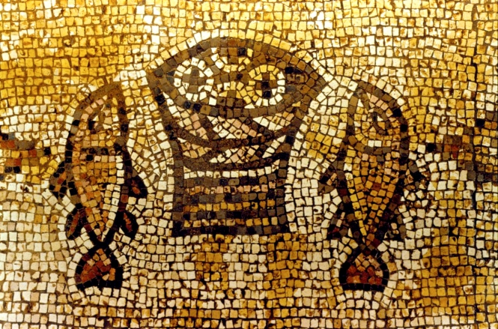
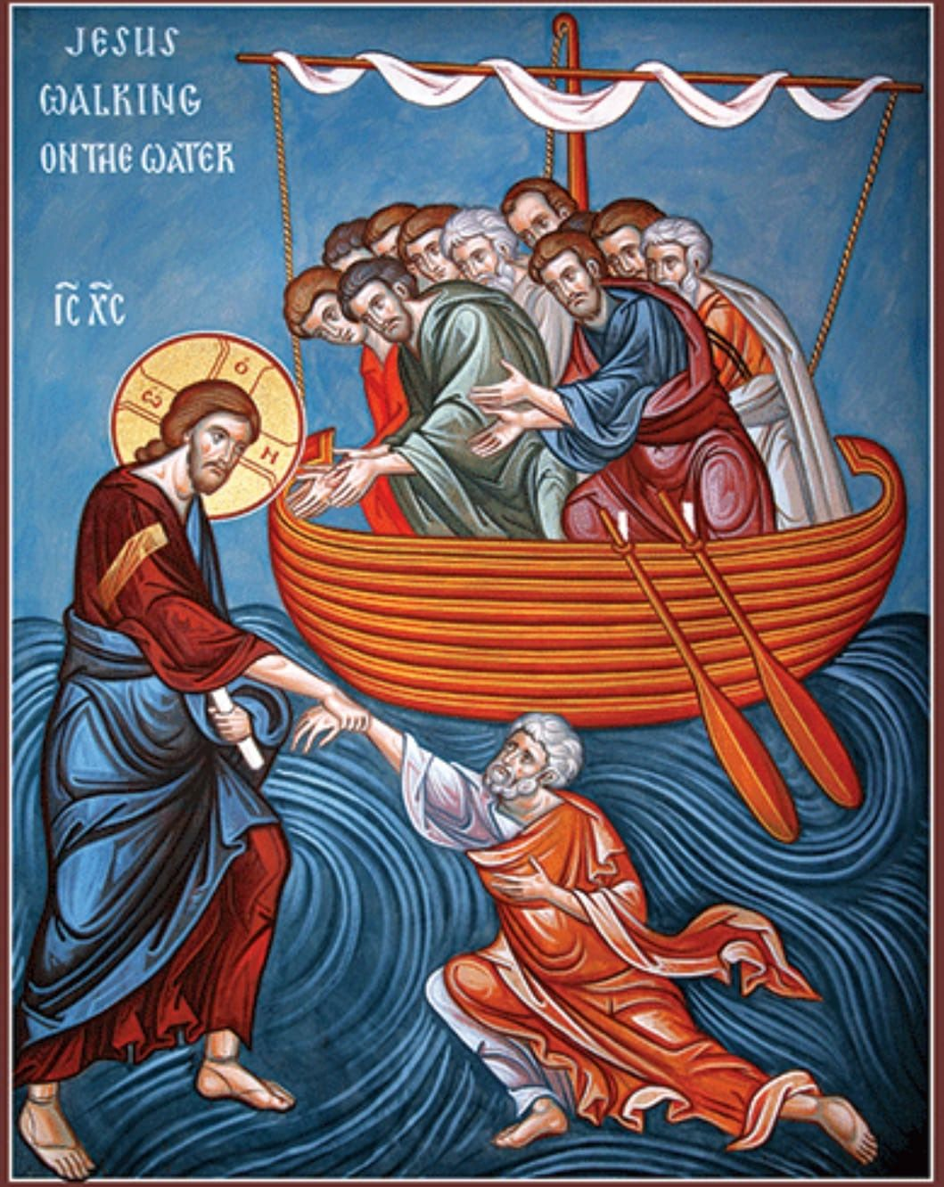
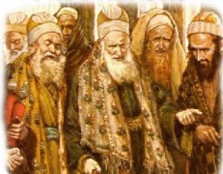
Traditions of the Elders;
Next Week
Good Morning!
St. Matthew 14:13b-36

Slide 2
As we continue from last Sunday’s study, our Lord’s “compassionate” ministry will continue, but not in Galilee. Jesus makes His “Divine withdraw” across the Sea of Galilee to Bethsaida; or as St. Matthew tells us “a deserted area,” more than likely just south of the city. There, Jesus plans to “debrief” His disciples after they have returned from their evangelization mission and to have a period of rest for them, and Himself, from the crowds (cf. St. Mark 6:30-32; St. Luke 9:10).
This “change of mission” is important, since now our Lord will no longer confront the scribes and Pharisees, but will start to prepare His disciples as He begins His journey to Jerusalem to suffer and die. Even so, Jesus will continue to meet the crowds and perform healings and other miraculous works, though His work will be done in secluded, “Gentile” areas, void of the prying eyes of the Pharisees (with one exception).
St. Matthew 14:13b-36
Introduction

Slide 3
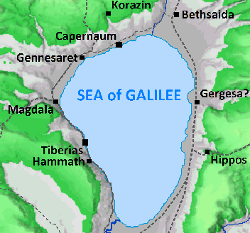
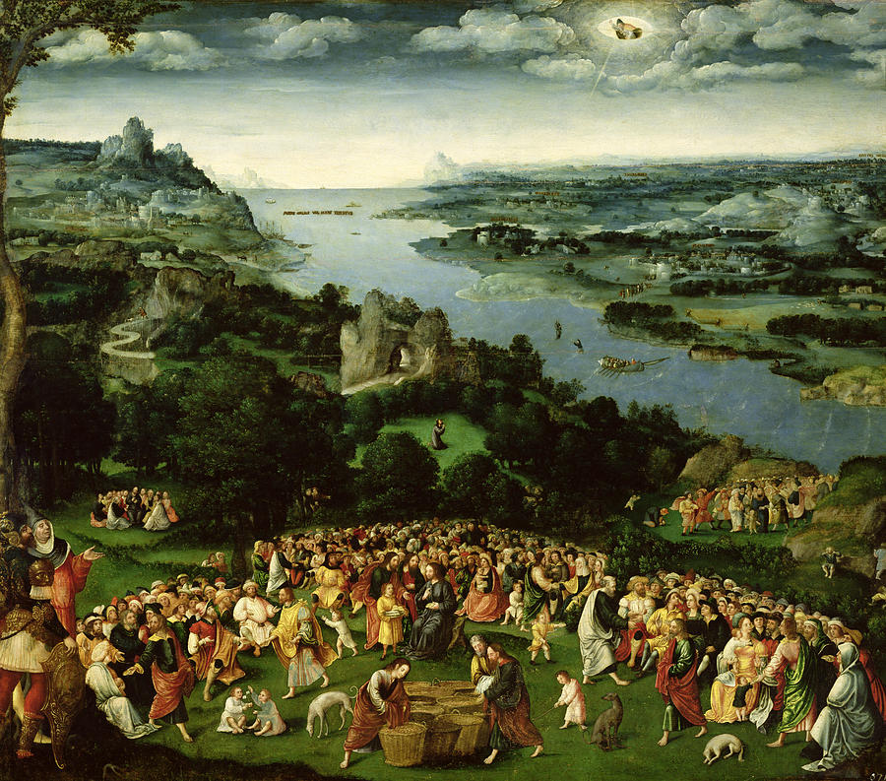
As our Lord and His disciples sail across the northern portion of the Sea of Galilee, the crowd sees them and begins to run ahead of them along the northern shore.
This journey from Capernaum to Bethsaida, by boat, is about 2 ½ mi. The crowd though runs to the area of Bethsaida (about six miles) and they arrive before our Lord!
St. Matthew now tells us that as He comes ashore, He sees the crowd and “He had compassion on them” (ejsplagcnivsqh) and heals their sick.
St. Matthew 14:13b-14
Our Lord’s Compassion!

Slide 4
The verb ejsplagcnivsqh is one of the most important Greek verbs used in the NT to show us the inner attitude of our Lord Jesus. It also reveals to us the kind of actions that He will take toward the crowd. This verb is use only twelve times in the Synoptic Gospels (Matthew: 5; Mark: 4; and Luke: 3). It is not used in the rest of the NT! This is important, since this verb is only used in regard to the revelation of the deep compassion of our Lord Jesus. This verb, ejsplagcnivsqh, literally describes the deep, visceral compassion that Jesus felt toward individuals or crowds in need. It conveys a profound emotional response that leads to merciful action.
St. Matthew 14:13b-14
Our Lord’s Compassion!

Slide 5
Thus in spite of all the unbelief that Jesus had been encountering and in spite of His intentions to withdraw from public activity in Galilee, His heart was deeply moved at the sight of this crowd. St. Matthew reports that in His compassion He began to “heal their sick.”
The healing of the sick also applies to you! Jesus has shown His merciful compassion (ejsplagcnivsqh) at the cross for your justification; in your Baptism, at the Altar (Sacrament of the Altar) and through His Word (Holy Scripture and Absolution).
Jesus has shown His merciful compassion to you, today, in the Means of Grace!
St. Matthew 14:13b-14
Our Lord’s Compassion!

Slide 6
St. Matthew now transition into one of our Lord’s most miraculous events commonly known as “The Feeding of the Five Thousand.” St. Matthew’s Gospel renders this wondrous event as both a misunderstanding and inabilities of the disciples and the stunning compassion of Jesus. Note that as event unfolds, the miracle becomes even more stupendous!
In v.15, the misunderstanding and shortcomings of the disciples is apparent in regards to the need of the crowd. To the disciples, since the daylight is now waning and there’s no way that the crowd’s need of food can be met in this deserted place; Jesus should just dismiss them so they could either travel back to Capernaum or go to Bethsaida to find food. It is remarkable, considering all that the disciples have seen Jesus do, that they doubted that He could satisfy the crowd!
St. Matthew 14:15-21
Feeding of the Five Thousand

Slide 7
Jesus, however, refuses to dismiss the crowd since it’s not necessary (16). He tells the disciples, rather emphatically, “you (uJmei:V) give them something to eat!” Instead of understanding the Lord’s meaning, they compound their doubt by responding that they only have five loaves of bread and two small fish (17). It should be clear that they are not looking to Jesus to provide what is needed!
Jesus now takes over! He calls for the crowd to be brought to Him (18), He takes the loaves and fish, pronounces a blessing, and gives the food to the disciples (19). Now the disciples can do what the Lord had directed them to do: “you give them something to eat.”
Note that all eat and are satisfied. And not only is the crowd satisfied, but there is abundance left over – twelve baskets! It also important to note that there were five thousand men present, not counting the women and children (21).
St. Matthew 14:15-21
Feeding of the Five Thousand

Slide 8
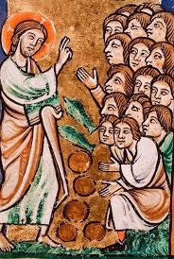
St. Matthew says nothing further about the crowd or their response (though St. John does, see 6:14). St. John 6:15 also shows us the reason for the hasty compulsion for the disciple to depart in the boat and for our Lord to dismiss the crowd; then to go up onto a mountainside to pray.
Jesus, though, in His great and merciful compassion acts and He will continue to act in proof of His Divinity! He will also reveal what kind of King He truly is!
St. Matthew 14:15-21
Feeding of the Five Thousand

Slide 9
The account of our Lord walking on the stormy Sea of Galilee has the same basic purpose as the Feeding of the Five Thousand; that is, to proclaim His Divine identity! Interestingly, Jesus sets the stage of His revelation via fear! Yet, His majesty and power, as the Son of God, shows His willingness to comfort His disciples, who are in real fear, and are subject to the foolishness of their spokesman – Peter!
As previously stated, St. John 6:14-15 sets the stage for us; yet, Matthew has his own purpose and he does show that Jesus is responsible for what is about to occur (22-24). Then Matthew offers the first movement: Jesus walking on the sea to His disciples (25-29a). Then following is the second movement that parallels and contrasts the first movement: Peter walking on the water to Jesus (29b-31). Matthew closes this pericope with the finale that takes place as Jesus and Peter enter into the boat and the disciples worship Him as the Son of God (32-33).
St. Matthew 14:22-33
Jesus Walks on the Sea

Slide 10
Here are some of the important aspects of this encounter:
1. The boat is “many stadia from the land” (v.24). A stadion was a Roman unit of measure that is approximately 1/8 of a mile (199 yards/182 meters). Note that they are “many” stadia from the land; meaning that they are more than 200 yards from the shore. The boat was being tossed by the waves and impended by the wind; though, it’s not a violent storm (cf. 8:24).
2. Verse 25 begins the first movement at the “fourth watch.” This time is in accord with the Roman watch (guard duty), which in this case, would have been from 3 am to 6 am. Sometime between these three hours, our Lord comes to the disciples walking on the water.
3. This leads to a three-fold response from the disciples in verse 26:
a) they are troubled;
b) they speak, “It’s a ghost” (favntasmav ejstin); and,
c) they cry out in fear!
The disciples immediately assume that this “ghost” that has appeared and is walking toward them can’t be good news. They are seized with fear and dread due to this apparition!
St. Matthew 14:22-33
Jesus Walks on the Sea

Slide 11
Jesus has now come into close proximity to the disciples and He continues the first movement from 27-29a. He, in parallel and contrast to the disciples, also responds in a three-fold fashion:
1. Jesus immediately seeks to calm His disciples with His invitation of “be courageous.”
2. Jesus then makes Himself known: “…it is I…. (ejgw eijmi).” We must be aware that with our Lord’s use of ejgw eijmi it is used to pronounce identity; rather than the usual expression of the Divine Name. This is confirmed by Peter’s response, “Lord, if it is you….”
3. Jesus speaks reassuring words to them: “…[do] not fear.”
St. Matthew 14:22-33
Jesus Walks on the Sea

Slide 12
Jesus matches their needs perfectly. His message is clear and straightforward, It is I, your Master, Jesus, therefore, you have no reason to be afraid. St. Matthew now begins a transition from the first movement to the second movement in verses 28-29a. It seems to be an interruption, by none other than Peter. Apparently, it’s not enough for Jesus to identify Himself and to comfort and reassure the disciples. Peter wants more! “Lord, if it is You, command me to come to You on the waters.” And, since Peter needs more, Jesus responds with a single word, “Come!” The Greek word that Matthew uses is a past tense, imperative, second person singular verb: A command: You (Peter) Come!”
St. Matthew 14:22-33
Jesus Walks on the Sea

Slide 13
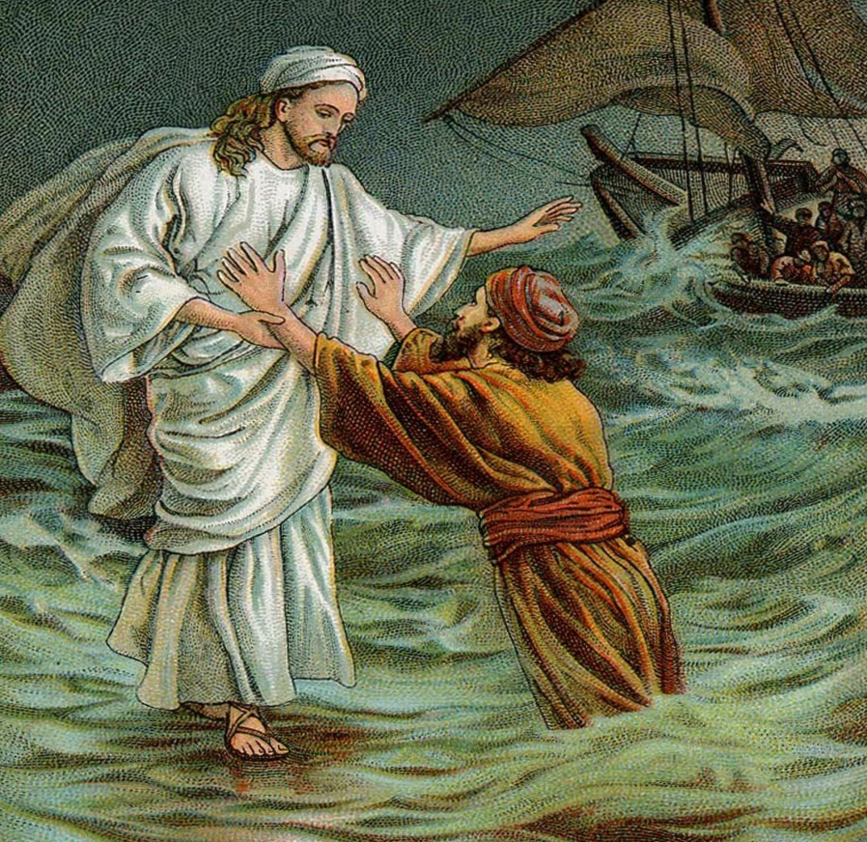
Thus, to close the second movement, we see Jesus saving Peter! As He is pulling Peter up from the water, Jesus tells him, “[You] of little faith, why did you doubt?” The Greek adjective for “little faith” is often applied to Jesus’ disciples and in this case, directly to Peter. When our Lord uses this term, He is always rebuking those who are “little-faiths.” However, and this is important, the result is that Jesus never rejects those who are His “little-faith” disciples! However weak or small their faith may be, they remain His disciples, His followers and believers in Him. So, “little-faiths” are not the same as unbelievers! Matthew then closes this account with the finale that takes place as Jesus and Peter entering into the boat and the disciples worship Him as the Son of God (32-33).
St. Matthew 14:22-33
Jesus Walks on the Sea

Slide 14
This short three verse pericope is used by St. Matthew as a closing bracket around two amazing miracles and the Lord’s Self revelation of Himself to His disciples as the Son of God, the saving Lord who has power over creation. Jesus and Peter get into the boat and as St. Matthew writes, “And having crossed over….” However, in the parallel account in St John 6:21, we read that “immediately (eujqevwV) was the boat at the land to which they were going.” Though not recorded by the Synoptics, St. John clearly tells us that our Lord worked another miracle for His disciples out of His grace and mercy. The time that the disciples were on the sea struggling against wind and wave is undetermined, though it had to be more than 8 hours. So, according to St. John, as soon as Jesus was in the boat they were eujqevwV in Gennesaret.
St. Matthew 14:34-36
Jesus Continues to Heal

Slide 15
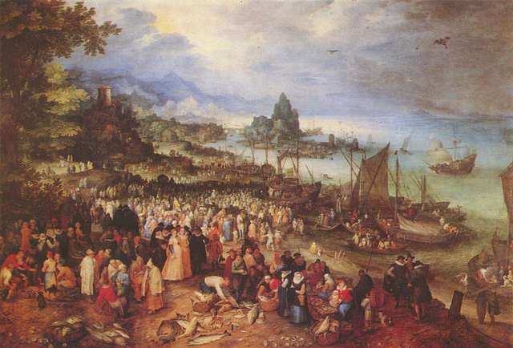
Upon their arrival, Jesus, being well known, was recognized and the word of His arrival quickly spread. The sick were brought to Jesus who healed all sorts of diseases. There were so
many that they were begging
to just touch the fringe of His
garment and those who did
were cured. Even here, Jesus
is showing His…
ejsplagcnivsqh!
St. Matthew 14:34-36
Jesus Continues to Heal

Slide 16
IV. Our Lord’s Withdrawals from Galilee (14:13b – 17:20)
A. To the Eastern Shore of the Sea of Galilee (14:13b – 15:20)
1. The Feeding of the Five Thousand (14:13b -21) (5/11)
2. Jesus Walks on the Water (14:22-36) (5/11)
3. The Tradition of the Elders (15:1-20) (5/18)
B. To Phoenicia (Tyre and Sidon) (15:21-28) (5/25)
C. To Decapolis (15:29 – 16:12) (6/1)
D. To Caesarea Philippi (16:13 – 17:21) (6/8)
V. Our Lord’s Last Ministry in Galilee (17:22-27) (6/15)
A. His Passion Foretold - #2 (17:22-23)
B. The Temple Tax (17:24-27)
VI. The Fourth Discourse: Life in the Kingdom (18:1 – 19:2)
A. Sayings on Humility and Forgiveness (18:1-35)
1. True Greatness (1-6)
2. Warnings of Hell (7-9)
3. The Lost Sheep (10-14)
4. Discipline (15-20)
5. Forgiveness (21-35)
B. Jesus Travels to Judea, Beyond the Jordan (19:1-2)
Our Outline of St. Matthew

Slide 17
Tradition of
the Elders
Next
Week
St. Matthew 15:1-20

