Slide 1
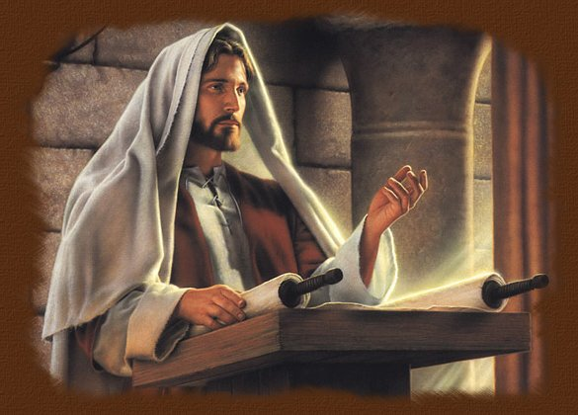
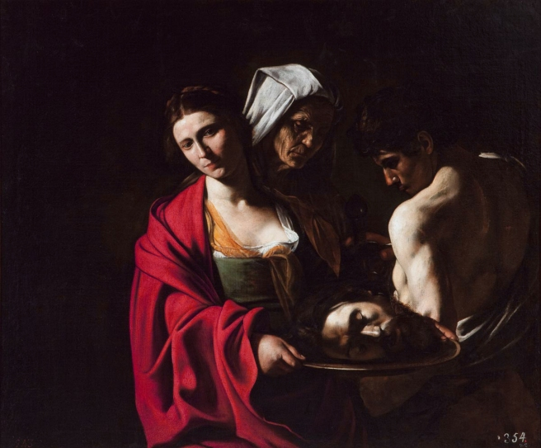
Rejection at Nazareth
and
Beheading of John the Baptist
Good
Morning!!!
St. Matthew 13:53 - 14:13a

Slide 2
Jesus has now explained to His disciples the preceding parables and He now decides to travel to Nazareth: “into His native town” (th;n patrivda aujtou:) (the region of His [own]). Our Lord’s “patris,” in the ancient world, was a significant part of identity, often tied to family lineage, heritage, and social status. The concept of a homeland was deeply ingrained in the Jewish culture, where land and lineage were central to God’s covenant promises. The idea of returning to one’s “patris” was also significant in the context of exile and restoration, themes prevalent in Jewish history.
St. Mark agrees (cf. 6:1) as does St. Luke 4:16, 23. It’s of interest that St. Matthew has already discussed what Jesus has said concerning His “family” ^{(12:46-50)}; and now, as Jesus is confronted by the people of His hometown (patris), a similar response is voiced by the townspeople as they see Jesus as only a member of their community and nothing more!
St. Matthew 13:53-58
Introduction

Slide 3
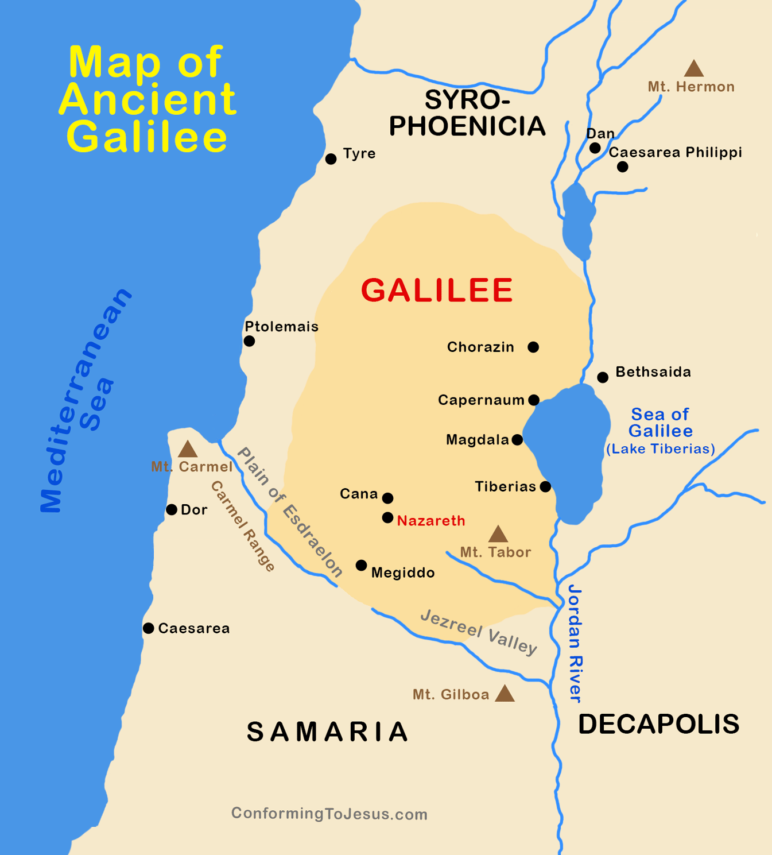
This brief encounter St. Matthew
introduces, as he did earlier in
12:46-50, with a new group of
people, namely the townspeople
of Nazareth. St. Matthew reflects
in a very interesting way what the
people in the synagogue are saying
as our Lord is teaching them. They
were astonished, utterly amazed by
the wisdom of Jesus; and His
miraculous powers, of which they had not seen, but certainly had heard! When Jesus had left Nazareth, they probably noted nothing too astounding about Him. Thus, they are bewildered and wondering how this is possible. Though this may not sound too derogatory in English; in Greek, St. Matthew uses a demonstrative pronoun (touvtw/) “to this [man]” that does set a derogatory tone.
St. Matthew 13:53-58
Jesus Rejected by His “Patris”

Slide 4
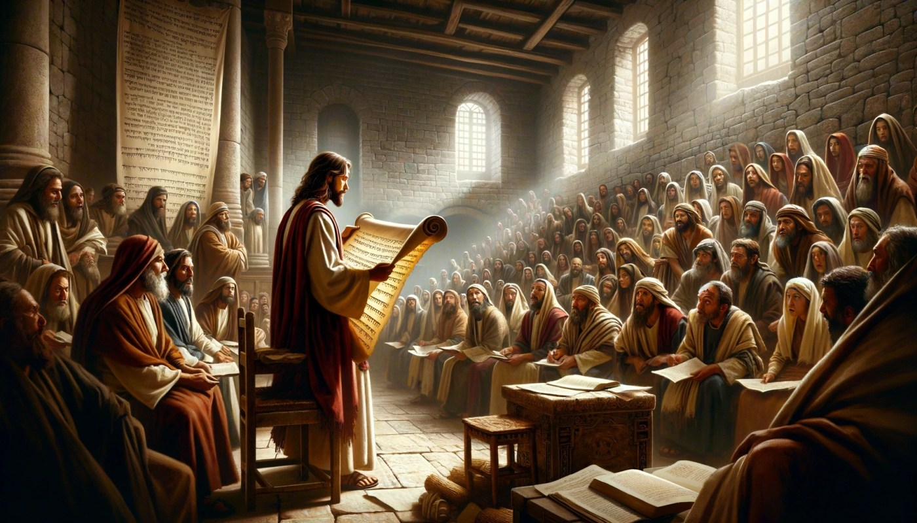
This leads them to recall that Jesus is the carpenter’s son. Note that Joseph isn’t named by St. Matthew, only his trade; however, St. Luke does name Joseph (4:22b). They also know that Jesus is the son of “Miryam” (.y2r3m1) as Matthew uses her Hebrew name, and that Jesus has at least four half-brothers that Matthew also list. Our Lord also has half-sisters, though they are not named, which in the first century they would have not been typically named since they, apparently, had already married and settled in their husbands’ homes in Nazareth. Once again, the demonstrative pronoun “toutoe” is used by Matthew to indicate that the townspeople are not speaking to highly of our Lord.
St. Matthew 13:53-58
Jesus Rejected by His “Patris”

Slide 5
If you think that maybe touvtw/ isn’t derogatory; well, verse 57 clearly indicates that they are “offended” (ejskandalivzonto). They all were “scandalized by” or “made a stumbling block by” Jesus. In the Greco-Roman world, the concept of a “stumbling block” was understood both literally and metaphorically. Literally, it referred to an obstacle that could cause someone to trip. Metaphorically, it was used to describe actions or teachings that could lead someone into moral or spiritual error. In Jewish culture, the idea of causing someone to stumble was particularly serious, as it could lead to breaking the Law and offending God!
St. Matthew 13:53-58
Jesus Rejected by His “Patris”

Slide 6
Therefore, knowing Jesus as they did, they could not bring themselves to think that His wisdom, teachings, and works of power were of Divine origin. There had to be something wrong with Him, maybe even Beelzebub had taken hold of Him! Jesus responds to them by saying that “a prophet is not honor-less except in his native town and his own house [or family].”
The old saying is true: familiarity breeds contempt! Note that Jesus classes Himself as a prophet and it is perfectly in order, for the contempt of the people arose during His teaching in the synagogue. St. Luke (4:18-19) lists the text that Jesus was reading: Isaiah 61:1-2 and 58:6.
St. Matthew 13:53-58
Jesus Rejected by His “Patris”

Slide 7
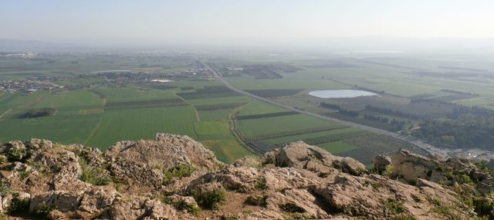
Jesus wanted to do many works of power in His hometown; however, due to their unbelief, He only did a few (St. Mark 6:5). It is clear that faith precedes each miracle of our Lord Jesus; and unbelief prevents the performance of miracles (cf. St. Luke 4:28-38).
Therefore, the people
of Nazareth rose up
and drove Jesus, one
of their own, out of
town and attempted
To kill Him (St. Luke
5:29)!
Mount Kedimum
St. Matthew 13:53-58
Jesus Rejected by His “Patris”

Slide 8
Introduction
The opposition that Jesus faced in His hometown of Nazareth is horrendous; now comes the active unbelief and hostility of Herod Antipas. St. Matthew now recounts opposition of a “violent man” (biavsthV, 11:12) that has risen up in opposition to the reign of God and the man who was sent to proclaim the coming Christ: John, the Baptizer.
St. Matthew 14:1-13a
Beheading of John the Baptist

Slide 9
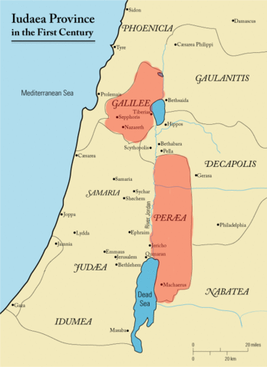
The Murder of John the Baptist (1-12)
Herod Antipas was a son of Herod the Great and was given a tetrarchy that consisted of Galilee and Perea as willed by his father. Antipas was no better, maybe worse, than his father. A brief explanation of Antipas’ marital situation will give a complete background prior to the Baptist’s death.
Antipas had been married to the daughter of the King of Nabatea. During a visit to Rome, he meet the wife of his half-brother Philip, Herodias. She was the granddaughter of Herod the Great; thus, making Philip her uncle; and Antipas her half-uncle. Philip and Herodias had a daughter, Salome.
St. Matthew 14:1-13a
Beheading of John the Baptist

Slide 10
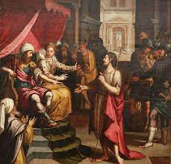
In spite of this, Antipas and Herodias began
an adulterous affair; resulting in Herodias
leaving her husband Philip and returning
to Galilee with Antipas. Antipas’ wife
returned to her father King Aretas, who
promptly declared war on Antipas. All
these events were publicly criticized by
John the Baptist; and Antipas’ response
was to imprison John.
In reality, Antipas was a weak and dithering ruler, who actually wanted to put the Baptist to death, but he didn’t have the courage since the people adorned John and thought of him as a great prophet. Herodias wanted John dead, yet had no power to command his execution.
St. Matthew 14:1-13a
Beheading of John the Baptist

Slide 11
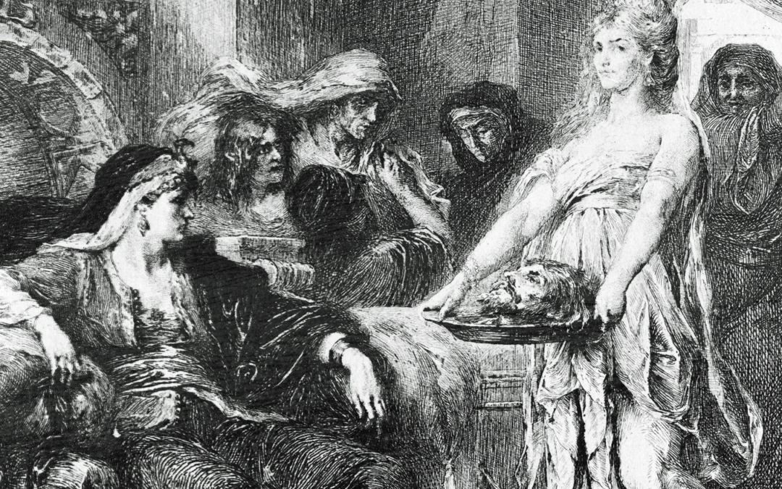
Given these circumstances, the beheading of John the Baptist should not be a surprise. The event that lead to John’s beheading was a birthday celebration for Herod. During the party Salome danced for Herod that he found to be “entertaining.” To show his appreciation, Herod promised to give Salome anything that she asked – even up to half of his kingdom! Salome consulted with her mother and Herodias seized the moment, seeing that now she would finally have revenge against the Baptist. Salome requested the head of John the Baptist on a platter (v.8). The Greek word for platter (pivnax) is often translated as a “silver platter.” Since this was a birthday party for Herod, it could have been a “silver” platter; though it may have been a decorative piece of pottery.
St. Matthew 14:1-13a
Beheading of John the Baptist

Slide 12
So the “king” was grieved (v.9). Note that Matthew does not use Herod’s name, but his title in irony. The “powerful” Herod Antipas has been taken advantage of by the wiles of his “wife” and her daughter. Now it becomes even more evident of Herod’s stupidity and rashness as he realized that he has taken oaths (o{rkouV) and that he was now obligated to grant Salome’s request. Everything about Herod’s oaths were completely wrong from beginning to end. He was prompted by an indecent performance; he took oaths in an uncertain matter; and he promised something that he had no right to grant; since he wasn’t a legitimate king (only Caesar Tiberius could have given Salome half of Herod’s tetrarchy).
St. Matthew 14:1-13a
Beheading of John the Baptist

Slide 13
Even so, Herod could not lose face before his entourage and nobles, as He was now willing to allow one sinful act lead to even greater wickedness. So John the Baptist was executed and his head was brought to Salome on a platter; she then gave the platter, not to Antipas, but to her mother! John’s disciples were allowed to claim his body and to grant a decent burial. They later told Jesus (v.12) about the death of the Baptist.
These events as recorded by Matthew were about a year before our Lord’s crucifixion. It is interesting that John was murdered just before Passover; and our Lord Jesus was murdered during Passover (cf. St. John 6:4). It’s clear that the bloody death of our Lord’s cousin, John the Baptist, was pointing forward to the death of John’s cousin, Jesus!
St. Matthew 14:1-13a
Beheading of John the Baptist

Slide 14
Our Lord decides to withdraw to the eastern shore of the Sea of Galilee and many conclude that it was due to the murder of John the Baptist. However, there may be another motive! The Twelve had just returned from their evangelization tour (cf. 10:5; ), and Jesus now desired to get away from the crowds in order to confer in private with His disciples (cf. St. Mark 6:30-31; St. Luke 9:10-17; St. John 6:1-4).
St. Matthew does not mention the return of the Twelve or this latter motive of our Lord. Sadly, many commentators surmise that our Lord withdrew due to fear of Herod Antipas! This is totally unmerited.
St. Matthew 14:13a
The Withdraw (ajvnecwvrhsen)

Slide 15
Note that St. Matthew does not mention that Jesus left Herod’s domain immediately. Its only incidental that St. Matthew mentions Jesus withdrawing, by boat, to a secluded place apart by Himself (again, see St. Luke 9:10).
Jesus isn’t beholden to Herod and neither is He afraid of Herod; rather, Jesus is now beginning a new course of action. His change of location was for the purpose of hearing from His disciples and then to begin His focus of going to Jerusalem to complete the Plan of Salvation (St. Luke 9:51).
St. Matthew 14:13a
The Withdraw (ajvnecwvrhsen)

Slide 16
The first half of verse 13 creates a bridge or transition between two units, 14:1-12 and 13b-21. This bridging transition “half-verse” is important since it informs that our Lord’s time is not yet. Jesus has no desire to escalate conflict with either Herod, the Pharisees or the Jewish authorities; so He publicly withdraws. Soon, within a year, Jesus will confront the Jews that ultimately will result in our Lord’s climatic defeat of all the sinister powers arrayed against Him.
St. Matthew 14:13a
The Transition and Closing

Slide 17
IV. Our Lord’s Withdrawals from Galilee (14:13b – 17:20)
A. To the Eastern Shore of the Sea of Galilee (14:13b – 15:20) (5/11)
1. The Feeding of the Five Thousand (14:13b -21)
2. Jesus Walks on the Water (14:22-36)
3. The Tradition of the Elders (15:1-20)
B. To Phoenicia (Tyre and Sidon) (15:21-28) (5/18)
C. To Decapolis (15:29 – 16:12) (5/25)
D. To Caesarea Philippi (16:13 – 17:21) (6/1)
V. Our Lord’s Last Ministry in Galilee (17:22-27) (6/8)
A. Prediction of His Death - #2 (17:22-23)
B. The Temple Tax (17:24-27)
VI. The Fourth Discourse: Life in the Kingdom (18:1 – 19:2) (6/15)
A. Sayings on Humility and Forgiveness (18:1-35)
1. True Greatness (1-6)
2. Warnings of Hell (7-9)
3. The Lost Sheep (10-14)
4. Discipline (15-20)
5. Forgiveness (21-35)
B. Jesus Travels to Judea, Beyond the Jordan (19:1-2)
Our Outline of St. Matthew

Slide 18
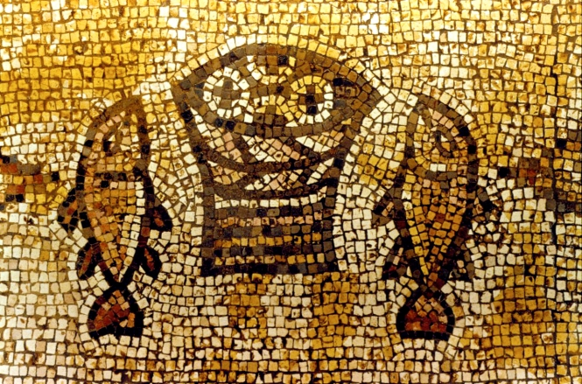
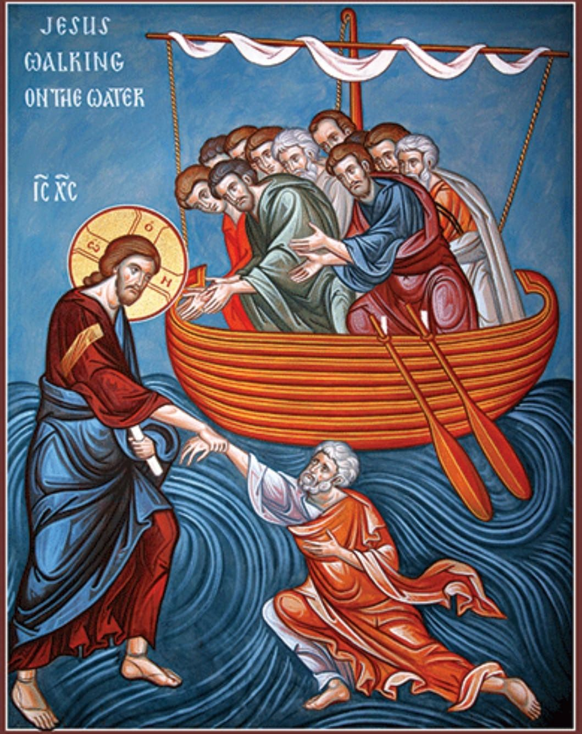
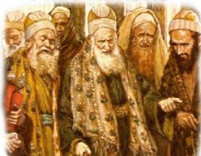
Next
Week
St. Matthew 14:13b – 15:20

