Slide 1
Today!
St. Matthew 13:36-52

Slide 2
The Triduum Sacrum
YET, FIRST!

Slide 3
Jesus now dismisses the crowd and returns to the house (again, probably Peter’s home) (cf. St. Mark 4:34b). Once they are in the house, His disciples come to Him asking for a more complete explanation of the Parable of the Weeds). Our Lord’s explanation has a specific purpose for His disciples and His Church. All of our Lord’s teachings are very clear with an ethical and spiritual aim – repentance and salvation!
Our Lord’s explanation stands on its own perfect merit, therefore, its not necessary to fully explain what Jesus means. What is necessary for us, today, is to understand that both our Lord’s parable and explanation require open and receptive ears (cf. v. 13). His Divine instruction and illumination call upon all our facilities to grasp and understand in faith. The Greek sentence structure that Matthew uses throughout this section calls for more than a mere single act, but for a constant and persistent attitude throughout one’s life.
St. Matthew 13:36-43
The Change & Explanation

Slide 4
Jesus’ explanation now flows into the second and last triad of parables: The Parable of the Treasure (44); the Parable of the Pearl (45-46); and the Parable of the Dragnet (w/an interpretation) (47-50). The purpose of these three parables concerns how the Kingdom of God is acquired.
In the Parable of the Treasure there are four important points:
1. It is hidden: This is an act that the disciples would have been familiar with, since banks did not exists. Therefore, a rich person would secretly bury certain treasures on their property for safekeeping. Yet, when a rich person suddenly dies, well, the treasure remains! God’s treasure, hidden, indeed, is to be found by you (cf. 11:25; St. Luke 19:42; Col. 4:3).
2. It is in a field: God has hidden His treasure where it can be found; it’s accessible, not hidden in heaven, but where it can be found…in Holy Scripture (cf. St. John 5:39)!
St. Matthew 13:44-50
The Second Triad of Parables

Slide 5
3: It is found: Note that the finding excludes all human effort. Its Divine counterpart is giving. It seems that the man accidently found; though, that doesn’t matter, since he did find. In reality, it’s God who placed the treasure, led the man to the treasure (cf. St. John 6:44, 65), and so he found!
4. It is secured for ownership: So the man finds, he sells all he has, and buys the field; all very legal and legitimate, since the treasure (Holy Scripture) can be acquired in no other way. Therefore, by you giving up every self-made, human doctrine and philosophy, however deep these may be, you may make the Word yours and in and with it all the treasures of salvation!
St. Matthew 13:44-50
The Second Triad of Parables

Slide 6
Jesus then moves to the Parable of the Pearl (45-46) to further elaborate on what He has just taught in the preceding parable concerning acquiring the Kingdom. As with the Parable of the Treasure, there are important points to consider:
1. The merchant (ejmpovrw/): Jesus’ use of this type of trader is important since the noun “emporos” refers to a person engaged in trade or commerce, specifically one who travels to conduct business. In the NT, it is used to describe individuals who buy and sell goods, often traveling long distances to do so. Thus, he’s not a peddler, but likely a rich merchantman who is seeking valuable pearls.
St. Matthew 13:44-50
The Second Triad of Parables

Slide 7
2. The pearl (margarivthV): Again, Jesus has a divine purpose in using pearls as an illustration to make His point. In the NT, “margarités” refers to pearls that are precious and valuable gems. Pearls are often used metaphorically to represent something of great value or worth. The term is used to illustrate the incomparable value of the Kingdom of Heaven and the wisdom of discerning what is truly valuable.
3. “having found one pearl of great price:” To be led to the Scriptures, so that He may be “found,” is of the greatest of treasures, a pearl of great price! Jesus, His Word and His salvation, are to be ranked with the very highest, the most valuable, and the greatest of all pearls! Your Lord and His Kingdom is beyond price, beyond any and all equivalents.
St. Matthew 13:44-50
The Second Triad of Parables

Slide 8
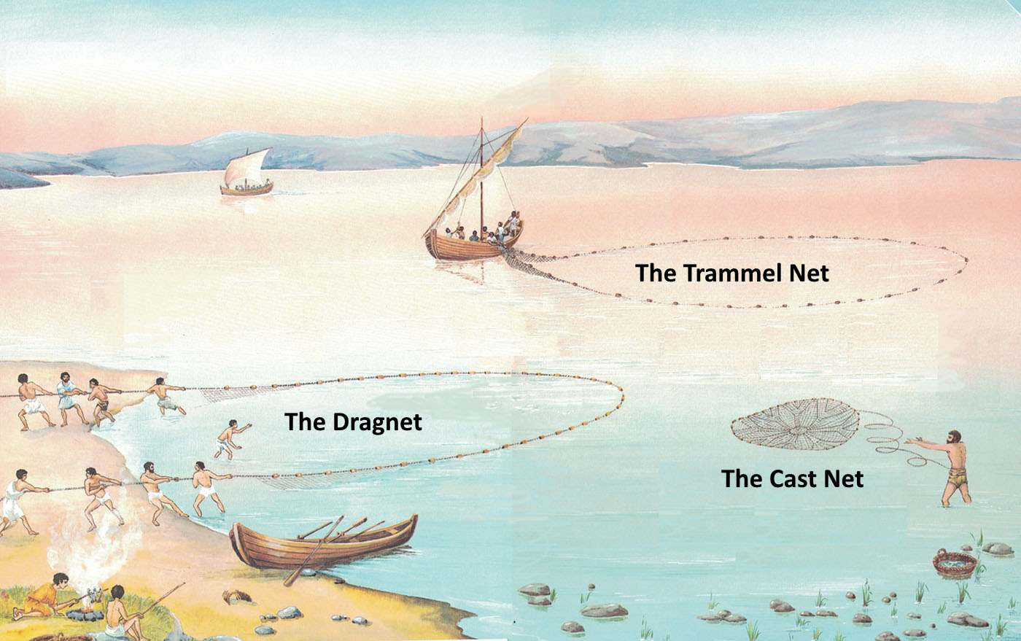
Jesus then moves to the final parable: The Parable of the Dragnet (47-50). In this parable, Jesus utilizes the ancient form of circular teaching. This parable isn’t the last link in His teaching, but rather our Lord teaching back through the parables to bring out His last point. He begins by, again, talking about something that the disciples were very familiar…the dragnet (saghvnh/). Fishermen used various types of nets, including the dragnet, which was designed to catch a large quantity of fish by being dragged along the bottom of the water. This imagery our Lord’s disciples would have easily understood. In the NT, it is used metaphorically, as Jesus does here, to describe the Kingdom of Heaven and the final judgment.
St. Matthew 13:44-50
The Second Triad of Parables

Slide 9
Verse 49 is important and, as much of what Jesus is describing to His disciples then; His disciples today also understand. Jesus sums up the parables with a description of the Final Judgment. When fishing, fishermen will naturally glean through their catch for “good” fish to keep and the “bad” fish to throw out. However, the fishing (preaching) with the dragnet (The Holy Gospel) is by the Church (the fishermen); yet, separating the evil from the righteous isn’t by the fishermen, but by angels (cf. 25:32-33).
Jesus follows this by describing only the fate of the evil “fish” in verse 50. You must take this parable as a warning; recalling that every Parable of the “Kingdom of Heaven” is a call to repentance and salvation, by faith, in Jesus Christ! Thus, the wicked, though “trapped” in the net of the Gospel, they refuse to repent and to confess that Jesus is their Redeemer and King! They are akin to the hard path, the rocky soil, the briar patch, and the darnel.
St. Matthew 13:44-50
The Second Triad of Parables

Slide 10
Jesus concludes by asking a properly pointed question, “Have you understood all these things?” So have you? To summarize the seven parables, it’s important to understand why our Lord uses the holy number of seven. The first three parables present God in His reign of grace, and the last four, represent the world of men to whom His rule comes. These seven parables picture the great work of the “Gospel-rule” of our Lord Jesus and its success and why it does “fail” (due to unbelief) among some people. Hiding much from people who cannot discern these parables are full of the clearest light for you, His true disciples.
St. Matthew 13:51-52
The Discipled Scribe

Slide 11
Lastly, Jesus tells His disciples what He has accomplished in them by bringing them to the understanding of what they have just acknowledged. The reason for Jesus using the term “scribe” (grammateu;V) is to show them that He had educated, trained them in the Law and Gospel, in the Word!
They are like a “master of a house” who brings out of his treasury things new and old. So the well-trained “discipled scribe” has acquired a rich fund of spiritual knowledge from their Divine Rabbi! These “new and old” are Divine truths that are new: not known and taught before; and others are old truths that are: known and often taught. The former standing on the shoulders of the latter!
St. Matthew 13:51-52
The Discipled Scribe

Slide 12
III. The Lord’s Ministry in Galilee (4:12 – 14:12)
A. The Beginning of His Galilean Ministry (4:12-25) (2/2)
B. First Discourse: The Sermon on the Mount – Ch 5 (2/9)
C. First Discourse: The Sermon on the Mount – Ch 6 (2/16)
D. First Discourse: The Sermon on the Mount – Ch 7 (2/23)
E. A Collection of Our Lord’s Miracles
1. Chapter 8: Capernaum & Gadarenes (3/2)
2. Chapter 9: Back in Capernaum (3/9)
F. The Second Discourse: The Commissioning of the Twelve Apostles – Ch 10 (3/16)
G. His Ministry Throughout Galilee (Chapter 11:1-30 (Part I)(3/23)
1. His Ministry Throughout Galilee (Chapter 12:1-32 (Part II) (3/30)
2. His Ministry Throughout Galilee (Chapter 12:33-45 (Part III) (4/6)
H. The Third Discourse: The Parables of the Kingdom
1. The Third Unit (vv. 36-50) & The Discipled Scribe (vv. 51-52) (4/27)
I. Rejection at Nazareth and Beheading of John the Baptist (13:53 – 14:12) (5/4)
This outline will be undated as we reach successive narratives and the discourses in St. Matthew.
Our Outline of St. Matthew

Slide 13
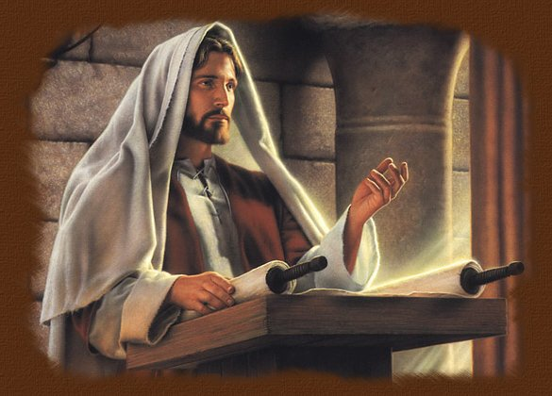
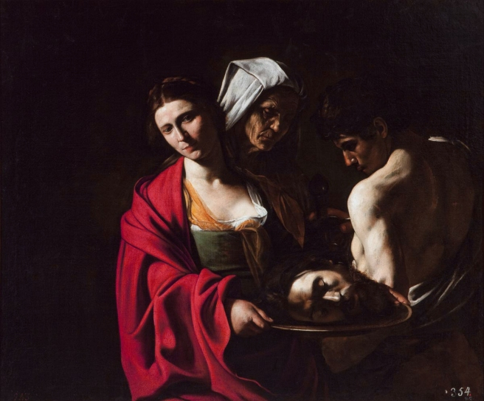
Rejection at Nazareth
and the
Beheading of John the Baptist
Next
Week
St. Matthew 13:53 - 14:12

