Slide 1
Part
Un
Today!
St. Matthew 12:46-13:52

Slide 2
St. Matthew ends the narrative of our Lord lengthy confrontations with the Pharisees and scribes, as he now turns the focus away from those who oppose Jesus. In this section of St. Matthew, the opponents fade into the background as the people (the crowd) becomes more prominent. Jesus is speaking to the crowd when his family (Mary and our Lord’s step-brothers and possibly sisters) appear. Jesus continues to teach and address the reality of his identity, which becomes an ongoing theme throughout the Gospel of St. Matthew.
St. Matthew 12:46-50
Introduction

Slide 3
Matthew will highlight the distinction between our Lord’s disciples and all others in Israel, including his biological relatives, in order to reveal both the necessity of discipleship and its radically subversive potential. Of all human relationships, none can be as important as the family relationship to our Lord Jesus that comes through being His disciple! Clearly, Jesus does not overturn familial ties, though He does subordinate them as He has already taught His disciples (cf. 8:21-22 and 10:34-39).
St. Matthew 12:46-50
Introduction

Slide 4
In this brief encounter, St. Matthew introduces a new group of people: our Lord’s immediate family. We know of their presence as someone within the crowd shouts out the presence of Jesus’ mother and brothers. Our Lord’s response in v.48 underscores the presence of His “family” by asking a question, “Who is my mother and who are my brothers?” The threefold repetition of “mother” and “brothers” highlights our Lord’s family and brings this encounter to a turning point!
St. Matthew 12:46-50
Jesus and His “Family”

Slide 5
Jesus’ rhetorical question is quickly answered as with a gesture He, “stretched His hand toward His disciples, He said, ‘Look, [here are] my mother and my brothers’” ^{(v.49)}. It’s not the crowd or His immediate family – but His family is “His disciples!”
It’s important for us to know the importance of family in Jewish and Eastern cultures. Such a statement by our Lord is shocking and possibly disturbing to many present. In first-century Galilee, one’s individual family was totally linked to the household group to which that person belonged. Moreover, the Fourth Commandment continues to testify that the Lord has commanded His people to revere and honor one’s progenitors and to fulfill the divinely required commitments to their biological family members. Later, Jesus will condemn the Pharisees for the way that they placed their traditions over the command to honor one’s father and mother (15:1-11).
St. Matthew 12:46-50
Jesus and His “Family”

Slide 6
However, Jesus is now placing the importance of discipleship to the forefront by saying that the most important relationship a person can have is to be His disciple! This isn’t unprecedented, since we may remember how YHWH honored the Levites (cf. Ex. 32:26-32 [known as the zeal of the Levites]; Dt. 33:9; also Ruth 2:11).
This relationship to Jesus is of a higher order, calling, and priority than the familial relationships established by God in marriage and family, despite the fact that the Lord has mandated special duties to one’s parents in the Torah. Our Lord’s disciples, then and today, are His Family, and He is their Brother in the most important and profound sense!
St. Matthew 12:46-50
Jesus and His “Family”

Slide 7
In v.50, now that Jesus has answered His rhetorical question, He explains His answer. His family is a person who “does the will of My Father who is in heaven.” Note that there is no different category of family members besides His disciples, nor are His disciples simply a subset of a larger group or family who does the Father’s will.
Rather, “whoever does the will of My Father…” is a person who believes and follows Jesus. That person, by definition, is a disciple of Jesus and therefore a member of His Royal, Divine Family!
St. Matthew 12:46-50
Jesus and His “Family”

Slide 8
What does Jesus mean with the phrase: “does the will of My Father?” We must understand this in a holistic sense as a reference to the life of discipleship. Therefore, there are two very important aspects to discipleship:
1. Our Lord’s disciples do the will of the Father when they acknowledge who Jesus is: The Lord of the Sabbath, the One who is greater than the Temple, and the One in whom the Father’s Spirit works now and on the Last Day!
2. Jesus’ disciples do the will of the Father by following Jesus into a life of light-shining and salt-spreading (5:13-16).
It’s clear that Israel’s religious leaders have failed and will not heed the Lord’s Divine Will. However, every genuine disciple of Jesus does the will of the Father who is in Heaven as they are called to that relationship of trust in Jesus Christ and the trusting obedience that follows from such faith in Him (St. John 6:29, 40).
St. Matthew 12:46-50
Jesus and His “Family”

Slide 9
The Structure of the Parables
The Lord teaches His Parables in a series of three-part teachings that can best be understood and followed by the below schema:
1. The First Unit is the Parable of the Sower that concerns our Lord’s ministry. After Jesus tells the parable, He provides an interpretation.
2. The Second Unit is from vv. 24-35 and is comprised of the first triad:
a. The Parable of the Weeds (24-30);
b. The Parable of the Mustard Seed (31-32); and,
c. The Parable of the Leaven (33).
+ Jesus follows these three parables with a short narrative conclusion in vv. 34-35, concerning the fulfillment of prophecy.
St. Matthew 13:1-52
The Third Discourse

Slide 10
The Third Unit is from vv. 36-50 and is comprised of a triad:
a. It begins with the interpretation of the Weeds in the Wheat in v.36, which is also a break from teaching the crowds to teaching His disciples in the house.
The Second Triad
b. The Parable of the Treasure ^{(v.44)};
c. The Parable of the Pearl ⁽⁴⁵⁻⁴⁶⁾; and,
d. The Parable of the Dragnet (w/an interpretation) ⁽⁴⁷⁻⁵⁰⁾
Jesus closes the Third Discourse with the Discipled Scribe ⁽⁵¹⁻⁵²⁾, which we will discuss all listed on this slide, next week!
St. Matthew 13:1-52
The Third Discourse

Slide 11
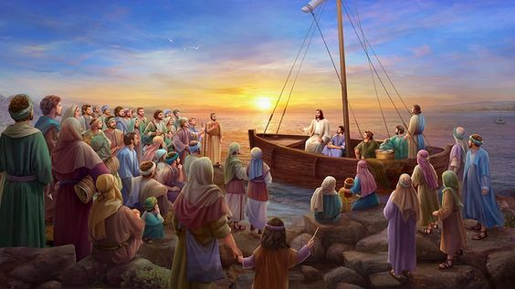
Jesus has just met with His relatives at the house (quite possibly Peter’s home) and He then walks to the seashore of the Sea of Galilee. Naturally, the crowds follow Him so He gets into a boat and the people are standing on the shore. Jesus will now teach using the wind that
habitually blows off the sea as His sound
system!
We will not “get into the weeds”
(no pun intended) concerning the
parables, since they are taught through
our Lutheran Missal. Even so, key points
will be discussed for each parable.
St. Matthew 13:1-23
The Parable of the Sower

Slide 12
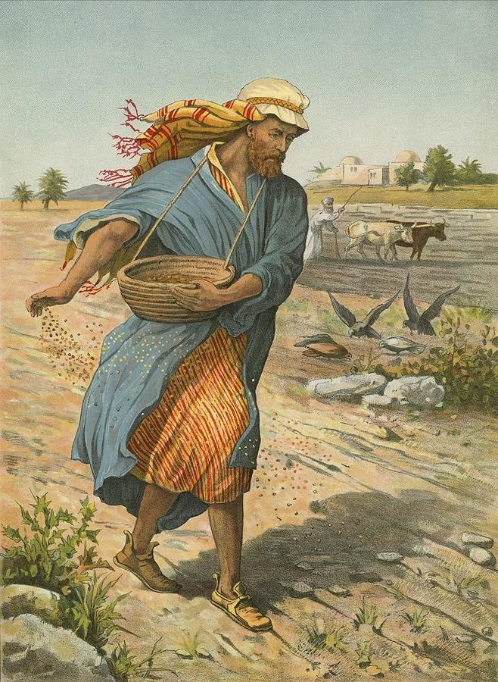
The Parable of the Sower
This parable would have been easily understood, though many of them may not have been farmers. Still, our Lord’s description is typically Jewish in nature and the techniques.
The major point that our Lord is making
concerns His Ministry throughout
Galilee; and that there is a spiritual
battle ongoing between God and Satan!
This is the reason why some hear and
believe and others do not. Jesus even
closes the parable with a call to the
hearers to use their ears. He is clear
that the subject of this parable is a
Sower; not necessarily the seed or soil.
St. Matthew 13:1-23
The Third Discourse

Slide 13
Why Jesus is Teaching in Parables (vv.10-17)
Matthew tells us in verse 10 that our Lord’s disciples drew near to Him to ask, “For what reason do You speak in parables to them?” This indicates that there would have been a space in time between all the parables. St. Mark is clearer, since, in 4:10, Mark tells us that they asked this question when Jesus was alone with them. Note that the disciples ask a double question of the Lord: Why speak in parables and what does the Parable of the Sower mean (cf. St. Luke 8:9)?
So, why does Jesus teach with parables?
St. Matthew 13:1-23
The Third Discourse

Slide 14
The mysteries of the Kingdom of God are all the blessed realities contained in the Divine rule of grace and glory! These are “mysteries” because men by nature and by their own abilities are unable to discover and to know them. They must be “given” to a man to “know!” This Divine giving is done by means of revelation, through the preaching and teaching of the Holy Gospel of the Kingdom.
Thus, the importance of being at Divine Service each Sunday. There the Divine Mysteries are preached, taught, and given! Importantly, the verb that St. Matthew uses in v.11 for “to be given” is devdotai; a Middle/Passive verb indicating that the giving is out of pure grace by God!
St. Matthew 13:1-23
The Third Discourse

Slide 15
Our Lord is also clear that there are those who are not granted the mysteries, which, again, should be understood that those, specifically the Pharisees, scribes, and others, cannot understand, since they refuse to hear with their ears! God is always willing to pour out His grace, but there will always be people who will refuse God’s grace and His gifts. They will remain without the ability to receive the mysteries of the Kingdom. The bottom line: they are the nullifiers, not God!
V.12 is not speaking of material wealth. Rather, the one who is shown pure grace and the ability to understand the mysteries of the Kingdom will “roll in spiritual wealth!” All the blessing of the Kingdom and the realities of the mysteries will be to open to them. Again, the verbs are passive: God is the doer; He is the agent of these actions!
Thus, the opposite is clear! The reason they are without is because they thought they were rich and sufficient in and of self. However, they will lose all and it will be given to others more worthy! The point is clear: In the Kingdom of God, there is no standing still; one moves forward and is blessed, or one move backward and shall be condemned!
St. Matthew 13:1-23
The Third Discourse

Slide 16
Jesus follows up with a quote from Isaiah 6:9-10 in verses 14-15. Israel is on the path of destruction and that doom is fast approaching (70 AD). The wrath of judgment is deserved since their unbelief has progressed to the point that they are not seeing or hearing; thus, producing nothing! God is about to cast them out into the outer darkness where there is weeping and gnashing of teeth ^{(v. 50; St. John 12:39-40, 43)}!
Remembering our class from last week, the reality is that all who have resisted and refused God’s grace are and will continue to draw from their evil, hardened hearts!
Lastly, the Jews acted as though for them the greatest calamity would be to repent so that God might heal them. They will now understand that they can no longer have such fear: God will not and intends not to force anyone into heaven!
St. Matthew 13:1-23
The Third Discourse

Slide 17
How does the Lord’s disciples receive the outpouring of His pure grace; how are they blessed? [Jesus uses the same word in 5:3] By seeing and hearing (v.16)! Then Jesus describes, in v.17, for the disciples just how great their blessedness truly is, which is by Divine Grace! The OT saints desired to hear and see what the disciples are now hearing and seeing. The OT saints did hear and see and they did understand; however, Jesus is saying that they did not get to see all that He is now doing (His divine works); nor did they get to hear all that He is teaching.
We close this section with a brief comment on our Lord’s explanation of the Parable of the Sower. What Jesus is describing is the final fate of the Word in the hearts of men; the final fate of the Word of God in the hearts of men now! Once death occurs, it’s over! God is the only One who can change the hearts of men from trodden path, rocky places, and briar patches into good soil for His Word. Jesus is aiming at the conscience and repentance, with the desire to open the soul for the Gospel!
St. Matthew 13:1-23
The Third Discourse

Slide 18
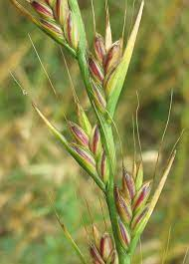
The Parable of the Weeds (Darnel) in the Wheat (vv. 24-30)
This parable can be explained in two parts: (1) a description of the situation (24-28a) and (2) a response to the situation (28b-30). The reign of heaven has become like a man who sowed good seed (wheat) in his field. Then, suddenly and remarkably, during the night an enemy came and sowed darnel (weeds) right over the top of the wheat! Both begin to grow, though the darnel will grow much faster and more be more “thick.” As the crop and weeds begin to ripen, the situation becomes known (24-26). Verses 27-28a serve as a “reinforcement” of what is already known; Jesus uses this repetition to set the situation firmly in place.
The second part (28b-30), Matthew uses as a turning point marked by the servants asking the owner what he wants to do about his crop and the weeds. The servants asks if they should remove the darnel, but the owner responds with a lengthy discourse explaining why he forbids such action by the servants, and then lays out the way things will develop until the future harvest. Jesus will later give His interpretation of this parable in vv. 36-50.
St. Matthew 13:24-35
The Third Discourse: Second Unit

Slide 19
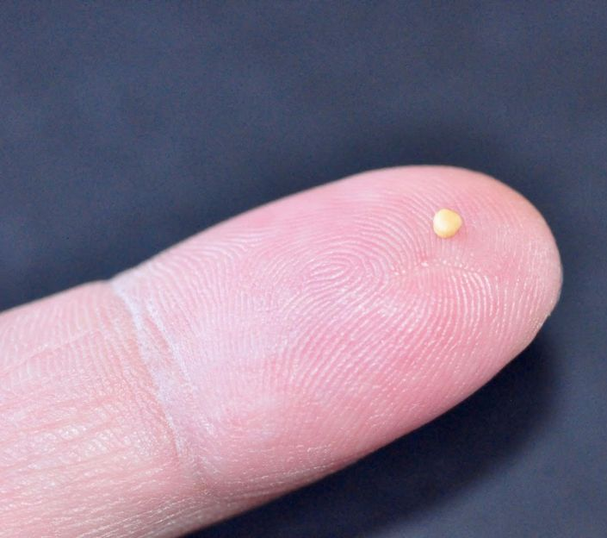
The Parable of the Mustard Seed (vv. 31-32)
St. Matthew presents another reign of the Kingdom parable from Jesus, which is again delivered to the crowd. Once again the our Lord’s parable will reveal how it is now within Israel and the world with the reigning of God that is now occurring through Jesus by way of His Words and Deeds!
This parable is short, yet to the point. In light of how Jesus discusses the small mustard seed and how it produces “greater than the garden herbs and it becomes a tree…” reveals what presently is – is not what will be! In fact, what will be is far beyond the crowds’ expectations, since the mustard plant does not grow into trees large enough to offer roost for birds. Thus, our Lord’s parables are true to life; however, many of His parables contain remarkably unrealistic and exaggerated features in order to teach what the reign of God is like! His point is meant for effect and impact: what may look small and unimpressive; yet, the ministry of Jesus is only in its beginning stages and – one day – it will come to a stunningly large fruition and result!
St. Matthew 13:24-35
The Third Discourse: Second Unit

Slide 20
The Parable of the Leaven (v. 33)
The final parable in this triad begins differently than the previous two. Rather than Jesus placing a parable before the crowd; He now speaks another parable to them. The leaven parable has features that are common with the previous two; however, there are two unexpected and surprising aspects. First, the central character is a woman and not a man; and, secondly, the positive element that the woman uses is leaven!
You must know that leaven almost always has a negative image in Holy Scripture, given the importance of the exodus from Egypt and its themes. The Israelites were commanded to eat unleavened bread as part of the Passover meal and during the seven day feast of the Unleavened Bread that began with the Passover; they were commanded to purge their homes of all leaven ^{(cf. Ex. 12:1-8; Dt. 16:1-8)}. Leaven also has a negative connotation in the NT (see Mt. 16:6, 11-12; Mark 8:15; Luke 12:1; 1 Cor. 5:6-8; and Gal. 5:1-9). The crowd would have certainly noticed that Jesus is using leaven in a positive sense.
21.5 lbs of flour
St. Matthew 13:24-35
The Third Discourse: Second Unit

Slide 21
In Fulfillment of Prophecy (v. 34-35)
St. Matthew now succinctly concludes this section with a summary and repeating of the fact that Jesus has begun to teach the people in parables (v.34) and the purpose for doing so (v.35). The Lord’s purpose is rooted in the OT and in order to fulfill Holy Scripture, in which Matthew cites Psalm 78. This psalm helps to affirm that even though Jesus’ parables initially hide the truths of the reign of God in response to the ongoing unbelief of Israel; the Lord’s purpose is still to reveal through these parables. Thus, Jesus has invited the crowd, by means of these three parables, to continue to search out the significance of His present ministry and not to turn away in continued unbelief.
St. Matthew 13:24-35
The Third Discourse: Second Unit

Slide 22
III. The Lord’s Ministry in Galilee (4:12 – 14:12)
A. The Beginning of His Galilean Ministry (4:12-25) (2/2)
B. First Discourse: The Sermon on the Mount – Ch 5 (2/9)
C. First Discourse: The Sermon on the Mount – Ch 6 (2/16)
D. First Discourse: The Sermon on the Mount – Ch 7 (2/23)
E. A Collection of Our Lord’s Miracles
1. Chapter 8: Capernaum & Gadarenes (3/2)
2. Chapter 9: Back in Capernaum (3/9)
F. The Second Discourse: The Commissioning of the Twelve Apostles – Ch 10 (3/16)
G. His Ministry Throughout Galilee (Chapter 11:1-30 (Part I)(3/23)
1. His Ministry Throughout Galilee (Chapter 12:1-32 (Part II) (3/30)
2. His Ministry Throughout Galilee (Chapter 12:33-45 (Part III) (4/6)
H. The Third Discourse: The Parables of the Kingdom
1. The Third Unit (vv. 36-50) & The Discipled Scribe (vv. 51-52) (4/27)
I. Rejection at Nazareth and Beheading of John the Baptist (13:53 – 14:12) (5/4)
This outline will be undated as we reach successive narratives and the discourses in St. Matthew.
Our Outline of St. Matthew

Slide 23
Next
Week
St. Matthew 13:36-52

