Slide 1
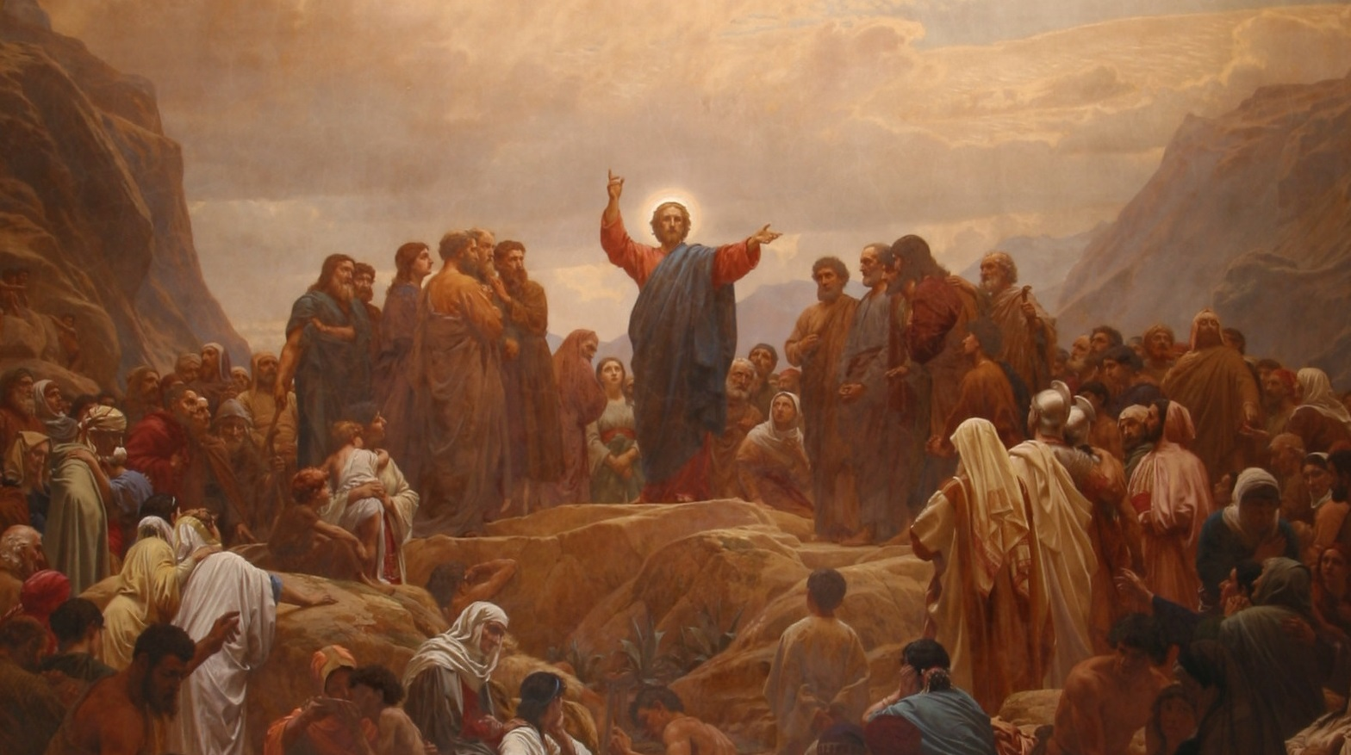
His Ministry
Throughout
Galilee
12:33-45
Part III

Slide 2
Our Lord’s teaching in verse 33-37 helps to explain His striking statement in vv.31-32. However, the imagery is quite unexpected! It’s impossible to allow “the tree” to be a representation of the Pharisees. How can Jesus order them either to make themselves
morally excellent (kalovV) or
morally worthless (saprovV)
when they already were so
vicious that He had already
convicted them of committing
blasphemy against the Holy
Spirit? No human can make
oneself a good “tree” and for
that matter; all are a
“worthless” tree!
St. Matthew 12:33-45
Preface

Slide 3
Rather, the “tree” is Jesus! He is using the same argument that He used in vv. 25-26. The evident good deeds of Jesus performed by freeing demoniacs cannot come from a person connected with Beelzebub; to have such a person, his deeds would have to be of the same type. The utter absurdity of the blasphemy of the Pharisees exposes its devilish hatred!
This then explains our Lord’s address, in v.34, which He hurls at the Pharisees, as did John the Baptist (see 3:7). The Pharisees are men filled with deadly hypocrisy, treachery, and fatal self-deceit who are children of the devil (cf. St. John 8:44). Jesus now lays bare the reality of their hearts! When they claimed that His expelling the demons proved His connection with Satan they were actually revealing that their hearts were overflowing with the same wickedness of their father; the devil.
12:33-37
Words that Acquit or Condemn

Slide 4
In v.35, Jesus then addresses the reservoir of the heart! The “treasure” is both the receptacle and its contents. Each man stores up what he thinks is valuable in thoughts, judgments, and convictions. As occasion arises, he draws on these “treasures” and they are exactly like the man who has stored them.
The “good” (ajgaqovV) man is in the sense of one who is beneficial to his neighbors. And the “wicked” (ponhrovV) man is exactly opposite; being depraved and evil to and toward others. Each man has only his own reservoir from which to draw. Thus, men are divided into only two classes! The case of a good man (Jesus) is evident; and the other class, to which belong the Pharisees, is also clear and they have drawn from their reservoir!
12:33-37
Words that Acquit or Condemn

Slide 5
Verse 36 then turns to a different subject signaled by the use of the Greek particle (dev) (“moreover”). Jesus immediately removes any excuses that the Pharisees may voice. Even idle words, those words that are not carefully considered, will also be used to hold a wicked man to account on Judgment Day.
Be comforted, this only applies to the wicked unbelievers; since, the idle words of believers will be “dismissed” for the sake of our Lord’s righteous work!
Good
or
Evil
12:33-37
Words that Acquit or Condemn

Slide 6
What is the reason that the wicked will be held accountable? Jesus is clear for it’s from the reservoir of the heart that the mouth speaks: “by the words from you” (ejk tw:n lovgwn sou). This is a forsenic (legal) phrase used between two “future” passive verbs (dikaiwqhvsh/) [you will be justified] and katadikasqhvsh/ [you will be condemned]) which proves that God is the Divine agent (v.37)!
By the wicked words of the unbelieving world, even those day by day evil words, will be recorded and used by the Lord Jesus, as the Judge, to render His righteous justice! Why? It’s because their evil hearts reveal their wicked, blasphemous lives. Even if the Pharisees, as an example, only let slip out an idle word that Jesus is Beelzebub, that word betrays them!
Good
or
Evil
12:33-37
Words that Acquit or Condemn

Slide 7
It seems now that a certain number of scribes and Pharisees are going to change tactics, though their confrontation with Jesus, is still related to the previous five verses. The scribes that St. Matthew identifies are probably of the sopherim (.yrp4Ws). They were considered to be the “experts” of the law. The demand from the scribes is meant to test Jesus, since, as they understood the law, a sign would have to be furnished by the Messiah to receive Jewish recognition!
You should note that Jesus has already related the “signs” of the Messiah to John’s disciples in 11:4-6, in fulfillment of Is. 29 and 35. In their testing of Jesus, they are certain that He will not pass their test. And, if He attempts to show a sign, and if He fails, that would be clear that Jesus’ power is from the devil.
12:38-39
The Sign of Jonah

Slide 8
Being the hypocrites that they are, they attempt to placate Jesus by calling Him “Teacher” (Didavskale or to translate into Hebrew: Rabbi (רַבִּי). While they do acknowledge that Jesus is one who is very learned (though they do not know how) in the law, they were in reality seeking to utterly ruin His standing with the people. To paraphrase their request in v.38, “What we really want to see from You (ajpo; sou:) is a genuine sign.”
They don’t want to see signs that He has already worked; they want something more noteworthy of the Messiah! Therefore, the sign these wretched men are asking for has to even more glorious that Jesus raising a dead girl, healing a paralytic or casting out demons, etc.!
12:38-39
The Sign of Jonah

Slide 9
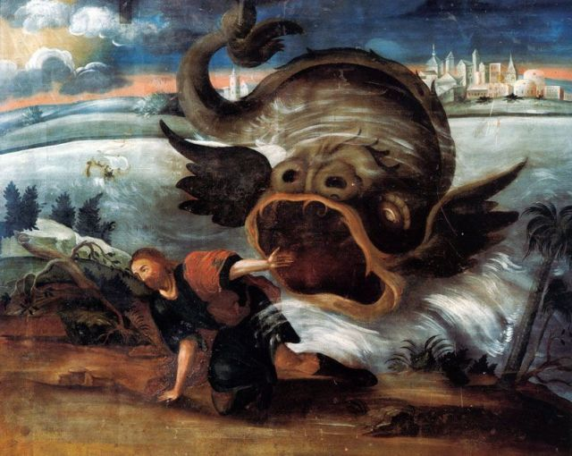
So Jesus gives answer, “A generation wicked and adulterous is out after a sign; and a sign shall not be given to it; save the sign of Jonah, the prophet” ^{(v.39)}. Jesus then expands the sign of Jonah, knowing that these men could not understand.
Before we go further, let’s explain what Jesus means by “adulterous” and its relationship with “wicked” (ponhra;).
12:38-39
The Sign of Jonah

Slide 10
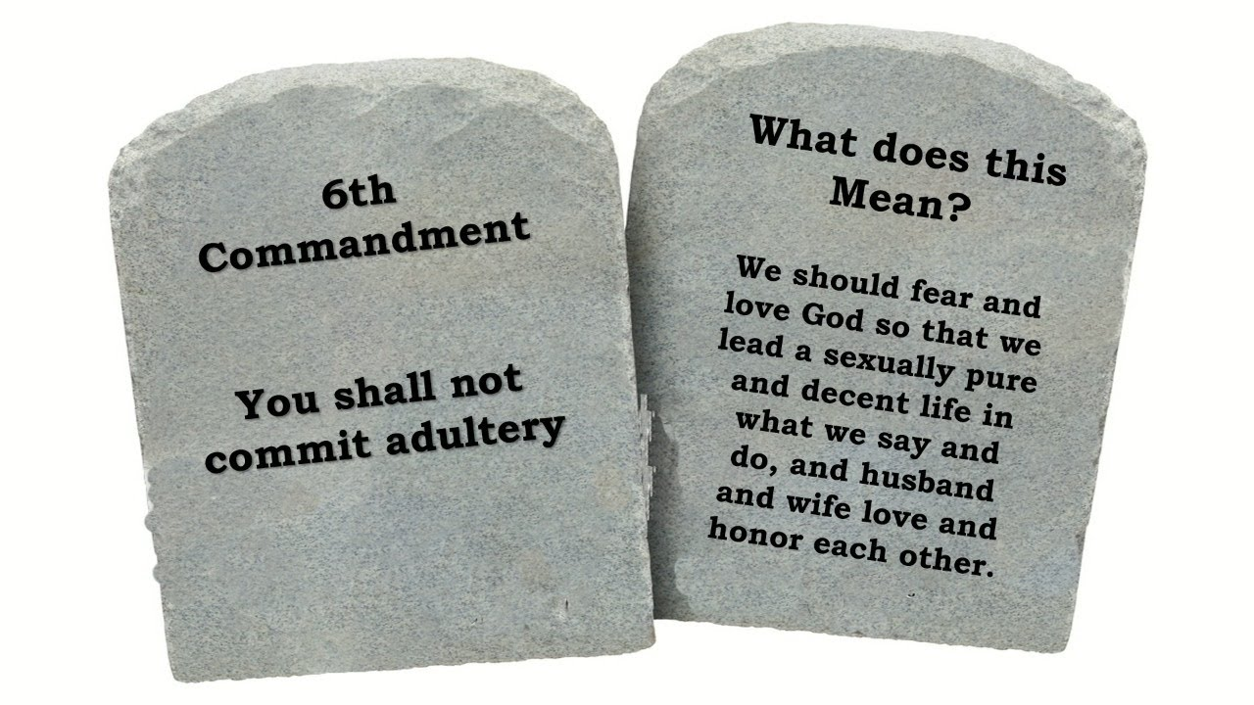
+ Adulterous (moicali;V): In the ancient Jewish context, adultery was considered a grave sin, violating the sanctity of marriage, which was a covenantal relationship reflecting God’s covenant with His people. The act of adultery was not only a personal moral failing but also a social and religious transgression that leads to severe consequences, including the death penalty under Mosaic Law ^{(Lev. 20:10)}. The metaphorical use of “adulteress” or “adulterous” to describe Israel’s unfaithfulness to God is rooted in
the prophetic literature of the
Old Testament, where idolatry
is often depicted as spiritual
adultery.
12:38-39
The Sign of Jonah

Slide 11
+ Wicked (ponhra;): In the Greco-Roman world, the concept of “evil” or “wickedness” was often associated with chaos, disorder, and actions that disrupted societal harmony. In the Jewish context, “ponhrovV” aligns with the Hebrew understanding of evil (er) as anything that opposes God’s will and righteousness. The New Testament writers, influenced by both Jewish and Hellenistic thought, used “ponhrovV” to describe the pervasive nature of sin and the spiritual battle between good and evil.
12:38-39
The Sign of Jonah

Slide 12
Adulterous, in the sense used here by Jesus, is always in the active sense. Jesus uses this adjective to describe the first, wicked. The wicked actions Jesus has in mind are adulterous breaches of the covenantal relationship (see the definition above) with God (cf. Hos. 1:2 – 2:15; Jer. 3:6-13; and Ezekiel 16).
This spiritual adultery is unfaithfulness to God, not only the old idolatry practiced during the history of the Israelites; but now turning away from Him in hypocrisy, being inwardly hostile toward Him, and, also, friendship with the world.
12:38-39
The Sign of Jonah

Slide 13
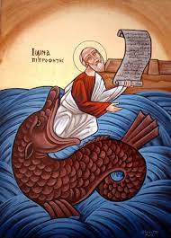
In the sense that we have in v.39, the adulterous character of the scribes, Pharisees, and the present generation appears in the scorning of the signs of love and grace (our Lord’s miracles), but also in rejection of Jesus’ saving ways. By the illegitimate demand that Jesus show them a sign revealed their inner divorce from God. They are no longer keeping the covenantal (marriage) tie!
And this is why Jesus rejects them and their demand of a sign, except for the sign of Jonah. And what’s is the sign of Jonah?
12:38-39
The Sign of Jonah

Slide 14
Jesus reveals what the sign will mean by
describing what happened to Jonah and
that the same Divine power will do the
same to the “Son of Man.” Jesus clearly
pointing to His human nature by which He
will die and rise. [Also note that Jesus
confirms the historical fact of what happened
to Jonah…it’s not a fable!].
However, Jesus will be in the “heart of the earth three days and three nights.” Thus, He is foretelling of His burial in the garden tomb and that He will physically be in the tomb, as Jonah was in the “belly of the great fish.”
12:40-45
The Sign of Jonah

Slide 15
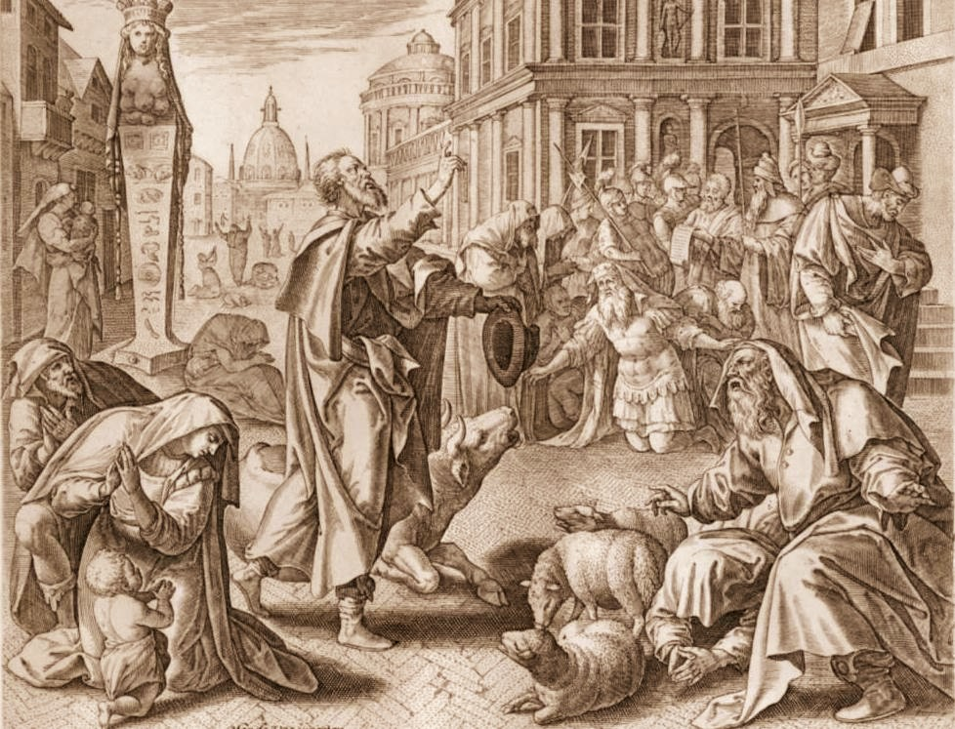
The Lord then states what this sign will reveal to this “wicked and adulterous generation” – condemnation! What Jesus states had to be astounding to the scribes and Pharisees, since Jesus is saying that Gentiles will stand with them in the Judgment and that the case of the Ninevites will serve as evidence for the condemnation of the Jews! Why?
The Ninevites repented, which makes this case doubly bad, since the Ninevites (Gentiles) had so little and repented; the Jews have so much and refused to repent. ”
12:40-45
The Sign of Jonah

Slide 16
Though this is enough, Jesus uses another comparison in v.42 that has the same effect and purpose. The example that Jesus uses was very familiar to the Jews from 1Kg 10:1-10. The point being is that a Gentile woman (the Queen of Sheba) travelled a very long distance to hear the “wisdom” of Solomon who is a type of Christ. The true wisdom that the Jews are now hearing, though, is not Solomon’s; but, true Divine Wisdom, as we have previously discussed!
12:40-45
The Sign of Jonah

Slide 17
Verses 43-45 are used by our Lord to illustrate what He has just told the Jews. Jesus closes His illustration by saying, “Thus will it be also with this wicked generation” ^{(v.45)}. He does this to unify His discourse against the Jews. And the generation that Jesus is speaking of are those presently before Him; not the OT generation, but the generation standing before Him. Now they have Jesus, but their spiritual condition is even worse that before (eight demons, vice one). Their spiritual condition would continue and become more ghastly up to the destruction of the Temple and Jerusalem in 70 A.D.
12:40-45
The Sign of Jonah

Slide 18
III. The Lord’s Ministry in Galilee (4:12 – 14:12)
A. The Beginning of His Galilean Ministry (4:12-25) (2/2)
B. First Discourse: The Sermon on the Mount – Ch 5 (2/9)
C. First Discourse: The Sermon on the Mount – Ch 6 (2/16)
D. First Discourse: The Sermon on the Mount – Ch 7 (2/23)
E. A Collection of Our Lord’s Miracles
1. Chapter 8: Capernaum & Gadarenes (3/2)
2. Chapter 9: Back in Capernaum (3/9)
F. The Second Discourse: The Commissioning of the Twelve Apostles – Ch 10 (3/16)
G. His Ministry Throughout Galilee (Chapter 11:1-30 (Part I)(3/23)
1. His Ministry Throughout Galilee (Chapter 12:1-32 (Part II) (3/30)
2. His Ministry Throughout Galilee (Chapter 12:33-45 (Part III) (4/6)
H. The Third Discourse: The Parables of the Kingdom (Ch 12:46 – 13:52) (4/13)
I. Rejection at Nazareth and Beheading of John the Baptist (13:53 – 14:12) (4/27)
This outline will be undated as we reach successive narratives and the discourses in St. Matthew.
Our Outline of St. Matthew

Slide 19
Next
Week
St. Matthew 12:46-13:52

