Slide 1
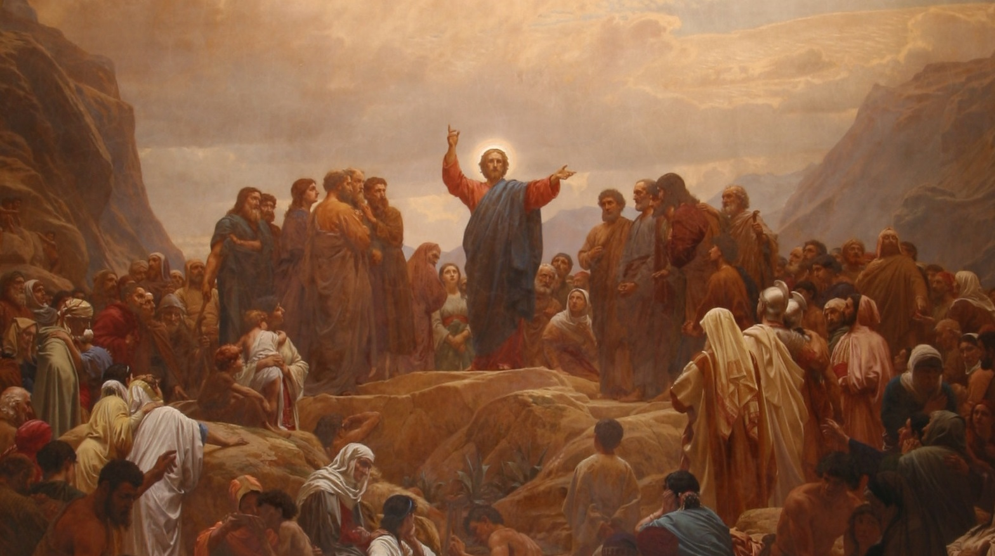
His Ministry
Throughout
Galilee
12:1-32
Part II

Slide 2
In Matthew 11:28, Jesus promised “rest.” This would immediately bring the idea of “Sabbath” to the Jewish mind. Yet, the rest that Jesus brings is much different than what the scribes and Pharisees may have been thinking. Thus, Matthew 12 begins with controversy between Jesus and the Pharisees over the Sabbath laws and regulations. It’s difficult for us to grasp the complexities and endless regulations which the Jewish religious leaders had put in place to “protect” the Sabbath (the total number is disputed, although I’ve read that it could be as high as 1,500 additional “laws”). The Sabbath laws stood in the center of Jewish piety, but such piety had departed far from the simplicity of the Lord’s intended rest, especially the rest that Jesus would bring through the forgiveness of sins.
St. Matthew 12
The Prologue

Slide 3
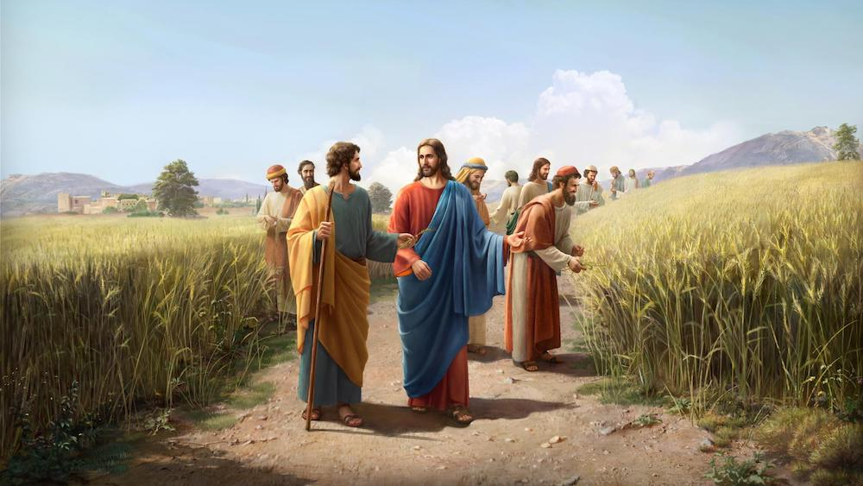
Jesus’ light yoke and easy burden is here contrasted to the heavy burdens which the Pharisees and their laws laid on people’s backs. But Jesus would not be yoked with such man-made laws; He is the giver of these laws, “For the Son of Man [he] is the Lord of the Sabbath” ^{(12:8)}. Therefore, Jesus teaches from the Scriptures about the Sabbath.
St. Matthew 12
The Prologue

Slide 4
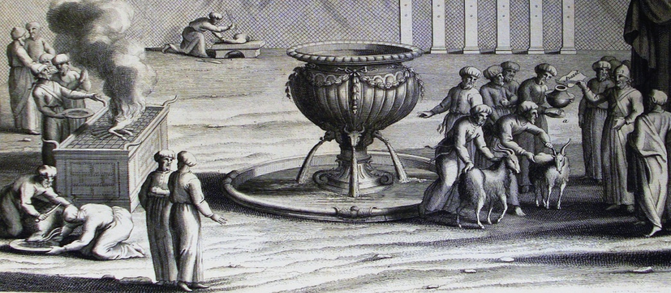
First, Jesus recounts the story of King David and his eating of the showbread from the Tabernacle, bread only permitted for the priests ^{(1Sam 21:1-6)}.
Second, Jesus reminds them that
the priests who serve in the Temple
do not profane the Sabbath by the
“work” that is performed on the
Sabbath ^{(cf. Num 28:9; Lev 24:5)}.
Third, Jesus quotes for a second time Hos 6:6: “I desire mercy and not sacrifice” ^{(v.7; 9:13)}. All this explains who Jesus is, the Son of Man, the greater Son of David. He is greater than the Temple! What a stunning thing for Jesus to say, and yet this is only the first of three “greater than” statements made in this chapter (v.6; 41; 42).
Lastly, Jesus heals on the Sabbath a man with a “withered” hand.
12:1-14
Jesus and the Sabbath

Slide 5
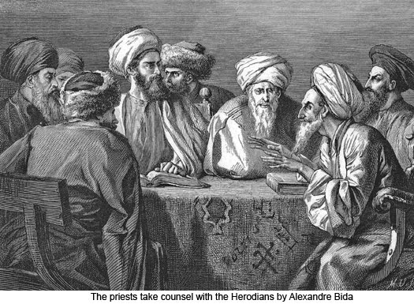
This verse is very informative. The enormity of the reaction of the scribes and Pharisees speaks volumes! St. Luke comments that our Lord
enraged them; while St. Mark
reports that they took counsel with
the Herodians (Jews who
supported Herodian rule).
Their resolve was to destroy Jesus!
It’s interesting that to heal on the
Sabbath was a “mortal” crime; but to plot murder…a perfectly lawful act in the mind of these evil men!
12:14
Jesus and the Sabbath

Slide 6
Jesus knows of the Pharisee’s council against Him, and so He withdraws, but a great crowd follows Him. As He does, He looks with mercy and compassion on the people, and heals them all, but He also warns them not to make this known. Jesus often gives this command following a healing, so that those who have benefitted from His being the Creator would keep it a secret (Cf. St. Matthew 9:30; St. Mark 7:34-36; St. Luke 8:54-56; additionally, St. Matthew 16:20; 17:9; St. Mark 1:43-45; 8:27-30; 9:9f; and, St. Luke 5:14f; 9:21).
Some theologians call these the “Messianic Secret”; Jesus is revealing Himself slowly, and keeping who He is and what He has done quiet until the time is right. In this chapter, we are told that Jesus’ keeping quiet is a fulfillment of the prophecy of Isaiah (the Messiah would be a humble servant, Is. 42:1-4).
Our Lord’s description of His mission takes in His ultimate objective: the bringing of the blessed Holy Gospel, His Gospel, of grace, redemption, and justification from Israel to the Gentile world.
12:15-21
The Unheard Voice

Slide 7
An Outline of this Section
v. 22 – The Exorcism of the blind and mute man
vv. 23-30 – Controversy following the miracle
v. 23 – The Amazement of the Multitude
v. 24 – The Indictment of the Pharisees: “by the power of Beelzebub”
vv. 25-30: Jesus’ three-fold response:
vv. 25-26 (#1): The devil’s kingdom is not divided
v. 27 (#2): The Jewish Exorcists
vv. 28-29 (#3): The Parable of the Strong Man and the Coming of the Kingdom
v.30 – Jesus’ Conclusion: The Pharisees are Indicted!
The Kingdom of God
and the House of the Devil
12:22-30

Slide 8
The casting out of a demon is nothing new for Jesus; He has come to overthrow the kingdom of the devil. Note that this chapter is full of Jesus’ disputes with the Pharisees, and the miracle of the healing of the blind and mute man is almost an introduction to the disputation that is to follow (much like the eating of the grain in v.1 and the healing of the withered hand in v.3).
The multitude was amazed at our Lord’s miracle; yet, for the Pharisees, its bad news. They had been plotting against Jesus for a while, determining how to spin His miracles so that the multitudes would not follow Him. They trot out the old line ^{(cf. 9:34)}, “This fellow does not expel the demons except in union with Beelzebub, ruler of the demons” ^{(v.24)}. Beelzebub is called the god of Ekron, a Philistine city ^{(cf. 2 Kings 1)}. Originally Beelzebal - “lord of the house”, but changed in mockery by the Hebrews to Beelzebub - “lord of the flies” or “lord of dung!”
vv.22-24
Exorcism/Amazement/Indictment

Slide 9
This time the false accusations will not go unanswered. Jesus makes a three-fold response:
1) If the devil cast out demons then his kingdom would be divided against itself, and would fall on its own. This is not the case; the kingdom of the devil must be overthrown from the outside, by one stronger than him. The devil would not destroy himself, his lust is for self-preservation, for self- glory, for vanity sake! Nor could Adam and Eve, even in their perfection, overthrow him. No, The God-Man, Jesus, however, can overthrow and bind the strong man and plunder his goods (vv.25-26; cf. St. Mark 3:20-30; St. Luke 11:14-23).
2) Jesus points out that there are exorcists among the Pharisees, and if they are condemning Jesus for casting out demons, then their own sons would stand under the same condemnation ^{(v.27; cf. St. Luke 11:19)}!
vv.25-30
Jesus’ Three-fold Response

Slide 10
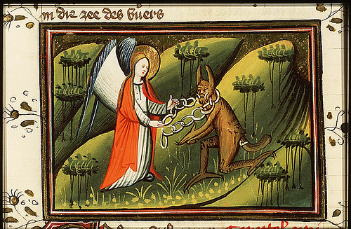
3) Jesus points out that He is casting out the demons by the power of “…the Spirit of God…” [The Holy Spirit…this is important and you will hear why in a moment!] ^{(v.28)}.
Then Jesus tells the parable of the strong man to teach the truth and to give an insight into the unseen reality of His miracles. “Or how is anyone able to enter into the house of the strong [man] and to plunder his goods, unless he first binds the strong [man]? And then he will plunder his goods” (v.29; see also St. Luke 11:21, 22).
vv.25-30
Jesus’ Three-fold Response

Slide 11
Jesus is not giving advice on how to become a cat burglar; He is explaining what He is doing. The strong man is the devil, his house is the world and the treasure is all sinful, fallen humanity who are held in bondage to the devil by the fear of death. Jesus, then, is the one doing the plundering, the binding. He disarms the devil in order to rescue and deliver us. So this “stealing” is our deliverance (thus the importance of Holy Baptism and its connection to Lent!).
vv.25-30
Jesus’ Three-fold Response

Slide 12
Jesus concludes the text with an ultimatum: “The [one] not being with Me is against Me; and the [one] not gathering with Me scatters” ^{(v.30)}.
The Pharisees scatter, they are sending the Lord’s people this way and that via false teaching; not gathering them together. Yet, Jesus is gathering, rescuing His people from the devil’s grasp and kingdom and gathering them into His holy Church, the Kingdom of His Grace and Light and Life.
vv.25-30
Jesus’ Three-fold Response

Slide 13
Jesus continues His accusation of the Pharisees with a discussion of the “unforgiveable sin.” The warning is repeated twice for emphasis: “blasphemy against [the] Spirit will not be forgiven” ^{(v.31)}; “whoever speaks against the Holy Spirit; it will not be forgiven him” ^{(v.32)}. So the Pharisees are justly accused of blasphemy. Later they will falsely accuse Jesus of the same, and condemn Him to death.
What is the Unforgiveable Sin?
Jesus speaks of the blasphemy of the Holy Spirit (cf. St. Mark 3:28-30 and St. Luke 12:10). We begin, then, with a discussion of blasphemy. Jesus first speaks of blasphemy, second of “speaking against.” What is blasphemy? The Christian Cyclopedia offers this definition: “Speech, thought, writing, or action manifesting irreverence toward God or anything sacred (Ps 74:10, 18; Isa 52:5; Rev 16:9, 11, 21).”
vv.31-32
The Unforgiveable Sin

Slide 14
False charges of blasphemy were brought against Jesus (cf. St. Matthew 26:64–66; St. John 10:33) and Stephen ^{(Acts 6:11)}. Saul (St. Paul) attempted to compelled Christians to blaspheme ^{(Acts 26:11)}. Transgressions of God’s people caused God’s name to be blasphemed ^{(Romans 2:24)}.
Blasphemy is to be distinguished from atheism, sacrilege, and criticism of religion. But in moral theology, it is often regarded as a sin against the virtue of religion. In 16th and 17th century England, it was dissent from the current religious dogma.
Blasphemy was severely punished under Jewish ^{(Lev 24:16; 1 Kgs 21:10)}, Greek (considered a crime against God and society), Justinian, and medieval laws. Approximately, 40% of all nations today prohibit blasphemy by law; since the Enlightenment, however, it is regarded as an offense against society rather than God. Christians regard it as a grave or mortal sin.
vv.31-32
The Unforgiveable Sin

Slide 15
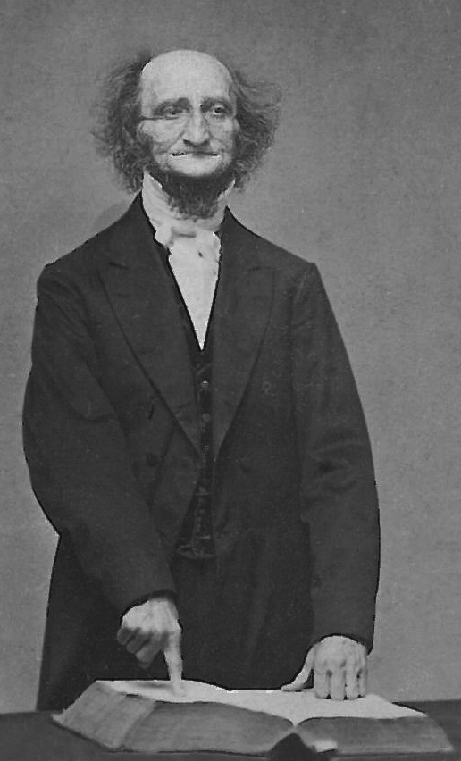
What is the blasphemy of the Holy Spirit?
The sin that will not be forgiven is not just blasphemy, but blasphemy of the Holy Spirit. In fact, this specificity is made clear when Jesus distinguishes between the blasphemy of the Holy Spirit and the blasphemy of the Son. “And whosoever speaks a word against the Son of man, it shall be forgiven him: but whosoever speaks against the Holy Ghost, it shall not be forgiven him, neither in this world, neither in the world to come” ^{(v.32)}.
C.F.W. Walther on the Unforgiveable Sin
C.F. W. Walther, the first president of the LCMS, was also was a pastor and a professor at the seminary in St. Louis where he gave lectures on Friday nights to the students. These lectures he called “The Lutheran Hour!” Walther’s topics on these Friday evening lectures were the proper distinction between Law and Gospel. He wrote and defended 25 theses on these topics. Thesis 24 has to do with the unforgiveable sin, and it reads as follows:
vv.31-32
The Unforgiveable Sin

Slide 16
Thesis XXIV. “In the twentieth place, the Word of God is not rightly divided when the unforgiven sin against the Holy Ghost is described in a manner as if it could not be forgiven because of its magnitude.”
Walther makes some distinctions that help us to understand what is blasphemy of the Holy Spirit. First, this sin is not blasphemy of the person of the Holy Spirit, but the office and work of the Holy Spirit!
“Accordingly, the meaning of this passage cannot be that the unforgivable sin is blasphemy against the person of the Holy Spirit; for blasphemy against the Father and the Son is exactly the same sin. The blasphemy to which our text refers is directed against the office, or operation, of the Holy Spirit; whoever spurns the office of the Holy Spirit, his sin cannot be forgiven. The office of the Holy Spirit is to call men to Christ and to keep them with Him.”
[Walther, The Proper Distinction Between Law and Gospel, p. 393; emphasis mine]
vv.31-32
The Unforgiveable Sin

Slide 17
The Holy Spirit calls us by the Gospel, creates faith in us which take a hold of Jesus’ work. To despise and spurn the work of the Holy Spirit is to reject the grace and promises of Jesus.
Second, this sin remains unforgiveable not because of its magnitude but because of its type.
• “The sin is not unpardonable because of its magnitude, - for the apostle, as we heard, has distinctly declared: ‘Where sin abounded, grace did much more abound,’ - but because the person committing this sin rejects the only means by which he can be brought to repentance, faith, and steadfastness in faith.” [Law and Gospel, p. 398]
• “A person who has committed the sin against the Holy Ghost is condemned not so much on account of this sin as rather on account of his unbelief.” [Law and Gospel, p. 400]
• “This is not a jesting matter; for unless the Holy Spirit brings us to faith, we shall never attain it. Whoever rejects the Holy Spirit is beyond help, even by God!” [Law and Gospel, p 395]
vv.31-32
The Unforgiveable Sin

Slide 18
Third, the symptoms of committing this sin are not terror or fear but lack of concern or even delight in speaking ill of God and His gifts.
We now see Walther’s pastoral approach to the discussion of the unforgiven sin.
• “As regards people who are distressed because they think they have committed the sin against the Holy Ghost, they would not feel distressed if they really had committed that sin and were in that awful condition of heart, but they would find their constant delight in blaspheming the Gospel. However, Christians in distress still have faith, and the Spirit of God is working in them; and if the Spirit of God is working in them, they have not committed the sin against the Holy Ghost.” [Law and Gospel, p. 399]
• Walther quotes Luther in this regard: “This sin is unto death when it is defended after having been sufficiently revealed and recognized as a sin, because it resists the grace of God, the means of grace, and the forgiveness of sin. Where there is no knowledge of sin, there is no forgiveness. For the forgiveness of sin is preached to those who feel their sin and are seeking the grace of God. But these persons [who have committed the sin against the Holy Ghost] are not frightened by any scruples of conscience, nor do they recognize and feel their sin” [Law and Gospel, p. 398].
vv.31-32
The Unforgiveable Sin

Slide 19
Finally, then, we can have a definition of the blasphemy of the Holy Spirit:
• “Here we have the record of an actual blasphemy against the Holy Ghost. Then Christ, by the finger of God, cast out devils, the Pharisees, who had come down from Jerusalem, declared this operation of the Holy Spirit a work of the devil. They were convinced in their hearts that it was a divine work, but since the Savior had rebuked them for their hypocrisy and mien of sanctimoniousness they conceived a deadly hatred against Christ, and that incited them to blasphemy against the Holy Ghost. Accordingly we have here this explanation offered us: To declare a work of the Holy Ghost a work of the devil when one is convinced that it is a work of the Holy Ghost, that is blasphemy against the Holy Ghost.” [Law and Gospel, p 394]
(Hebrews 6:4-8) – “For it is impossible for those who were once enlightened, and have tasted of the heavenly gift, and were made partakers of the Holy Ghost, And have tasted the good word of God, and the powers of the world to come, If they shall fall away, to renew them again unto repentance; seeing they crucify to themselves the Son of God afresh, and put him to an open shame.”
vv.31-32
The Unforgiveable Sin

Slide 20
This text points us to a major theme in Holy Scriptures: Jesus was anointed with the Holy Spirit in the fullest measure. The reason Jesus is discussing the blasphemy of the Holy Spirit is because the Pharisees are guilty of this sin! How? Did they not accuse Jesus of being possessed by Beelzebub? How is this blaspheming the Holy Spirit instead of Jesus? The answer is found in Jesus’ response:
“If I cast out demons by the Spirit of God then the kingdom of God has come upon you” ^{(v.28)}.
Because Jesus is full of the Holy Spirit, and more, because Jesus works miracles by the Holy Spirit (in fact it was by the Holy Spirit that the demon was cast out) the Pharisees were calling the Holy Spirit…Satan, the devil, Beelzebub! Thus their accusing Jesus of casting out demons by Beelzebub is a blasphemy of the Holy Spirit!
vv.31-32
Jesus and The Holy Spirit

Slide 21
III. The Lord’s Ministry in Galilee (4:12 – 14:12)
A. The Beginning of His Galilean Ministry (4:12-25) (2/2)
B. First Discourse: The Sermon on the Mount – Ch 5 (2/9)
C. First Discourse: The Sermon on the Mount – Ch 6 (2/16)
D. First Discourse: The Sermon on the Mount – Ch 7 (2/23)
E. A Collection of Our Lord’s Miracles
1. Chapter 8: Capernaum & Gadarenes (3/2)
2. Chapter 9: Back in Capernaum (3/9)
F. The Second Discourse: The Commissioning of the Twelve Apostles – Ch 10 (3/16)
G. His Ministry Throughout Galilee (Chapter 11:1-30 (Part I)(3/23)
1. His Ministry Throughout Galilee (Chapter 12:1-32 (Part II) (3/30)
2. His Ministry Throughout Galilee (Chapter 12:33-45 (Part III) (4/6)
H. The Third Discourse: The Parables of the Kingdom (Ch 12:46 – 13:52) (4/13)
I. Rejection at Nazareth and Beheading of John the Baptist (13:53 – 14:12) (4/27)
This outline will be undated as we reach successive narratives and the discourses in St. Matthew.
Our Outline of St. Matthew

Slide 22
His Ministry
Throughout
Galilee
Next
Week
St. Matthew 12:33-45

