Slide 1
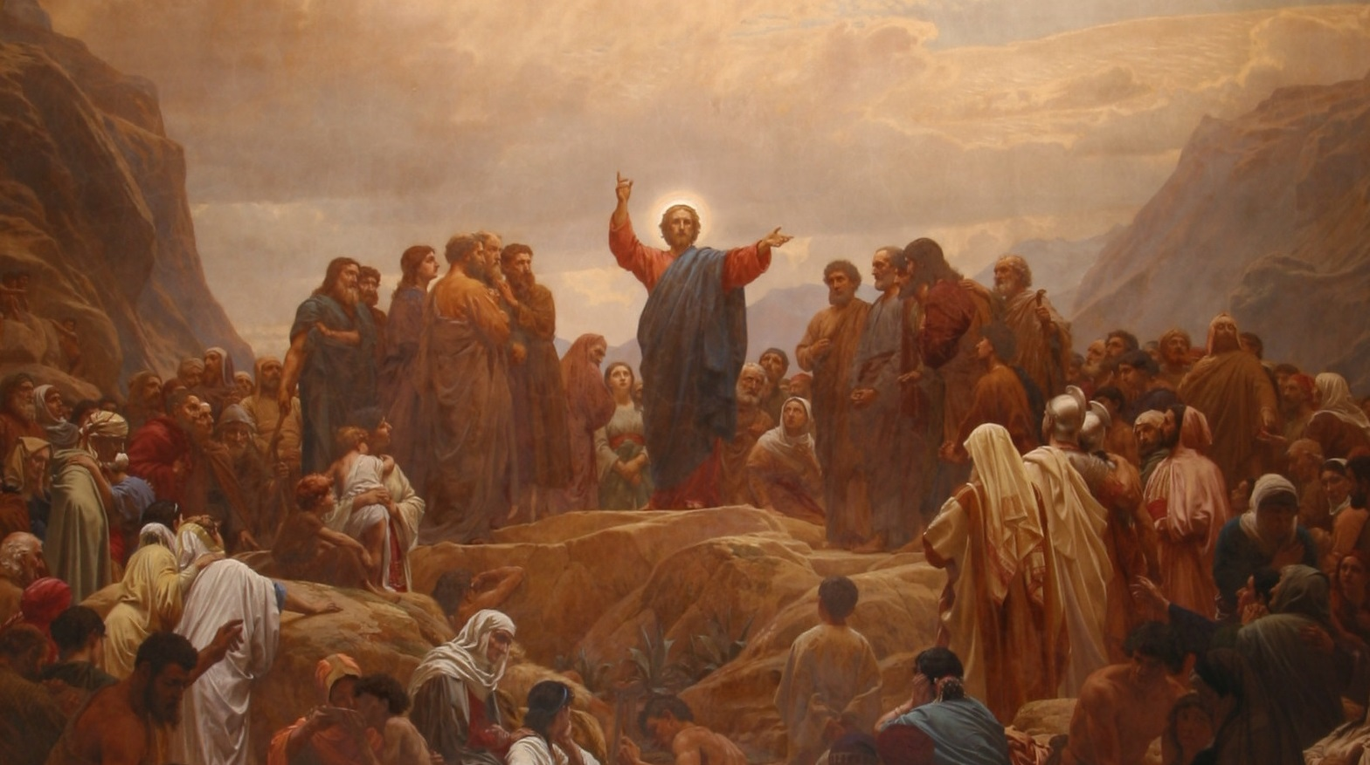
His Ministry
Throughout St. Matthew 11:1 – 12:45
Galilee
11:1-30
Part I

Slide 2
Chapter 11 is mostly filled with the conversation between Jesus and John’s disciples; and , then, our Lord’s testimony concerning John the Baptist. It’s interesting that Jesus sends His disciples out while John the Baptist sends his disciples to Jesus.
Jesus also preaches a harsh word of law to the unrepentant cities, and this chapter ends with Jesus speaking of Himself and His Father who reveals His wisdom not to the wise; but to babes! Lastly, we are tenderly invited to take up the light and easy yoke of our Lord’s Holy Gospel.
St. Matthew 11
Introduction

Slide 3
John the Baptist was thrown in prison for preaching the law to Herod (cf. 4:12; 14:3), and from His cell He hears of Jesus’ works. This shows how the words and acts of Jesus were being proclaimed widely and that even while in prison the Baptist heard news of Jesus. John the Baptist is in contact with his disciples, which is not surprising. Since in the ancient world, the only way a prisoner could survive is if he is supported by friends, family or disciples! The “state” did not support prisoners. So John sends his disciples to Jesus to asking, “Are You the Coming One, or do we look for another?” ^{(v.3)}
St. Matthew 11:1-3
John Sends Disciples to Jesus

Slide 4
The Coming One
(oJ ejrcovumenoV)
This is a title of the Messiah, the long expected and promised Savior of the world (cf. Ps 40:7; 118:26; Dan 7:13-14). Literally, this Greek verb means The Coming One! “The Coming One” not only referred to a physical manifestation, but also carried significant spiritual and eschatological implications, especially in Jewish and early Christian thought. The anticipation of the Messiah’s coming was a central theme in Jewish eschatology, which carried over into Christian expectations of Christ’s return (cf. Heb 10:37).
St. Matthew 11:1-3
John Sends Disciples to Jesus

Slide 5
“Do We Look for Another?”
The questions in regard to the “we” of v. 3 are: Who is the “we” addressing? Is John the Baptist part of the “we” or not? Was John having doubts about Jesus, or was He just sending his disciples to learn of Jesus for themselves? The answers are found in the Greek grammar!
John has clearly asked a question and Jesus gives a clear answer. The Greek verb, prosdokw:men is a third person plural active verb; thus, the “we” has to be John asking and associating himself through and with his sent disciples!
St. Matthew 11:1-3
John Sends Disciples to Jesus

Slide 6
“Do We Look for Another?”
It is not strange for prophets to doubt the promises they have been given (and John the Baptist is no exception). Consider Elijah in the wilderness (1 Kings 19:1-10). This is, in fact, the stunning definition of worship we find in our Confessions: “faith fighting against despair” ^{(Treatise 44)}.
Yet, it’s to Jesus that John looks to for answers and assurance. His faith was not quenched; but strained. John had promised the Messiah’s grace as well as His judgment. Jesus, it seems to John, is only come with grace and mercy.
St. Matthew 11:1-3
John Sends Disciples to Jesus

Slide 7
“You See and Hear”
Jesus strengthens John’s faith, and the faith of his disciples, by reporting the miracles He has preformed. These are His witnesses (cf. St. John 5:36; 10:25). But there is more to our Lord’s answer than a list of His miraculous accomplishments; these are marks of the Messiah that were promised by the prophets.
(Isaiah 35:4-6) “Say to them that are of a fearful heart, Be strong, fear not: behold, your God will come with vengeance, even God with a recompense; he will come and save you. ⁵Then the eyes of the blind shall be opened, and the ears of the deaf shall be unstopped. ⁶Then shall the lame man leap as an hart, and the tongue of the dumb sing: for in the wilderness shall waters break out, and streams in the desert.” (See also: Ps 22:26; 72:12-13; 146:8; Is. 29:18; 42:6-7; 43:8; 61:1-3, 66:2; and Zech 11:7).
St. Matthew 11:4-6
John Sends Disciples to Jesus

Slide 8
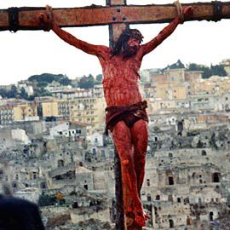
“You See and Hear”
We find in Jesus’ answer that comfort established in the promises of the Scriptures. “Yes,” is Jesus’ answer to John’s question; “Yes, I am the Promised Coming One.”
Jesus had told the disciples that He
Had come to bring “not peace, but a
sword” ^{(10:34).} Now He promises
blessings to those who are not
offended by the offense of the Gospel.
“Blessed is he who is not offended
because of Me” ^{(v.6)}.
St. Matthew 11:4-6
John Sends Disciples to Jesus

Slide 9
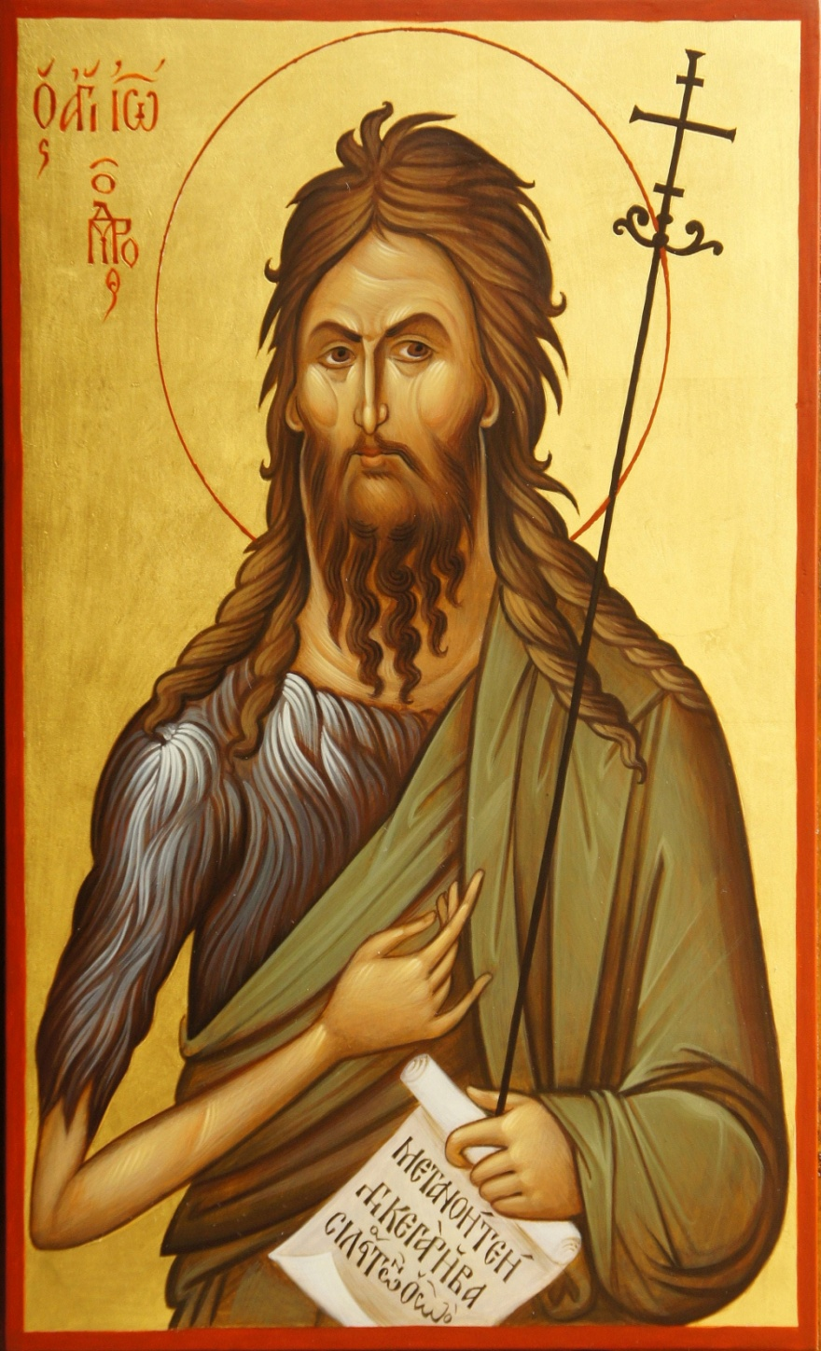
When John’s disciples depart Jesus begins to teach about John. John was promised, as Jesus quotes Malachi 3:1. We know that John was also promised in Is. 40:1ff and Mal 4:5-6, the last verses of the OT. John is a prophet, and even “more than a prophet” ^{(v.9)}. We rightly consider John to be the last and greatest prophet of the OT; he did with his hand what all the other prophets could only do with their mouth: point to the Messiah: “Behold the Lamb of God who takes away the sin of the world” ^{(St. John 1:29)}.
St. Matthew 11:7-11
The Significance of John

Slide 10
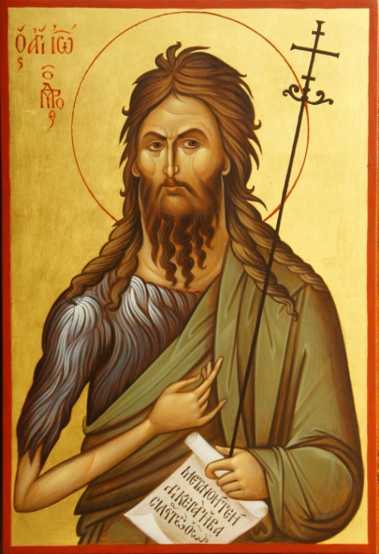
But the greatness of John is a comfort to us as Jesus says, “Truly I say to you there has not risen among [those] born of women one greater than John the Baptist; yet the least in the kingdom of [the] heavens, is greater than he” ^{(v.11)}. What a paradox: John is the greatest, and yet less than the least in the kingdom.
Such is the privilege of the children of the kingdom, that they would see the suffering and death of Jesus, and would behold His resurrection. John would be the last martyr before the death of Jesus, cut off before He could see the glory of the Lord in the suffering face of Jesus. So it is that all of you are greater than the prophets, since: “all these [OT saints], having obtained a good testimony through faith, did not receive the promise, God having provided something better for us, that they should not be made perfect apart from us” ^{(Heb 11:39-40)}.
St. Matthew 11:7-11
The Significance of John

Slide 11
Jesus has preached this sermon before, noting that the prophets were all rejected (5:11-12) and that the disciples would likewise be rejected (10:16ff). John the Baptist was imprisoned for his testimony, and would be killed, and so goes the Lord Jesus.
Since more than all the prophets and apostles, the Lord Jesus was despised, rejected, and killed. Such violence is still found in the church, or better yet, against the church. The devil never rests or stops seeking those Christians whom he can devour. This is as Jesus promised, “In this world you will have tribulation, but be of good cheer, I have overcome the world” ^{(St. John 16:33)}.
So Jesus ends His discourse on John by saying that He is the last of the prophets. “For all the prophets and the law prophesied until John” ^{(v.13)}. St. John the Baptist is the great hinge between the Old and the New, between the promise and the fulfillment, between the waiting and the rejoicing, the one who would come in the office of Elijah (Malachi 4:5).
St. Matthew 11:12-15
The Kingdom Suffers Violence

Slide 12
Jesus then takes opportunity to contrast Himself and John, and chastise the people who rejected them both. John came with severity and austerity, fasting and living in the wilderness, and they said he had a demon. Jesus came eating and drinking and He was called a glutton and drunkard, a friend of sinners. So Jesus tells a short parable, almost like a verse from a nursery rhyme, to explain their confused rejection of God’s kingdom:
“We played the flute for you,
And you did not dance;
We sang a dirge,
And you did not wail.”
St. Matthew 11:16-24
Jesus Chastises “this Generation”

Slide 13
“We played the flute for you,
And you did not dance;
We sang a dirge,
And you did not wail.”
Like children who refused to play wedding, and then refused to play funeral. Their rejection of both John the Baptist and Jesus shows that their objections were only a cloak for their hypocritical unbelief. They deemed the Baptizer’s ministry to harsh, to repulsive; so they refused to heed John’s call to mourn in repentance (3:7-12). Conversely, they viewed Jesus’ ministry too “liberal” and unabashedly celebratory; He was welcoming sinners and even associated with them. But the mind of the flesh cannot receive the things of the Spirit of God (cf. 1 Cor. 2:14). Those who rejected John and then Jesus were like silly little children who were upset when John wouldn’t join the party, or when Jesus refused to mourn!
St. Matthew 11:16-24
Jesus Chastises “this Generation”

Slide 14
Jesus ends this section with a rather ironic, even sarcastic phrase: “But wisdom is justified by her deeds” ^{(v.19d)}.
The figure of Divine Wisdom was well-known and well-developed in the OT, as early as Job and very prominent in the books of Solomon (Proverbs, Ecclesiastes and Song of Song) and the Wisdom Psalms (Ps. 19:7-14; 34; 37; 49; 73; 78; 111; 112; 119; 127; 128; 133; and 139).
In the NT, this Divine Wisdom is personified in the Second Person of The Holy Trinity, the preexistent Son, who is the agent of creation and was incarnate in the Person of Jesus, the Christ!
St. Matthew 11:16-24
Jesus Chastises “this Generation”

Slide 15
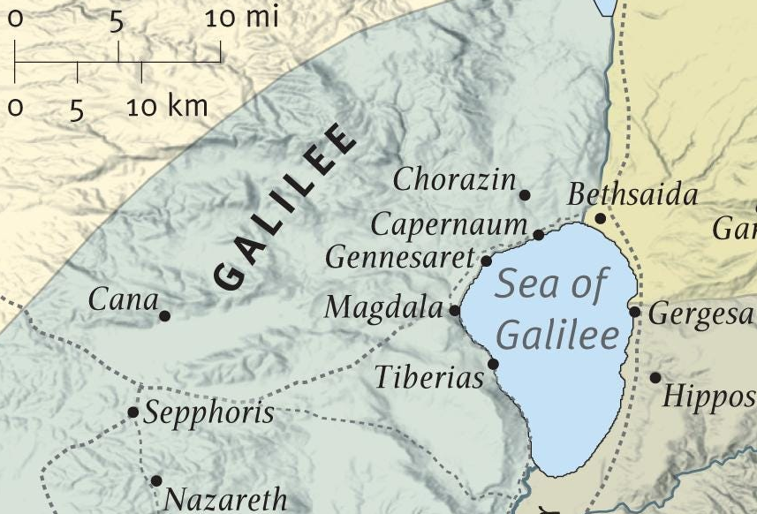
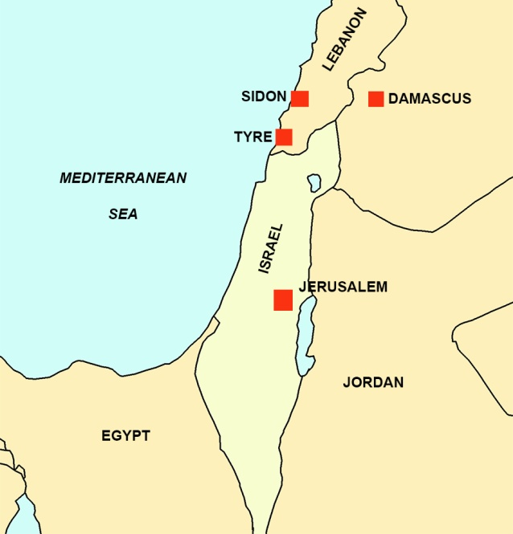
The “Woes” (vv.20-24)
According to “this generation”, wisdom is acquitted of any association with John or Jesus! And, therefore, in their tragic view “wisdom is declared innocent (justified) of her deeds” ^{(v.19)}. Yet, Divine Wisdom has come and is at work in John and Jesus, the forerunner and the worker, respectively, of the very reign of God Almighty. The bottom line: to reject John and Jesus is to reject God’s Wisdom!
Just as Jesus had commanded the disciples to shake the dust off their feet if the cities they went to did not receive them, so Jesus pronounces woes to the cities who did not repent when He did His miracles in their midst.
There are two chastisements, first for Chorazin and Bethsaida, two small cities on the shore of Galilee very near Capernaum. Jesus did signs and wonders in their eyes, but they did not repent. Their shame is double, says Jesus, for if such work were done in Tyre and Sidon, two pagan sea ports north of Israel on the Mediterranean Sea, they would have repented.
St. Matthew 11:16-24
Jesus Chastises “this Generation”

Slide 16
The “Woes” (vv.20-24)
The worst denunciation falls on Capernaum, the city Jesus used as His “base of operations.” The Lord was continually coming and going from Capernaum, and yet they did not repent. Jesus says that even Sodom would have repented if they had see His marvelous works. And so, warns
Jesus, Capernaum's judgment will be more severe than Sodom’s. Please note the following: First, Jesus is not nice, He comes preaching wrath and judgment. Second, we see that the Law is always toward repentance, and judgment is sure for the unrepentant!
St. Matthew 11:16-24
Jesus Chastises “this Generation”

Slide 17
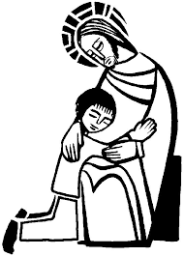
The last six verses of chapter 11 include Jesus’ prayer, His teaching of the giving between the Father and the Son, and then ends with the invitation for the weary and heavy laden to take on Jesus' light and easy yoke.
St. Matthew 11:25-30
Your Lord’s Invitation!

Slide 18
The wise and prudent of the world (i.e., the cities who have been condemned, the unbelieving synagogues, etc.) cannot see that Jesus’ witness is true. Babes (nhpivoiV), on the other hand, are given eyes to see and ears to hear the truth of Jesus. It’s a radical statement, since the adjective “nhpivoV” is used in the NT to describe someone who is an infant or child, both in a literal and metaphorical sense. It often conveys the idea of immaturity, simplicity, or lack of understanding. In a spiritual context, it can refer to those who are immature in their faith or understanding
of spiritual matters.
In Jewish culture, children were valued as a
blessing from God, yet they were also expected
to grow into maturity and wisdom.
St. Matthew 11:25-30
Your Lord’s Invitation!

Slide 19
The truths of the Scripture are not immediately accessible to the mind of the flesh, for the things the Lord says are for believing, not understanding. “The natural person does not accept the things of the Spirit of God, for they are folly to him, and he is not able to understand them because they are spiritually discerned” ^{(1 Cor. 2:14)}.
Again: “For consider your calling, brothers:
not many of you were wise according to
worldly standards, not many were powerful,
not many were of noble birth. But God
chose what is foolish in the world to shame
the wise; God chose what is weak in the
world to shame the strong” ^{(1 Cor. 1:26,27)}.
St. Matthew 11:25-30
Your Lord’s Invitation!

Slide 20
St. Matthew, in v.27, now writes of the profound nature of the Holy Trinity, things which St. John delighted to write. That all things are delivered to Jesus by the Father indicates that Jesus is both God and Man; for, according to His Divine Nature, He already possesses all things, and yet according to His human nature all things are delivered to Him. And yet, to receive them He must be God. This communication of Divine Attributes to the human nature of Christ we call the “Communication of Attributes,” and specifically the genus maiestaticum, the “Majestic Kind.”¹
¹For a complete understanding please review the Formula of Concord, Solid Declaration, VIII.50-55.
St. Matthew 11:25-30
Your Lord’s Invitation!

Slide 21
And Jesus is talking about more than Himself and the Father, He also says that He is the only means to know the Father (cf. St. John 1:18; 14:6). These exclusive claims of Jesus might sound harsh to our ears, more like Law than Gospel. However, Jesus comforts us with His mercy and compassion, inviting to Himself (to He who is gentle and lowly in heart) the weak and heavy laden. That Jesus is THE way to know the Father is Good News, the sweetest Gospel!
St. Matthew 11:25-30
Your Lord’s Invitation!

Slide 22
A yoke, just by virtue of being a yoke, is heavy and burdensome. Such was Jesus’ cross the yoke of man’s sin and the burden of God’s wrath. That was our yoke, what we should have born; and yet, Jesus takes it from us and bears alone the weight of sin, death and despair. He take our yoke and gives us His, the light yoke of freedom and joy and forgiveness and life. “Christ's burden does not oppress but makes light and itself bears rather than is borne.” [Luther]
We are born harnessed to the yoke of the law and its punishments, to sin, to slavery, to death (the “yoke of bondage” (zugw:/ douleivaV) (Gal. 5:1)). But Jesus has set us free in the giving of the yoke of the Gospel, in the blessedness of the forgiveness of our sins.
St. Matthew 11:25-30
Your Lord’s Invitation!

Slide 23
III. The Lord’s Ministry in Galilee (4:12 – 14:12)
A. The Beginning of His Galilean Ministry (4:12-25) (2/2)
B. First Discourse: The Sermon on the Mount – Ch 5 (2/9)
C. First Discourse: The Sermon on the Mount – Ch 6 (2/16)
D. First Discourse: The Sermon on the Mount – Ch 7 (2/23)
E. A Collection of Our Lord’s Miracles
1. Chapter 8: Capernaum & Gadarenes (3/2)
2. Chapter 9: Back in Capernaum (3/9)
F. The Second Discourse: The Commissioning of the Twelve Apostles – Ch 10 (3/16)
G. His Ministry Throughout Galilee (Chapter 11:1-30 (Part I)(3/23)
1. His Ministry Throughout Galilee (Chapter 12:1-45 (Part II) (3/30)
H. The Third Discourse: The Parables of the Kingdom (Ch 12:46 – 13:53) (4/6)
This outline will be undated as we reach successive narratives and the discourses in St. Matthew.
Our Outline of St. Matthew

Slide 24
His Ministry
Throughout St. Matthew 11:1 – 12:45
Galilee
Next
Week
St. Matthew 12:1-45

