Slide 1
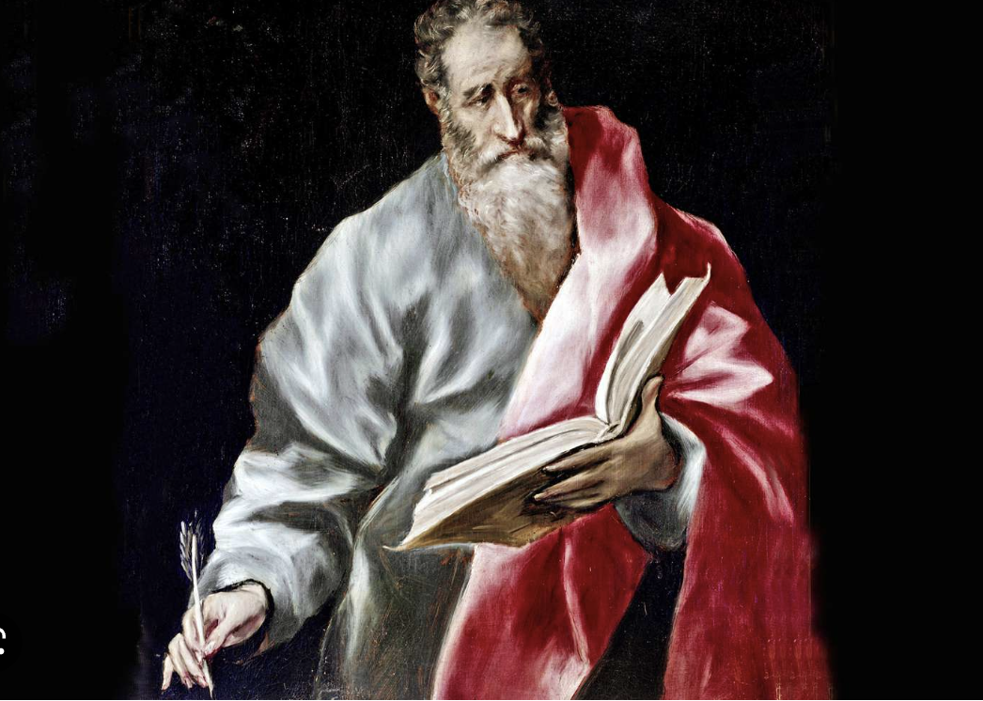
The Commissioning
of the Twelve
Apostles
The Second Discourse: The Missionary Discourse
St. Matthew 10

Slide 2
After telling His disciples to “pray the Lord of the harvest to send out laborers into His harvest” ^{(9:38)}, Jesus then send His disciples out to the harvest! St. Matthew’s tenth chapter comprises the second of the five great discourses in the Gospel, sometimes called the “Missionary Discourse.”
Within this chapter, we will learn that Jesus chooses Twelve Disciples to send into the harvest field; as He first gives them “authority” and then sends them forth. Also, and importantly, is our Lord’s instruction on the opposition which the Gospel always faces, then and today!
St. Matthew 10
Introduction

Slide 3
Chapter ten begins with Jesus calling the
twelve to Him and giving them authority
(ejxousiva, not power) to cast out demons
and to heal all kinds of sicknesses, the same
authority that Jesus had demonstrated in
chapter 9. Unlike power, authority may be transferred or conferred! Authority concerns office and vocation while power is intrinsic to the self.
St. Matthew then lists the twelve who had been conferred this authority. It is illustrative to compare the list with those in St. Mark 3:13-19; St. Luke 6:12-16; and Acts 1:13.
10:1-15
Disciples to Apostles!

Slide 4
St. Matthew 10:2-4 | St. Mark 3:16-19 | St. Luke 6:14-16 | Acts 1:13
Now the names of the Twelve Apostles are these: 1. first, Simon, called Peter and 2. Andrew his brother; 3. James the [son] of Zebedee, 4. and John his brother; 5. Philip, 6. and Bartholomew; Thomas, and Matthew the tax collector; 9. James the [son] of Alphaeus, 10. and Thaddaeus; 11. Simon the Zealot, 12. and Judas Iscariot, the [one] having betrayed Him. | 1. And Simon surnamed Peter; 2. And James the [son] of Zebedee, 3. and John the brother of James; and he surnamed them Boanerges, which is, Sons of Thunder: 4. And Andrew, 5. and Philip, 6. and Bartholomew, 7. and Matthew, 8. and Thomas, 9. and James the [son] of Alphaeus, 10. and Thaddaeus, 11. and Simon the Cananaean, 12. And Judas Iscariot, who also betrayed Him. | 1. Simon, (whom he also named Peter), 2. and Andrew his brother; 3. and James 4. and John; 5. and Philip 6. and Bartholomew; 7. and Matthew 8. and Thomas; 9. and James [son of] Alphaeus; 10. and Simon the [one] called Zealot; 11. And Judas [son] of James; 12. and Judas Iscariot, who became [the] betrayer. | 1. Peter, 2. and John, 3. and James, 4. and Andrew; 5. Philip, 6. and Thomas; 7. Bartholomew, 8. and Matthew; 9. James [son] of Alphaeus, 10. and Simon the Zealot, 11. and Judas [son] of James.
10:1-15
Disciples to Apostles!

Slide 5
Sent (Ones)
The Greek word for “sent” is (ajpostevllw), apostle; literally, “to send forth one(s).” The disciples are hearers and followers, the apostles (ajpostovlwn) are sent forth! Their sending is a temporary commission, before the ascension; it will soon be timeless.
Jesus gives the Apostles very specific instructions:
1. Where to go (to whom): vv.6-7
2. What to do: vv.7-8
3. What to bring: vv.9-10
4. What to do upon arrival and departure: vv.11-15
5. What to expect: vv.16-31
10:1-15
Disciples to Apostles!

Slide 6
First, we notice the difference between the send here and the send at the end of the Gospel. After His ascension, Jesus sends the Twelve “to all the nations.” Here it is not to the Gentiles, but only to “the lost sheep of the house of Israel” (compare to 9:36). The Twelve disciples are to go only to the Twelve Tribes. The Gospel is first to Jerusalem and then to Samaria and the ends of the earth.
See also what these Twelve are to be doing: preaching that “the kingdom of heaven is at hand,” (cf. 3:2; 4:17), and healing the sick, cleansing lepers, raising the dead, and casting out demons. All this is a gift, given to them that they are to do. Miracles were a means to accompany the apostolic preaching to comfort the hearers. The signs also show that the Twelve have been given authority to preach and heal. This is necessary because the apostles have an “immediate call,” like the prophets they are called directly by God without means.
10:1-15
Disciples to Apostles!

Slide 7
Martin Chemnitz comments thus on immediate calls:
“What is a call without means, and how does it take place? When someone is called and sent to the ministry neither by men nor through men as through regular means, but without means, By God Himself, and through God Himself, as God in this way called the patriarchs, prophets, and apostles, without and intervening human means. And they who have thus been called have the testimony of the Spirit and of miracles that they do not err in doctrine. And the rest of the ministers of the church take their doctrine from them, and they must prove it thereby. And besides, the ministry of those who have been called without means is not bound and anchored to a certain church at only one place, but they have the command to teach all people everywhere.”¹
¹Chemnitz, Martin. Ministry, Word, and Sacraments: An Enchiridion, trans. Luther Poellet (St. Louis: Concordia Publishing House, 1981), 30-31.
10:1-15
Disciples to Apostles!

Slide 8
Jesus had warned the disciples of persecutions in the Sermon on the Mount. He again warns His disciples that troubles will follow the preaching of the Gospel. The disciples go out like sheep in the midst of wolves, but they go with the gift of the authority of the Gospel, therefore they need not be afraid. In the face of ferocious wolves they can be peaceful and wise. The authority Jesus gives also serves to bind the disciples to Jesus, so that what happens to Him happens to them. Their discipleship is being rejected, picking up the cross, dying and then going to be with the Father. “You will be hated by all for My name’s sake. But he who endures to the end will be saved” ^{(10:22)}. This hatred and persecution is a mark of the Lord’s Church; the prophets have always been killed.
10:16-31
Persecutions are Coming

Slide 9
Notice how the Gentiles will hear the testimony of the apostles: in their persecution. “You will be brought before governors and kings for My sake, as a testimony (martuvrion) (martyr, witness) to them and to the Gentiles” ^{(v.18)}. In that hour the Lord Jesus promised to give the disciples the very words to speak. This is via the inspiration of the Holy Spirit.
“This, of course, is Inspiration, Verbal Inspiration (lalei:n throughout), that
which none other exists. It is here promised to the apostles for specific
occasions, but that does not change what is promised. The argument is
quite invincible that, if God's Spirit inspired the apostles when they were
subjected to court trials, he was able to inspire them in the same manner at
other times, for interest that were far greater (the Word for all ages and
nations) according to Christ’s promise, John 14:26.”²
² Lenski, R.C.H. Interpretation of St. Matthew’s Gospel. (Minneapolis: Augsburg Publishing House, 1961), p. 402-03.
10:16-31
Persecutions are Coming

Slide 10
Before the Son of Man Comes
Jesus commands the Twelve to flee persecution because “…you will not have gone through the cities of Israel before the Son of Man comes” ^{(v.23)}. What does this mean? What is this coming? Jesus refers to this coming in three other places in St. Matthew:
(Matthew 16:28) “Truly, I say to you, there are some standing here who will not taste death until they see the Son of Man coming in his kingdom.”
(Matthew 24:34) “Truly, I say to you, this generation will not pass away until all these things take place.”
(Matthew 26:64) “Jesus said to him, You have said so. But I tell you, from now on you will see the Son of Man seated at the right hand of Power and coming on the clouds of heaven.”
10:16-31
Persecutions are Coming

Slide 11
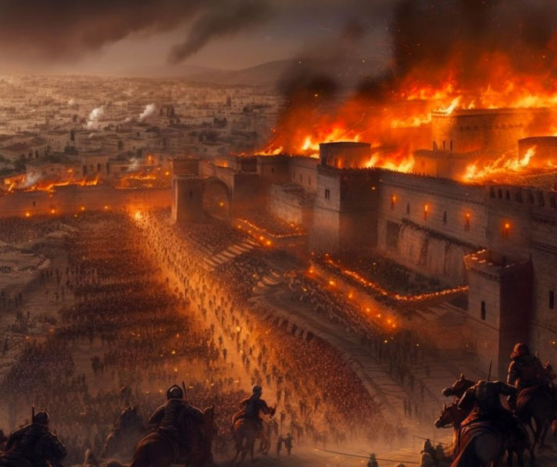
Before the Son of Man Comes
This coming is the terrible judgment that
came upon Israel in 70 A.D. when Rome
destroyed the city and the temple. Jesus
(Matthew 22:7; 23:38-39) warned that this
destruction was coming and explained why.
The destruction of Jerusalem is a key
historical event for understanding the Scriptures,
and especially many of the discourses of Jesus.
In the ancient church, Josephus’ (an ancient Jewish historian writing for the Roman Empire) account of the destruction of Jerusalem was read on the 10th Sunday after Trinity (the Gospel reading in Luke 19:41-48, Jesus weeping over Jerusalem. The 10th Sunday after Trinity often falls close to the anniversary of the destruction of Jerusalem, August 10th, 70 A.D.
Fall of Jerusalem AD 70. © History Skills
10:16-31
Persecutions are Coming

Slide 12
Do Not Fear
After warning the disciples of the trouble and hardship that is to follow them on their tour, Jesus comfort them, saying, “So have no fear of them” ^{(v.26)}. It is He, Jesus, who is sending them as sheep into the mouths of wolves, and so there is really no danger. They are in the service of the Lord, and there is no other master or Lord. Jesus is handing them over to them “who kill the body but cannot kill the soul” ^{(v.28a)}; that is, the devil and evil kings, but the only One to be feared is “Him who is able to destroy both soul and body in hell” ^{(v28b)}.
This fear of God is keeping the First Commandment to have no other gods before the only true God. As Luther wrote, “We should fear, love and trust in God above all things.” Jesus even reminds them of the comfort He had delivered in the Sermon on the Mount, assuring them that no a sparrow falls dead apart from the knowing of the Father, and that we are of more value than the sparrow (vv.29, 31).
10:16-31
Persecutions are Coming

Slide 13
Jesus now speaks of confession, “Whoever confesses Me before men...” ^{(v.32)}. The word “confess” in the Greek is homologēsei (oJmologhvsei), “to say the same thing” or “echo back” or “agree.” We confess when we say what we have heard, when we agree with God. There are many different types of confession:
1. We confess our sins when we agree with God that we are sinners.
2. We confess our faith when we agree with God about who He is and what He has done.
What is Confession?
Confession has two parts. First, that we confess our sins, and second, that we receive absolution, that is, forgiveness, from the pastor as from God Himself not doubting, but firmly believing that by it our sins are forgiven before God in heaven.
10:32-42
Confess Christ Before Men

Slide 14
This text tells us the content of our confession, “Whoever confesses Me....”
It tells us the audience of our confession, “Whoever confesses Me before men....”
And it tells us the result of our confession, “Whoever confesses Me before men, him I will confess (oJmologhvsw) before My Father who is in heaven.”
This is a tremendous verse which gives great instruction and comfort. The Lord’s Church continues to bear the name of Jesus and confess Him before men. By this word of Jesus He has seen to it that His True Church would always be a “confessing” Church. On the other hand, denying Christ will have a similar result in heaven (v.33).
10:32-42
Confess Christ Before Men

Slide 15
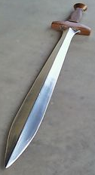
Confessing Brings Division
The Word of Jesus and the confession of His name always brings division. “Do not think that I have come to bring peace upon the earth. I did not come to bring peace, but a sword” ^{(v.34)}.
These words are difficult. Is Jesus not the Prince of peace! Is not His church a haven of peace? His greeting “Peace to you” and His apostles the bearers of peace (v.12, 13)? All this is true! However, “upon the earth” takes in the world of men, and the effect of Christ’s coming which means His mission is the opposite of “peace,” namely war as symbolized by “a sword.”
10:32-42
Confess Christ Before Men

Slide 16
Confessing Brings Division
The idea is this: had Jesus Christ not come, the earth would have continued, undisturbed, in its sin and its guilt until the day of its doom. Now Jesus has come to take away, to redeem, that sin and guilt. At once war resulted, since in their perversion men clung to their sin, fought against Jesus and the Holy Gospel; thus produced are two hostile camps (cf. St. Luke 11:21-22).
So it is today that confessing the truth often brings strife and division, even within families. It is easy to cry out for peace, but this is, in effect, muting the saving confession of Jesus which comes with the sword.
10:32-42
Confess Christ Before Men

Slide 17
Confessing Brings Division
Luther wrote:
“The sectarians who deny the bodily presence of Christ in the Lord’s Supper accuse us today of being quarrelsome, harsh, and intractable, because, as they say, we shatter love and harmony among the churches on account of the single doctrine about the Sacrament. They say we should not make so much of this little doctrine...” [Luther responds] “Thus in theology a tiny error overthrows the whole teaching. Therefore doctrine and life should be distinguished as sharply as possible. Doctrine belongs to God, not to us; and we are called only its ministers. Therefore we cannot give up or change one dot of it (Matt. 5:18).”
[Luther on Galatians 5:9, AE 27.37]
10:32-42
Confess Christ Before Men

Slide 18
Confessing Brings Division
Fighting for the pure confession of Jesus’ name is what the Church is and does, and there is to be no desire for compromised peace when the truth of the Scriptures is at hand. But while the confessor of Christ enters into warfare, the sword is not for him to yield, but to yield unto. The confession of Jesus is taking us the cross, the instrument of one’s own death.
St. Matthew 10:38 is the first mention of the cross in Matthew. It must have been somewhat troubling to the disciples to hear. Yet, Jesus meant walking the way of the cross, but then Jesus adds the comfort that losing our life for His sake is finding it. This is how it always is in the Kingdom of Heaven; things are turned on their head. The Lord kills in order to make alive, He casts down in order to lift up, and life must be lost to be found.
10:32-42
Confess Christ Before Men

Slide 19
And there’s more, comfort not just for the disciples, but for you! You are given the promise that hearing the disciples is hearing Jesus, and receiving the disciples is receiving Jesus. What here serves as a promise for the disciples is instruction for pastors and teachers in the church; we are to speak the written, apostolic Word and whoever hears the pastor…hears Jesus!
So, in the sphere of your pastor, within the Divine Service places him also in the blessing of Christ Jesus!
10:32-42
A Comforting Conclusion

Slide 20
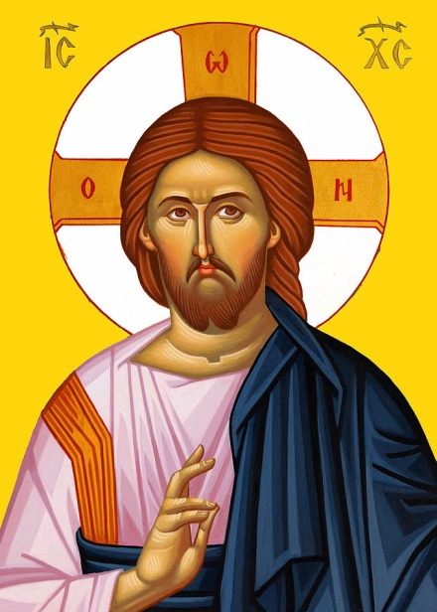
Last week was a question about the Greek Letters in the Halo of our Lord Jesus. Here is the right explanation of what is seen.
This icon, and the letter in the Halo, were used circa. 1000 and following to combat a heresy (the Bogomil heresy) which rejected the OT. What could be a stronger affirmation of the close link between the NT and OT as well as of the identity of the God of Israel and the Father of Jesus than putting Ὁ ὬΝ in the cruciform halo of Christ?
The theological affirmation becomes obvious: He whom we see in the image, Jesus of Nazareth, who was crucified, who died and was raised from the dead; this same person is precisely the same one who told Moses on Mount Sinai that His name is Yahweh
(Ὁ ὬΝ) (אֶֽהְיֶ֑ה).
A Better Explanation!
oJ w N

Slide 21
III. The Lord’s Ministry in Galilee (4:12 – 14:12)
A. The Beginning of His Galilean Ministry (4:12-25) (2/2)
B. First Discourse: The Sermon on the Mount – Ch 5 (2/9)
C. First Discourse: The Sermon on the Mount – Ch 6 (2/16)
D. First Discourse: The Sermon on the Mount – Ch 7 (2/23)
E. A Collection of Our Lord’s Miracles
1. Chapter 8: Capernaum & Gadarenes (3/2)
2. Chapter 9: Back in Capernaum (3/9)
F. The Second Discourse: The Commissioning of the Twelve Apostles – Ch 10 (3/16)
G. His Ministry Throughout Galilee (Chapter 11:1 to 12:45) (3/23)
H. The Third Discourse: The Parables of the Kingdom (Ch 12:46 – 13:53) (3/30)
This outline will be undated as we reach successive narratives and the discourses in St. Matthew.
Our Outline of St. Matthew

Slide 22
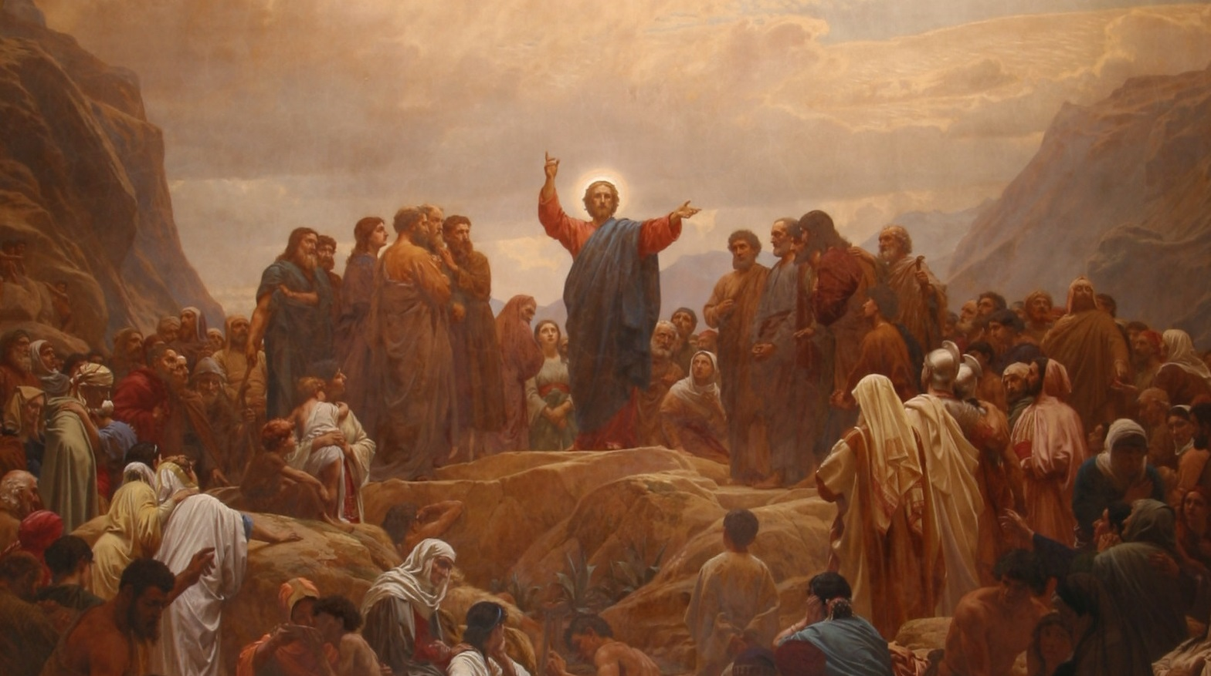
His Ministry
Throughout
Galilee
Next
Week
St. Matthew 11:1 – 12:45

