Slide 1
Vigil of The Epiphany
Genealogy of Our Lord

Slide 2
The Gospel according to St. Matthew begins with a very profound statement. The literal translation of v.1 from the Greek is: “The book of [the] genealogy of Jesus Christ, son of David, son of Abraham.” The word “genealogy” in Greek is: genevsewV. This Greek word for “genesis” primarily refers to the origin or beginning of something. In the NT, it is used to denote the genealogy or lineage of individuals, emphasizing the concept of origin or birth. It can also imply the broader idea of creation or the beginning of events. In the Jewish and Christian traditions, it is closely associated with the creation narrative found in the Book of Genesis, which details the origins of the world and humanity. The concept of genealogy was crucial in Jewish culture, as it established identity, heritage, and fulfillment of prophecies.
Vigil of The Epiphany
The “Genesis”

Slide 3
St. Matthew makes it clear that Jesus is the “Christ” (CristovV) in v.1 by using this word as a title, which he will repeat in v.16 and then by using our Lord’s title alone in v.17. At the time of the NT, this phrase: “Jesus Christ” can seem to function as a compound name; however, here at the beginning of Gospel, “Christ” is the first of three titles that stand in apposition to our Lord’s given name, Jesus.
Vigil of The Epiphany
The “Genesis”

Slide 4
What exactly does this title mean? It is derived from the Greek verb crivw (chrio), meaning “to anoint.” In Jewish tradition, anointing was a symbolic act of consecration to a holy or sacred office, such as that of a king, priest, or prophet (hint, hint!). The expectation of a coming Messiah, an anointed leader, who would deliver Israel, was deeply rooted in Jewish eschatology. The NT writers identified Jesus as this Messiah (j1yv3m2) (Mashiach) (cf. Lev 4:5; 1 Sam 24:6, Ps. 2:2), fulfilling the prophecies and expectations of the OT. The term “Christos” or “Mashiach” became a central title for Jesus, affirming His identity and mission, which also carries royal, eschatological overtones.
Vigil of The Epiphany
The “Genesis”

Slide 5
Lastly, note that St. Matthew gives two further titles of our Lord Jesus, those being: “son of David, son of Abraham.” As you will see in the genealogy of Jesus, this order is reversed here. In the genealogy, St. Matthew begins with Abraham through David. Here in v.1, he begins with David, which points out that Jesus is of Royal descent, and he ends with Abraham, which points out that Jesus is of Jewish descent (cf. 3:9 and Acts 13:26).
Vigil of The Epiphany
The “Genesis”

Slide 6
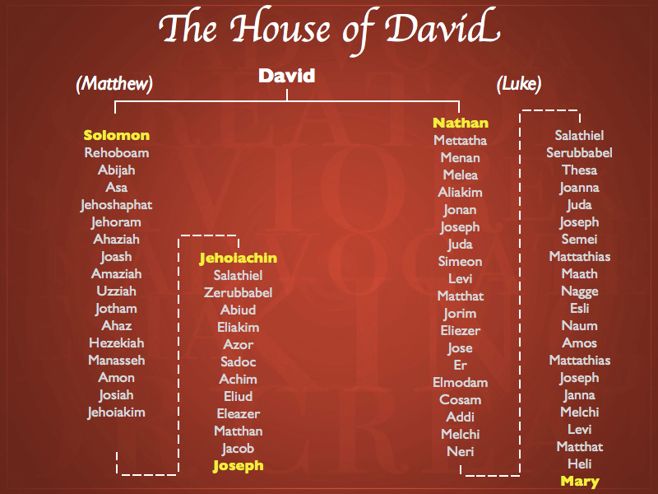
Why is a genealogy important? In the OT world, such a genealogy communicated the status of the person in view, as well as to show the connection between the individual and the whole of society. We should not consider the genealogy of St. Matthew as “just information!” On the contrary, for St. Matthew, the readers of this Gospel then; and even for us, today, this tripartite genealogy communicates the importance of Jesus!
Obed
(from Ruth)
Jesse
DAVID
Vigil of The Epiphany
The Genealogy of Jesus, the Christ

Slide 7
St. Matthew organizes our Lord’s genealogy into three groups of fourteen ancestors. Matthew is intent on getting the fourteen, and shortens the second and third group to get at this number. This is reflected by omissions in the genealogy, which, by the way, does not mean that this genealogy is not complete or authoritative. The first list of fourteen is a list of the fathers, the patriarchs, from Abraham to David. The lives of Abraham to Judah can be read in Genesis.
The genealogy from Perez to David is traced in Ruth 4:18-22 (Perez begot Hezron; Hezron begot Ram, and Ram begot Amminadab; Amminadab begot Nahshon, and Nahshon begot Salmon; Salmon begot Boaz, and Boaz begot Obed; Obed begot Jesse, and Jesse begot David).
Vigil of The Epiphany
The Genealogy of Jesus, the Christ

Slide 8
The second list of fourteen is a list of Kings of Judah! The list can be found in 1 Chronicles 3:10-16. Matthew excludes three kings, Ahaziah, Joash and Amaziah between Jehoram and Uzziah. There is nothing that these kings have in common (length of reign, good or bad, etc.) to indicate why they are left out, and it appears that Matthew did this to make the lists equal in length.
Vigil of The Epiphany
The Genealogy of Jesus, the Christ

Slide 9
The third list from the deportation into Babylon to Jesus is not drawn directly from Holy Scripture, though you do see some of those descendants listed in 1 Chronicles; however, this portion of the genealogy is most likely from the priestly
records
Vigil of The Epiphany
The Genealogy of Jesus, the Christ

Slide 10
Comparing the genealogy in Matthew with Luke’s [3:23-38], we make the following observations:
1. Matthew is presenting us Jesus’ Regal genealogy, through His step-father Joseph. Luke is presenting us with our Lord’s consanguinity (by blood) and human genealogy from Joseph (Mary) to Nathan to David to Adam!
The two genealogies are in reverse order! St. Matthew begins with Abraham and ends with Jesus. St. Luke begins with Jesus and ends with Adam and God.
3. The genealogies are the same from Abraham to David. They then diverge as Matthew follows Solomon and Luke follows Nathan (see #1).
Interestingly, the lines converge at 16 (or so) generations later for two generations (Shealtiel & Zerubbabel) then splits toward Joseph and Mary.
5. St. Matthew has a fivefold mention of King David (vv. 1, 6 [twice], 17 [twice]) that serves as a reminder that the Herodians were impostors by definition and thus, not the rightful “kings” of Israel or of the Jews! David is only mentioned once by St. Luke.
Vigil of The Epiphany
The Genealogy of Jesus, the Christ

Slide 11
The chief characters of the genealogy are Abraham and David. Concerning this, Luther says, “For this reason he [St. Matthew] refers only to those two fathers, Abraham and David, because he has a definite intention with regard to this nation, in order that he might influence them, as heirs of the promise, in a charming manner, to accept the Christ prophesied to them and to believe that this man was Jesus whom they had crucified.”¹
The promise that the Messiah would come through the line of Abraham can be found in Genesis 12:3; 18:18; and 22:18. The promise that He would come through the line of David can be found in 2 Samuel 7:1-17; 12:13; Psalm 89:3, 4; 132:11; Isaiah 11:1; and Jeremiah 23:5. The genealogy puts Jesus before us as the Son of David, exactly as the Scriptures promised. [See Matthew 9:27; 12:23; 15:22; 20:30, 31; 21:9, 15; 22:42]
¹Luther, Martin. Annotations on Matthew and Sermons on the Gospel of St. Matthew. Vol. 67, edited by Christopher Boyd Brown and Benjamin T. G. Mayes. St. Louis: Concordia, 2009, p.9.
Vigil of The Epiphany
The Promise of the Gospel

Slide 12
Bible students, may you, often come to the long genealogies of the Scriptures and skip them all together (after all, they are booooring!); yet, the genealogies in Sts. Matthew and Luke teach us how to read the genealogies of the Scriptures. They teach you the purpose of all the genealogies: Jesus, The God-Man! So too all the genealogies in the Old Testament: they are all pushing toward the birth of the Messiah who will save His people from their sins! In this way, we can understand the genealogies as the history of the promise of the Gospel, that the Son of God would be born of a woman to destroy the devil by His death. [Genesis 3:15]
Vigil of The Epiphany
Why Read the Genealogies?

Slide 13
Matthew mentions four women in Jesus family tree: Tamar, Rahab, Ruth, and “the wife of Uriah” (Bathsheba). One may think that Matthew is either ignoring or doesn’t know Uriah’s wife’s name and this would not be consistent with Biblical scholarship. What St. Matthew is doing is identifying Bathsheba (Bathshua) by way of her Gentile husband (Uriah, a Hittite); even though she was a Jewess, the daughter of Ammiel (1 Chr. 3:5). Bathsheba was the mother of Solomon and Nathan, of who were our Lord’s paternal and maternal grandfathers respectively. St. Matthew does highlight that Bathsheba was the wife of another man and even though David and Bathsheba married, their union was the result of adultery and treachery. It should be noted that only Ruth is of “untarnished” reputation, through she is also a Gentile.
Vigil of The Epiphany
Women of the Genealogies?

Slide 14
The question may arise as to why these four women are so important? Well, let’s answer this question, but first all little about them!
Tamar (Gen 38; Ruth 4:12; 1 Chr. 2:4) – the Canaanite (?) wife of Onan, who after his death, had twin sons (Perez & Zerah) fathered by her father-in-law, Judah!
Rahab (Josh 2:1-20, 6:25; Ruth 4:18-21; Matthew 1:5; Heb 11:31; Jas 2:25) – a Canaanite harlot who sheltered the spies sent by Joshua to spy out Jericho. She was later married to Salmon; the mother of Boaz; and the great-grandmother to David!
Ruth (Book of Ruth; Matthew 1:5) – a Moabitess proselyte; a descendent of Lot (Gen 19:30); the wife of Boaz; mother of Obed; the grandmother of David.
Bathsheba (2 Sam 11:3; 1 Chr. 3:5; 2 Sam 5, 11, 12; Matthew 1:6; Luke 3:31) – the daughter of Eliam (Ammiel) and the wife of a Hittite, Uriah. She was the mother of Solomon and Nathan.
Vigil of The Epiphany
Women of the Genealogies?

Slide 15
The fact is that within our Lord’s bloodline appears grave blemishes of sexual immorality (adultery and incest), and murder! Matthew, and to a lesser degree Luke, are pointing out the dysfunction and sin of those humans in our Lord’s genealogy. What Matthew also describes, which Luke does not, is that it seems that Mary has committed adultery!
Yet, what is really behind this ancestral stain? Lenski points out:
“When he [St. Matthew] recounts how the Messiah was born he brings out a
feature that Luke does not mention, namely that before Joseph took Mary to
himself [third phase of the Jewish marriage] she was found to be with child,
which in fact at first in Joseph’s eyes and in after years in the eyes of Jewish
slanderers laid her open to the gravest accusation of unfaithfulness to
Joseph. These Jewish claim that the father of Jesus was Pandira
[Panthera], and for this reason reject Him. These based slanderers are
reminded by Matthew of what they might well call real blemishes in the
Messiah’s Abrahamitic and Davidic bloodline.” ²
²Lenski, R.C.H. The Interpretation of St. Matthew’s Gospel. Minneapolis: Augsburg Press, 1943, p. 28-29.
Vigil of The Epiphany
Women of the Genealogies?

Slide 16
The principal purpose of St. Matthew’s genealogy is to prove that Christ is the culmination of the OT. With the prominence of many Gentiles, St. Matthew is also pointing out that Gentiles do have a place in the Church. Again, three of the four women in our Lord’s genealogy are Gentiles! St. Matthew uses this fact as a subtle device for hearers of this Gospel to accept Gentiles as equals for the sake of Christ Jesus. So then, by including Gentiles in our Lord’s background, St. Matthew provided a preliminary answer about their place in the Church, and from that matrix, the issue of Gentiles in the Church is developed into a major theme in this Gospel.
Vigil of The Epiphany
Matthew’s Genealogical Purpose

Slide 17
You may have notice that there is a quadruple reference to the Babylonian captivity (cf. vv. 11, 12, 17 [twice]). Why the fourfold reference? It seems that St. Matthew wants to focus one’s attention on the judgment of God from which Israel (and our Lord’s ancestors) could not escape. David is the dividing point between the first and second generational set; so then, Babylon is the dividing point between the second and third sets. The threat of punishment and judgment by exile and death in a foreign land, suggested by the multiple references to Babylon, finds an explicit place in the preaching of John the Baptist (cf. 3:10) and in our Lord’s predictions concerning the fall of Jerusalem (the Fifth Discourse).
Vigil of The Epiphany
Why Babylon?

Slide 18
The three periods or divisions of St. Matthews genealogy represented the three governments which the Jews had: Theocracy, Monarchy, and Hierarchy (the judges, kings, and priests).
St. Matthew also reports Joseph’s royal (legal) line, as we have studies and even though our Lord’s mother, Mary, was not in the “royal” line of David, she was related to David via his third son born of Bathsheba. Therefore, in the fullest of terms, Jesus was indeed the son of David, the promised Messiah!
Vigil of The Epiphany
The Summary

Slide 19
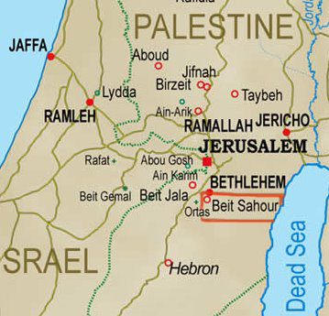
A place where or near where these shepherds might have been.
Thus, the reason that the angel went to the shepherds first was to fulfill the prophesy of Micah 4:8.
According to Micah 4:8, the Messiah would first be revealed at Migdal-eder, the “tower of the Flock” (cf. Gen. 35-21)
Tradition identifies Migdal-eder with a shepherds’ village just outside of Bethlehem called Beit Sahour.
Vigil of The Epiphany
Addendum (The Shepherds)

Slide 20
I. The Birth and Early Years of our Lord (Ch. 1-2)
A. Genealogy (1:1-17) (Jan 5)
B. Birth (1:18 – 2:12) (taught during Dec)
C. His Sojourn in Egypt (2:13-23) (taught during Dec)
II. The Lord’s Ministry Begins (3:1 – 4:11)
A. His Forerunner (3:1-12) (Jan 12)
B. His Baptism (3:13-17) (Jan 19)
C. His Temptation (4:1-11) (Jan 26)
III. The Lord’s Ministry in Galilee (4:12 – 14:12)
A. The Beginning of His Galilean Ministry (4:12-25) (Feb 2)
B. First Discourse: The Sermon on the Mount – Ch 5 (Feb 9)
C. First Discourse: The Sermon on the Mount – Ch 6 (Feb 16)
D. First Discourse: The Sermon on the Mount – Ch 7 (Feb 23)
Vigil of The Epiphany
Our Outline of St. Matthew

Slide 21
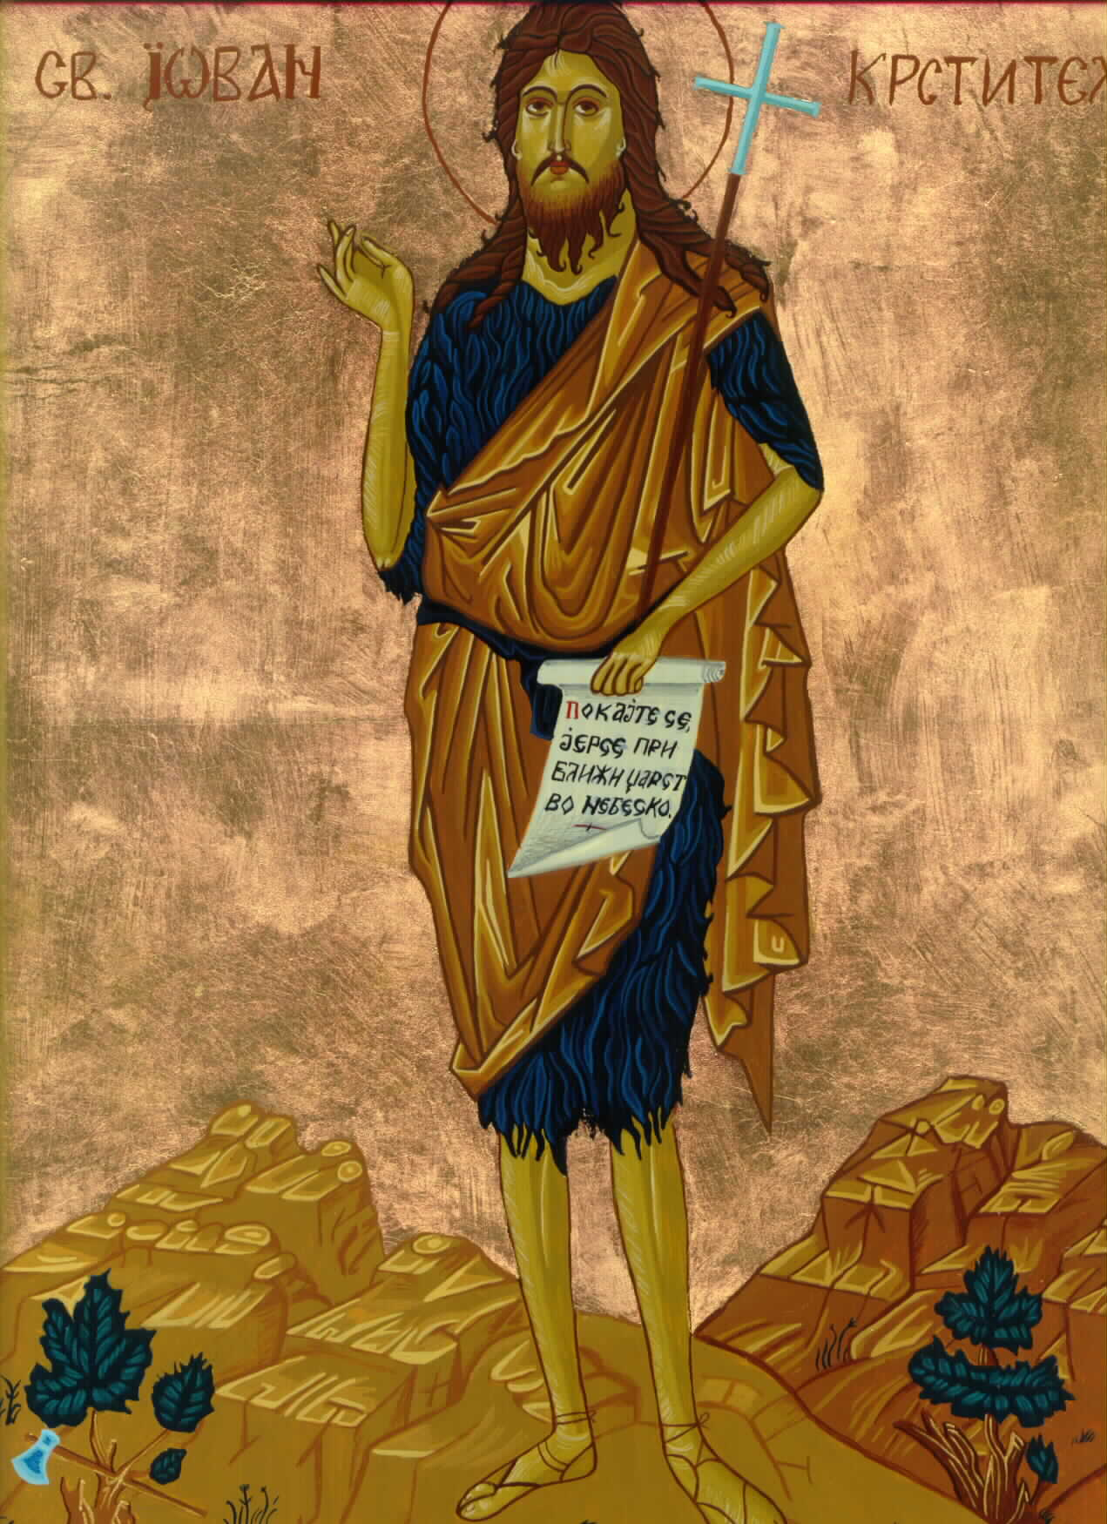
St.
Matthew
3:1-12
Next Week
His Forerunner

