Slide 1
The Gospel According to St. Matthew
Christmas I
INTRODUCTION

Slide 2
The church has always attributed the first Gospel to St. Matthew, also called Levi, one of Jesus’ twelve disciples who was called from collecting taxes to follow Jesus (cf. St. Matthew 9:9-13; St. Mark 2:13-17; St. Luke 5:27-32). After the first six disciples (Andrew, Peter, James and John, Philip and Nathanael), Matthew’s call is the only one recounted in the Gospels.
St. Matthew
The Author

Slide 3
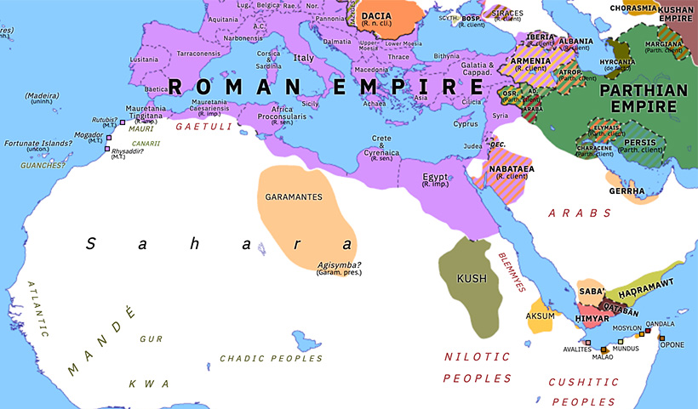
Matthew’s grasp of the depth of the Lord’s mercy can be traced back to his calling, when Jesus said, “For I did not come to call the righteous, but sinners, to repentance” ^{(St. Matthew 9:13)}. Matthew’s apostolic works are know only through the tradition of the church, which says that he remained, for a while, in Palestine preaching to the Jews, and then traveled (according to different traditions) to Ethiopia (Aksum).
St. Matthew
The Author

Slide 4
The date of the Gospel is derived from these three indicators:
Matthew 28:15 “to this day,” indicates that some time had passed between the events of Jesus’ death and resurrection and the writing of the Gospel, dating it after the Lord’s resurrection (33 A.D.).
2) In 24:1-2, Jesus predicts the total destruction of Jerusalem and the Temple, an event which occurred in 70 A.D., which Matthew does not address.
3) The early church has always considered this Gospel to be written from Palestine, probably in Jerusalem, by St. Matthew, circa. 55 to 60 A.D. The dating, though a historical question, does not, however, affect its apostolic authorship.
St. Matthew
Date

Slide 5
Eusebius, a church historian writing between 303 and 337, states that St. Matthew wrote the Gospel when he was preparing to leave Palestine and travel abroad:
“Nevertheless, of all the disciples of the Lord, only Matthew and John have left us written memorials, and they, tradition says, were led to write only under pressure of necessity. For Matthew, who had at first preached to the Hebrews, when he was about to go to other peoples, committed his Gospel to writing in his native tongue (Aramaic ), and thus compensated those whom he was obliged to leave for the loss of his presence.” [Eusebius, Church History, III.24.6-7]
St. Matthew
Language

Slide 6
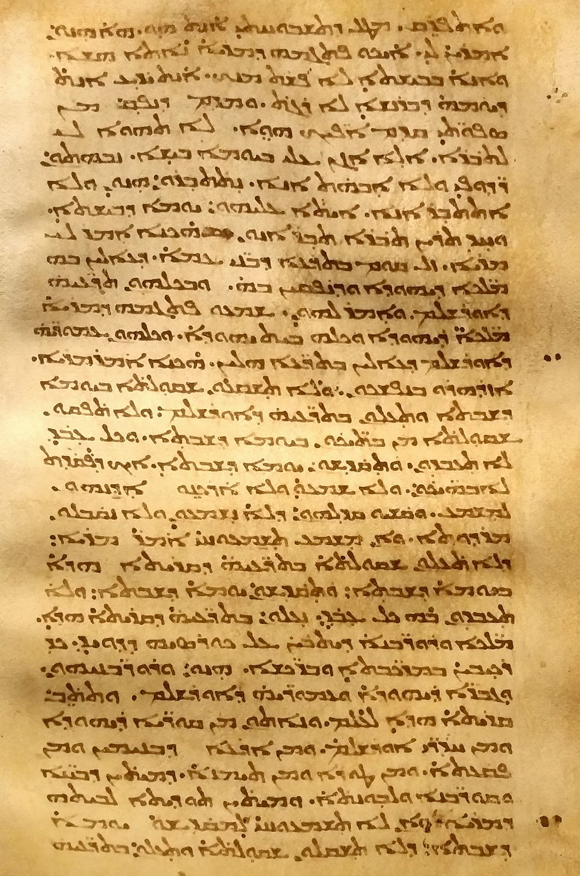
Even if it was not written
in Aramaic, the Gospel
according to St. Matthew
does have very Jewish
flavor, rooted in the life
and traditions of
Palestine. It is with
confidence, then, that
we can state that the
Gospel of St. Matthew
was composed in
Jerusalem or the
surrounding area.
St. Matthew
Language

Slide 7
St Matthew’s purpose in writing this Gospel is, like all of the Evangelists, to set before all the Good News of Jesus Christ Who came to die, to atone for sin, and save and deliver all mankind.
“And truly Jesus did many other signs in the presence of His disciples, which are not written in this book; but these are written that you may believe that Jesus is the Christ, the Son of God, and that believing you may have life in His name” ^{(St. John 20:30-31)}.
St. Matthew
Purpose

Slide 8
There are a few emphases that are unique to St. Matthew; for example, he focuses on Jesus as the prophesied Messiah. There are at least 62 quotations of the OT, more than any other NT book (besides Romans, which has 66). Also, the genealogy, which we will study next week, serves as an introduction to the Gospel and intends to connect Jesus with the history of the OT, which is nothing more than the history of the promise of the Gospel. This strong connection to the OT fits well with the ancient understanding of the context of the writing (cf. the previous Eusebius quotation), that St. Matthew was writing for the churches in Jerusalem and Palestine.
St. Matthew
Purpose

Slide 9
St. Matthew was, like all of the prophets and apostles who composed the Holy Scriptures, inspired by the Holy Spirit, and that the very words that he wrote were given to him by the Holy Spirit (verbal and plenary inspiration of the Scriptures, 2 Tim. 3:16-17). Jesus is pleased to build His church on the teachings of the prophets and His apostles.
“Now, therefore, you are no longer strangers and foreigners, but fellow citizens with the saints of God, having been build on the foundation of the apostles and prophets, Jesus Christ Himself being the chief cornerstone, in whom the whole building, being joined together, grows into a holy temple in the Lord, in whom you also are being built together for a habitation of God in the Spirit” ^{(Eph. 2:19-22)}.
St. Matthew
Purpose

Slide 10
St. Matthew arranged this narrative in a very artistic way and it is woven around five discourses:
1. Chapters 5-7 (The Sermon on the Mount);
2. Chapter 9:35 – 11:1 (Apostolic Ministry);
3. Chapter 12:46 – 13:53 (The Parables);
4. Chapter 18:1 – 19:1 (Casuistry);
5. Chapters 23:1 – 26:1 (The End Times).
This method is clear as Matthew ends each discourse with, “When Jesus had finished…,” or a similar statement (cf. 7:28; 11:1; 13:53; 19:1; 26:1). Between each discourse are narrative sections that appropriately lead into the ensuing discourse section. Chapters 1 and 2 are the prologue and Matthew ends the Gospel with a very challenging epilogue (28:16-20).
St. Matthew
Structure

Slide 11
The method of this Study will follow Matthew’s style; therefore, this teaching outline is submitted as our guide through Feb 2025:
I. The Birth and Early Years of our Lord (Ch. 1-2)
A. Genealogy (1:1-17) (Jan 5)
B. Birth (1:18 – 2:12) (taught during Dec)
C. His Sojourn in Egypt (2:13-23) (taught during Dec)
II. The Lord’s Ministry Begins (3:1 – 4:11)
A. His Forerunner (3:1-12) (Jan 12)
B. His Baptism (3:13-17) (Jan 19)
C. His Temptation (4:1-11) (Jan 26)
III. The Lord’s Ministry in Galilee (4:12 – 14:12)
A. The Beginning of His Galilean Ministry (4:12-25) (Feb 2)
B. First Discourse: The Sermon on the Mount – Ch 5 (Feb 9)
C. First Discourse: The Sermon on the Mount – Ch 6 (Feb 16)
D. First Discourse: The Sermon on the Mount – Ch 7 (Feb 23)
This outline will expand as we reach successive narratives and discourses in St. Matthew.
St. Matthew
Structure

Slide 12
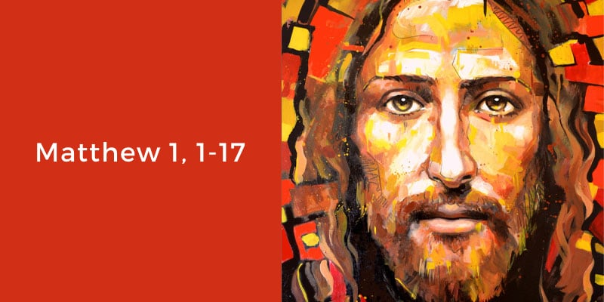
Next Week
The Genealogy of Our Lord Jesus

