Slide 1
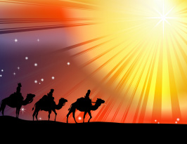
Harmonization of the Matthean and Lukan Infancy Narratives¹
Matthew Luke
2 2
¹Gibbs, Jeffrey A. Matthew 1:1 – 11:1. Concordia Commentary. St. Louis: Concordia Publishing House, 2006, p. 150.

Slide 2
Harmonization of the Matthean and Lukan Infancy Narratives
The harmonization of the infancy narratives of our Lord Jesus in the Gospels according to St. Matthew and St. Luke have proven to be difficult; but, not impossible! Since only Matthew and Luke have the infancy narratives we will give a “chronological” layout, according to each Gospel and then suggest to you the best possible solution.

Slide 3
Harmonization of the Matthean and Lukan Infancy Narratives
So let’s “set the stage!” First, we know from St. Luke (1: 26-27, 56; and 2:4) that Joseph and Mary are living in Nazareth. An Augustan decree of 8 B.C. ordered a census and tax (the vicesima hereditatium and the centesima rerum venalium) of the Roman world. At some specified time, Joseph and Mary travel to Bethlehem (Luke 2:1-4) since Joseph is a direct descendant of King David (and Mary is also!).

Slide 4
Harmonization of the Matthean and Lukan Infancy Narratives
We do not know the “exact” time that Joseph and Mary travelled to Bethlehem. Note that St. Luke does not say that Jesus was born as soon as they arrived or even soon afterwards (cf. 2:6)!
Then comes St. Matthew’s narrative. It’s very selective history; yet, it is a history that we must examine!

Slide 5
Harmonization of the Matthean and Lukan Infancy Narratives
Yes, attempting to integrate every event in St. Matthew 2 and St. Luke 2 will result in difficulty. One major “issue” concerns the “supernatural” star that guided the Magi – was it to Bethlehem or to Nazareth? We will explore this and come to a conclusion as Scripture interprets Scripture!

Slide 6
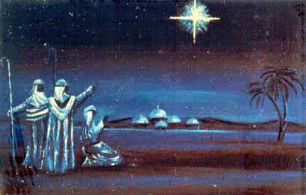
Harmonization of the Matthean and Lukan Infancy Narratives
The Magi see the star that signals the birth of the “King of the Jews!”
Text: St. Matthew 2:2

Slide 7
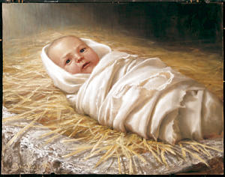
Harmonization of the Matthean and Lukan Infancy Narratives
2. Jesus is born in Bethlehem.
Text: St. Luke 2:1-7

Slide 8
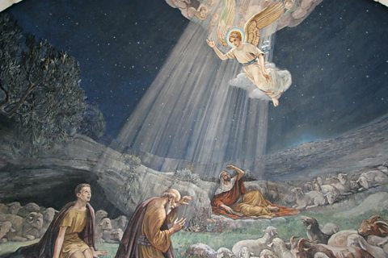
Harmonization of the Matthean and Lukan Infancy Narratives
3. An Angel (Gabriel (?)) announces Jesus’ birth to shepherds; they hurry to see the child lying in a manger.
Text: St. Luke 2:8-20

Slide 9
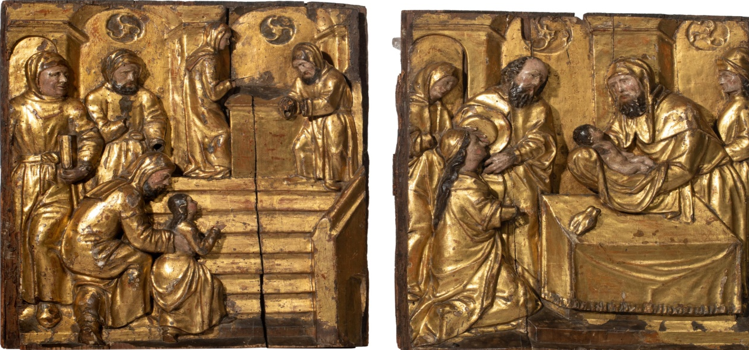
Harmonization of the Matthean and Lukan Infancy Narratives
4. On the Eighth day, Jesus is circumcised. Mary’s purification and our Lord’s presentation happens on the fortieth day after His birth (Feb 2). Simeon and Anna praise God for His birth. The holy Family departs for Nazareth!
Text: St. Luke 2:21-39

Slide 10
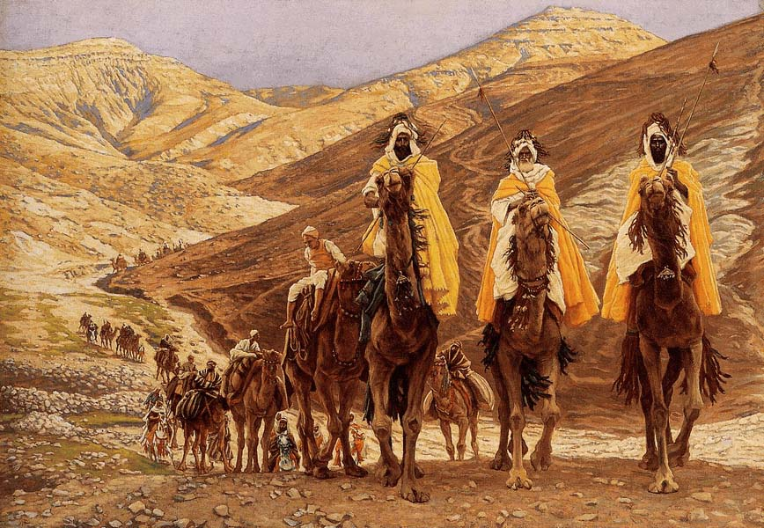
Harmonization of the Matthean and Lukan Infancy Narratives
5. The Magi arrive in Jerusalem some months later (exact time is unknown) and inquire about the “King of the Jews” who has been born.
Text: St. Matthew 2:1-8

Slide 11
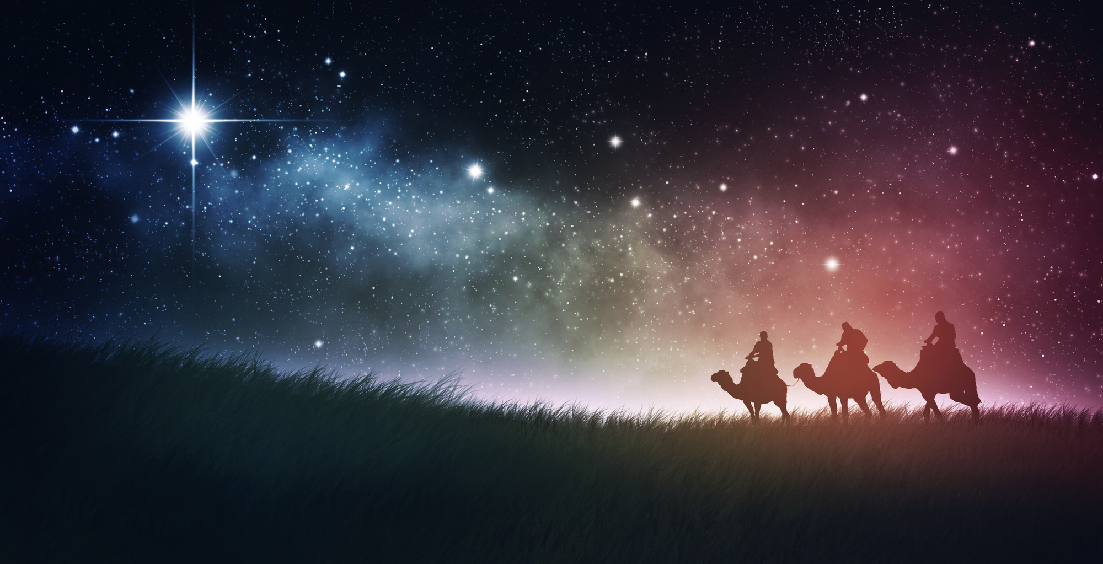
Harmonization of the Matthean and Lukan Infancy Narratives
6. A “supernatural” star guides the Magi to where Jesus is! They show reverence to Him. Then, warned by an angel not to return to Herod, they depart for their country by another route.
Text: St. Matthew 2:9-12

Slide 12
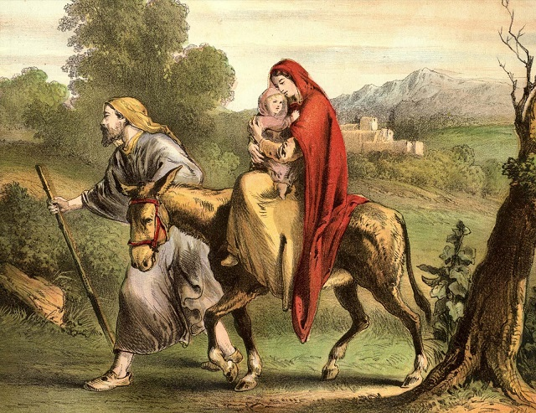
Harmonization of the Matthean and Lukan Infancy Narratives
7. An angel (Gabriel (?)) warns Joseph to flee to Egypt. The holy Family goes down to Egypt.
Text: St. Matthew 2:13-15

Slide 13
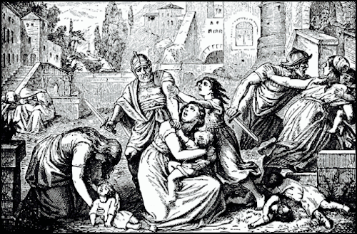
Harmonization of the Matthean and Lukan Infancy Narratives
8. Herod, realizing he has been deceived by the Magi, orders the slaughter of Bethlehem’s male children two years and under.
Text: St. Matthew 2:16-18

Slide 14
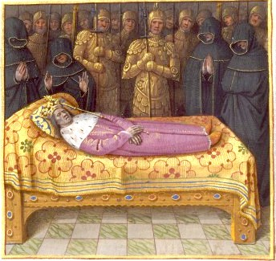
Harmonization of the Matthean and Lukan Infancy Narratives
9. Herod dies (early 1 BC). Archelaus succeeds Herod as ruler of Judea.
Text: St. Matthew 2:19-22

Slide 15
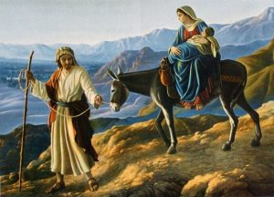
Harmonization of the Matthean and Lukan Infancy Narratives
10. Joseph and his family returns to Israel but Joseph “…was afraid to go there [Judea],” so he travels back to Nazareth (Galilee) (fulfilling prophecy).
Text: St. Matthew 2:21-23

Slide 16
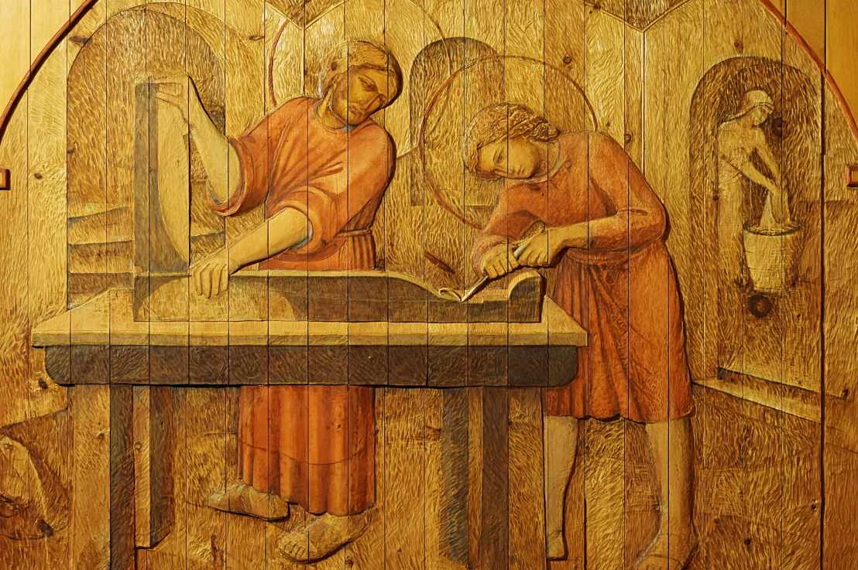
Harmonization of the Matthean and Lukan Infancy Narratives
11. Living in Nazareth, Jesus grows in wisdom and stature.
Text: St. Luke 2:40
Stephen Foster / The Childhood of Christ / Wood-carving / 1995

