Slide 1
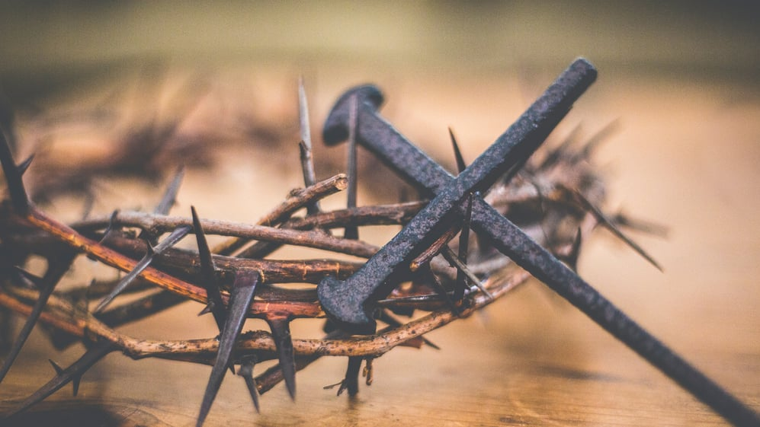
The Doctrine of Justification
CONSEQUENCES
Of the
Doctrine of Justification
The Chief Article of Our Faith

Slide 2
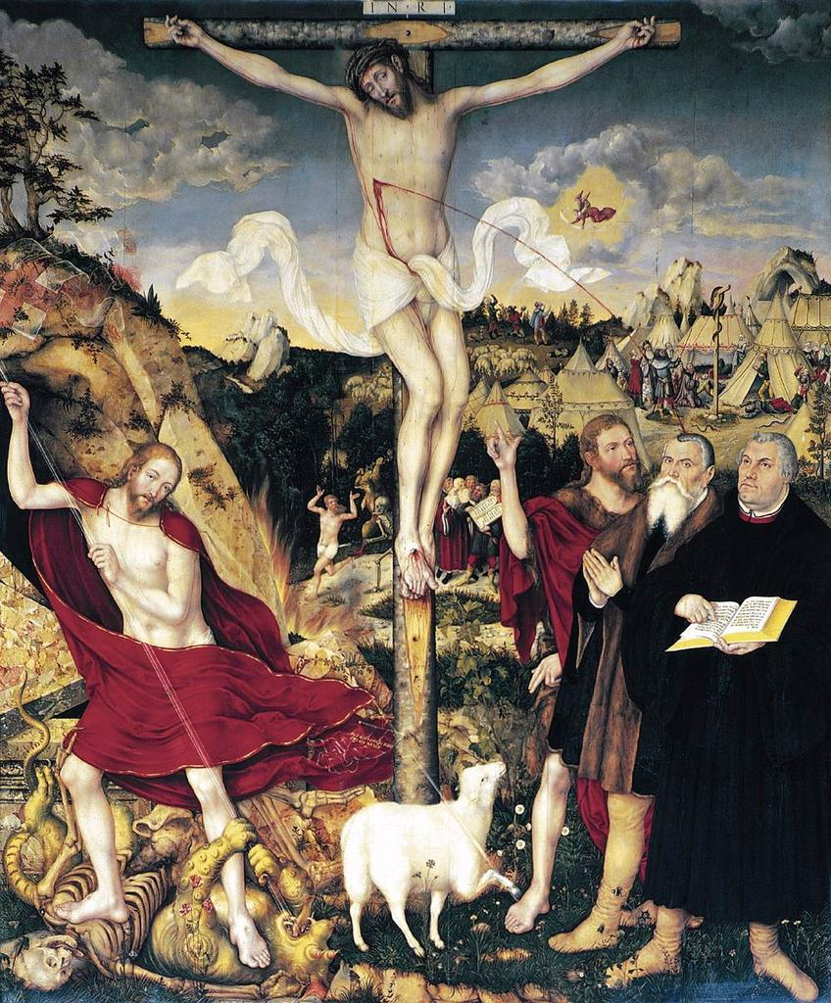
The Doctrine of Justification
SPIRITUAL BLESSINGS
Romans 5:1-5 and 1 Corinthians 3:21
Any conception of a limited atonement – contending that Jesus only died for and has justified some sinners – renders an empty Gospel. A limited view of the atonement removes confidence in the forgiveness of sins, not simply for some, but for all sinners. Such a view declares that only some are justified and turns the Gospel into a provisional message: God may have forgiven your sins because He may have sent Jesus to die for you, because He may have created in you a divine faith rather than a human faith, because he may have elected you unto salvation.
The Chief Article of Our Faith

Slide 3
The Doctrine of Justification
The Biblical Witness is that God, in Christ Jesus, has been reconciled to all sinners and He has declared them righteous, forgiving all their sins. The Gospel proclaims this reality to all sinners. Therefore, let’s read, again, 2 Cor.5:19, Acts 16:30-31, and Eph 2:8-10.
Only the unconditional Word of justification can give comfort and consolation to every sinner loaded down with guilt and fear. Assurance of forgiveness lies in the objective Word of the Gospel so that what the sinner hears is what the sinner gets! In the proclaimed Gospel, faith is exhorted and in the teaching of the Gospel we teach about faith as a gift of the Holy Spirit by which we receive and live with God’s justified verdict - the righteousness of Christ, the forgiveness of sins, the favor of God, etc.; and are so saved!
The Chief Article of Our Faith

Slide 4
The Doctrine of Justification
Therefore, as the Biblical Witness clearly teaches, you are an HEIR OF GOD and a JOINT HEIR WITH CHRIST JESUS!
(Rom 8:16, 17) – “The Spirit Himself bears witness with our spirit that we are children of God, and if children, then heirs—heirs of God and joint heirs with Christ, if indeed we suffer with Him, that we may also be glorified together.”
You, as an heir, wear the colors of your King! Luther aptly calls the cross of Christ, “the marks of Christ, which are not painted on the wall, but are branded in the flesh and blood of the Christians” ^{(Pieper, III, p.72)}.
The Chief Article of Our Faith

Slide 5
The Doctrine of Justification
Thusly, as an heir, your are not lacking ANY spiritual gift! Let’s review:
1 Cor 1:4-7
Eph 1:3-8
As an heir, you are NO LONGER UNDER WRATH - Eph 2:1-3
You are AT PEACE WITH GOD - Rom 5:1
The Chief Article of Our Faith

Slide 6
The Doctrine of Justification
Another Spiritual Blessing is that you have been shown DIVINE GRACE and, as an heir, you have the gift of ETERNAL SALVATION!
1. Romans 5:12
2. Certainty of Grace
a. The Blessed Assurance
i. Holy Baptism
ii. The Lord’s Supper
iii. Romans 8:37-39
The Chief Article of Our Faith

Slide 7
The Doctrine of Justification
II. THE DOCTRINAL WITNESS
There is comfort and consolation for the baptized and the un-baptized only in the Holy Gospel that proclaims the unconditional justification of the sinner for the sake of the Crucified Christ. It isn’t dependent on any of your decisions, commitments, prayers, or feelings!
“Toward forgiveness is directed everything that is to be preached concerning the sacraments and, in short, the entire Gospel and all the duties of Christianity. Forgiveness is needed constantly, for although God’s grace has been won by Christ, and holiness has been wrought by the Holy Spirit through God’s Word in the unity of the Christian Church, yet because we are encumbered with our flesh we are never without sin” ^{(Tappert, LC, Creed, 54)}.
The Chief Article of Our Faith

Slide 8
The Doctrine of Justification
III. FOR YOUR CONSIDERATION
The Gospel proclaims the justification of all sinners as a past event, revealed as a present reality, and bestowed unconditionally.
We need to preach and teach that God justifies sinners unto faith by the work of the Holy Spirit, not in view of faith or because of faith. We need also to teach justification by faith apart from works; yet, also apart from experience. The fallen world around us and the blade of the law will color much of our experience of our life in Christ before the Great Day. Our comfort is in the saving Word given to faith, not our experience of faith.
The Chief Article of Our Faith

Slide 9
The Doctrine of Justification
III. FOR YOUR CONSIDERATION
God’s Word of Pardon is very powerful. It’s impact creates, sustains, and matures faith and life in Christ and empowers all works that serve Christ in our vocations. God’s justification sanctifies the believer - all part and parcel of God’s monergistic salvation of the sinner! Exhorting good works does not produce or increase them. They are empowered and increased only by the continual impact of the Gospel as you live and grow in Christ.
Justification and sanctification are articles of faith. They are God’s secrets held in Heaven, yet revealed and bestowed in Divine Service as He nurtures you with His Means of Grace. All comfort and consolation come to you from Him through these mysteries that have been entrusted to Servants of His Word. You, the baptized, have it all!
The Chief Article of Our Faith

Slide 10
Reformation Study
“So if the son sets you free, you will be free indeed.”
ST. JOHN 8:31-36

