Slide 1
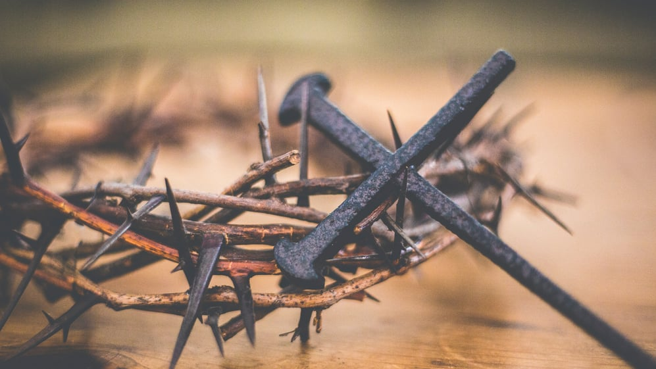
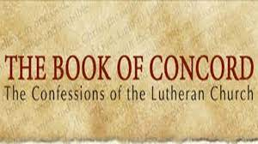
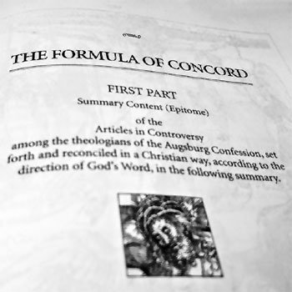
The Doctrine of Justification
DOCTRINAL WITNESSES!
The Chief Article of Our Faith

Slide 2
The Doctrine of Justification
As we begin looking at the Doctrinal Witnesses
from our Lutheran Reformers’ point-of-view, let’s
review by beginning with the Apology to the
Augsburg Confession (1531). The Apology was
written to defend their positions against the
Pontifical Confutation (Charles V’s response to
the Augsburg Confession).
The Apology of the Augsburg Confession is the longest and most detailed confession in the Book of Concord. The driving force in the Apology is the repeated insistence that the most important and comforting teaching in God’s Word is Justification by Grace Alone!
The Chief Article of Our Faith

Slide 3
The Doctrine of Justification
“The law would seem to be harmful since it has made all men sinners, but when the Lord came he forgave all men the sin that none could escape and by shedding His blood canceled the bond that stood against us (Col. 2:14). . . . For after the whole world was subjected, He took away the sin of the whole world, as John testified when he said (John 1:29), ‘Behold the Lamb of God, who takes away the sin of the world!’” ^{[Tappert, Apology IV: 103]}
How does the reality He forgave all men effect how the Gospel is to be rightly taught and applied?
For those who may express alarm that they do not feel that God has actually forgiven them some particular vexing sins, how does continual teaching about this understanding of justification provide comfort and assurance?
The Chief Article of Our Faith

Slide 4
The Doctrine of Justification
Our life on earth continues to be punctuated by sinful wretchedness from within and without. Externally, trial and tribulation visits us in this fallen world. God also hammers us with His Law, internally, as it has been inscribed on our hearts. This is life under the cross of the justified sinner! Yet, we know that soon our better day of glory is to come with our Lord’s return!
Justification renders a Divine Citizenship along with all of God’s saving gifts and blessings of salvation in, with, and under our temporal citizenship and all that its fallen character can bring us.
The Chief Article of Our Faith

Slide 5
The Doctrine of Justification
“Faith alone justifies because we receive the forgiveness of sins and the Holy Spirit by faith alone. The reconciled are accounted righteous and children of God not on account of their own purity but by mercy on account of Christ, if they grasp this mercy by faith. We shall therefore add clear testimonies stating that faith is the very righteousness by which we are accounted righteous before God. This is not because it is a work worthy in itself, but because it receives God’s promise that for Christ’s sake He wishes to be propitious to believers in Christ and because it believes that ‘God made Christ our wisdom, our righteousness and sanctification and redemption’ (I Cor. 1:30).” ^{[Tappert, Apology IV 86]}
The Chief Article of Our Faith

Slide 6
The Doctrine of Justification
In light of the justification of all sinners in the cross of Christ, what kind of language can best clarify the role of faith so that it is not seen either as a work or a condition for forgiveness?
Faith must never be presented as a work or a virtue that God demands in order to be forgiven, as if God were saying, “I have some forgiveness for those who can muster some good believing in me!” The Holy Gospel proclaims God’s declaration of the sinner being righteous for the sake of Christ! The Holy Gospel exhorts faith, but not as a condition to be forgiven; rather, as the means by which you receive and live with it. Moreover, Lutheran’s also teach that saving faith is also a gift of God.
The Chief Article of Our Faith

Slide 7
The Doctrine of Justification
Now we move to another one of the confessions within the Book of Concord: The Smalcald Articles of 1537. This document is a summary of Lutheran doctrine, written by Martin Luther in 1537 for a meeting of the Schmalkaldic League in preparation for an intended ecumenical Council of the Church. Luther’s patron, Elector John Frederick of Saxony, asked him to prepare these articles for the League’s meeting in 1537, held again in Schmalkalden. The League had been organized in 1531 as a union of various Lutheran territories and cities, to provide a united military and political front against Roman Catholic politicians and armies, led by Emperor Charles V.
The Chief Article of Our Faith

Slide 8
The Doctrine of Justification
Just before the Schmalkaldic League met, Luther became very ill with a severe case of kidney stones and was unable to attend the meeting. The league ultimately determined not to adopt the articles Luther had written. They were influenced not to adopt the Smalcald Articles by Melanchthon, who was concerned that Luther’s writing would be regarded as divisive by some. Melanchthon was asked to write a clear statement on the Papacy and this he did, a document that was adopted at the meeting as the Treatise on the Power and Primacy of the Pope. The Smalcald Articles, though they were not adopted at the meeting of the Schmalkaldic League, were widely used and were incorporated into the Book of Concord in 1580.
The Chief Article of Our Faith

Slide 9
The Doctrine of Justification
4] Now, since it is necessary to believe this, and it cannot be otherwise acquired or apprehended by any work, law, or merit, it is clear and certain that this faith alone justifies us as St. Paul says, Rom. 3:28: For we conclude that a man is justified by faith, without the deeds of the Law. Likewise 3:26: That He might be just, and the Justifier of him which believeth in Christ.
5] Of this article nothing can be yielded or surrendered [nor can anything be granted or permitted contrary to the same], even though heaven and earth, and whatever will not abide, should sink to ruin. For there is none other name under heaven, given among men whereby we must be saved, says Peter, Acts 4:12. And with His stripes we are healed, Is. 53:5. And upon this article all things depend which we teach and practice in opposition to the Pope, the devil, and the world. Therefore, we must be sure concerning this doctrine, and not doubt; for otherwise all is lost, and the Pope and devil and all things gain the victory and suit over us.
The Chief Article of Our Faith

Slide 10
The Doctrine of Justification
Following Luther, in 1578, Jacob Andreae prepared articles in the Formula of Concord (the Epitome and Solid Declaration). This confession was written to combat major arguments between the Philippists and Gnesio-Lutherans. A third group arose during this time and quelled the controversies by preparing the Formula of Concord, primarily written by Andreae and Martin Chemitz (aka “The Second Martin”).
The primary focus of the Formula of Concord was to encourage all Lutherans to stick to the pattern of sound doctrine and refrain from introducing novel way of speaking about Biblical teachings. Thus, on June 25, 1580, the Formula was published in Dresden (and note that it is exactly Fifty years to the date of the reading of the Augsburg Confession!).
The Chief Article of Our Faith

Slide 11
The Doctrine of Justification
“…it is the obedience of the entire person, therefore it is a perfect satisfaction and reconciliation of the human race, since it satisfied the eternal and immutable righteousness of God revealed in the law. This obedience is our righteousness which avails before God and is revealed in the Gospel upon which faith depends before God and which God reckons to faith….” ^{[Tappert, FCSD III, 57]}
It is a fiction that hell is a place where God’s justice is meted out against unrepentant sinners. He already executed His justice against all evil and evil doers onto His Son on the cross. Jesus died for all, not simply the repentant. Here we part serious company with the Reformed who champion a limited atonement on the cross. All in hell are both forgiven and justified. They just insist on living separated from these realities and the Author of them. Hell, then, is populated with all who insist on their rights and what they deserve…of which, they are willing to die (spiritually) for it!
The Chief Article of Our Faith

Slide 12
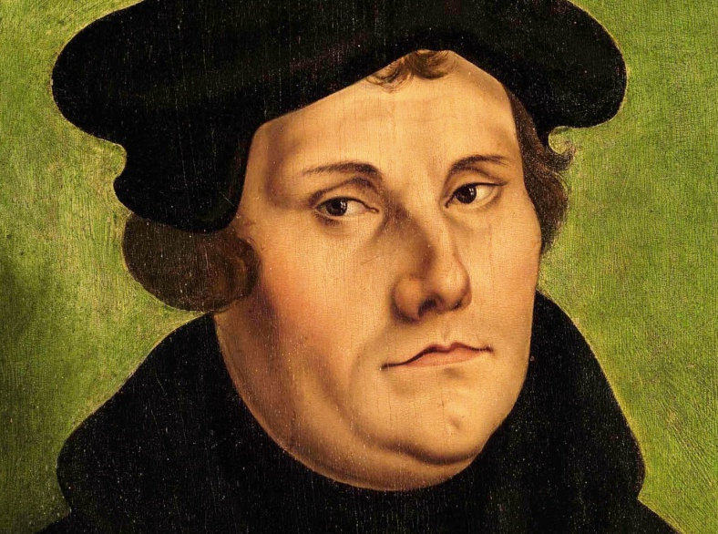
The Doctrine of Justification
So let’s close this morning with words, again, from Luther:
“If this only article [Article of Justification] remains true on the battlefield, the Christian Church also remains pure and in joyous harmony and without sects.” And, “Those who repudiate this article are outside of the church.”
The Chief Article of Our Faith

Slide 13
The Doctrine of Justification
Thus, we as Lutherans, confess:
“I believe in Jesus Christ, His only Son, our Lord...”
What does this mean?
“I believe that Jesus Christ, true God, begotten of the Father from eternity, and also true man, born of the virgin Mary, is my Lord. He has redeemed me, a lost and condemned creature, purchased and won me from all sins, from death and from the power of the devil, not with gold or silver, but with his holy, precious blood and with his innocent suffering and death. All this he did that I should be his own, and live under him in his kingdom, and serve him in everlasting righteousness, innocence and blessedness, just as he has risen from death and lives and rules eternally. This is most certainly true.”
The Chief Article of Our Faith

Slide 14
The Doctrine of Justification
CONSEQUENCES
Of the
Doctrine of Justification
The Chief Article of Our Faith

