Slide 1
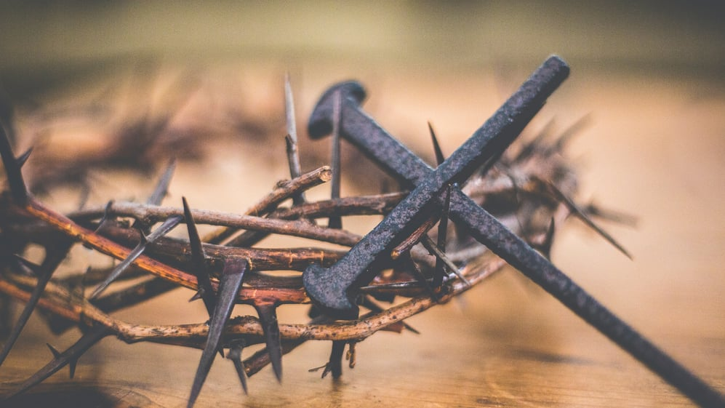
The Doctrine of Justification
The Chief Article of Our Faith

Slide 2
The Doctrine of Justification
For many Christians, justification is understood as a singular pronouncement that happens when you “get saved” at the beginning of your life in Christ. The dominate focus of the Christian life then turns to sanctification. The astonishing reality that our Lord and Redeemer pardons wretched sinners fades into the background of daily Christian concern as attention turns to greater obedience to the Law and gaining a victory over sinful habits of life. Sadly, this understanding produces spiritual burnout and a horrible sense of failure.
The Chief Article of Our Faith

Slide 3
The Doctrine of Justification
Therefore, the purpose of our study of the Doctrine of Justification is to teach you, otherwise, about God’s justification of sinners and how He sanctifies believers (you!). Faith is to be anchored completely in the external Word of promise, not in anything that you may experience in your life in Christ Jesus! You are justified by grace through faith alone, apart from your experience!
You must be honest, your experience in this life continues to be punctuated by sinful wretchedness from within and without!
The Chief Article of Our Faith

Slide 4
The Doctrine of Justification
For this reason, while you are completely justified in your Baptism, you continually are in need of God’s justification for your sanctification - that your faith and life in Christ may not die, but grow and mature. Indeed, it is the saving Word of justification that continually sanctifies the Christian as a life-long renewing work.
The Chief Article of Our Faith

Slide 5
The Doctrine of Justification
So then, where do we begin? We will start this very important study by looking at this doctrine from God’s Holy Word; then from our Lutheran Confessions; followed by a discussion on Limited Atonement (?); and we’ll conclude on how this Chief Article provides you with great comfort and consolation!
We begin with The Scriptural Witness!
The Chief Article of Our Faith

Slide 6
The Doctrine of Justification
As a starting point, Luther and the Lutheran fathers understood as virtual synonyms of justification:
1. The Forgiveness of Sins;
2. The Righteousness of God (aka
righteousness of Christ and righteousness of
faith);
3. The Favor of God; and,
4. Reconciliation.
As our study continues, we will clarify important aspects of justification and how they relate to your sanctification.
The Chief Article of Our Faith

Slide 7
The Doctrine of Justification
We will also explore Biblical answers to these questions:
1. How was this saving work accomplished and its gifts appropriated by God?
2. Where are these gifts revealed and bestowed on individual sinners?
3. And how does the individual sinner receive, live, and grow with them?
The Chief Article of Our Faith

Slide 8
The Doctrine of Justification
Let’s begin…where we left off…in Romans!
*1. (Romans 5:18) “Therefore, as through one man’s offense judgment came to all men, resulting in condemnation, even so through one Man’s righteous act the free gift came to all men, resulting in justification of life.”
2. (II Corinthians 5:18, 19) “Now all things are of God, who has reconciled us to Himself through Jesus Christ, and has given us the ministry of reconciliation, that is, that God was in Christ reconciling the world to Himself, not imputing their trespasses to them, and has committed to us the word of reconciliation.”
3. (St. John 1:29) “The next day John saw Jesus coming toward him, and said, “Behold! The Lamb of God who takes away the sin of the world!”
*All Biblical Texts from the New King James Version
The Chief Article of Our Faith

Slide 9
The Doctrine of Justification
What is the one act of righteousness?
Note how the non-imputation of sin (judicial focus) is connected with God’s reconciliation (a relational focus).
What are the terms that Paul equates with justification in the Corinthian passage and how does each passage clarify those for whom Christ has already justified?
Notice the parallel in John 1:29 expressing the sins of the world.
The Chief Article of Our Faith

Slide 10
The Doctrine of Justification
Notice how justification, reconciliation, and the forgiveness of sins are presented by Paul as objective existing realities in the cross of Christ for all men.
When we proclaim God’s justification of the sinner, we proclaim the objective reality of an existing verdict!
God declares to the sinner, you are righteous - not you can be righteous, if . . . or you will be righteous when…!
With God’s justice in the cross of Christ, everyone gets what they do not deserve!
The Chief Article of Our Faith

Slide 11
The Doctrine of Justification
The Scriptural Witness continued:
(Romans 1:16, 17) “For I am not ashamed of the gospel of Christ, for it is the power of God to salvation for everyone who believes, for the Jew first and also for the Greek. For in it the righteousness of God is revealed from faith to faith; as it is written, ‘The just shall live by faith.’”
(Romans 3:21-26) “But now the righteousness of God apart from the law is revealed, being witnessed by the Law and the Prophets, even the righteousness of God, through faith in Jesus Christ, to all and on all who believe. For there is no difference; for all have sinned and fall short of the glory of God, being justified freely by His grace through the redemption that is in Christ Jesus, whom God set forth as a propitiation by His blood, through faith, to demonstrate His righteousness, because in His forbearance God had passed over the sins that were previously committed, to demonstrate at the present time His righteousness, that He might be just and the justifier of the one who has faith in Jesus.”
The Chief Article of Our Faith

Slide 12
The Doctrine of Justification
Where does Paul indicate the righteousness of God is made known?
Note how Paul interrelates the righteousness of God, the propitiation of sin by Christ, and justification!
There are two different means of discourse that God uses in the Gospel to reveal and bestow His gift of justification.
1. The didactic or informational means that informs about Christ’s saving work and that God forgives sinners for His sake.
2. The prophetic or personal voice that pronounces the forgiveness of sins as a personal address from God. This voice employs I-you language. In Holy Absolution, God personally addresses you, a sinner, with His declaration of righteousness. He personally bestows the forgiveness of sins on you!
The Chief Article of Our Faith

Slide 13
The Doctrine of Justification
The Scriptural Witness continued:
6. (Gal 2:16) “…knowing that a man is not justified by the works of the law but by faith in Jesus Christ, even we have believed in Christ Jesus, that we might be justified by faith in Christ and not by the works of the law; for by the works of the law no flesh shall be justified.’”
(Eph 2:8) “For by grace you have been saved through faith, and that not of yourselves; it is the gift of God…, ”
How would you explain the role of faith in God’s justification of the sinner?
How should the prepositions by and through [faith] be described when explaining the relationship between the saving grace of God’s justification of the sinner and faith?
The Chief Article of Our Faith

Slide 14
The Doctrine of Justification
Faith receives an objective, existing forgiveness of sin and righteousness of Christ, whereby the reckoning of God becomes a received reckoning by trust in God’s Word and Work!
By the power of the Gospel, the reconciling God reconciles sinners to Himself creating a saved relationship. Faith receives the saving gifts; it does not create or cause them. You are justified by grace through faith, not because of faith or in view of faith.
The Chief Article of Our Faith

Slide 15
The Doctrine of Justification
The Scriptural Witness continued:
6. (2 Cor. 5:17, 18) “Therefore, if anyone is in Christ, he is a new creation; old things have passed away; behold, all things have become new. Now all things are of God, who has reconciled us to Himself through Jesus Christ, and has given us the ministry of reconciliation.”
(Rom 6:11, 18, 22) ¹¹“Likewise you also, reckon yourselves to be dead indeed to sin, but alive to God in Christ Jesus our Lord.” ¹⁸“And having been set free from sin, you became slaves of righteousness.” ²²“But now having been set free from sin, and having become slaves of God, you have your fruit to holiness, and the end, everlasting life.”
How does St. Paul describe what it means to be a new creation in Christ? How did this come about?
The Chief Article of Our Faith

Slide 16
The Doctrine of Justification
The power of God (Rom 1:16) is the Word of God’s gracious pardon! The righteousness of Christ that justifies also sanctifies. The power of the Gospel that bestows the righteousness of Christ also creates and empowers a new life in Christ. As the Spirit works through the Gospel, the powerful pardon creates a new life in Christ, matures that life, and empowers faithful living. This is sanctification! It is not a separate work of God from justification. Rather, both are two Divine Works of how God saves sinners. Justification is to life in Christ as sanctification is to growth in Christ. All of this is what “getting saved” is all about in Eph 2:8.
The Chief Article of Our Faith

Slide 17
The Doctrine of Justification
The Scriptural Witness continued:
8. (Eph 4:13-15) “…till we all come to the unity of the faith and of the knowledge of the Son of God, to a perfect man, to the measure of the stature of the fullness of Christ; that we should no longer be children, tossed to and fro and carried about with every wind of doctrine, by the trickery of men, in the cunning craftiness of deceitful plotting, but, speaking the truth in love, may grow up in all things into Him who is the head—Christ…”
9. (Eph 2:10) “For we are His workmanship, created in Christ Jesus for good works, which God prepared beforehand that we should walk in them.”
10. (St. John 15:5) “I am the vine, you are the branches. He who abides in Me, and I in him, bears much fruit; for without Me you can do nothing.”
The Chief Article of Our Faith

Slide 18
The Doctrine of Justification
What are the two things that God would produce in us as we have become a new creation in Christ?
Why is it important to distinguish these three: 1.) sanctification; 2.) the cause of sanctification; and 3.) the effects of sanctification.
Evaluate the following: As a new creation in Christ, you become and do more and more as you already are.
The Chief Article of Our Faith

Slide 19
The Doctrine of Justification
As faith grows and matures, Christ’s righteousness matures a new creation into a mature likeness of His human nature. As Jesus, according to His human nature, grew in wisdom and stature, so also does the New Creation that has come forth in Holy Baptism.
The more you grow in Christ, the more daily living takes on a reflection of His righteousness and the fruit of faithfulness increasingly accents your life. This is sanctification! Sanctification is the hidden secret of God that continually happens when you are captivated, again and again, by the free grace of Christ. God’s Word that justifies, sanctifies!
The Chief Article of Our Faith

Slide 20
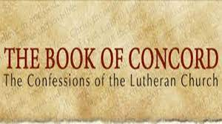
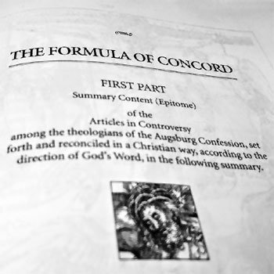
The Doctrine of Justification
DOCTRINAL WITNESSES!
The Chief Article of Our Faith

