Slide 1
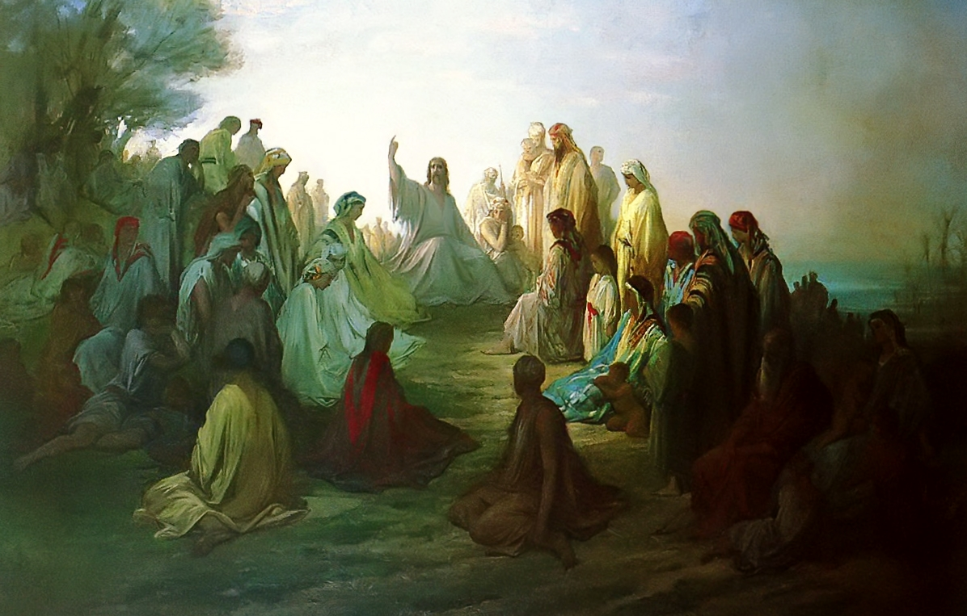
The Beatitudes
Matthew 5:1-12
All saints’

Slide 2
The Beatitudes
The Narrative Introduction
Matthew 4:25 – 5:2
+ Matthew now introduces his first of five discourses:
- “The Sermon on the Mount”
- Three verses of preparation
A very large crowd from the known region;
Jesus ascends a mountain;
Having sat down (the posture of a teacher);
His disciples came to Him;
Opening His mouth and taught them.
Matthew 5:1-12
All saints’

Slide 3
The Beatitudes
+ Note that Jesus is teaching His disciples…not the crowd!
- Yet they hear his teachings;
- They understand His authority;
- They are astonished!
+ Jesus speaks with Divine Authority
- He is the Son of God!
- Not the new Moses!
Matthew 5:1-12
All saints’

Slide 4
The Beatitudes
Verse 3 – First Beatitude
Note the first word…it’s emphatic…
Makavrioi – blessed, saved, redeemed!
- It’s an adjective in the present tense!
- Why are you blessed, saved, redeemed?
Matthew 5:1-12
All saints’

Slide 5
The Beatitudes
Verse 3 – First Beatitude
Because you are “…poor in (the) spirit…”
+ oiJ ptwcoi; tw:/ pneuvmati…this phrase is very important for you!
- Why are you blessed, saved, redeemed?
- This phrase is in the dative of respect…which means that it’s not economic; but, spiritual…spiritually poor!
- Refers to objective status…condition
Matthew 5:1-12
All saints’

Slide 6
The Beatitudes
Verse 3 – First Beatitude
To be spiritually poor is to be spiritually destitute, without any way or means to save oneself.
+ Therefore, another must provide your salvation
When He saw the crowds, He had compassion for them, because they were harassed and helpless, like sheep without a shepherd (9:36); “…but go rather to the lost sheep of the house of Israel” (10:6).
+ Embraces all mankind…all need to hear His Good News of life and salvation only found in Jesus!
Matthew 5:1-12
All saints’

Slide 7
The Beatitudes
Verse 3 – First Beatitude
“…for theirs is the Kingdom of heaven.”
+ Jesus declares that those who are spiritually poor and, therefore, hear His Word and believe His Gospel, will inherit the kingdom of heaven…it is theirs (yours!)!
+ This blessing, salvation, redemption is extended to you… in Baptism, forgiveness of all your sin, power of the Holy Spirit, Body and Blood of Christ, and the fellowship of the redeemed.
Matthew 5:1-12
All saints’

Slide 8
The Beatitudes
Verse 4– second Beatitude
To mourn is an aspect of the Christian Life
+ As a result of the Fall.
+ Yet as you mourn, you will be comforted!
- “… ὅτι αὐτοὶ παρακληθήσονται.”
- This clause is in the future passive voice
- Which means it’s a PROMISE!
- You mourn now…yet in the future, when Jesus comes on the Great Last Day…your mourning will end…forever!
Matthew 5:1-12
All saints’

Slide 9
The Beatitudes
Verse 5– Third Beatitude
The meek (humble) will inherit the earth
+ Meekness or humbleness is not an attitude…
…rather, it a condition!
+ Psalm 37:10, 11
- οἱ πραεῖς: “to be humble” is a spiritual condition
- So the sense is that you are humbled, spiritually, or oppressed by Satan and sin!
- Yet you will receive a blessing!
Matthew 5:1-12
All saints’

Slide 10
The Beatitudes
Verse 5– Third Beatitude
+ You will…inherit the earth!
+ Again, this is future tense!
- At the restoration of the Earth, the New Earth, that comes down out of heaven, that you’ll inherit!
- So on Judgment Day, there will be a great reversal…all evil will be cast out…but the true Saints’ will inherit the Earth (New Eden) and live eternally in the presence of God!
Matthew 5:1-12
All saints’

Slide 11
The Beatitudes
Verse 6– Fourth Beatitude
Mourning and spiritual oppression naturally produce a hungering and thirsting for righteousness…or rather…the Righteous One!
+ So on Judgment Day, as you hunger and thirst…you will be satisfied!
+ How?
- Jesus! He is your Righteousness One!
- Since He is present, so is His Righteousness!
Matthew 5:1-12
All saints’

Slide 12
The Beatitudes
Verse 6– Fourth Beatitude
+ Since He is present…
…you will be filled (satisfied)!
- Body and Blood
- A foretaste of the Feast of the Lamb!
- On Judgment Day and thereafter, you will be constantly filled (satisfied)!
Matthew 5:1-12
All saints’

Slide 13
The Beatitudes
Verse 7– Fifth Beatitude
Now comes a noticeable shift
with this beatitude
+ Prior beatitudes described the inability of Jesus’ disciples to accomplish anything, spiritually.
+ Jesus begins to describe His disciples.
Matthew 5:1-12
All saints’

Slide 14
The Beatitudes
Verse 7– Fifth Beatitude
+ “The merciful are blessed, because they will be shown mercy.”
+ It bespeaks of the transforming power of discipleship and of Jesus’ call to faith.
+ Our Lord is mercy incarnate, perfect mercy!
+ So His disciples must also show mercy.
Matthew 5:1-12
All saints’

Slide 15
The Beatitudes
Verse 7– Fifth Beatitude
+ The best way to explain: St. Mt. 18:23-35
- the Master (the Lord) shows mercy;
- His mercy is also to change the servant so that he too will be merciful;
- the servant refuses to be merciful;
- which proves he’s not the Master’s servant!
Matthew 5:1-12
All saints’

Slide 16
The Beatitudes
Verse 7– Fifth Beatitude
+ Jesus empowers each of you to be merciful!
- Your mercy is not perfect;
- Yet being merciful is to remind you of your Lord;
- Reminds you of your identity and the final promise of blessing and mercy that will be shown to you on the Last Day!
Matthew 5:1-12
All saints’

Slide 17
The Beatitudes
Verse 8 – sixth Beatitude
“Blessed [the] pure in heart,
because they will see God”
+ What does Jesus mean by “pure in heart?”
- This phrase is only found here and Ps. 24:4.
- In light of Scripture, Jesus is referring to one who hears the Good News, believes that He is the Messiah, is forgiven [cleansed] and given a pure heart!
Matthew 5:1-12
All saints’

Slide 18
The Beatitudes
Verse 8 – sixth Beatitude
“The pure in heart are blessed, because they will see god”
+ Therefore, they, and only they, will see God!
- Not like Moses (Ex. 33:20)
- “They will see His face….” (Rev. 22:4a)
- Actually see God as He truly is, the Divine Holy Trinity!
Matthew 5:1-12
All saints’

Slide 19
The Beatitudes
Verse 9 – seventh Beatitude
“Blessed are the peacemakers, for they will be called the sons of God”
+ Only place in Scripture where this adjective: εἰρηνοποιοί, is used.
- Literally, one who declares one at peace or in a state of wholeness before God - (the Atonement).
- These are they who proclaim the Holy Gospel.
- At the fulfillment, Jesus will call peacemakers, the sons of God – those who now inherit heaven!
Matthew 5:1-12
All saints’

Slide 20
The Beatitudes
Verse 10 – eighth Beatitude
“Blessed are those having been persecuted on account of righteousness, for theirs is the kingdom of the heavens”
The promise of this Beatitude is completed by the Ninth Beatitude…
Matthew 5:1-12
All saints’

Slide 21
The Beatitudes
Verse 11 – Ninth Beatitude
“Blessed are you when they shall insult you, and shall persecute you, and shall say all kinds of evil against you, lying on account of Me.”
Jesus is describing you…and notice the: “…shall insult you…shall persecute you…shall say all kinds of evil against you.…”
Matthew 5:1-12
All saints’

Slide 22
The Beatitudes
Verse 11 – Ninth Beatitude
“Blessed are you when they shall insult you, and shall persecute you, and shall say all kinds of evil against you, lying on account of Me.”
This beatitude applies to all of our Lord’s disciples, though your experiences may differ; ultimately, it’s because of Jesus and the lies told about Him.
Matthew 5:1-12
All saints’

Slide 23
The Beatitudes
Verse 11 – Ninth Beatitude
“Blessed are you when they shall insult you, and shall persecute you, and shall say all kinds of evil against you, lying on account of Me.”
But there is a blessing…!
Matthew 5:1-12
All saints’

Slide 24
The Beatitudes
Verse 11 – Ninth Beatitude
“Rejoice and exult, for your reward is great in the heavens; thus indeed they persecuted the prophets before you.”
+ Rejoice! Your (reward) payback…is Heaven!
+ You will stand with the greatest prophets of old!
+ So stand firm, endure unto the end, wait upon the Lord and His reward which He will give you!
Matthew 5:1-12
All saints’

Slide 25
The Beatitudes
Summation
The Beatitudes are often seen as the “doorway” into the remainder of the Sermon on the Mount.
The “they” of Beatitude 1-8, become the “you” of Beatitude 9 and is a continuation of the “you” throughout the rest of the sermon.
Matthew 5:1-12
All saints’

Slide 26
The Beatitudes
Summation
The Beatitudes do not make ethical demands; neither do they exhort.
The beatitudes do, however, find fulfillment in Christ Jesus!
+ He is the subject of the “oJti” clauses. Since only in Him you are blessed four time over!
+ And He is the Merciful One, the pure in heart, the peacemaker, and the Redeemer from persecution and evil.
Matthew 5:1-12
All saints’

Slide 27
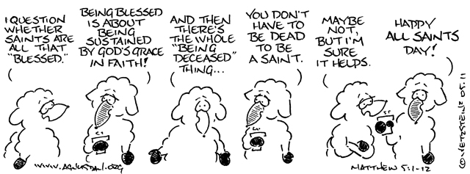
The Beatitudes
Matthew 5:1-12
All saints’

